Slide 1
“Cleaning House” Leviticus (Part 2 of 2)
For XICF.org
4-February 2018
Jim Arneberg

Slide 2
Review of Leviticus Part 1

Slide 3
Key Themes of Leviticus
The Lord is present among his people and central
Sin and impurity must be addressed
Strive for personal holiness in every area of your life
To approach God, be wholehearted in devotion
Standards and expectations are higher for spiritual leaders such as priests
Total cleansing of sins is done when the innermost part of the tent of meeting is purified.
Ultimate purification of uncleanness is impossible for humans to achieve.
The Call to Holiness : chapter 19

Slide 4
Leviticus 1:1
1 The Lord called Moses
and spoke to him from the tent of meeting…
From Exodus 36:1 – 2
And Moses called Bezalel and Oholiab and every craftsman in whose mind the Lord had put skill…
and intelligence to know how to do any work
in the construction of the sanctuary

Slide 5
Preparing the tabernacle
Exodus 40:33-35
33 And he erected the court around the tabernacle and the altar…
So Moses finished the work.
34 Then the cloud covered the tent of meeting,
and the glory of the Lord filled the tabernacle.
35 And Moses was not able to enter the tent of meeting because the cloud settled on it,
and the glory of the Lord filled the tabernacle.

Slide 6
Leviticus 10:1 – 2a
10 Now Nadab and Abihu, the sons of Aaron,… offered unauthorized fire before the Lord,
which he had not commanded them.
2 And fire came out from before the Lord and consumed them, and they died before the Lord.

Slide 7
Three basic states in OT
Clean
Unclean
Holy

Slide 9
Open Heart Surgery

Slide 10
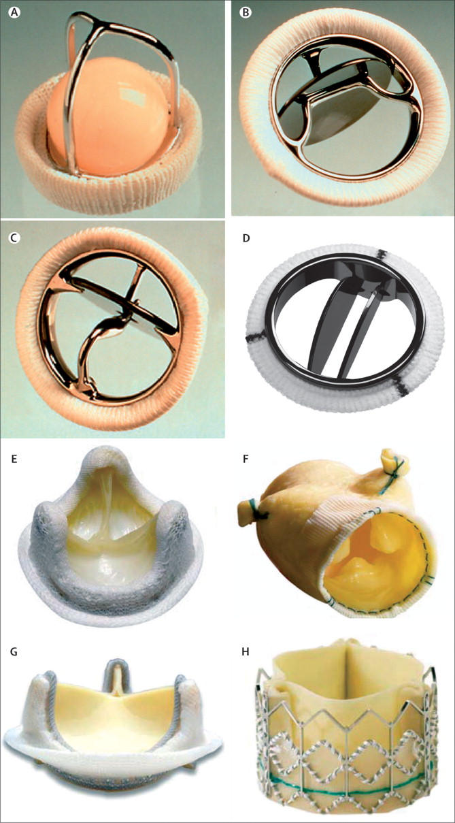
Heart Valves

Slide 11
Industrial Clean Room

Slide 12
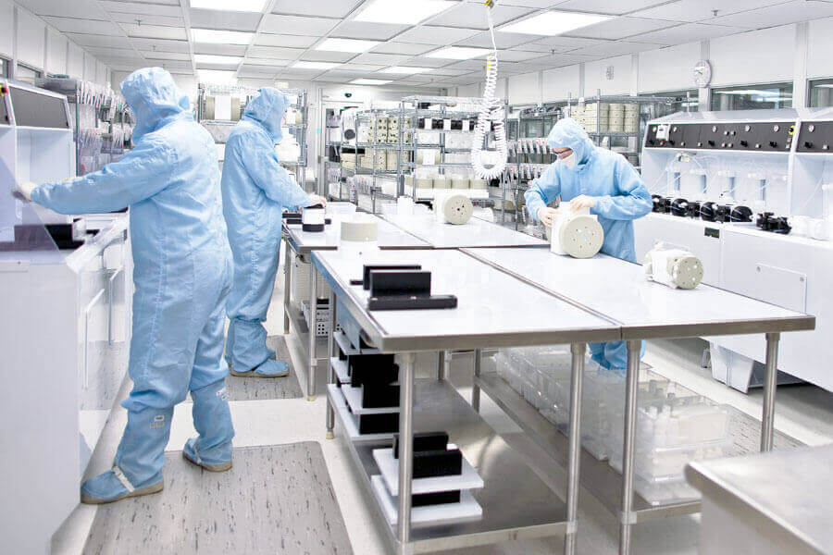

Slide 13
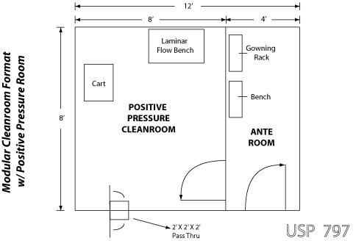
Floor Layout

Slide 14
The Holy Place
The Holy
of Holies

Slide 15
Leviticus 19:1-2
1 And the Lord spoke to Moses, saying,
2 “Speak to all the congregation of the people of Israel and say to them,
You shall be holy,
for I the Lord your God am holy.
Matt. 5:48 (echoing Lev. 19:2)
48 You therefore must be perfect,
as your heavenly Father is perfect.

Slide 16
2 Corinthians 5:20-21
20 Therefore, we are ambassadors for Christ,
God making his appeal through us.
We implore you on behalf of Christ,
be reconciled to God.
21 For our sake he made him to be sin who knew no sin, so that
in him we might become the righteousness of God.

Slide 17
Mark 12:33 Greatest Commandment
33 And to love him
with all the heart
and with all the understanding
and with all the strength,
and to love one's neighbor as oneself,
is much more than all whole burnt offerings and sacrifices.”

Slide 18
Expectations;
requirements
External Restrictions
Time (>3500 years)

Slide 19
Expectations;
requirements
Moral
Conduct
External Restrictions
Time (>3500 years)

Slide 20
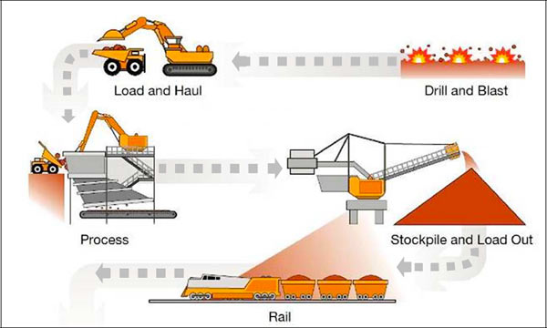
Iron Mining

Slide 21
Key Takeaways (Leviticus Part 1):
Do some digging! Apply yourself.
“Clean” must be from within.
We are the temple of God’s Spirit.
Outward acts don’t matter if the heart is not right.
Human heart is like the Holy of Holies.
Seek the Lord and be in right relationship with him.
.

Slide 22
The Book of Leviticus “The Levitical laws”, “The manual of the Priest”
Thematic areas
Sacrifice
Priesthood
Worship
Wisdom Kwabla Dewortor - 1

Slide 23
Sacrifice – offerings (Leviticus 1 – 7)
Characteristics
Without blemish, brought at the tent of the meeting. A pleasing aroma to God.
Principles
Gift
Consummation
Change over (Substitution)
Bonding (Relationship)
Ephesians 5:1-2
Wisdom Kwabla Dewortor - 2

Slide 24
Priesthood (Leviticus 8 – 10)
Qualification, Appearance and role
8 ⁶ And Moses brought Aaron and his sons and washed them with water. ⁷ And he put the coat on him and tied the sash around his waist and clothed him with the robe and put the ephod on him and tied the skillfully woven band of the ephod around him, binding it to him with the band. ⁸ And he placed the breastpiece on him, and in the breastpiece he put the Urim and the Thummim. ⁹ And he set the turban on his head, and on the turban, in front, he set the golden plate, the holy crown, as the Lord commanded Moses.
9 ²² Then Aaron lifted up his hands toward the people and blessed them… ²³ and the glory of the Lord appeared to all the people… ²⁴ and when all the people saw it, they shouted and fell on their faces.
Wisdom Kwabla Dewortor - 3

Slide 25
Worship
Sacrifice, temple and priest
Romans 12:1-2
¹ I appeal to you therefore, brothers, by the mercies of God, to present your bodies as a living sacrifice, holy and acceptable to God, which is your spiritual worship. ² Do not be conformed to this world, but be transformed by the renewal of your mind, that by testing you may discern what is the will of God, what is good and acceptable and perfect.
1 Corinthians 6:19-20
¹⁹ Or do you not know that your body is a temple of the Holy Spirit within you, whom you have from God? You are not your own, ²⁰ for you were bought with a price. So glorify God in your body.
1 Peter 2:9
⁹ But you are a chosen race, a royal priesthood, a holy nation, a people for his own possession, that you may proclaim the excellencies of him who called you out of darkness into his marvellous light.
Wisdom Kwabla Dewortor - 4

Slide 26
1 Corinthians 6:19 (ESV)
¹⁹ Or do you not know that
your body is a temple of the Holy Spirit
within you, whom you have from God?
You are not your own,…

Slide 29
Revelation 3:20 (ESV)
²⁰ Behold, I stand at the door and knock.
If anyone hears my voice and opens the door,
I will come in to him and eat with him,
and he with me.

Slide 30
Revelation 3:19-20 (ESV)
¹⁹ Those whom I love,
I _________ and _________,
so be zealous and ________.
²⁰ Behold, I stand at the door and knock.
If anyone hears my voice and opens the door,
I will come in to him and eat with him,
and he with me.

Slide 31
Revelation 3:19-20 (ESV)
¹⁹ Those whom I love,
I reprove and discipline,
so be zealous and repent.
²⁰ Behold, I stand at the door and knock.
If anyone hears my voice and opens the door,
I will come in to him and eat with him,
and he with me.

Slide 32
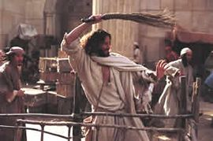
1 Corinthians 6:19 (ESV)
¹⁹ Or do you not know that
your body is a temple of the Holy Spirit
within you, whom you have from God?
You are not your own,…

Slide 33
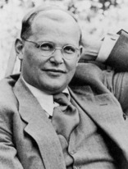
“Cheap grace is the grace we bestow on ourselves.
Cheap grace is the preaching of forgiveness
without requiring repentance,
baptism without church discipline,
Communion without confession...
Cheap grace is
grace without discipleship,
grace without the cross,
grace without Jesus Christ, living and incarnate.”
― Dietrich Bonhoeffer

