Slide 1
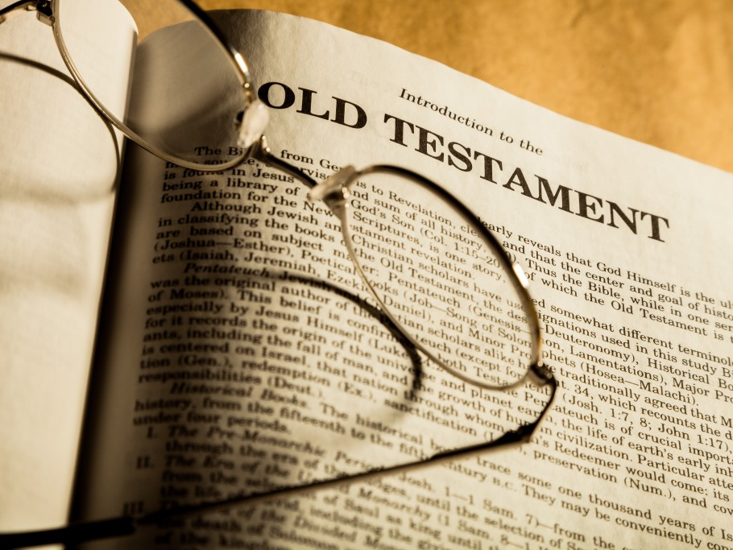
lessons from the old testament
judges 3:12-30

Slide 2

The judges cycle
An overview of

Slide 3
the different stages
The judges cycle

Slide 4
the different stages
The judges cycle
Israel rejects God and turns to serve false gods

Slide 5
the different stages
The judges cycle
Israel rejects God and turns to serve false gods
God reacts to Israel’s idolatry with righteous anger

Slide 6
the different stages
The judges cycle
Israel rejects God and turns to serve false gods
God reacts to Israel’s idolatry with righteous anger
God hands Israel over to the oppression of her enemies

Slide 7
the different stages
The judges cycle
Israel rejects God and turns to serve false gods
God reacts to Israel’s idolatry with righteous anger
God hands Israel over to the oppression of her enemies
Israel repents and cries out to God for mercy

Slide 8
the different stages
The judges cycle
Israel rejects God and turns to serve false gods
God reacts to Israel’s idolatry with righteous anger
God hands Israel over to the oppression of her enemies
Israel repents and cries out to God for mercy
God raises up a judge to rescue Israel from her enemies

Slide 9
the different stages
The judges cycle
Israel rejects God and turns to serve false gods
God reacts to Israel’s idolatry with righteous anger
God hands Israel over to the oppression of her enemies
Israel repents and cries out to God for mercy
God raises up a judge to rescue Israel from her enemies
The judge dies and Israel returns to her idolatry

Slide 10
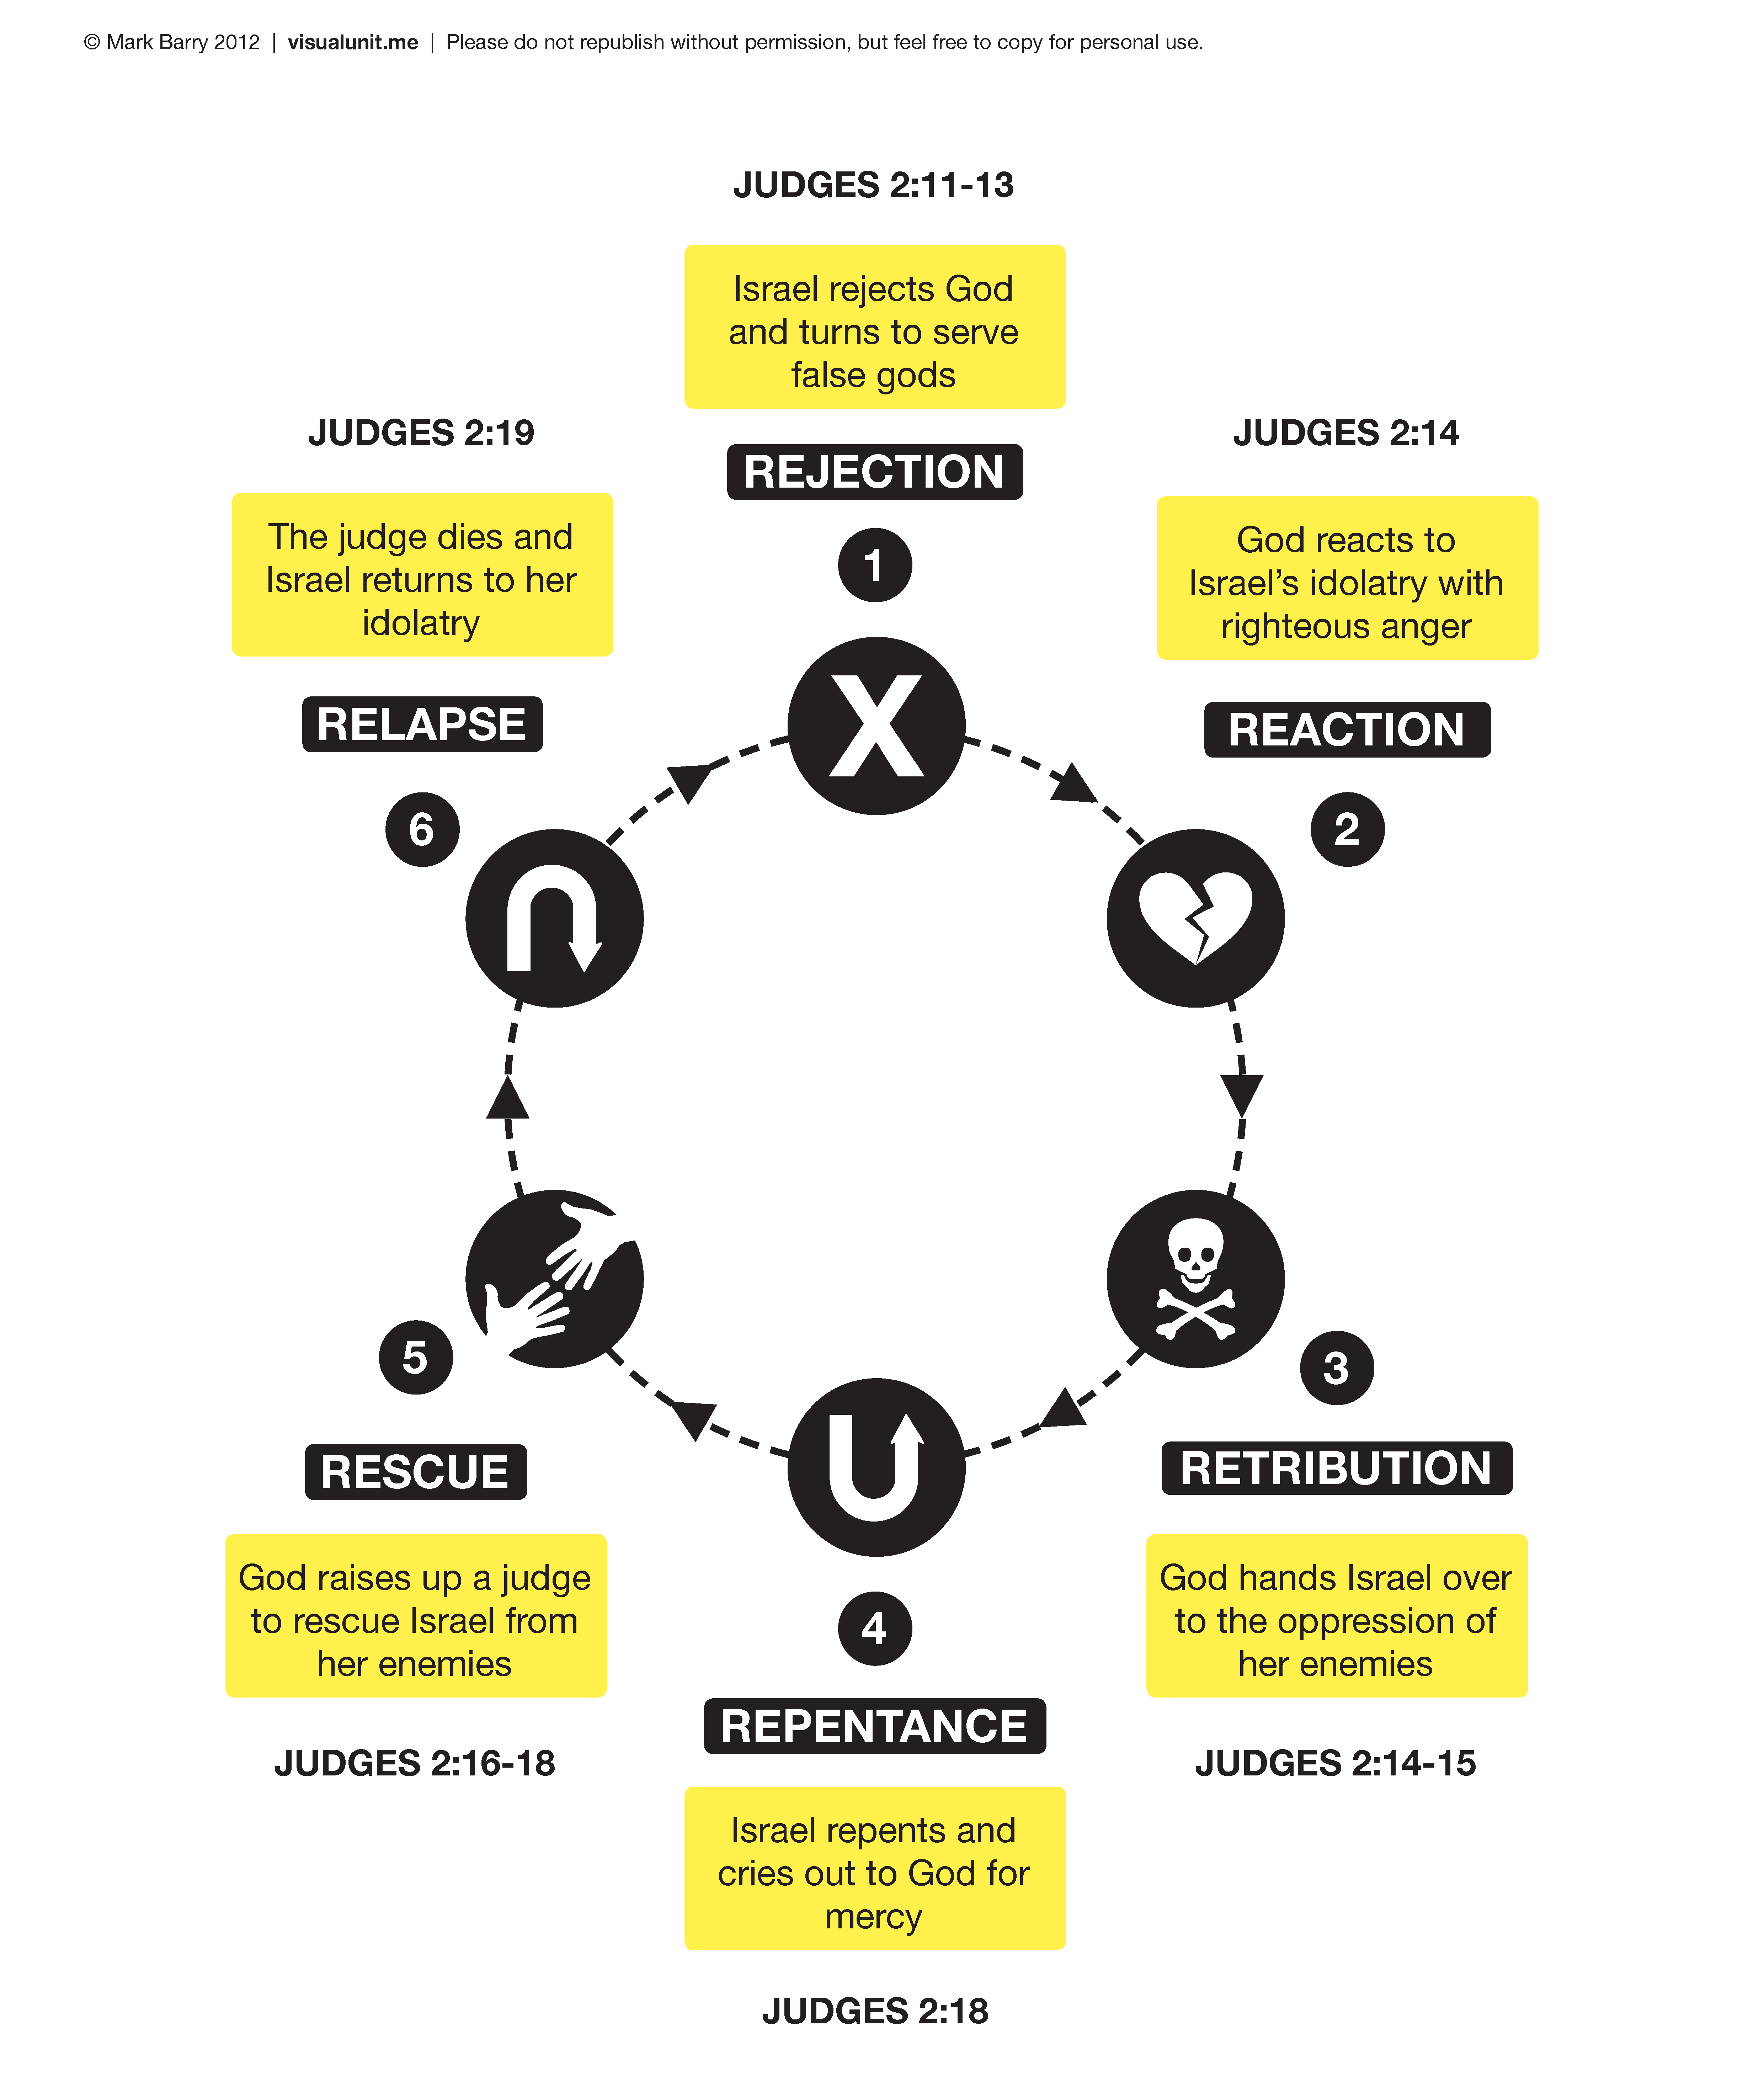

Slide 11
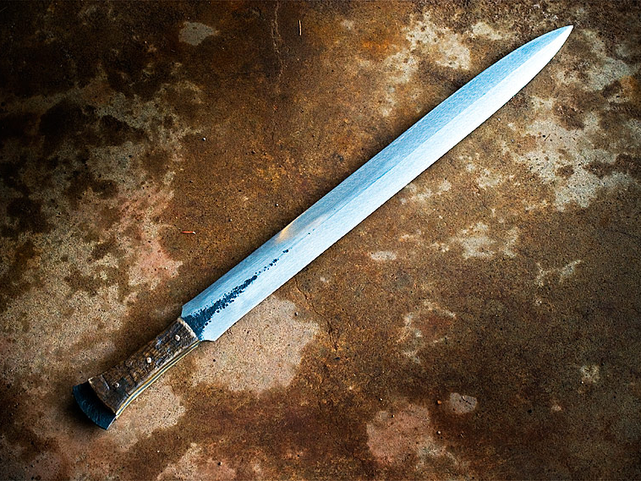
The story of ehud
Judges 3:12-30

Slide 12
judges 3:12-14
The story of ehud
12 And again the Israelites did evil in the eyes of Yahweh. So Yahweh strengthened Eglon king of Moab against Israel, because they did evil in the eyes of Yahweh. 13 He gathered to himself the Ammonites and Amalekites, and he went and defeated Israel, and they took possession of the city of palms. 14 And the Israelites served Eglon king of Moab eighteen years.

Slide 13
Judges 3:15-18
the story of ehud
15 And the Israelites cried out to Yahweh, and Yahweh raised up for them a deliverer, Ehud son of Gera, a Benjaminite and a left-handed man. And the Israelites sent a tribute to Eglon king of Moab through him. 16 Ehud made for himself a short, two-edged sword (a cubit in length), and he fastened it under his clothes on his right thigh. 17 Then he presented the tribute to Eglon king of Moab. Now Eglon was a very fat man. 18 When Ehud had finished presenting the tribute, he sent away the people who carried the tribute.

Slide 14
judges 3:19-23
the story of ehud
19 But he turned back from the sculptured stones that were near Gilgal, and he said, “I have a secret message for you, O king.” And he said, “Silence!” So all those standing in his presence went out, 20 and Ehud came to him while he was sitting alone in his cool upper room. And Ehud said, “I have a message from God for you.” So he got up from his seat. 21 Then Ehud reached with his left hand for the sword on his right thigh, and he thrust it into his stomach. 22 And the handle also went in after the blade, and the fat closed over the blade because he did not draw back the sword from his stomach; and it went protruding out the back. 23 And Ehud went out the vestibule, and he closed the doors of the upper room and locked them behind him.

Slide 15
judges 3:24-25
the story of ehud
24 After he left, his servants returned. When they saw that the doors of the upper room were locked, they thought, “Surely he is relieving himself in the cool inner room.” 25 And they waited so long they became embarrassed because he did not open the doors of the upper room. So they took the key and opened the doors, and there their lord was lying on the ground dead.

Slide 16
judges 3:26-30
the story of ehud
26 And Ehud escaped while they delayed. He passed by the sculptured stones and escaped to Seirah. 27 And when he arrived he sounded the trumpet in the hill country of Ephraim, and the Israelites went down from the hill country with him leading them. 28 And he said to them, “Follow after me! Yahweh has given Moab your enemies into your hand.” So they went down after him, and they captured the fords of the Jordan toward Moab; and they did not allow anyone to cross over. 29 And they struck Moab at that time, about ten thousand men, all strong and able men; no one escaped. 30 And Moab was subdued on that day under the hand of Israel. And the land rested eighty years.

Slide 17
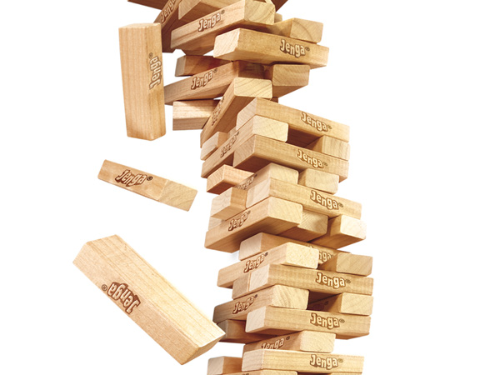
The breakdown
Judges 3:12-30

Slide 18
judges 3:12-14
The story of ehud
12 And again the Israelites did evil in the eyes of Yahweh. So Yahweh strengthened Eglon king of Moab against Israel, because they did evil in the eyes of Yahweh. 13 He gathered to himself the Ammonites and Amalekites, and he went and defeated Israel, and they took possession of the city of palms. 14 And the Israelites served Eglon king of Moab eighteen years.

Slide 19
judges 3:12-14
The story of ehud
12 And again the Israelites did evil in the eyes of Yahweh. So Yahweh strengthened Eglon king of Moab against Israel, because they did evil in the eyes of Yahweh. 13 He gathered to himself the Ammonites and Amalekites, and he went and defeated Israel, and they took possession of the city of palms. 14 And the Israelites served Eglon king of Moab eighteen years.

Slide 20
judges 3:12-14
The story of ehud
12 And again the Israelites did evil in the eyes of Yahweh. So Yahweh strengthened Eglon king of Moab against Israel, because they did evil in the eyes of Yahweh. 13 He gathered to himself the Ammonites and Amalekites, and he went and defeated Israel, and they took possession of the city of palms. 14 And the Israelites served Eglon king of Moab eighteen years.

Slide 21
Judges 3:15-18
the story of ehud
15 And the Israelites cried out to Yahweh, and Yahweh raised up for them a deliverer, Ehud son of Gera, a Benjaminite and a left-handed man. And the Israelites sent a tribute to Eglon king of Moab through him. 16 Ehud made for himself a short, two-edged sword (a cubit in length), and he fastened it under his clothes on his right thigh 17 Then he presented the tribute to Eglon king of Moab. Now Eglon was a very fat man. 18 When Ehud had finished presenting the tribute, he sent away the people who carried the tribute.

Slide 22
lessons from the old testament
Then he cried out to the Lord, “Lord my God, have you brought tragedy even on this widow I am staying with, by causing her son to die?” Then he stretched himself out on the boy three times and cried out to the Lord, “Lord my God, let this boy’s life return to him!” the Lord heard Elijah’s cry, and the boy’s life returned to him, and he lived.
I Kings 17:20-22

Slide 23
Lessons from the old testament
When the chariot commanders saw Jehoshaphat, they thought, “This is the king of Israel.” So they turned to attack him, but Jehoshaphat cried out, and the Lord helped him. God drew them away from him.
II Chronicles 18:31

Slide 24
lessons from the old testament
King Hezekiah and the prophet Isaiah son of Amoz cried out in prayer to heaven about this. And the Lord sent an angel, who annihilated all the fighting men and the commanders and officers in the camp of the Assyrian king.
II Chronicles 32:20-21

Slide 25
lessons from the old testament
As they sailed, he fell asleep. A squall came down on the lake, so that the boat was being swamped, and they were in great danger. The disciples went and woke him, saying, “Master, Master, we’re going to drown!” He got up and rebuked the wind and the raging waters; the storm subsided, and all was calm.
Luke 8:23-24

Slide 26
lessons from the old testament
Many rebuked him and told him to be quiet, but he shouted all the more, “Son of David, have mercy on me!” Jesus stopped and said, “Call him.” So they called to the blind man, “Cheer up! On your feet! He’s calling you.” Throwing his cloak aside, he jumped to his feet and came to Jesus. “What do you want me to do for you?” Jesus asked him. The blind man said, “Rabbi, I want to see.” “Go,” said Jesus, “your faith has healed you.”
Mark 8:48-52

Slide 27
The characteristics of ‘crying out’
lessons from the old testament

Slide 28
The characteristics of ‘crying out’
lessons from the old testament
Genuine humility

Slide 29
The characteristics of ‘crying out’
lessons from the old testament
Genuine humility
Unconditional surrender

Slide 30
The characteristics of ‘crying out’
lessons from the old testament
Genuine humility
Unconditional surrender
A plea for mercy

Slide 31
The characteristics of ‘crying out’
lessons from the old testament
Genuine humility
Unconditional surrender
A plea for mercy
Personal helplessness

Slide 32
The characteristics of ‘crying out’
lessons from the old testament
Genuine humility
Unconditional surrender
A plea for mercy
Personal helplessness
Faith in God’s power and resources

Slide 33
The characteristics of ‘crying out’
lessons from the old testament
Genuine humility
Unconditional surrender
A plea for mercy
Personal helplessness
Faith in God’s power and resources
Desperation

Slide 34
Judges 3:15-18
the story of ehud
15 And the Israelites cried out to Yahweh, and Yahweh raised up for them a deliverer, Ehud son of Gera, a Benjaminite and a left-handed man. And the Israelites sent a tribute to Eglon king of Moab through him. 16 Ehud made for himself a short, two-edged sword (a cubit in length), and he fastened it under his clothes on his right thigh. 17 Then he presented the tribute to Eglon king of Moab. Now Eglon was a very fat man. 18 When Ehud had finished presenting the tribute, he sent away the people who carried the tribute.

Slide 35
Judges 3:15-18
the story of ehud
15 And the Israelites cried out to Yahweh, and Yahweh raised up for them a deliverer, Ehud son of Gera, a Benjaminite and a left-handed man. And the Israelites sent a tribute to Eglon king of Moab through him. 16 Ehud made for himself a short, two-edged sword (a cubit in length), and he fastened it under his clothes on his right thigh. 17 Then he presented the tribute to Eglon king of Moab. Now Eglon was a very fat man. 18 When Ehud had finished presenting the tribute, he sent away the people who carried the tribute.

Slide 36
Judges 3:17-19
the story of ehud
17 Then he presented the tribute to Eglon king of Moab. Now Eglon was a very fat man. 18 When Ehud had finished presenting the tribute, he sent away the people who carried the tribute. 19 But he turned back from the sculptured stones that were near Gilgal, and he said, “I have a secret message for you, O king.” And he said, “Silence!” So all those standing in his presence went out,

Slide 37
judges 3:19-23
the story of ehud
19 But he turned back from the sculptured stones that were near Gilgal, and he said, “I have a secret message for you, O king.” And he said, “Silence!” So all those standing in his presence went out, 20 and Ehud came to him while he was sitting alone in his cool upper room. And Ehud said, “I have a message from God for you.” So he got up from his seat. 21 Then Ehud reached with his left hand for the sword on his right thigh, and he thrust it into his stomach. 22 And the handle also went in after the blade, and the fat closed over the blade because he did not draw back the sword from his stomach; and it went protruding out the back. 23 And Ehud went out the vestibule, and he closed the doors of the upper room and locked them behind him.

Slide 38

the wrap-up
lessons from the old testament

Slide 39
the wrap-up
lessons from the old testament

Slide 40
the wrap-up
lessons from the old testament
Do you turn to God only when you are overwhelmed?

Slide 41
the wrap-up
lessons from the old testament
Do you turn to God only when you are overwhelmed?
  Are you crying out to God because things have become so desperate?

Slide 42
the wrap-up
lessons from the old testament
Do you turn to God only when you are overwhelmed?
  Are you crying out to God because things have become so desperate?
  Will you forget His goodness when times are easy?

Slide 43
the wrap-up
lessons from the old testament
God raises us up to face our challenges

Slide 44
the wrap-up
lessons from the old testament
God raises us up to face our challenges
  Is your situation preparing you for something?

Slide 45
the wrap-up
lessons from the old testament
God raises us up to face our challenges
  Is your situation preparing you for something?
Our disadvantages can become unique advantages

Slide 46
the wrap-up
lessons from the old testament
God raises us up to face our challenges
  Is your situation preparing you for something?
Our disadvantages can become unique advantages
  Can God use you no matter what your circumstance is?

