Slide 1

XICF, What do you see?
Jeremiah 24:1-10

Slide 2
Jeremiah 24:1-3
After Jehoiachin son of Jehoiakim king of Judah and the officials, the skilled workers and the artisans of Judah were carried into exile from Jerusalem to Babylon by Nebuchadnezzar king of Babylon, the Lord showed me two baskets of figs placed in front of the temple of the Lord.
2 One basket had very good figs, like those that ripen early; the other basket had very bad figs, so bad they could not be eaten.
3 Then the Lord asked me, “What do you see, Jeremiah?”
“Figs,” I answered. “The good ones are very good, but the bad ones are so bad they cannot be eaten.”

Slide 3
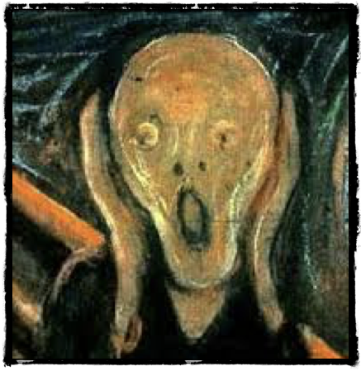
Terror invades our hearts
Fear
Sadness
Insecurity
Doubts
Uncertainty
Angriness
Depression

Slide 4
Jeremiah 24:4-7
Then the word of the Lord came to me:
5 “This is what the Lord, the God of Israel, says: ‘Like these good figs, I regard as good the exiles from Judah, whom I sent away from this place to the land of the Babylonians.
6 My eyes will watch over them for their good, and I will bring them back to this land. I will build them up and not tear them down; I will plant them and not uproot them.
7 I will give them a heart to know me, that I am the Lord. They will be my people, and I will be their God, for they will return to me with all their heart.

Slide 5
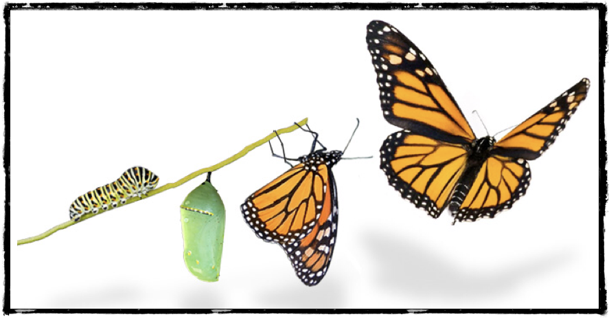
I regard as good the exiles from Judah

Slide 6
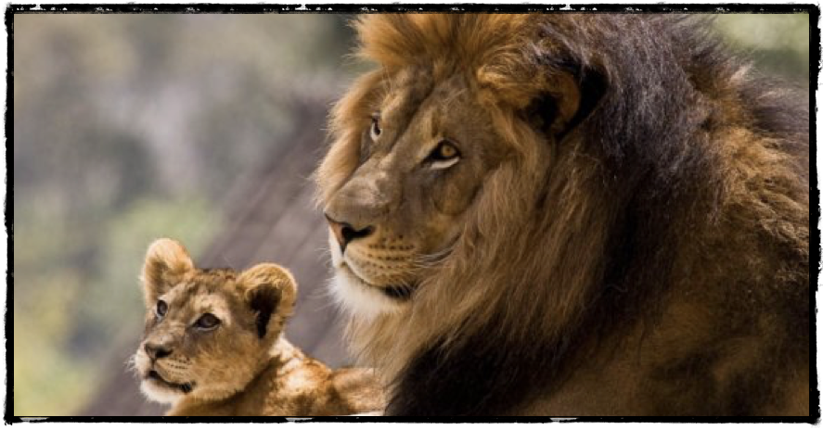
My eyes will watch over them for their good

Slide 7

I will bring them back to this land

Slide 8

I will build them up and not tear them down
I will plan them and not uproot them

Slide 9

I will give them a heart to know me, that I am the Lord. They will be my people, and I will be their God, for they will return to me with all their heart.

Slide 10
XICF, What do you see?
See as God sees you.
See how God is working around you transforming you and the world.
Invest your life in others, mainly those of the community.

Slide 11
XICF has been called to train the christian leaders of the world

