Slide 1
Paradigm Shift
The Birth that Changed the World
Antwi Stephen B. (Ph.D)

Slide 2
Christmas

Slide 3
In our human settings, do we mourn over the birth of a child?
Is it wrong in our moral settings to remember the birth of a great leader?
In our cultural settings, is it wrong to place value on events which have positively shaped our societies?

Slide 4
And I will put enmity between you and the woman, and between your seed and her Seed; He shall bruise your head, And you shall bruise His heel.”
Genesis 3:15

Slide 5
Therefore the Lord Himself will give you a sign: Behold, the virgin shall conceive and bear a Son, and shall call His name Immanuel.
Isaiah 7:14

Slide 6
“Glory to God in the highest, And on earth peace, goodwill toward men!”
Luke 2:14

Slide 7
The angels
The shepherds
The political elite
The destitute

Slide 8
The Angels
And suddenly there was with the angel a multitude of the heavenly host praising God …………
Luke 2:13

Slide 9
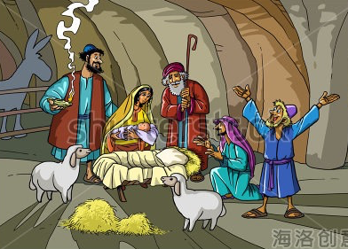
The Shepherds
And behold, an angel of the Lord stood before them, and the glory of the Lord shone around them, and they were greatly afraid.
Luke 2:9
20 Then the shepherds returned, glorifying and praising God for all the things that they had heard and seen, as it was told them.
Luke 2:20

Slide 10
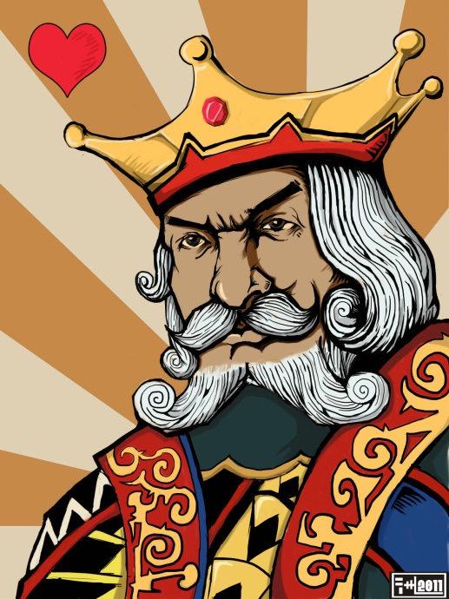
The Political Elite
2 saying, “Where is He who has been born King of the Jews? For we have seen His star in the East and have come to worship Him.” 3 When Herod the king heard this, he was troubled, and all Jerusalem with him.
Matthew 2:2-3

Slide 11
The Destitute
For He made Him who knew no sin to be sin for us, that we might become the righteousness of God in Him.
2 Corinthians 5:21
Now, therefore, you are no longer strangers and foreigners, but fellow citizens with the saints and members of the household of God,
Ephesians 2:19

Slide 12
Without Christ
Still be strangers in God’s household
Still be subject to God’s wrath
Still be wearing the destiny tag, “condemnation“

Slide 13
With Christ
Members of God’s household
Royal priesthood (chosen people)
Living hope (changed status)
Free access into the throne room of grace

