Slide 1
THE STORY OF RUTH
Sooo Much Hope!!!

Slide 2
Then she fell on her face, bowing to the ground, and said to him, “Why have I found favour in your eyes, that you should take notice of me, since I am a foreigner?”
Ruth 2:10 - ESV

Slide 3
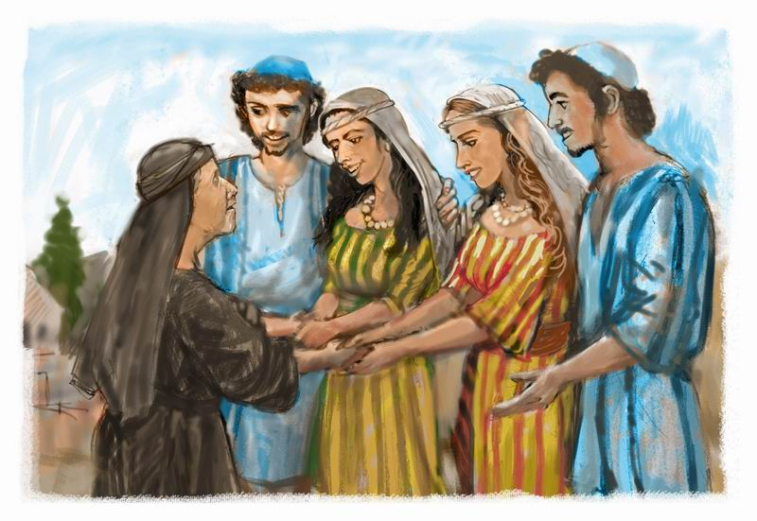
Life is not a journey of roses. Situations may arise.
The story of Ruth nicely presents the idea of hope in the wake of adversity.

Slide 4
My Summary
The story of Ruth is a remarkable one. It begins with the joy of family and an expedition to find greener pastures and is gradually infused by the sorrow of Naomi who looses almost everything except the faithfulness of her daughter in law Ruth.
With the departure of Orpah her other daughter in law after the demise of her husband and two sons, Naomi and Ruth set their path to Bethlehem in the season of great harvest.
As grace and favour will have it, the Obedience of Ruth to her mother in law would yield an unfathomable result. They received abundance of provision and a complete change of lives as Boaz marries Ruth and they are included in the genealogy of Jesus Christ through the birth of Obed.

Slide 5
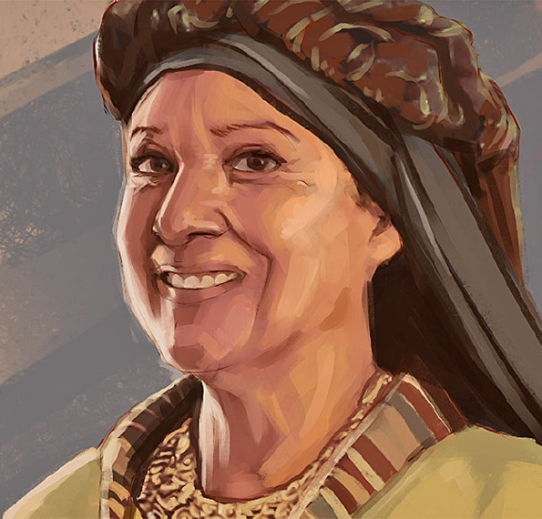
Character study: Naomi
She was not self-centred and was very honest. (1:11-13)
A woman of great wisdom and understanding. (3:1-4)
She was a woman of great patience.

Slide 6
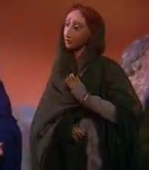
Character study: Orpah
She loved Naomi. The kiss a sign of love. (1:14)
She did not stay.
Nothing is heard of her again.

Slide 7
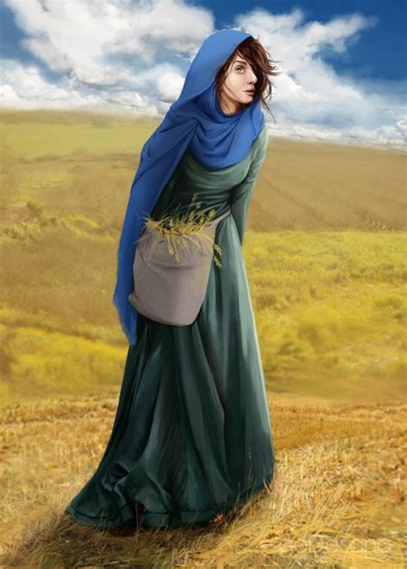
Character study: Ruth
She understood Service and faithfulness.
She was very obedient.
She was duly rewarded for her decisions.

Slide 8
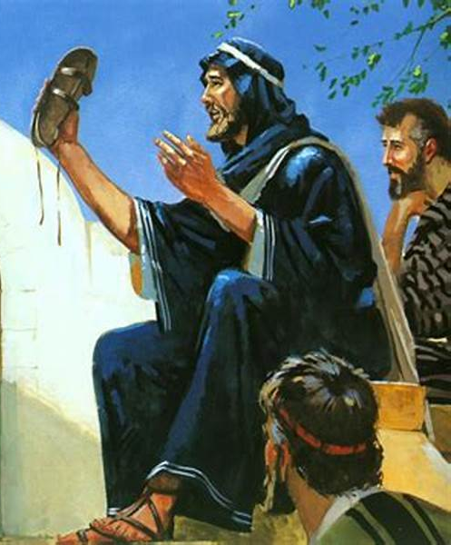
Character study: Boaz
He was a man of authority yet welcoming. (2:11)
He knew what he wanted.
He understood the traditions of the Land. (4:1-8)

Slide 9
Character study: God
He was there from the scratch.
He provided guidance through people.
He had a plan of redemption and accomplished it. (4:17-22)

Slide 10
Key Notes
In life some unfortunate situations may happen to you either by your doing or by no contribution of yours.
When the wind of life blows against you not all the people around you will stay.
Faithfulness and obedience really pay well.
If you want something it’s always possible to get it with God on your side.
God is always in the business of over-doing. We must trust Him completely.

Slide 11
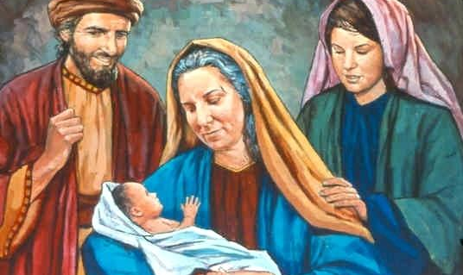
There is sooo much hope for us in Christ Jesus.
No matter how hard life hits us with unexpected events we still triumph in Jesus mighty name. Giving up is not an option. We will never allow situations to steal the joy and hope Christ has made available for us.
Just like the story of Ruth, the Lord shall surely show up. He is faithful even when we are not faithful.

