Slide 1
Connecting Our Eternal Hope
to Our Daily Grind

Slide 2
Hope defined:

Slide 3
Hope defined:
n. A desire accompanied by expectation of or belief in fulfillment v. To cherish a desire with anticipation: to want something to happen or be true

Slide 4
Hope is necessary to live.
Notes:
no one hopes for a worse future…. as human beings we are always hoping for something better… we’re hard wired for hope
cannot have faith without hope: Now faith is the assurance of things hoped for, the conviction of things not seen. Heb. 11:1

Slide 5
When our hopes fail, we despair.
To the degree we had hoped, to that degree we shall despair.

Slide 6
Any hope not based on God’s promises will ultimately fail.

Slide 7
What is our eternal hope?

Slide 8

having a hope in God, which these men themselves accept, that there will be a resurrection of both the just and the unjust.
(Ac. 24:15)

Slide 9
we wait eagerly for adoption as sons, the redemption of our bodies.
For in this hope we were saved.
(Ro. 8:23-24)

Slide 10
But someone will ask, “How are the dead raised? With what kind of body do they come?” You foolish person! What you sow does not come to life unless it dies. And what you sow is not the body that is to be, but a bare kernel, perhaps of wheat or of some other grain. But God gives it a body as he has chosen, and to each kind of seed its own body.So is it with the resurrection of the dead… What is sown is perishable; what is raised is imperishable. It is sown in dishonor; it is raised in glory. It is sown in weakness; it is raised in power. It is sown a natural body; it is raised a spiritual body. The first man was from the earth, a man of dust; the second man is from heaven. As was the man of dust, so also are those who are of the dust, and as is the man of heaven, so also are those who are of heaven. Just as we have borne the image of the man of dust, we shall also bear the image of the man of heaven.
(1 Cor. 15:35-49)

Slide 11
They will see his face, and his name will be on their foreheads. And night will be no more. They will need no light of lamp or sun, for the Lord God will be their light, and they will reign forever and ever.
(Rev. 22:4-5)

Slide 12
If we have died with him,
we will also live with him;
if we endure,
we will also reign with him;
if we deny him, he also will deny us;
if we are faithless, he remains faithful—
for he cannot deny himself.
(2 Tim. 2:11-13)

Slide 13
Our eternal hope must match God’s eternal purpose!
(Eph. 1:10)
as a plan for the fullness of time, to unite all things in him, things in heaven and things on earth. (Eph. 1:10)

Slide 14
Your Hope Manifests Now!
Notes:
Our goal for eternity and our goals for the present should be fueled by the same hope.
The visible creation, Adam and Eve… made with a purpose!
If your eternal hope to escape from this world, your daily life will reflect that. But if your eternal hope is to see everything made new your daily life will reflect that. So our hope must be aligned with God’s promises- otherwise your hope will fail and you will be disappointed.

Slide 15
How is God inviting me to fill this earth with his goodness?
What has God deposited in me to hare with the world?
What skill set can I develop now that will be useful 5,000 years from now?
Notes:
You were made for a purpose! Not just to sit on a beach some where.
You were created to be in fellowship with God and be the visible demonstration of his goodness! The goal is not less responsibility, but more!
5,000 year skill: Understand what the Father wants to do and use his resources to do it. and enjoying it!

Slide 16
God wants to grow you into a mature, royal son who delegates the family authority.
Using God’s resources to do God’s will for God’s glory.
Notes:
heaven is not about escaping responsibility—
God’s eternal plan is not to take us out of the visible creation (Ps. 115)
God wants us to fill the earth with His glory. as His image bearers, animated by His Spirit inside of us! Jesus didn’t die to bring you to heaven… Jesus died so you could become the dwelling place of God on earth.

Slide 17
“God likes watching things grow.”
(Beth Moore)
God is all about the process, the adventure, the relationship.

Slide 18
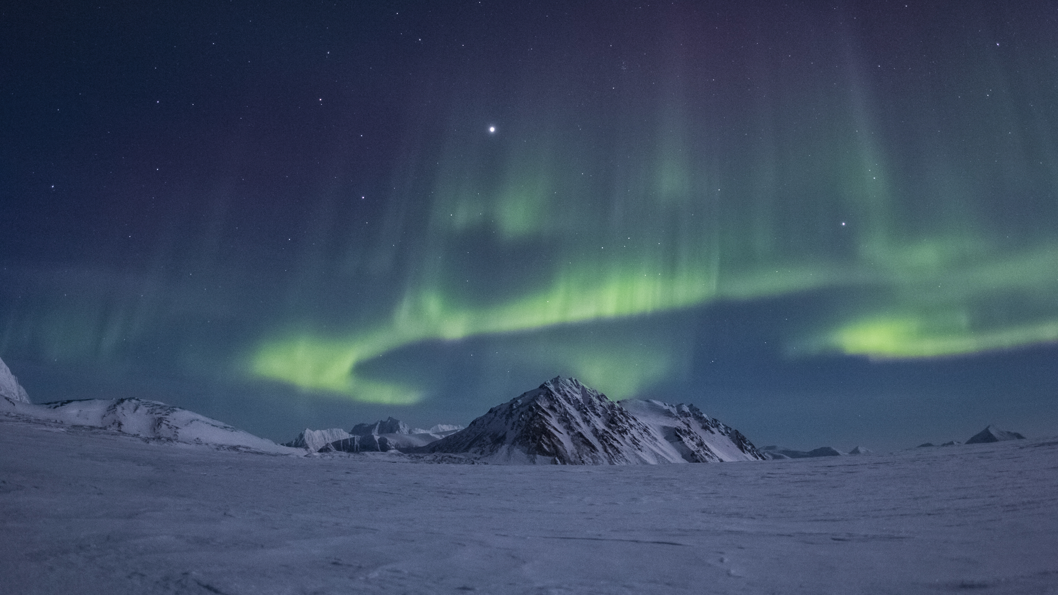
So how do we connect our
eternal hope to our daily grind?
Notes:
changing diapers, making sales calls, serving customers, doing schoolwork

Slide 19
Abiding Prayer

Slide 20
Abiding Prayer
So Jesus said to them, “Truly, truly, I say to you, the Son can do nothing of his own accord, but only what he sees the Father doing. For whatever the Father does, that the Son does likewise.
“I can do nothing on my own. As I hear, I judge, and my judgment is just, because I seek not my own will but the will of him who sent me.
(John 5:19, 30)

Slide 21
Abiding Prayer
I am the vine; you are the branches. Whoever abides in me and I in him, he it is that bears much fruit, for apart from me you can do nothing.
(John 15:5)
pray without ceasing,
(1 Thes. 5:17)
let us also keep in step with the Spirit.
(Ga. 5:25)

Slide 22
Acting in Love

Slide 23
Act in Love
Let each of you look not only to his own interests, but also to the interests of others. Have this mind among yourselves, which is yours in Christ Jesus,
(Phil. 2:5)
If I give away all I have, and if I deliver up my body to be burned, but have not love, I gain nothing.
(1 Cor. 13:3)

Slide 24
Act in Love
We know that we have passed out of death into life, because we love the brothers. Whoever does not love abides in death.
(1 John 3:14)
So we have come to know and to believe the love that God has for us. God is love, and whoever abides in love abides in God, and God abides in him.
(1 John 4:16)

Slide 25
Experience Joy

Slide 26
Experiencing Joy
Now I rejoice in my sufferings for your sake, and in my flesh I am filling up what is lacking in Christ's afflictions for the sake of his body, that is, the church,
(Col. 1:24)
Therefore, since we have been justified by faith, we have peace with God through our Lord Jesus Christ. Through him we have also obtained access by faith into this grace in which we stand, and we rejoice in hope of the glory of God. Not only that, but we rejoice in our sufferings,
(Ro. 5:1-3)

Slide 27
Experiencing Joy
You make known to me the path of life;
in your presence there is fullness of joy;
at your right hand are pleasures forevermore.
(Ps. 16:11)
he put them into the inner prison and fastened their feet in the stocks.About midnight Paul and Silas were praying and singing hymns to God, and the prisoners were listening to them
(Ac. 16:24-25)

Slide 28
Experiencing Joy
Rejoice always, pray without ceasing, give thanks in all circumstances; for this is the will of God in Christ Jesus for you.
(1 Thes. 5:16-18)
Whatever you do, work heartily, as for the Lord and not for men, knowing that from the Lord you will receive the inheritance as your reward. You are serving the Lord Christ.
(Col. 3:23-24)
looking to Jesus, the founder and perfecter of our faith, who for the joy that was set before him endured the cross,
(Heb. 12:2)
Rejoice in hope, be patient in tribulation, be constant in prayer.
(Ro. 12:12)

Slide 29
Have you ever been disappointed?
What were you hoping in/for that disappointed you?
How have you traditionally understood what we will be doing for all eternity?
Do you think your eternal hope is connected to your daily grind?

