Slide 1
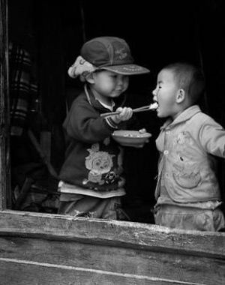
BLESSED TO BE A BLESSING
Bro Perry Ackon

Slide 2
Ephesians 1:3 Blessed be the God and Father of our Lord Jesus Christ, who has blessed us in Christ with every spiritual blessing in the heavenly places,
In Christ we have everything that we could ever need. In Him we are satisfied. This is the best foundation and most effective way to approach life.

Slide 3
THE TRUE DEFINITION OF BEING BLESSED. Matthew 5:1-11 The Sermon on the Mount - The Beatitudes 1. Seeing the crowds, he went up on the mountain, and when he sat down, his disciples came to him. 2. And he opened his mouth and taught them, saying: 3. “Blessed are the poor in spirit, for theirs is the kingdom of heaven. 4. “Blessed are those who mourn, for they shall be comforted. 5. “Blessed are the meek, for they shall inherit the earth. 6. “Blessed are those who hunger and thirst for righteousness, for they shall be satisfied. 7. “Blessed are the merciful, for they shall receive mercy. 8. “Blessed are the pure in heart, for they shall see God. 9. “Blessed are the peacemakers, for they shall be called sons of God. 10. “Blessed are those who are persecuted for righteousness' sake, for theirs is the kingdom of heaven. 11. “Blessed are you when others revile you and persecute you and utter all kinds of evil against you falsely on my account. 12. Rejoice and be glad, for your reward is great in heaven, for so they persecuted the prophets who were before you.

Slide 4
Classification of blessings in our walk of love: 1. Spiritual blessings - Our identity - Our inheritance - Our calling 2. People 3. Opportunities 4. Materials
Grace versus obedience: God will not give you anything that will destroy you.

Slide 5
Principles that trigger a release of a blessing: 1. Persistence - Hebrews 11:6 - And without faith it is impossible to please him, for whoever would draw near to God must believe that he exists and that he rewards those who seek him. - The story of the widow and the judge 2. Humility & Service - Matthew 23:11,12 - The greatest among you shall be your servant. Whoever exalts himself will be humbled, and whoever humbles himself will be exalted. 3. Giving - Luke 6:38 - give, and it will be given to you. Good measure, pressed down, shaken together, running over, will be put into your lap. For with the measure you use it will be measured back to you.” - John 12:24 - Truly, truly, I say to you, unless a grain of wheat falls into the earth and dies, it remains alone; but if it dies, it bears much fruit.

Slide 6
KEYS ON UNDERSTANDING KINGDOM BLESSINGS 1. God’s priority is for us to have a Christ like Character above every material blessing. 2. God is more willing to release a blessing over your life if your motives and heart for others is right. 3. What you have and what you do does not matter unless it’s tied to the finished work of Christ.

Slide 7
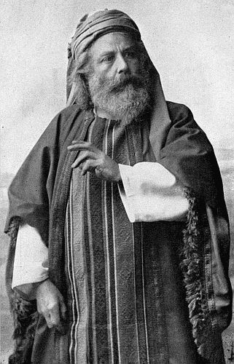
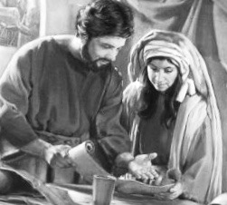
Aquila & Priscilla
Joseph of Arimathea

Slide 8
JOSEPH OF ARIMATHEA 1. He was a great man of influence and a respected member of the council. 2. He was a disciple of Jesus Christ. 3. He used his place of influence to ask Pilate to take away the body of Jesus and gave Him a befitting burial

Slide 9
Aquila and Priscilla 1. Christian Missionary Couple who had given themselves as bond servants of Christ. 2. They went on missionary journeys with Paul and discipled members of the church including Apollos 3. The hosted a church in their home

Slide 10
Take homes from today’s sermon 1. Our relationship with God should be our priority 2. We should equally invest on our heart and character. 3. Others Others Others 4. Heaven is counting on us
“Behold, I am coming soon, bringing my recompense with me, to repay each one for what he has done. Revelations 22:12

