Slide 1
Best Christmas Ever
A Portrait of Jesus from the Gospel of Luke and the Response of Worship

Slide 2
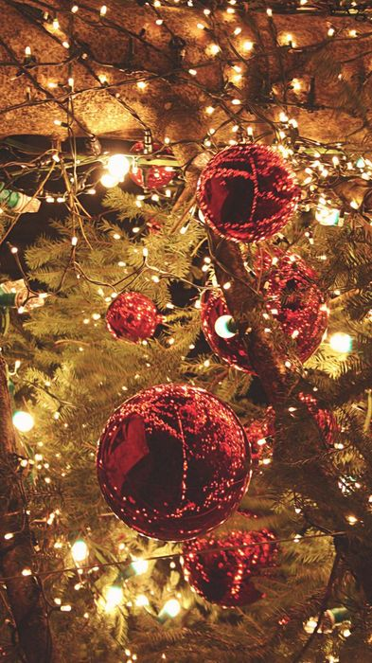
Merry Christmas!!!
Are you having a good Christmas?
What does a “good Christmas” look like?
Could Christmas 2020 be the Best Christmas Ever?

Slide 3
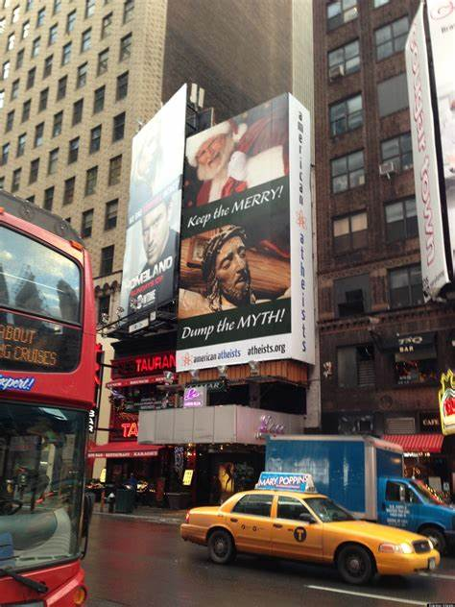
Christmas Perspective
2012 Times Square, NY
“Atheist Americans” billboard said:
Keep the Merry (Santa)
Dump the Myth (Jesus)
Seriously, which is more likely myth?
Perhaps got many people thinking about Jesus.

Slide 4
Christmas Traditions
Colorful Lights
+ Decorated Trees
+ Tasty Cookies
+ Presents
+ Santa Claus
+ Silly Songs
= Peripheral (Extra Stuff)

Slide 5
Christmas – True Meaning
Christmas is all about
CHRIST!!!
It’s all about Jesus!

Slide 6
Outline
Looking in Luke
The Manger
The Man
The Mission
The Message

Slide 7
The Manger (Luke 2:1-20 ESV)
1 In those days a decree went out from Caesar Augustus that all the world should be registered.
2 This was the first registration when Quirinius was governor of Syria.
3 And all went to be registered, each to his own town.
4 And Joseph also went up from Galilee, from the town of Nazareth, to Judea, to the city of David, which is called Bethlehem, because he was of the house and lineage of David,
5 to be registered with Mary, his betrothed, who was with child.
6 And while they were there, the time came for her to give birth.
7 And she gave birth to her firstborn son and wrapped him in swaddling cloths and laid him in a manger, because there was no place for them in the inn.

Slide 8
The Manger (Luke 2:1-20 ESV)
8 And in the same region there were shepherds out in the field, keeping watch over their flock by night.
9 And an angel of the Lord appeared to them, and the glory of the Lord shone around them, and they were filled with great fear.
10 And the angel said to them, “Fear not, for behold, I bring you good news of great joy that will be for all the people.
11 For unto you is born this day in the city of David a Savior, who is Christ the Lord.
12 And this will be a sign for you: you will find a baby wrapped in swaddling cloths and lying in a manger.”
13 And suddenly there was with the angel a multitude of the heavenly host praising God and saying,
14“Glory to God in the highest,
and on earth peace among those with whom he is pleased!”

Slide 9
The Manger (Luke 2:1-20 ESV)
15 When the angels went away from them into heaven, the shepherds said to one another, “Let us go over to Bethlehem and see this thing that has happened, which the Lord has made known to us.”
16 And they went with haste and found Mary and Joseph, and the baby lying in a manger.
17 And when they saw it, they made known the saying that had been told them concerning this child.
18 And all who heard it wondered at what the shepherds told them.
19 But Mary treasured up all these things, pondering them in her heart.
20 And the shepherds returned, glorifying and praising God for all they had heard and seen, as it had been told them.

Slide 10
The Manger (Luke 2:1-20 ESV)
God chose to reveal his message to shepherds. Why shepherds?
A few ideas:
Jesus - the Lamb of God
Jesus - our great shepherd
The Church - his flock of sheep
Shepherds were a ready audience
Shepherds were poor
God likes shepherds?
Not sure

Slide 11
The Manger (Luke 2:1-20 ESV)
The shepherds were watching and waiting.
8 And in the same region there were shepherds out in the field, keeping watch over their flock by night.
Imagine how the shepherds felt!
9 And an angel of the Lord appeared to them, and the glory of the Lord shone around them, and they were filled with great fear.
Literal translation: “They feared with great fear.”

Slide 12
The Manger (Luke 2:1-20 ESV)
The angels were excited!
10 And the angel said to them, “Fear not, for behold, I bring you good news of great joy that will be for all the people.
11 For unto you is born this day in the city of David a Savior, who is Christ the Lord.
12 And this will be a sign for you: you will find a baby wrapped in swaddling cloths and lying in a manger.”
13 And suddenly there was with the angel a multitude of the heavenly host praising God and saying,
14“Glory to God in the highest,
and on earth peace among those with whom he is pleased!”

Slide 13
The Manger (Luke 2:1-20 ESV)
The heart of the angel’s message:
11 For unto you is born this day in the city of David a Savior, who is Christ the Lord.

Slide 14
The Manger (Luke 2:1-20 ESV)
Mary’s response
19 But Mary treasured up all these things, pondering them in her heart.

Slide 15
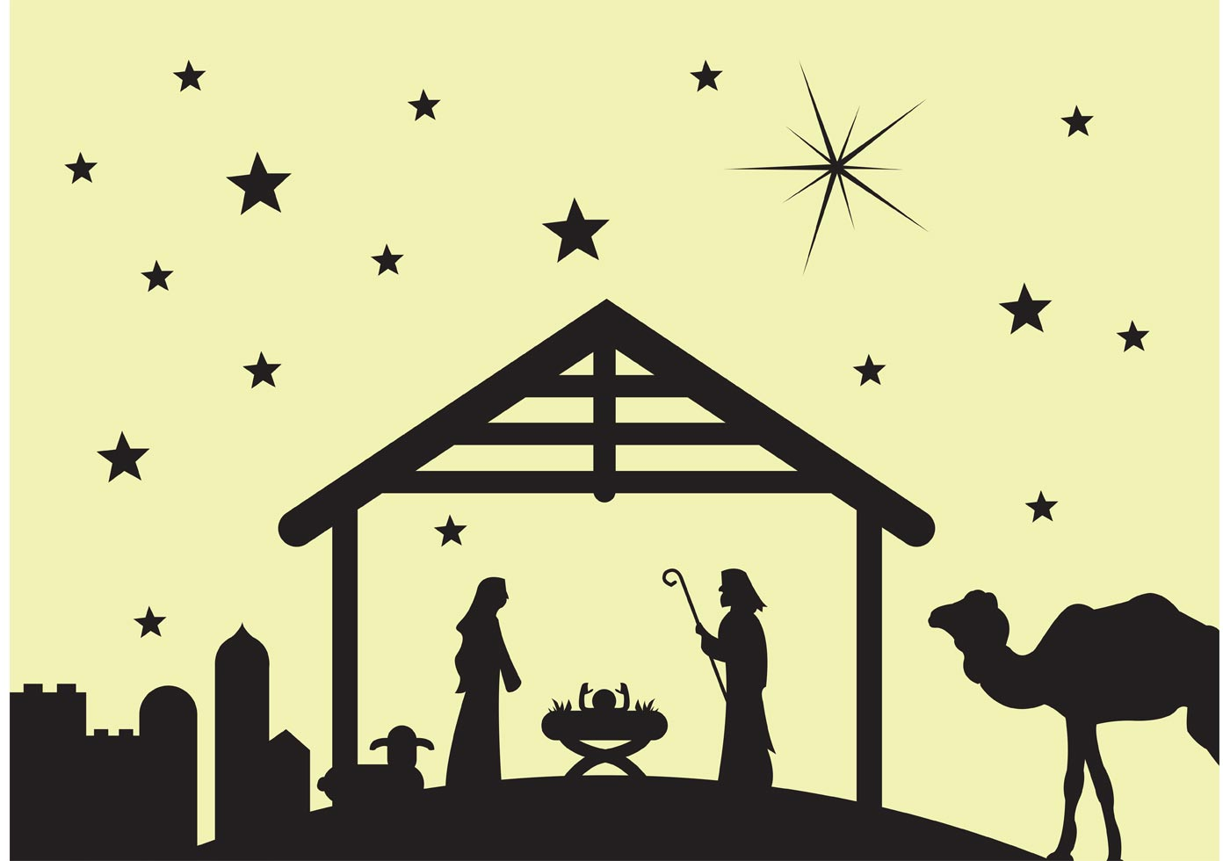
The Man

Slide 16
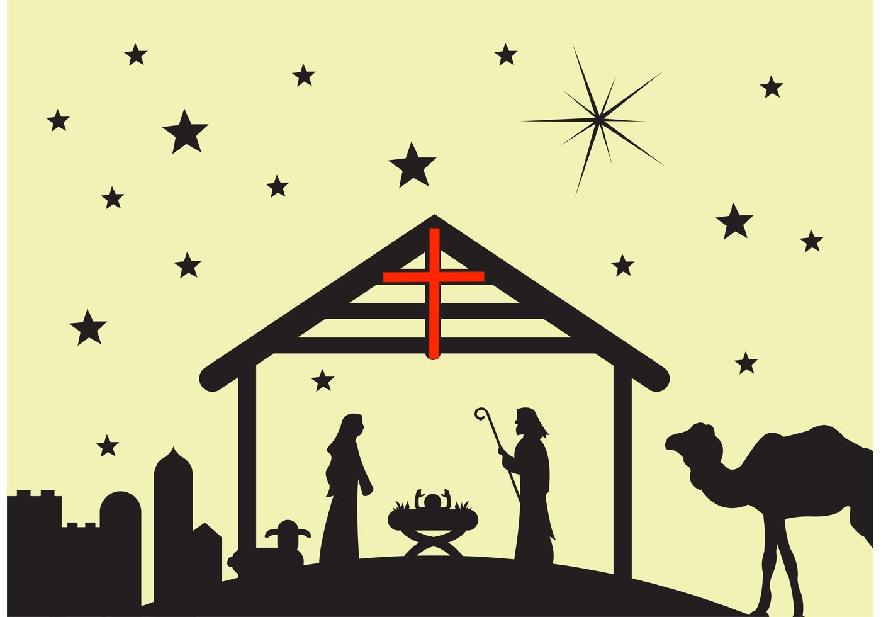
The Man

Slide 17
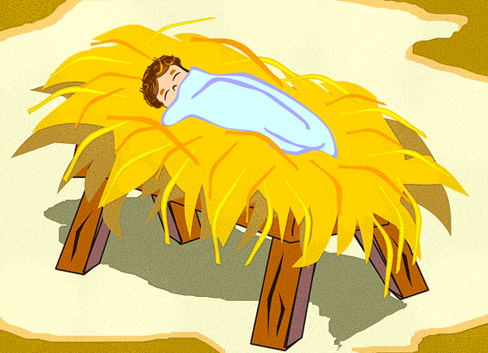
The Man

Slide 18
The Man
Jesus claimed to be Lord of the Sabbath (Luke 6:5)
Forgave sinners (Luke 5:24, 19:9)
Called sinners to repentance (Luke 5:32)
Fulfilled Old Testament prophecy (Luke 4:21)
Taught people countless deep spiritual truths (throughout Luke)
Healed people of leprosy (Luke 5:13, 17:14)
Healed people of paralysis (Luke 5:25)
Healed a withered hand, a woman’s bleeding, edema, all kinds of diseases (6:10, 8:44, 14:4, 4:40)

Slide 19
The Man
He brought dead people back to life (7:14, 8:55)
He fed 5000 people with 5 loaves and 2 fish (9:10ff)
He told a storm to stop storming, and the weather obeyed him (8:22ff)
He cast demons out of people (8:26ff)
He faced Satan himself and Jesus didn’t give into a single temptation (4:1ff)
More than once the voice of God the Father came from heaven saying, “This is my son.” (3:22, 9:35)
More than once he predicted his own death and his own resurrection (9:21ff, 9:44ff, 18:31ff)

Slide 20
The Man
Jesus initiated a new covenant in his own blood (22:19-20).
He died on the cross for our sins (23:46).
He was buried (23:50ff).
On the third day, he came back to life (Luke 24).

Slide 21
The Mission
“To seek and save the lost” (Luke 19:10)
To call “sinners to repentance” (Luke 5:32)
Repentance = Turning around (from going the wrong way to going the right direction)
Away From: Selfishness, lust, pride, greed, lies, gossip/rumors, hate
Toward: Love for God, love for others, honesty, faithfulness, forgiveness, kindness, humility

Slide 22
The Message
“… the Christ should suffer and on the third day rise from the dead, and that repentance for the forgiveness of sins should be proclaimed in his name to all nations …” (Luke 24:46-47)

Slide 23
Our Response
Prayer of repentance: “God, have mercy on me, a sinner. I believe in you as my savior and I commit to follow you as my Lord.”
Process of repentance
Worship

Slide 24
Angels from the Realms of Glory
Angels from the realms of glory,
wing your flight o'er all the earth;
ye who sang creation's story,
now proclaim Messiah's birth:
Come and worship, come and worship,
worship Christ, the newborn King.

Slide 25
Angels from the Realms of Glory
Shepherds in the fields abiding,
watching o'er your flocks by night,
God with us is now residing,
yonder shines the infant Light:
Come and worship, come and worship,
worship Christ, the newborn King.

Slide 26
Angels from the Realms of Glory
Though an infant now we view him
he will share his Father's throne,
gather all the nations to him;
every knee shall then bow down.
Come and worship, come and worship,
worship Christ, the newborn King.

