Slide 1
COUNT THE CO$T
Luke 14:33

Slide 2
Salvation Is Free
For the wages of sin is death, but the free gift of God is eternal life in Christ Jesus our Lord. (Romans 6:23)
… if you confess with your mouth that Jesus is Lord and believe in your heart that God raised him from the dead, you will be saved. For with the heart one believes and is justified, and with the mouth one confesses and is saved. (Romans 10:9-10)
For by grace you have been saved through faith. And this is not your own doing; it is the gift of God, not a result of works, so that no one may boast. (Ephesians 2:8-9)
For we are his workmanship, created in Christ Jesus for good works, which God prepared beforehand, that we should walk in them. (Ephesians 2:10)

Slide 3
What’s The Catch?
When we choose to follow Jesus, we surrender everything we are and everything we have over to him. He guides our lives and our choices. All our relationships are to be lived out according to his desires. The activities with which we spend our time are to be according to his direction. The appropriation of our possessions (even how we spend our money) is to be according to his guidance.
Christians sometimes refer to this concept as “the Lordship of Jesus” meaning we respond to Jesus as the Lord (or Master, King, Boss, The One In Charge) of our lives.

Slide 4
The Mission Of Jesus
“To seek and save the lost” (Luke 19:10)
To call “sinners to repentance” (Luke 5:32)
Repentance = Turning around (from going the wrong way to going the right direction)
Away From: Selfishness, lust, pride, greed, lies, gossip/rumors, hate
Toward: Love for God, love for others, honesty, faithfulness, forgiveness, kindness, humility

Slide 5
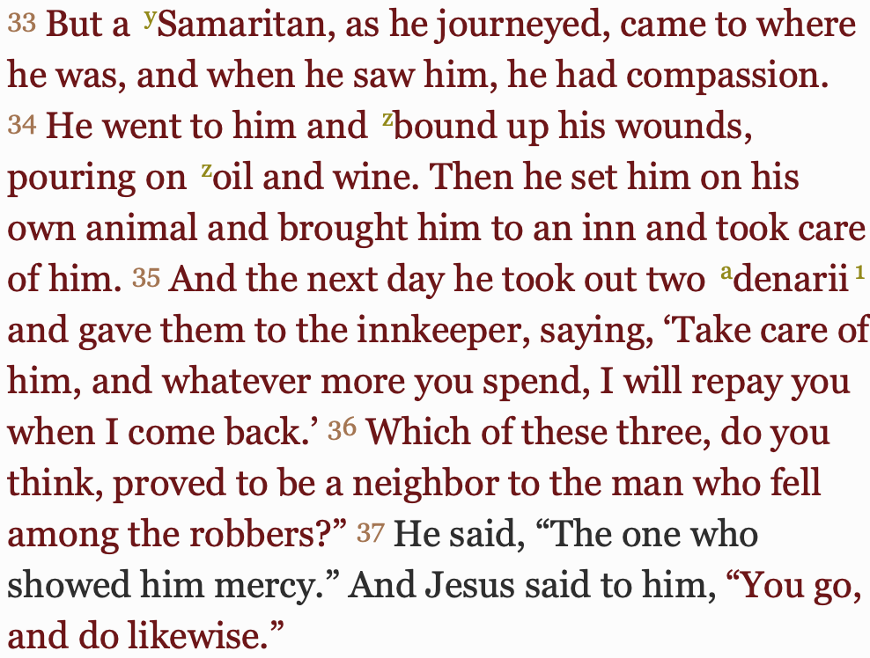
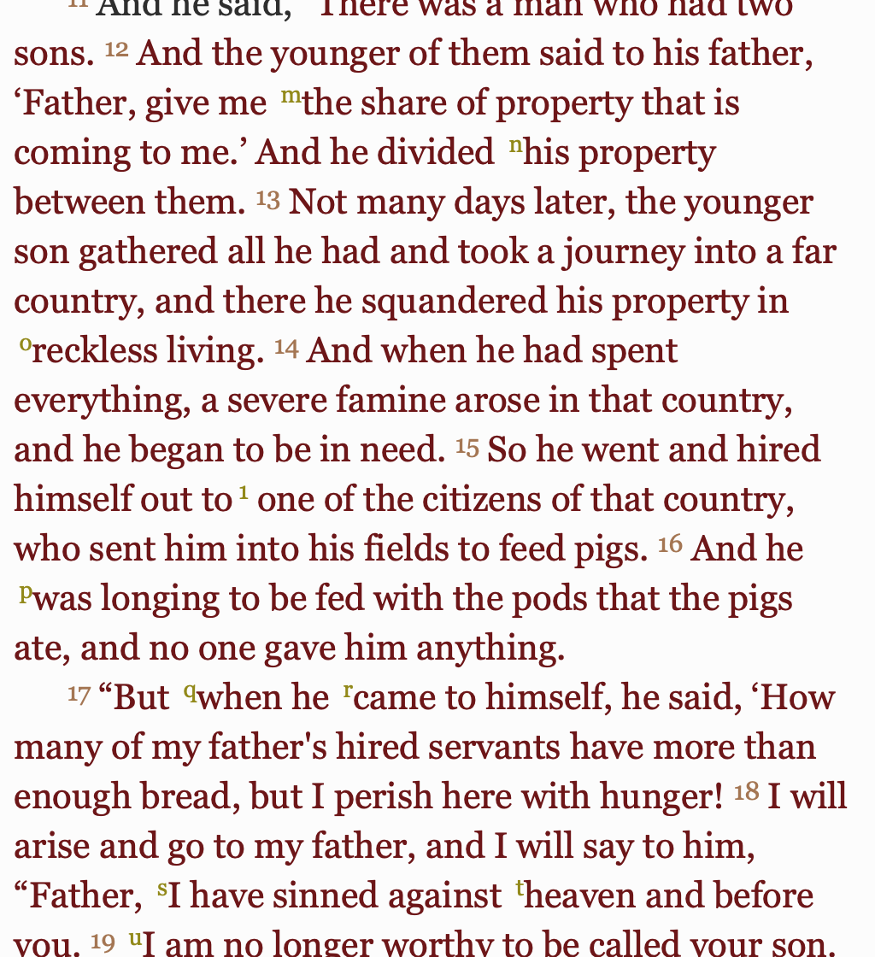
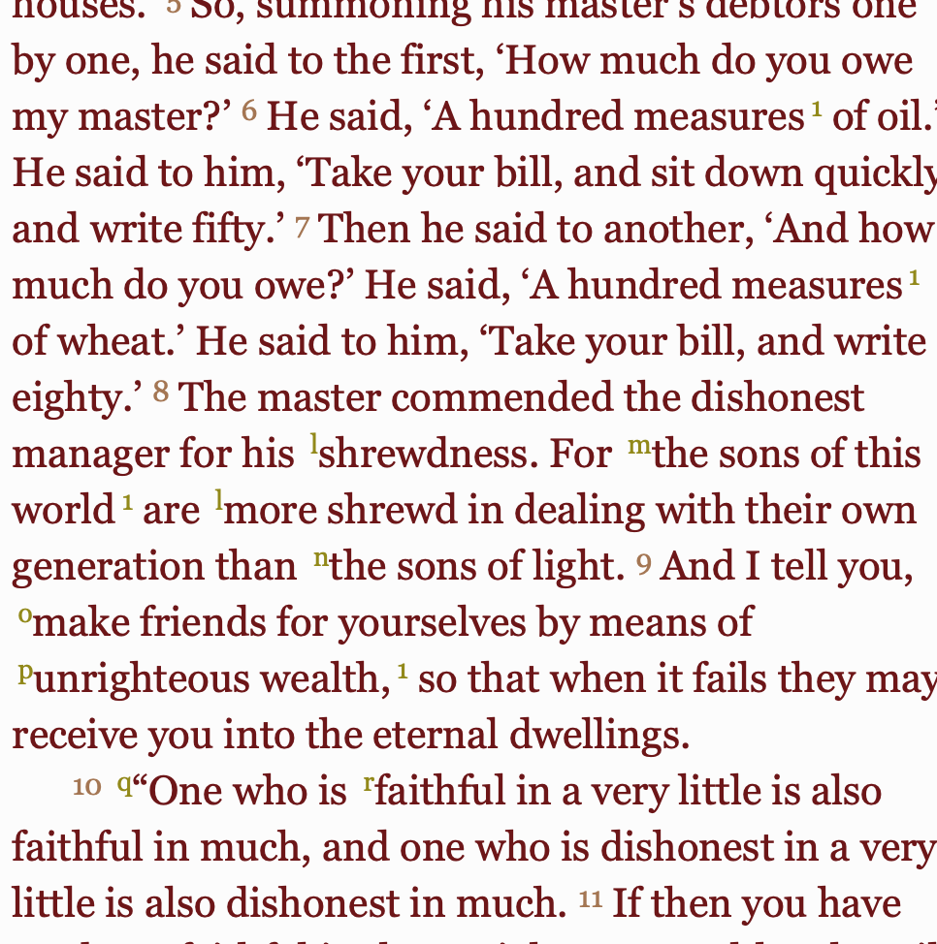
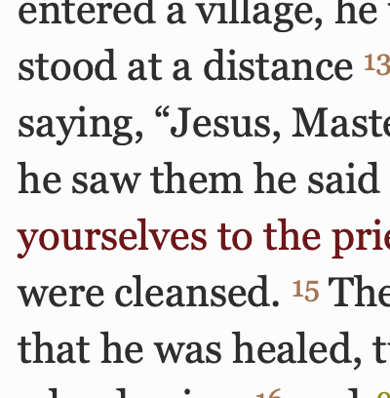
The Gospel Of Luke
COMPASSION
FORGIVENESS
JUSTICE
REDEMPTION
GENEROSITY

Slide 6
The Gospel Of Luke

Slide 7
The Gospel of Luke
Summary
The Gospel of Luke is the story of Jesus’ life, from the virgin birth through his boyhood, his ministry as an adult, his death, and it finishes with his powerful resurrection and ascension.
The narrative also includes many of the teachings of Jesus.

Slide 8
Who Was Luke?
Friend of Paul, beloved, Physician “Luke the beloved physician greets you” (Colossians 4:14)
Close friend of Paul “Luke alone is with me.” (2 Timothy 4:11)
Writer of Acts and says “we” in parts of travels with Paul including shipwreck (Acts 20 and following)
Not one of the Twelve apostles, but a compiler/historian of first-hand accounts of people who had been with Jesus

Slide 9
Purpose Of Luke’s Book
“Inasmuch as many have undertaken to compile a narrative of the things that have been accomplished among us, just as those who from the beginning were eyewitnesses and ministers of the word have delivered them to us, it seemed good to me also, having followed all things closely for some time past, to write an orderly account for you, most excellent Theophilus, that you may have certainty concerning the things you have been taught.” (Luke 1:1-4)

Slide 10
People
People

Slide 11
A Pattern In Luke
“he has filled the hungry with good things, and the rich he has sent away empty.” (Luke 1:53, Mary’s Song)
“For unto you is born this day in the city of David a Savior, who is Christ the Lord. And this will be a sign for you: you will find a baby wrapped in swaddling cloths and lying in a manger.” (Luke 2:11-12, God the Son becomes poor cf. 2 Corinthians 8:9 “For you know the grace of our Lord Jesus Christ, that though he was rich, yet for your sake he became poor, so that you by his poverty might become rich.”)
‘And the crowds asked him, “What then shall we do?” And he answered them, “Whoever has two tunics is to share with him who has none, and whoever has food is to do likewise.” Tax collectors also came to be baptized and said to him, “Teacher, what shall we do?” And he said to them, “Collect no more than you are authorized to do.” Soldiers also asked him, “And we, what shall we do?” And he said to them, “Do not extort money from anyone by threats or by false accusation, and be content with your wages.’ (Luke 3:10-14)
‘“The Spirit of the Lord is upon me, because he has anointed me to proclaim good news to the poor.”’ (Luke 4:18)

Slide 12
A Pattern In Luke
“And when they had brought their boats to land, they left everything and followed him.” (Luke 5:11, Peter, James and John)
“And leaving everything, he rose and followed him.” (Luke 5:28, Levi)
“Blessed are you who are poor, for yours is the kingdom of God.” (Luke 6:20)
“But woe to you who are rich, for you have received your consolation.” (Luke 6:24)
Generosity teachings, e.g. “Give to everyone who begs from you” (Luke 6:27-38)
Jesus raises a widow’s only son, she actually goes from poor to not poor (Luke 7:11-17)
Parable showing God forgiving sins is like a moneylender forgiving debts (Luke 7:41-42)
Jesus’ financial situation - some of Jesus’ female disciples were rich women who provided for his needs (Luke 8:3)
Parable of the Sower - Riches choke the seed of God’s word and prevent fruitfulness (Luke 8:14)

Slide 13
A Pattern In Luke
‘And he said to them, “Take nothing for your journey, no staff, nor bag, nor bread, nor money; and do not have two tunics.”’ (Luke 9:3, sending out the twelve)
Feeding 5000 hungry people (Luke 9:10-17)
“For what does it profit a man if he gains the whole world and loses or forfeits himself?” (Luke 9:25)
‘And Jesus said to him, “Foxes have holes, and birds of the air have nests, but the Son of Man has nowhere to lay his head.”’ (Luke 9:58)
“Carry no moneybag” (Luke 10:4, sending out the 72)
“And the next day he took out two denarii and gave them to the innkeeper, saying, ‘Take care of him, and whatever more you spend, I will repay you when I come back.’” (Luke 10:35, good Samaritan)
“Give us each day our daily bread” (Luke 11:3)
Parable of the Rich Fool (Luke 12:31-21)
Many instructions about material possessions, e.g. “Sell your possessions, and give to the needy.” (Luke 12:22-34)

Slide 14
A Pattern In Luke
Parable of evil people who become disinherited and spiritually homeless (Luke 13:27)
“But when you give a feast, invite the poor, the crippled, the lame, the blind, and you will be blessed, because they cannot repay you. For you will be repaid at the resurrection of the just.” (Luke 14:13-14)
“So therefore, any one of you who does not renounce all that he has cannot be my disciple.” (Luke 14:33, key verse for today)
Undeserving son goes from rags to riches (Luke 15:22)
Rich Man and Lazarus, poor man gets good, rich man gets bad (Luke 16:19ff)
One day when Christ returns, everyone will lose everything. (Luke 17:31)
“For it is easier for a camel to go through the eye of a needle than for a rich person to enter the kingdom of God.” (Luke 18:25)

Slide 15
A Pattern In Luke
‘And Zacchaeus stood and said to the Lord, “Behold, Lord, the half of my goods I give to the poor. And if I have defrauded anyone of anything, I restore it fourfold.”’ (Luke 19:8)
Greedy Vineyard Tenants lose their jobs (and lives) (Luke 20:16)
Widow’s status as a giver higher than the rich (Luke 21:3-4)
“And they were glad, and agreed to give him money.” Traitor gets richer (Luke 22:5)
God uses Joseph of Arimathea to provide a brand new tomb for Jesus (Luke 23:53)

Slide 16
Today’s Key Verse = Luke 14:33
“So therefore, any one of you who does not renounce all that he has cannot be my disciple.”
(English Standard Version)

Slide 17
Today’s Key Verse = Luke 14:33
“So therefore, any one of you who does not renounce all that he has cannot be my disciple.”
(English Standard Version)

Slide 18
Luke 14:33
Version | “renounce” | “all that he has”
NIV | give up | everything you have
NLT | giving up | everything you own
KJV | forsaketh | all that he hath
HCSB | say good-bye to | all his possessions

Slide 19
Luke 14:33 Immediate Context
25 Now great crowds accompanied him, and he turned and said to them, 26 “If anyone comes to me and does not hate his own father and mother and wife and children and brothers and sisters, yes, and even his own life, he cannot be my disciple. 27 Whoever does not bear his own cross and come after me cannot be my disciple. 28 For which of you, desiring to build a tower, does not first sit down and count the cost, whether he has enough to complete it? 29 Otherwise, when he has laid a foundation and is not able to finish, all who see it begin to mock him, 30 saying, ‘This man began to build and was not able to finish.’ 31 Or what king, going out to encounter another king in war, will not sit down first and deliberate whether he is able with ten thousand to meet him who comes against him with twenty thousand? 32 And if not, while the other is yet a great way off, he sends a delegation and asks for terms of peace. 33 So therefore, any one of you who does not renounce all that he has cannot be my disciple.
34 “Salt is good, but if salt has lost its taste, how shall its saltiness be restored? 35 It is of no use either for the soil or for the manure pile. It is thrown away. He who has ears to hear, let him hear.”

Slide 20
Luke 14:33 Interpretation
“Great crowds”
Hyperbole: Exaggeration not meant to be interpreted literally
Use caution when calling Jesus’ words hyperbole, as he is usually straightforward.
“hate” in verse 26 must be hyperbole
Opposite of so many of his other commands to love one another
(I’ve found) no other reference where Jesus recommends hate
Great cross-reference in Matthew 10:37, “Whoever loves father or mother more than me is not worthy of me, and whoever loves son or daughter more than me is not worthy of me.”

Slide 21
Luke 14:33 Interpretation
So, could verse 33 also be hyperbole?
Not likely.
Verse 27 about taking up our cross is for real. We see some of the disciples dying for their faith in Luke’s second book, Acts.
Observe the rich people in all those other verses we looked at earlier.

Slide 22
Application
How do we apply what appears to be a difficult command?

Slide 23
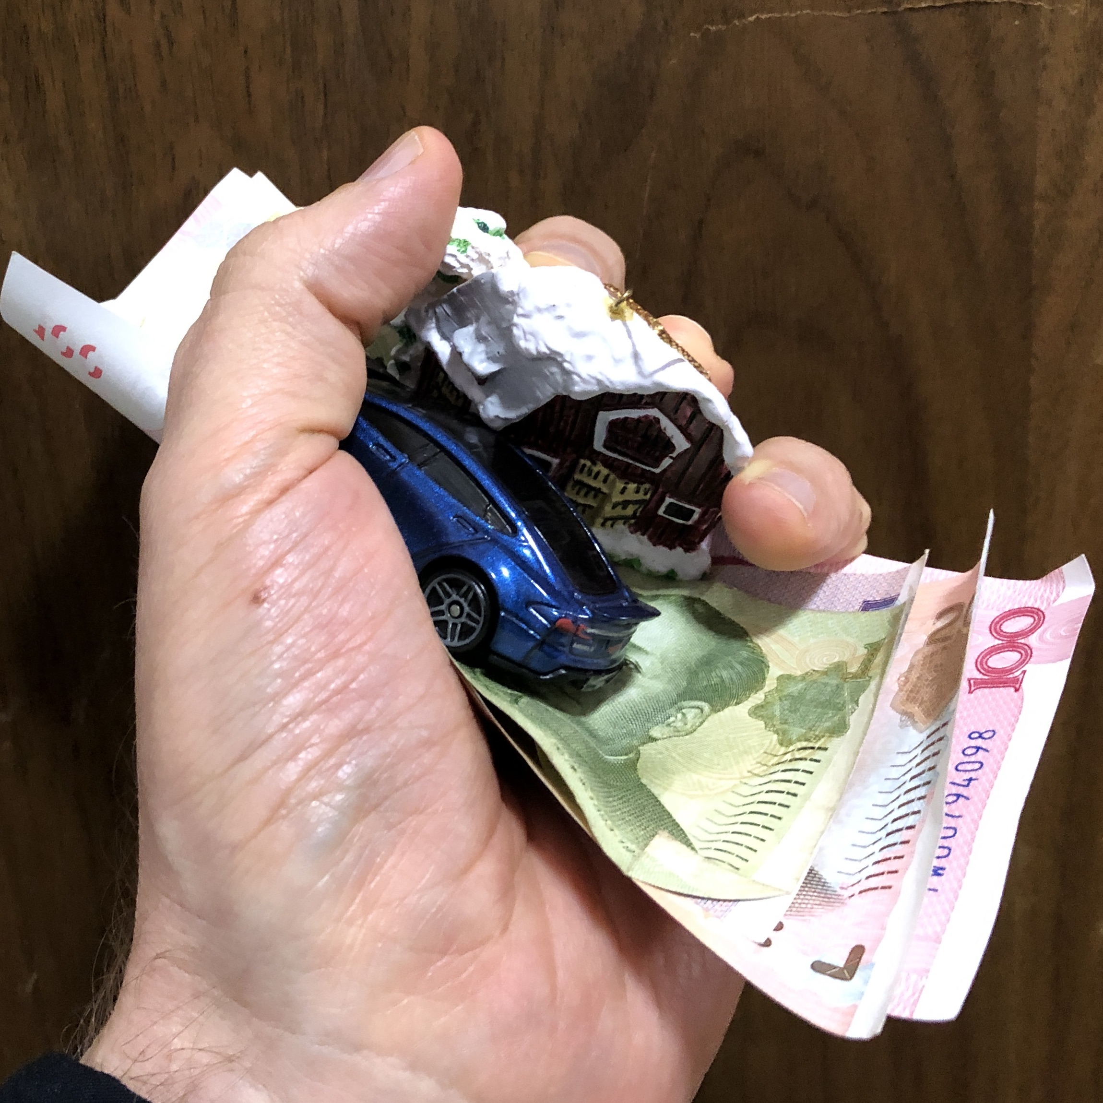
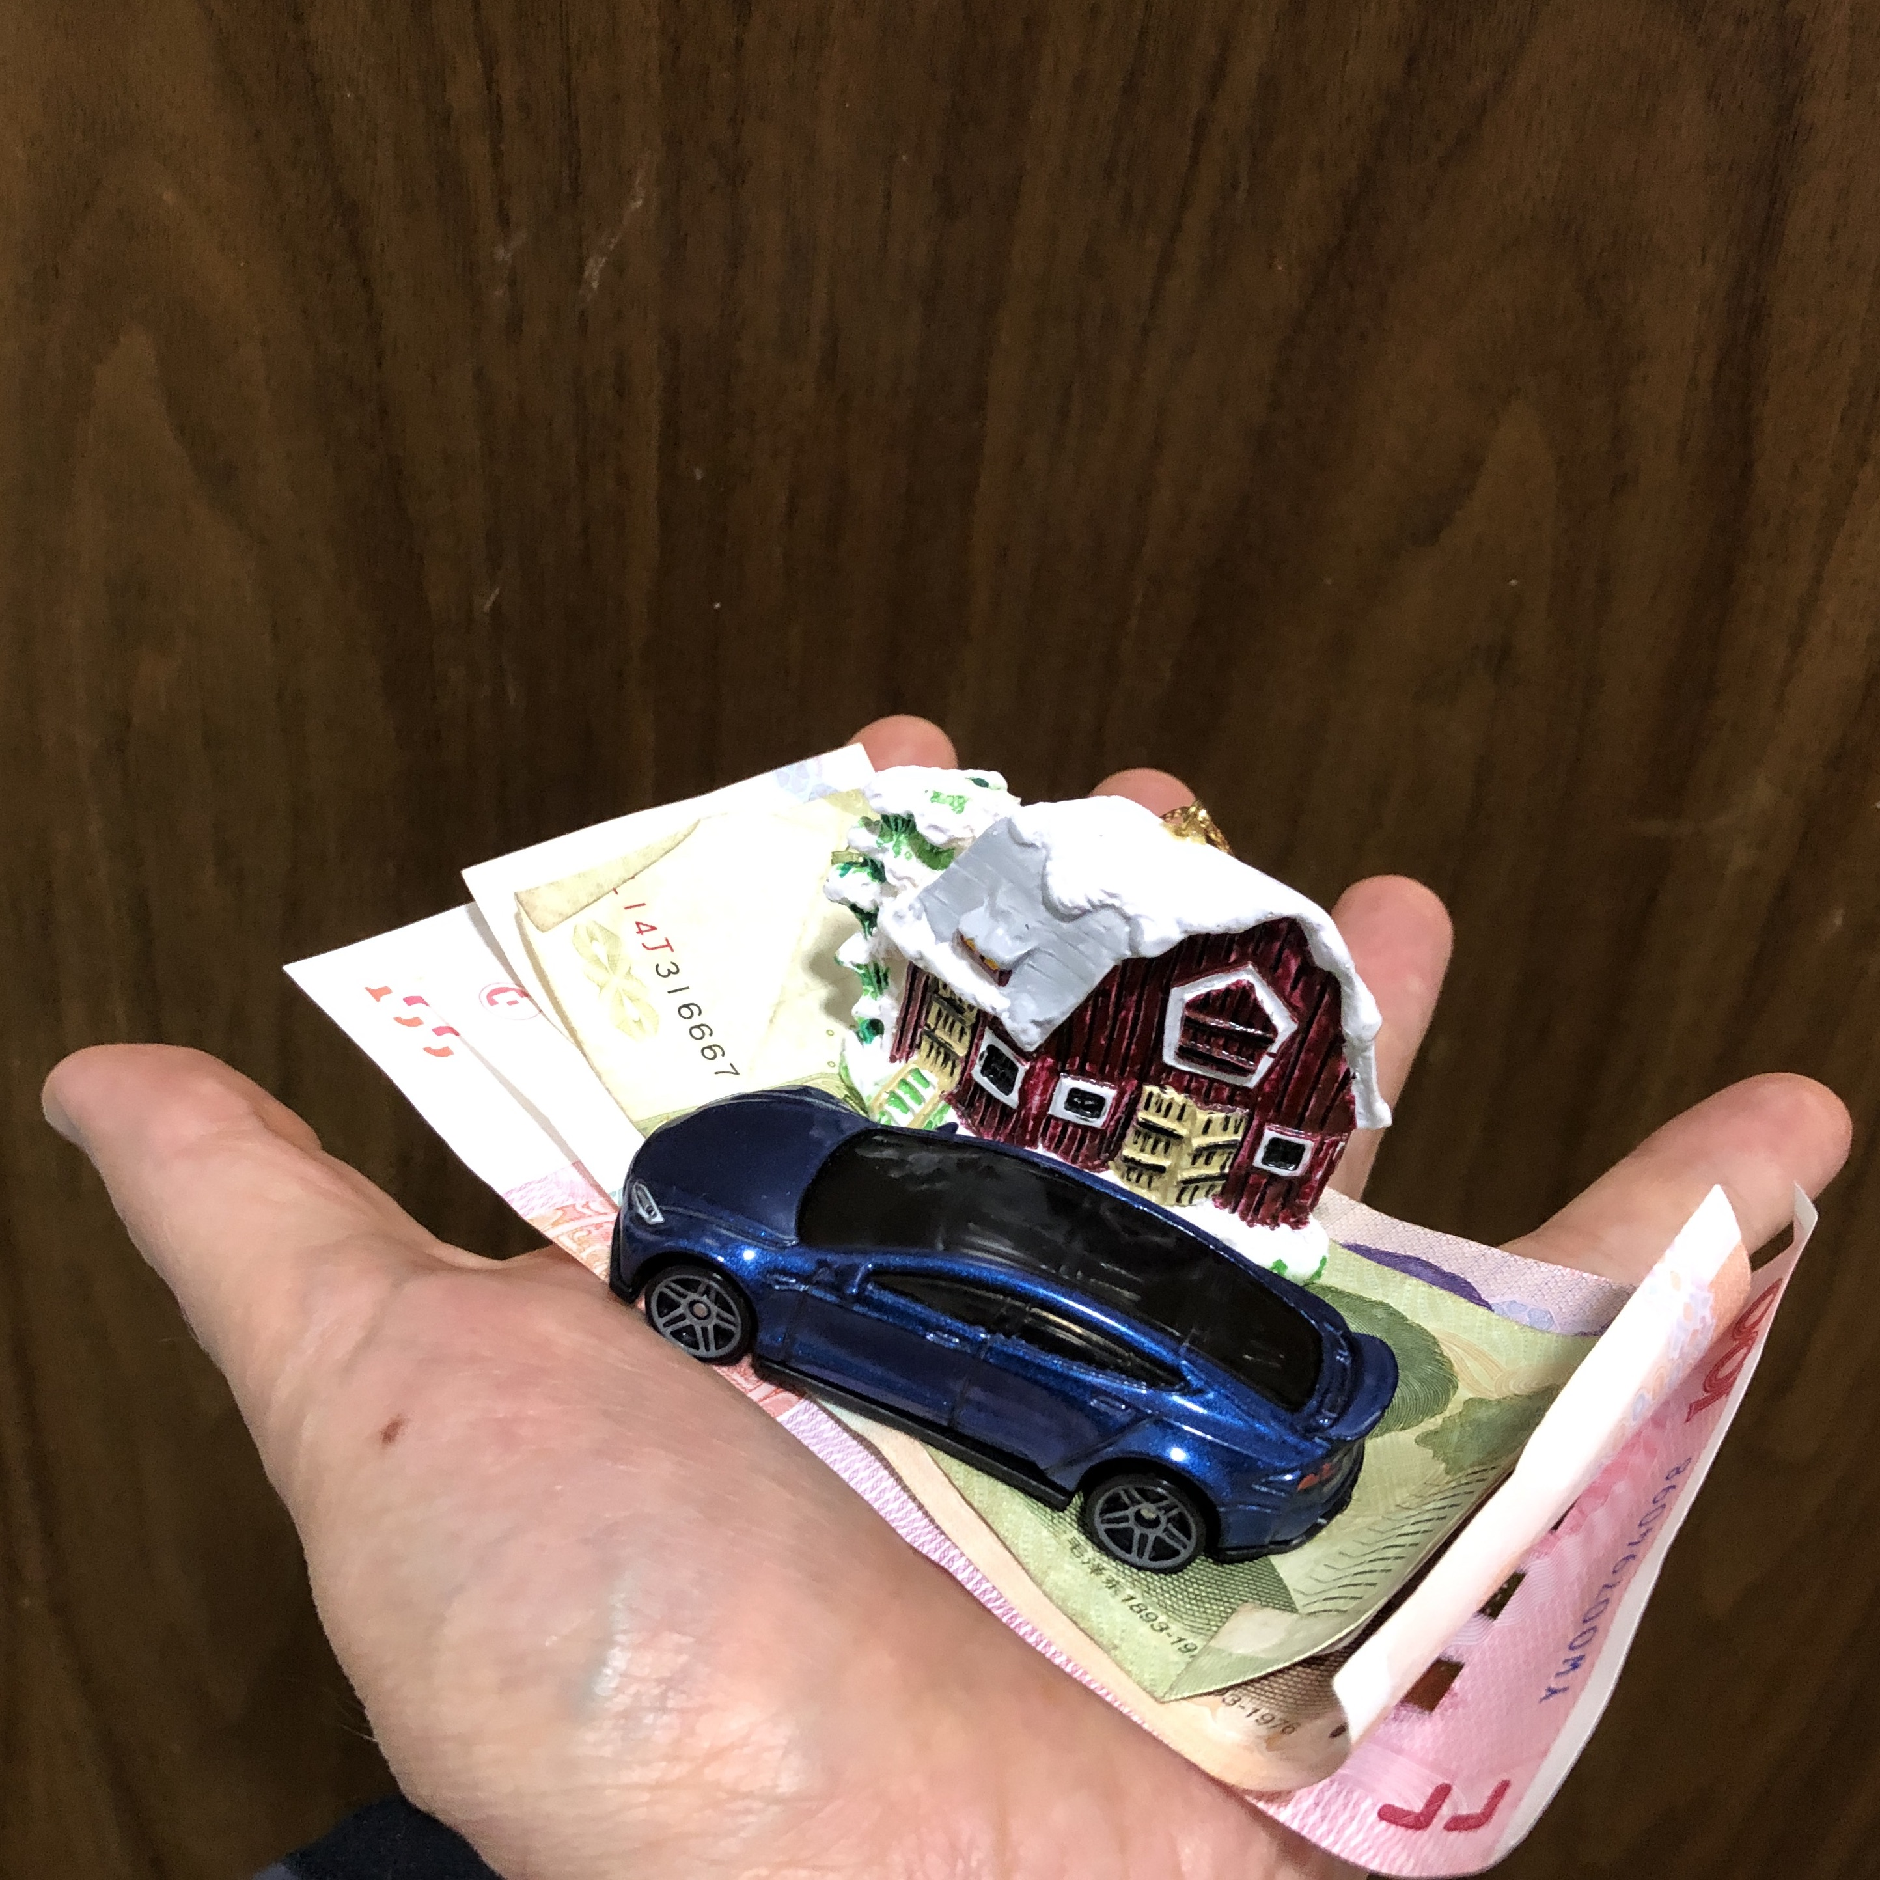
Application: Saying Good-bye, Generous Heart Attitude

Slide 24
Application
Why interpret Luke 14:33 as a character description instead of a command or requirement?
Women who supported Jesus
Joseph of Arimithea
Nicodemus
Paul taking collections for famine relief (Acts 11:28-30)
Paul’s instructions about rich believers (1 Timothy 6)

Slide 25
Application - Comments
Luke 14:33 is not intended to open us up to abuse or being taken advantage of.
Good money management prepares us for generosity.
Persecution can include seizure of property. (Hebrews 10:34)

Slide 26
The Dynamic Nature of Cash Flow and God’s Economy: Giving Is Not The End!
“Give, and it will be given to you.” Luke 6:38

Slide 27
The Gospel Of Luke
COMPASSION
FORGIVENESS
JUSTICE
REDEMPTION
GENEROSITY

