Slide 1
People Are Valuable
Luke 16:1-9

Slide 2
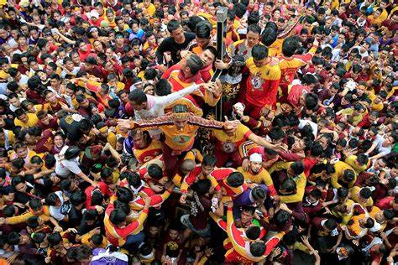
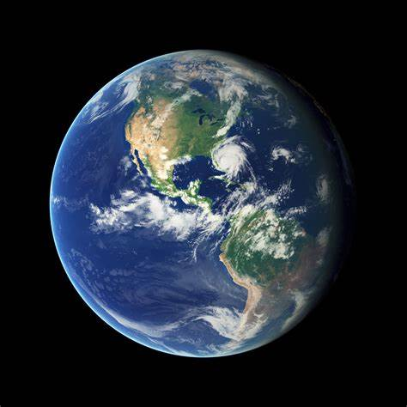
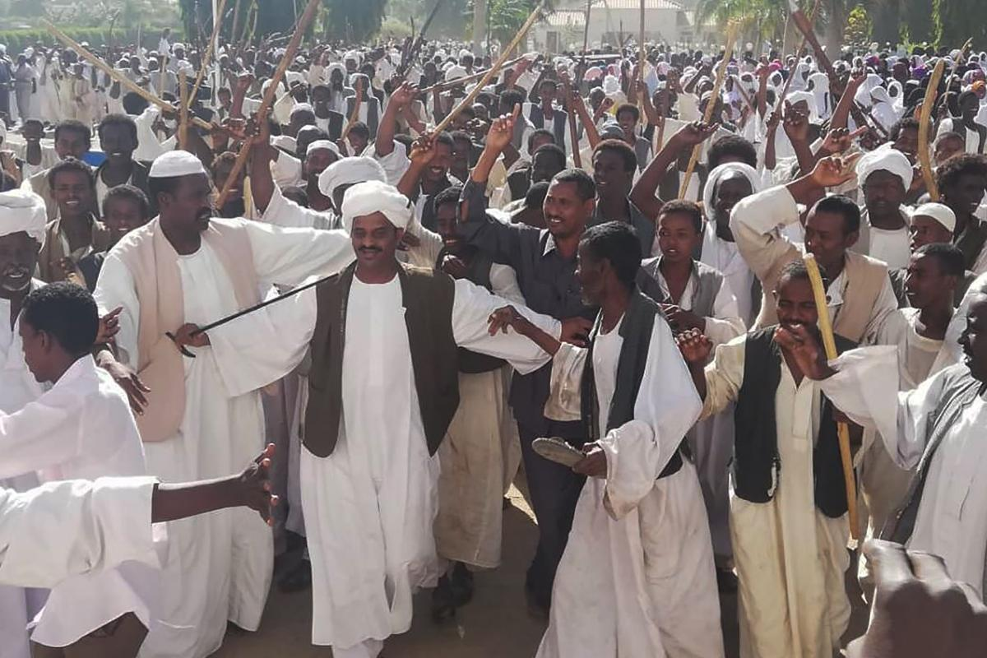
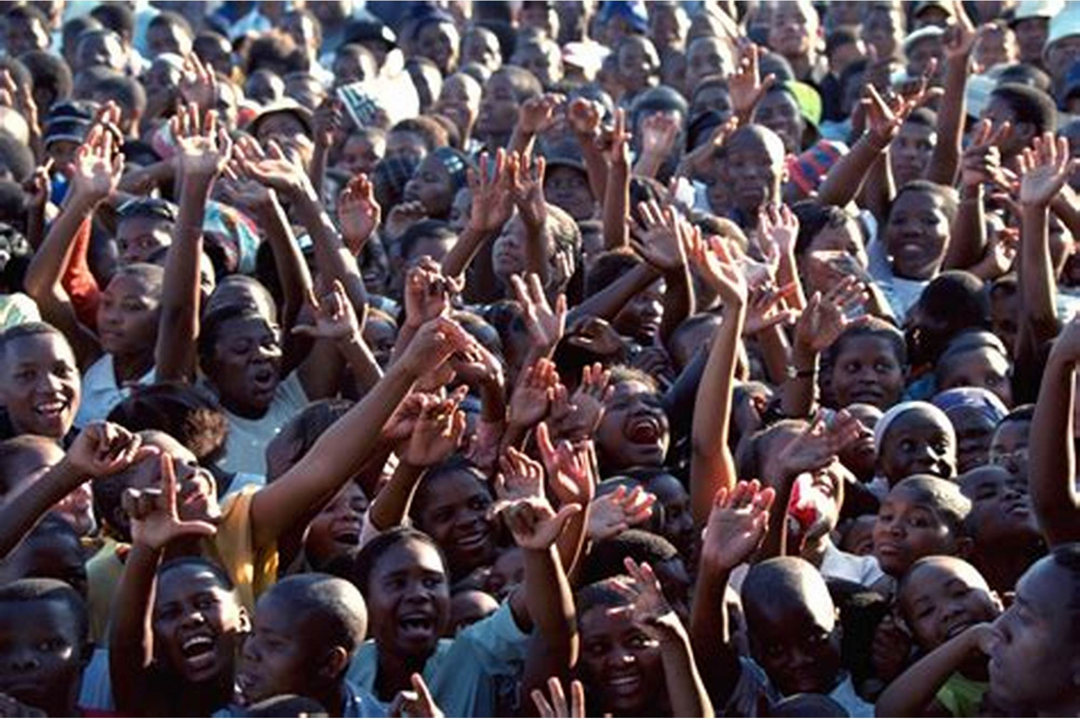
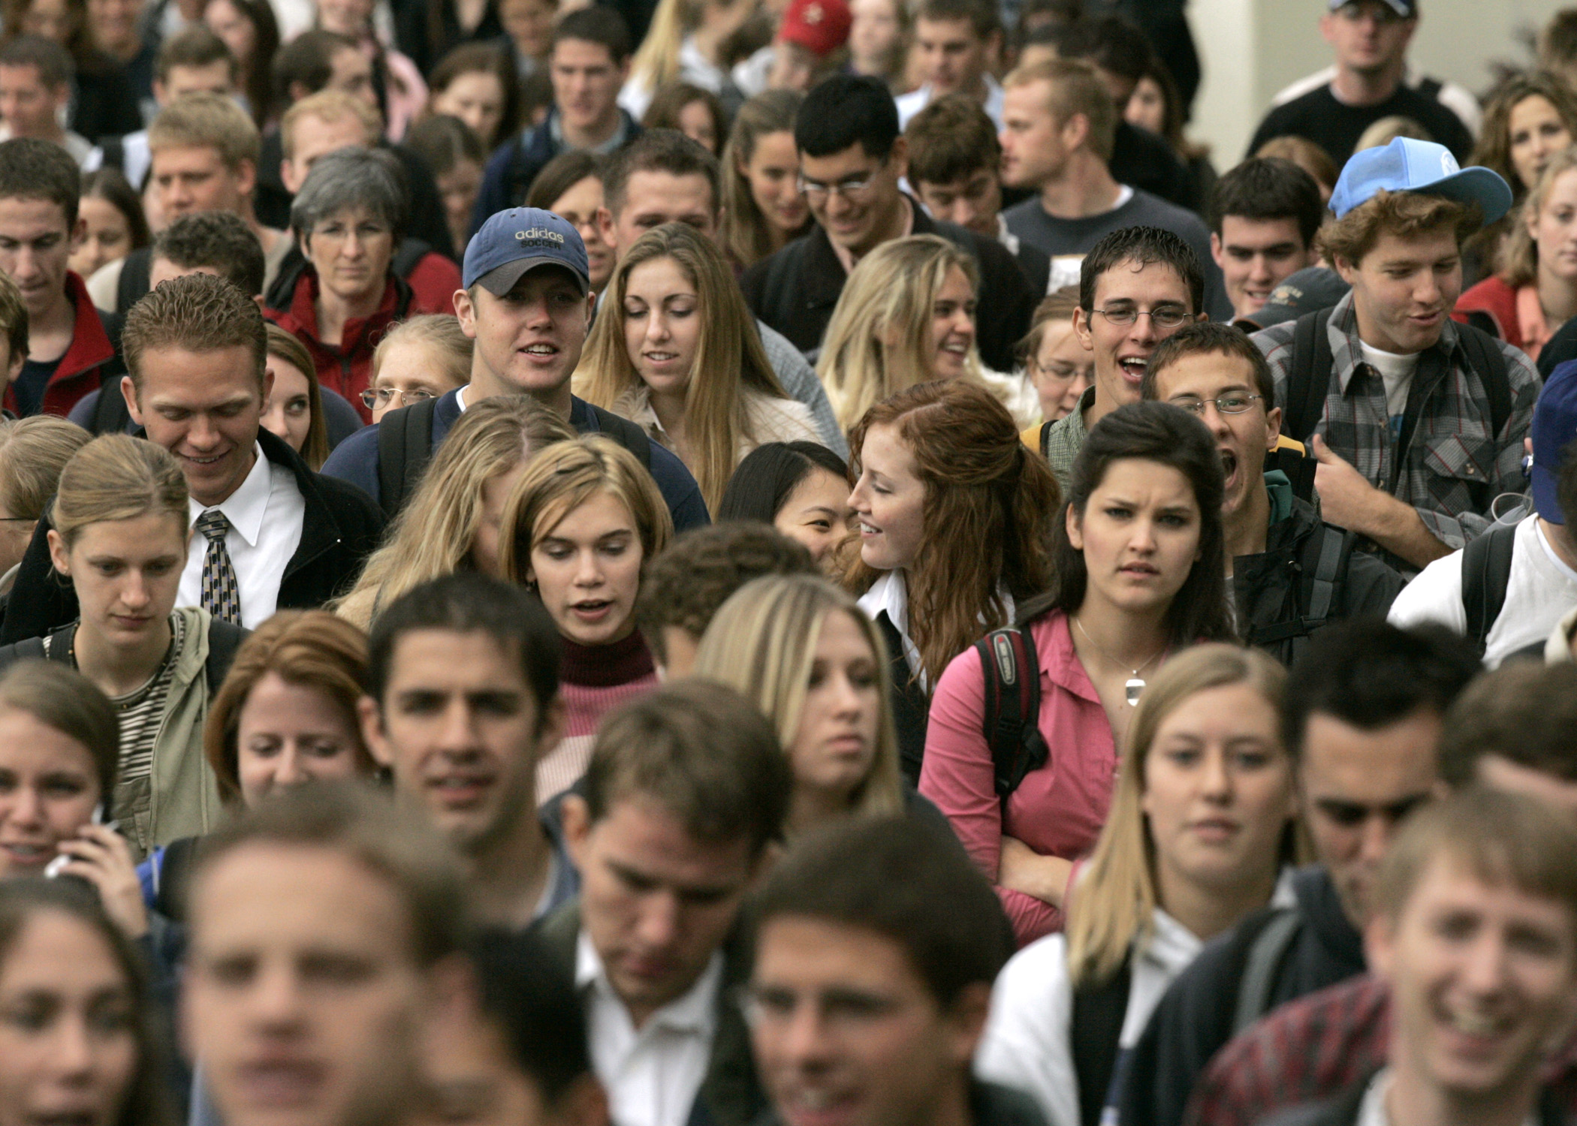
Notes:
This month in Zimbabwe a young mother lost her life when her husband’s mining explosives accidently went off in her house. Miraculously her baby survived among the debris. While we’re happy for the baby, the mother’s death is tragic.
Several years ago a small airplane crashed in Kentucky, USA. The pilot was the father of the family, and all the family members on board perished except the seven year old daughter who managed to make it to a stranger’s home and receive help. Again, we’re happy for the child, but she’s growing up without a family. The death of her family members is a tragedy.
Some of you may remember about a decade ago a two year old in Foshan was hit by a truck, hit and run. Security video captured the scene, and it shows over a dozen people walk past her without noticing. The story made international news as many people expressed their outrage at disbelief that no one noticed the girl and helped her.
Anyone with a heart can hear these stories feel a sense of loss as we consider the loss of human life.
Contrast Thad – people are the problem, war, pollution, oppression. fewer people the answer.
Contrast Darwin – people like animals, separate races, stronger races will wipe out weaker, he couldn’t have imagined how people in later years would apply those theories.

Slide 3
“Ideas have consequences. Bad ideas have victims.”

Slide 4
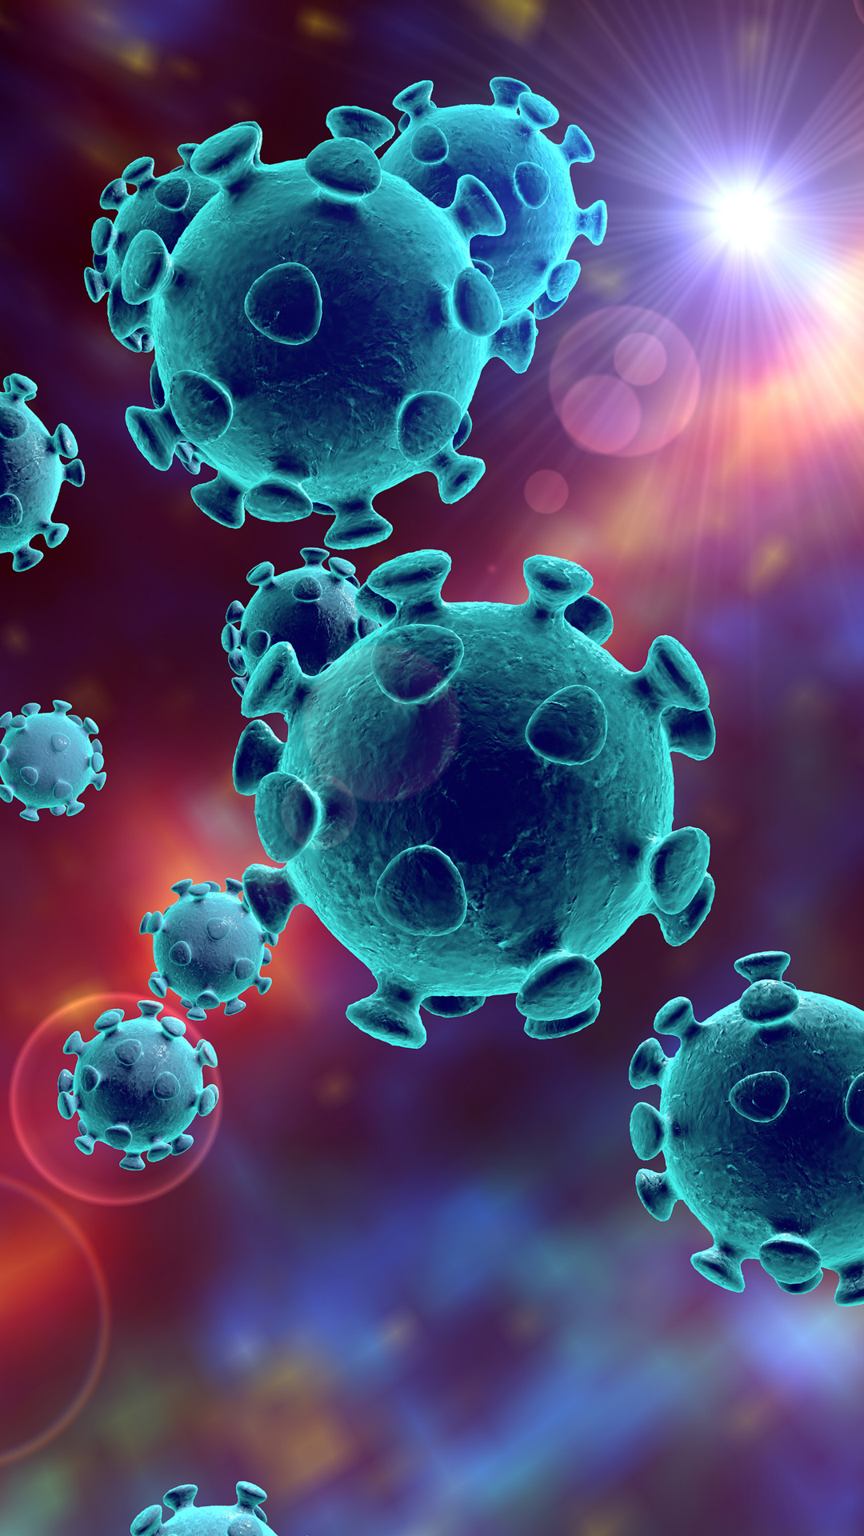
COVID-19
2,191,489 Deaths
1 : 5000
Notes:
Why is the number important? Our species is not in danger of extinction.

Slide 5
People Are Valuable
Why?

Slide 6
People Are Valuable
“So God created man in his own image, in the image of God he created him; male and female he created them.” (Genesis 1:27)
“And God saw everything that he had made, and behold, it was very good.” (Genesis 1:31)
“Are not five sparrows sold for two pennies? And not one of them is forgotten before God. Why, even the hairs of your head are all numbered. Fear not; you are of more value than many sparrows.” (Luke 12:6-7)
Notes:
In my image – dreams, thinking, imagining, inventing, writing, building, problem solve, plan, joy, love

Slide 7
People Are Valuable
Rich people (Luke 5:27-32, Luke 18:18-22, Luke 19:1-10)
Poor people (Luke 9:10-17, Luke 18:41)
Children (Luke 18:18)
The elderly (Luke 7:13)
Men (Luke 6:12-16)
Women (Luke 8:2, Luke 23:28-31)
Notes:
Jesus treats people as valuable, engaging people with truth and compassion
Face to face, eye to eye
A lot about women in the book of Luke, by the way

Slide 8
People Are Valuable
Low status (Luke 5:1-11)
High status (Luke 8:41)
Religious rulers (Luke 14:1-6)
Criminals (Luke 23:42-43)
Diseased (Luke 5:12-16)
Demon possessed (Luke 6:18, Luke 8:26-39)
Dead people (Luke 7:14-15, Luke 8:49-56)
Notes:
People mattered to Jesus

Slide 9
People Are Valuable
Lost Sheep (Luke 15) 99/100

Slide 10
People Are Valuable
Lost Coin (Luke 15) 9/10

Slide 11
People Are Valuable
x – 1 = K
x = J
Notes:
Every single person is valuable.

Slide 12
People Are Valuable
people > things
things = 0 (eternally)
Notes:
On the other hand, the things of this world, our money and material possessions, are of relatively little value here on earth.
And when we consider that people are spiritual beings who will spend an eternity either in God’s presence or separated from God’s presence, while the things of this earth will all pass away, then we see the things of earth have no eternal value and can’t even be compared to the value of people.

Slide 13
Come to Jesus, the one who says you’re worth dying for.
A prayer of surrender: “God have mercy on me, a sinner. Jesus, I believe that you died on the cross to save me from my sins and rose back to life on the third day. I surrender control of my whole life over to you.”
“if you confess with your mouth that Jesus is Lord and believe in your heart that God raised him from the dead, you will be saved” (Romans 10:9)

Slide 14
People Are Valuable
People are more important than things.
Notes:
On the other hand, the things of this world, our money and material possessions, are of relatively little value here on earth.
And when we consider that people are spiritual beings who will spend an eternity either in God’s presence or separated from God’s presence, while the things of this earth will all pass away, then we see the things of earth have no eternal value and can’t even be compared to the value of people.

Slide 15
Luke 16:1-9
1 He also said to the disciples, “There was a rich man who had a manager, and charges were brought to him that this man was wasting his possessions. 2 And he called him and said to him, ‘What is this that I hear about you? Turn in the account of your management, for you can no longer be manager.’ 3 And the manager said to himself, ‘What shall I do, since my master is taking the management away from me? I am not strong enough to dig, and I am ashamed to beg. 4 I have decided what to do, so that when I am removed from management, people may receive me into their houses.’ 5 So, summoning his master’s debtors one by one, he said to the first, ‘How much do you owe my master?’ 6 He said, ‘A hundred measures of oil.’ He said to him, ‘Take your bill, and sit down quickly and write fifty.’ 7 Then he said to another, ‘And how much do you owe?’ He said, ‘A hundred measures of wheat.’ He said to him, ‘Take your bill, and write eighty.’ 8 The master commended the dishonest manager for his shrewdness.
For the sons of this world are more shrewd in dealing with their own generation than the sons of light. 9 And I tell you, make friends for yourselves by means of unrighteous wealth, so that when it fails they may receive you into the eternal dwellings.
Notes:
Not like parables in Luke 15
Bad example making a good point
Parable: Bad guy gets fired
The account (ledger) is the deliverable the master requires
He doesn’t even know how much they owe! What does he do? While he’s making his ledger, he changes the invoices.
Make friends for yourselves = make disciples
Unrighteous wealth = worldly wealth, see vs 11 Jesus wants us to be faithful with this worldly wealth
It fails = runs out
Use your resources

Slide 16
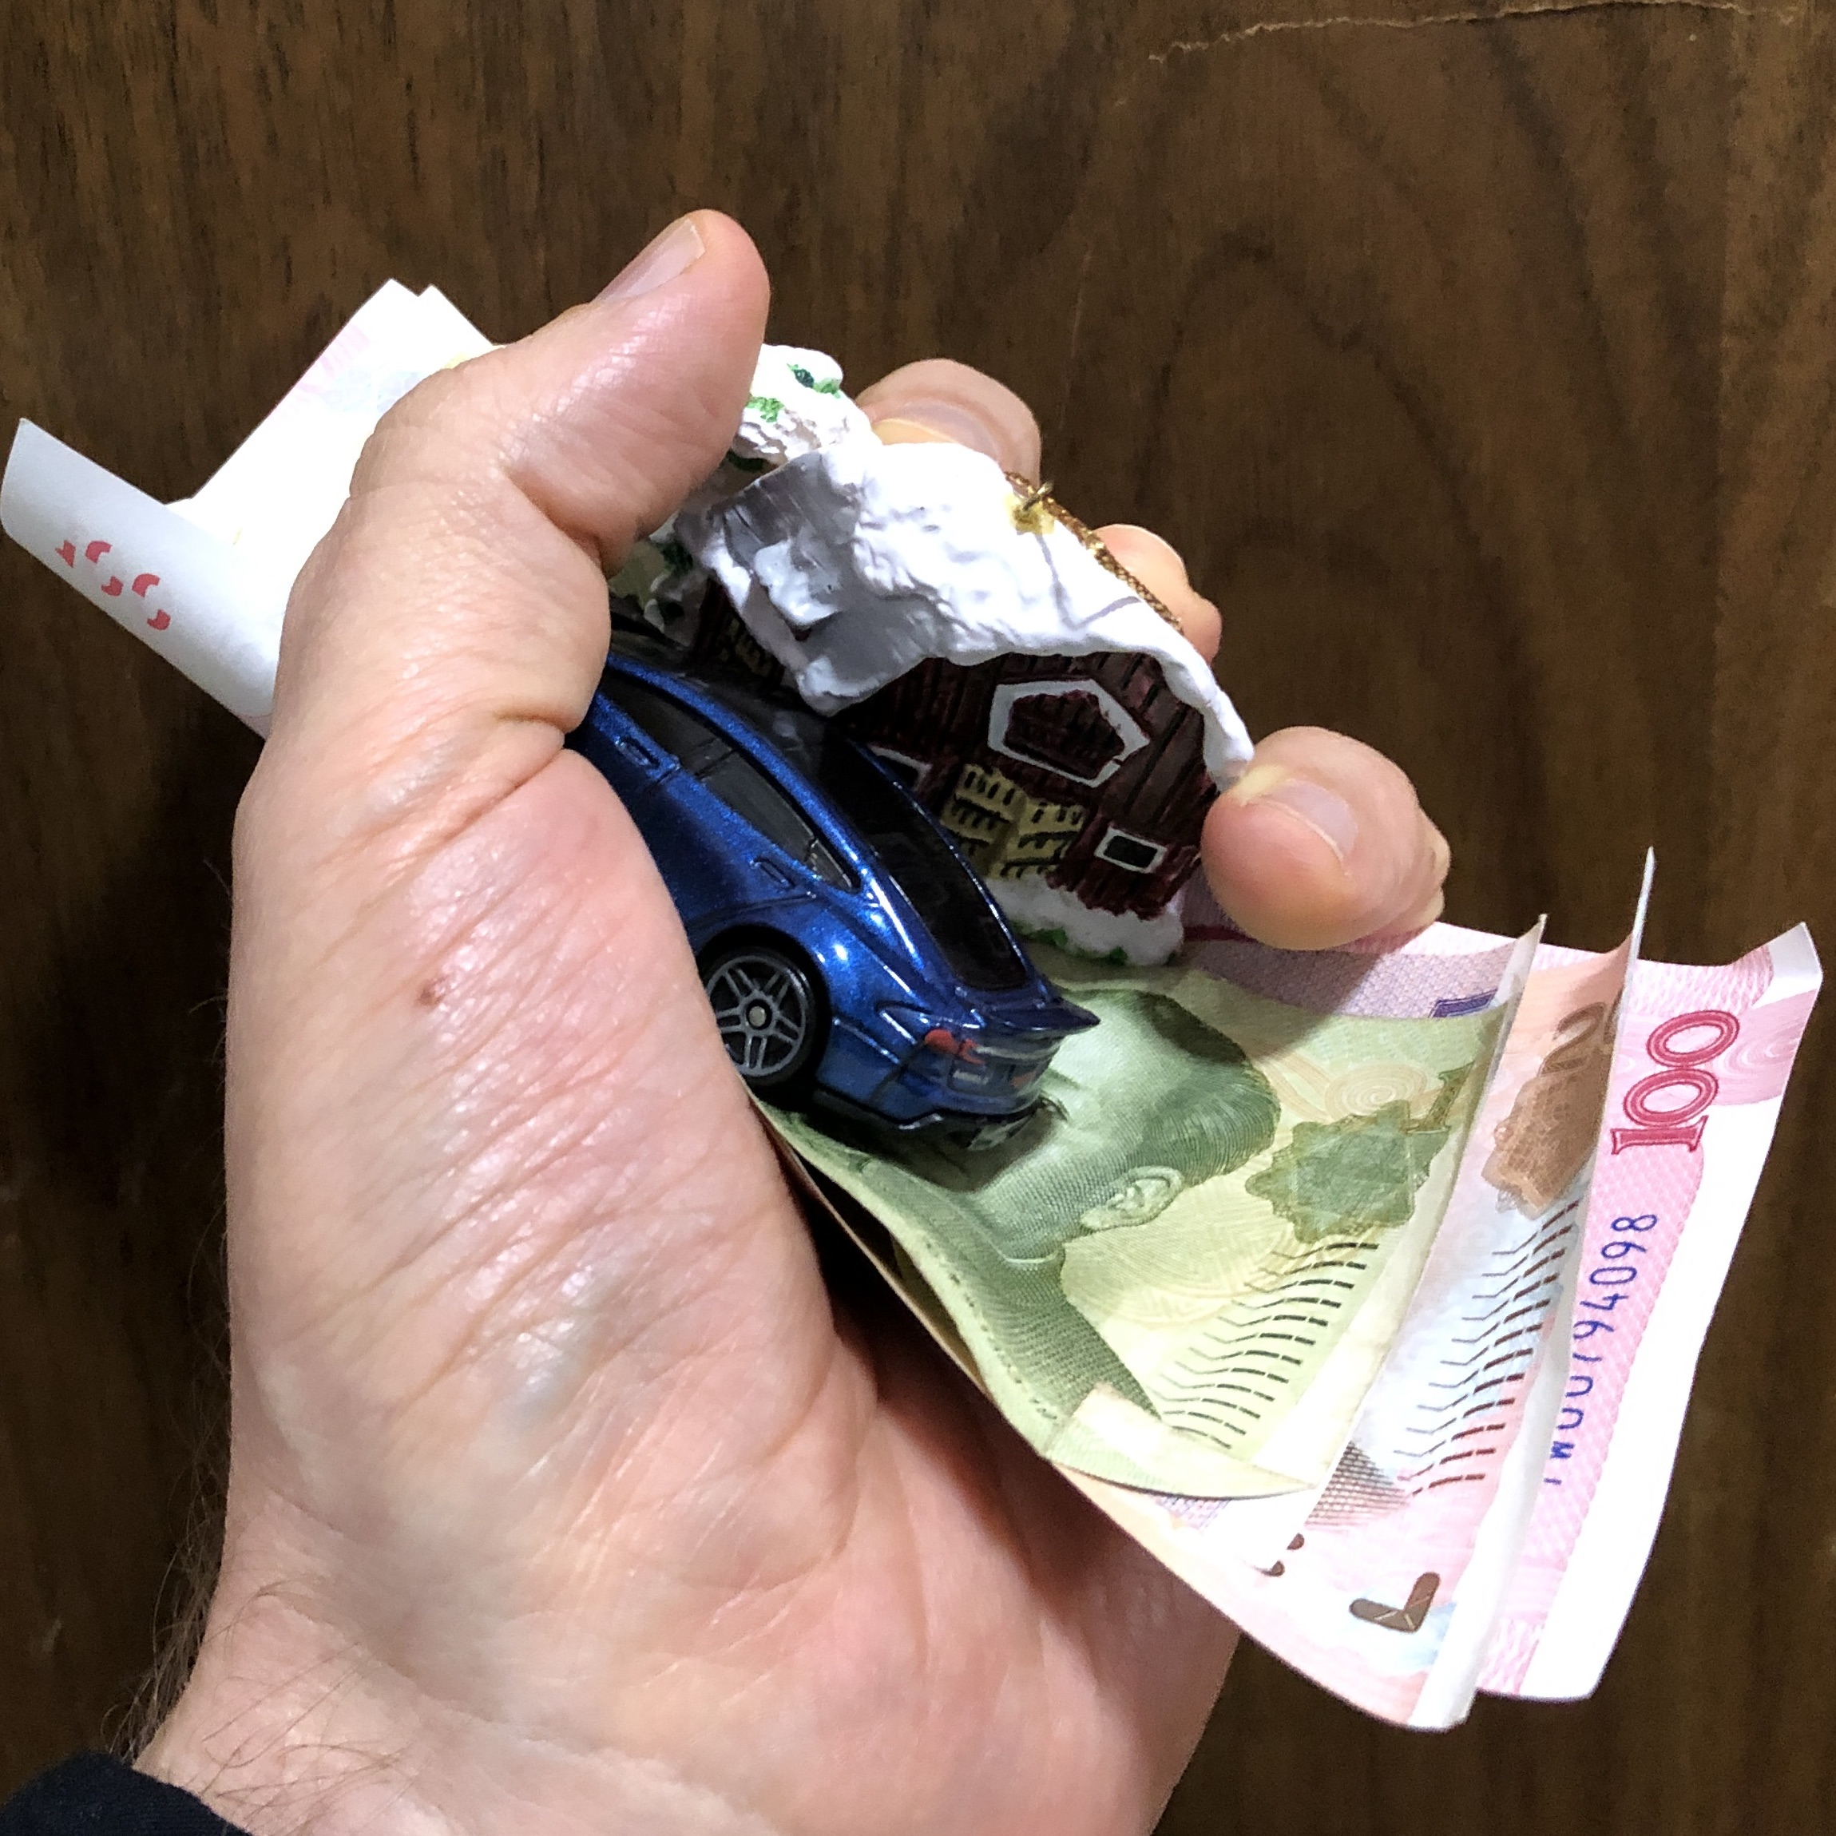
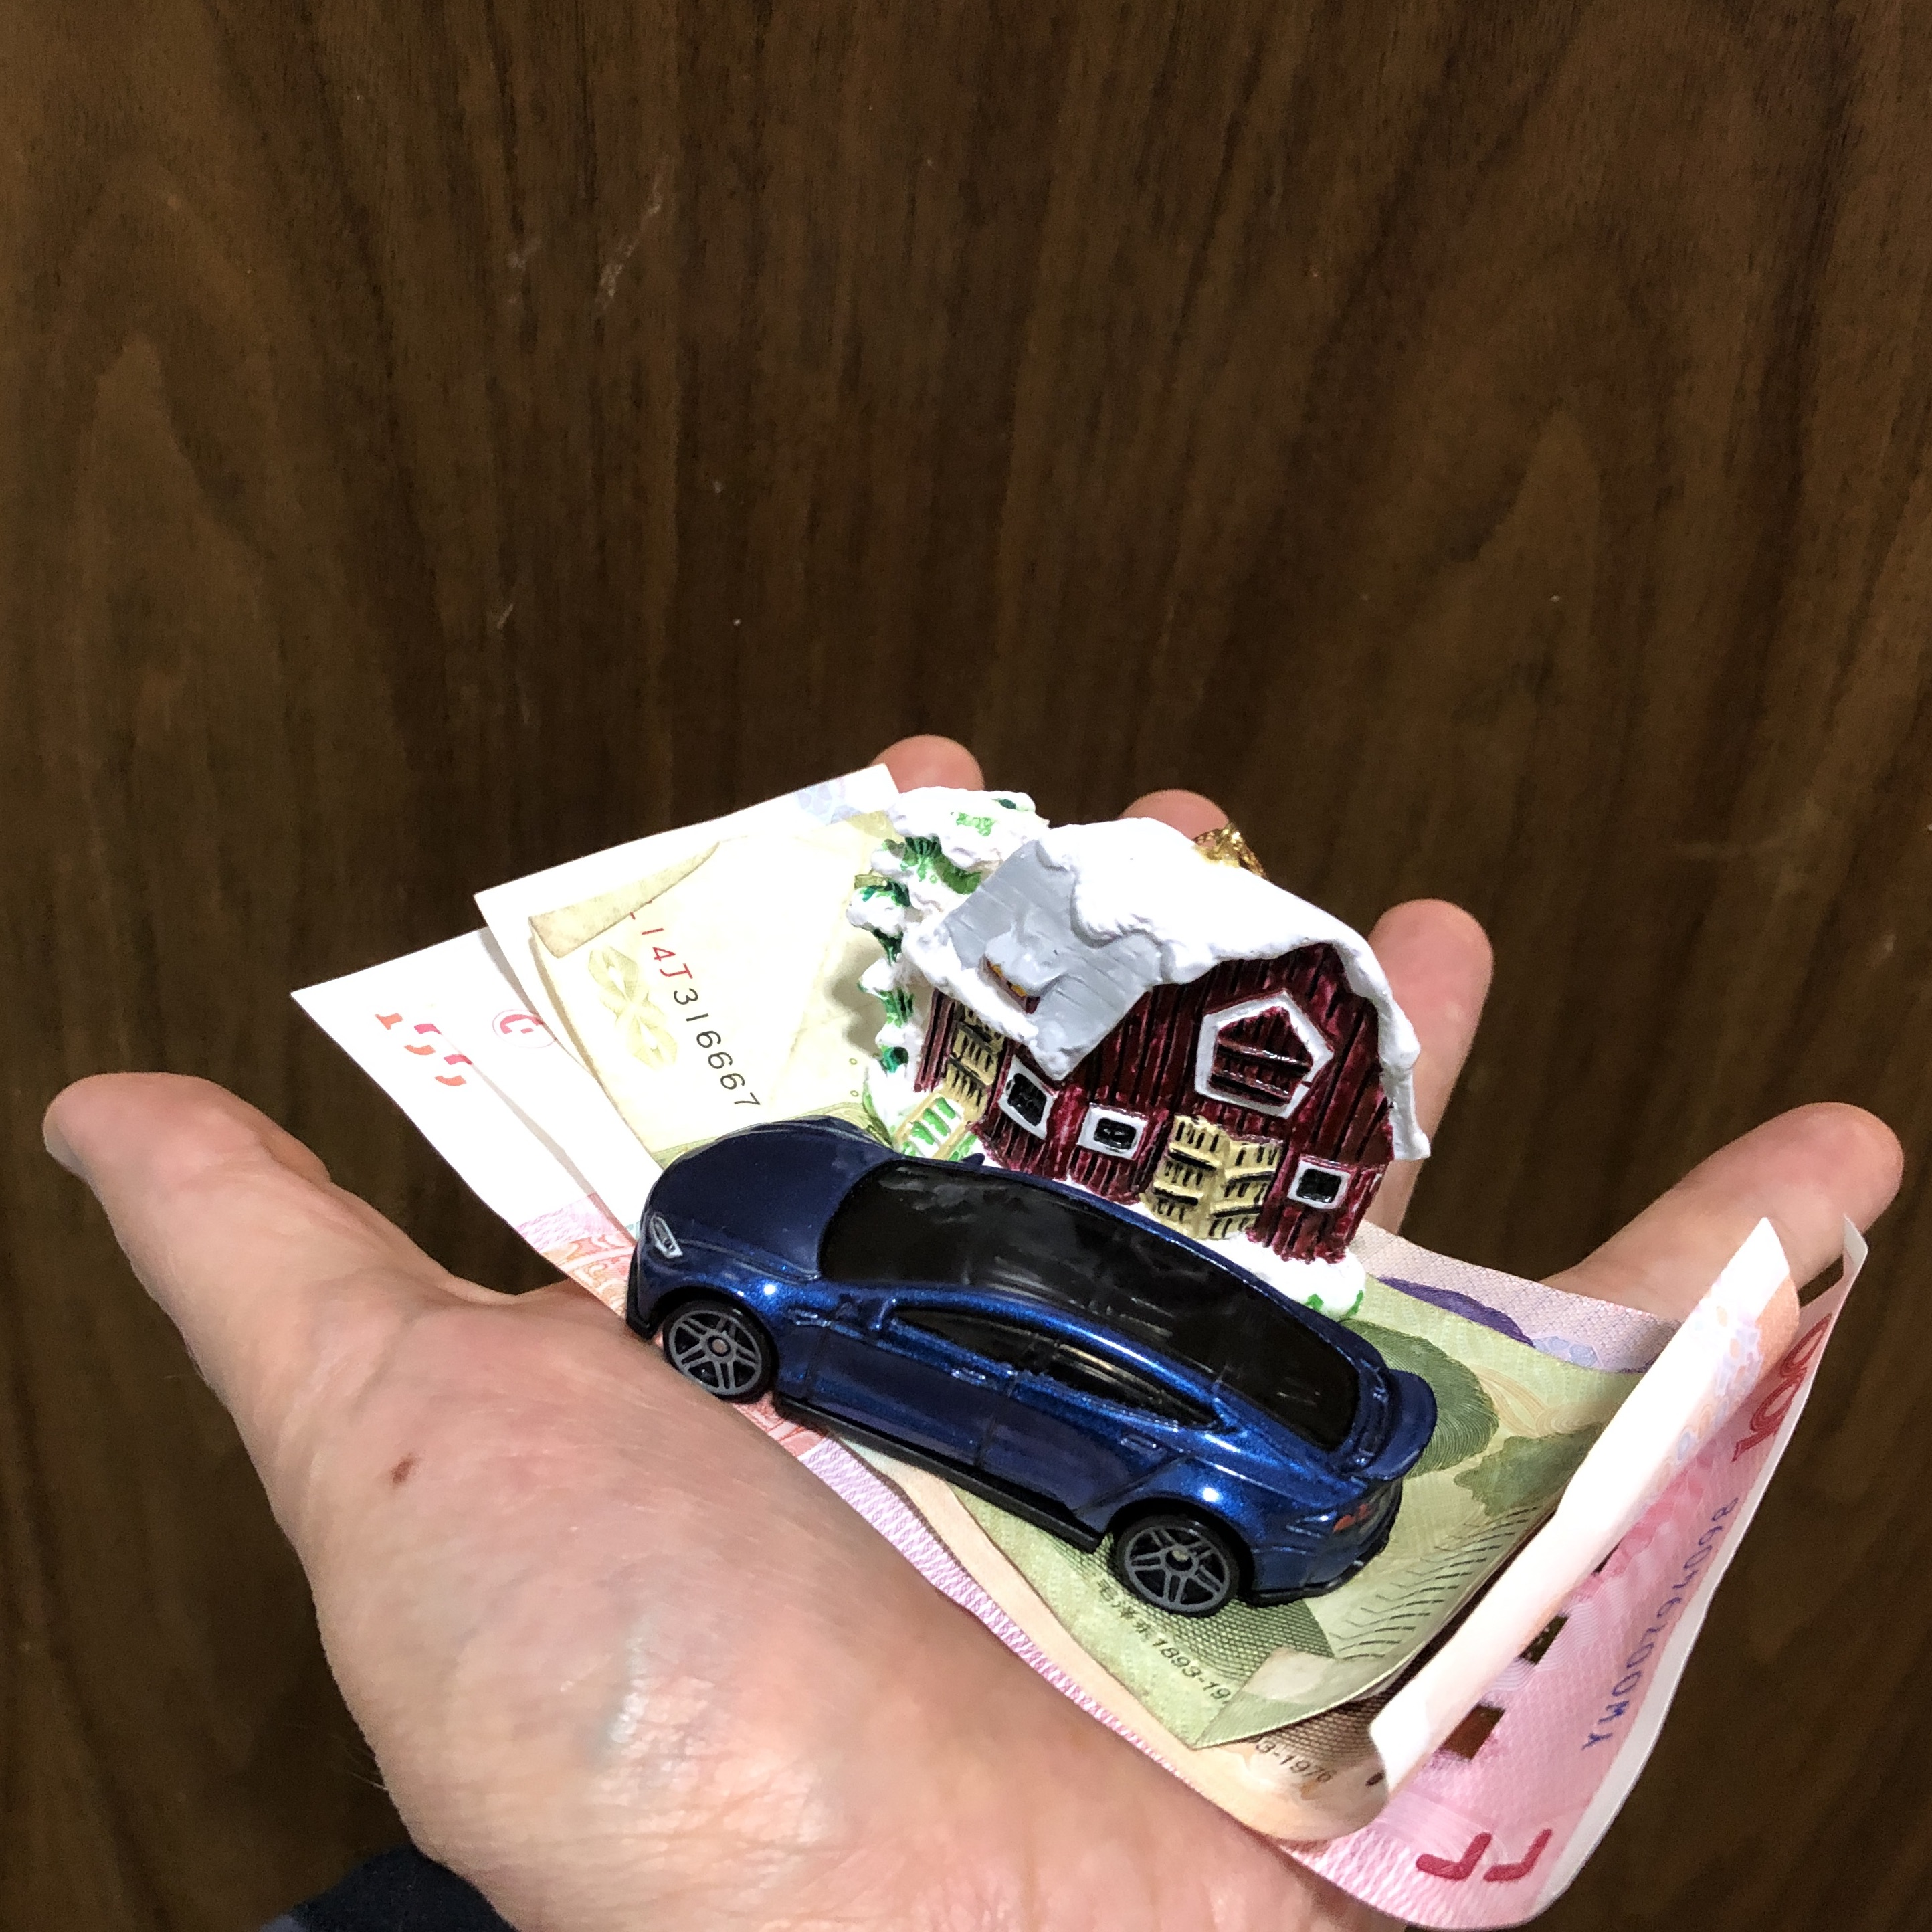
Application: Saying Good-bye, Generous Heart Attitude

Slide 17
Infinite Applications of Luke 16:9
Donating to disaster relief
Giving to your church back home
Xiamen International Christian Fellowship gives to partners who affirm the value of human beings
Starting a business with a commitment to run it on biblical principles
Personal impact – loving our neighbors

Slide 18
Personal impact – loving our neighbors
PG’s Neighbors
“I took him to the clinic, and I paid for his medical bills”
“I took [his son] to the clinic, and I paid for his medical bills”
Neighbor’s wife could not afford to bring her father’s remains back to be buried. “No worries, I will help, so that you can bring your dad here, and you can bury him.”
Open door for sharing eternal truth unto salvation

Slide 19
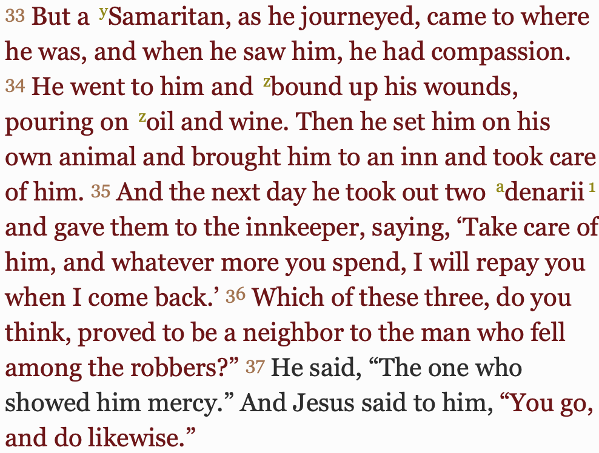
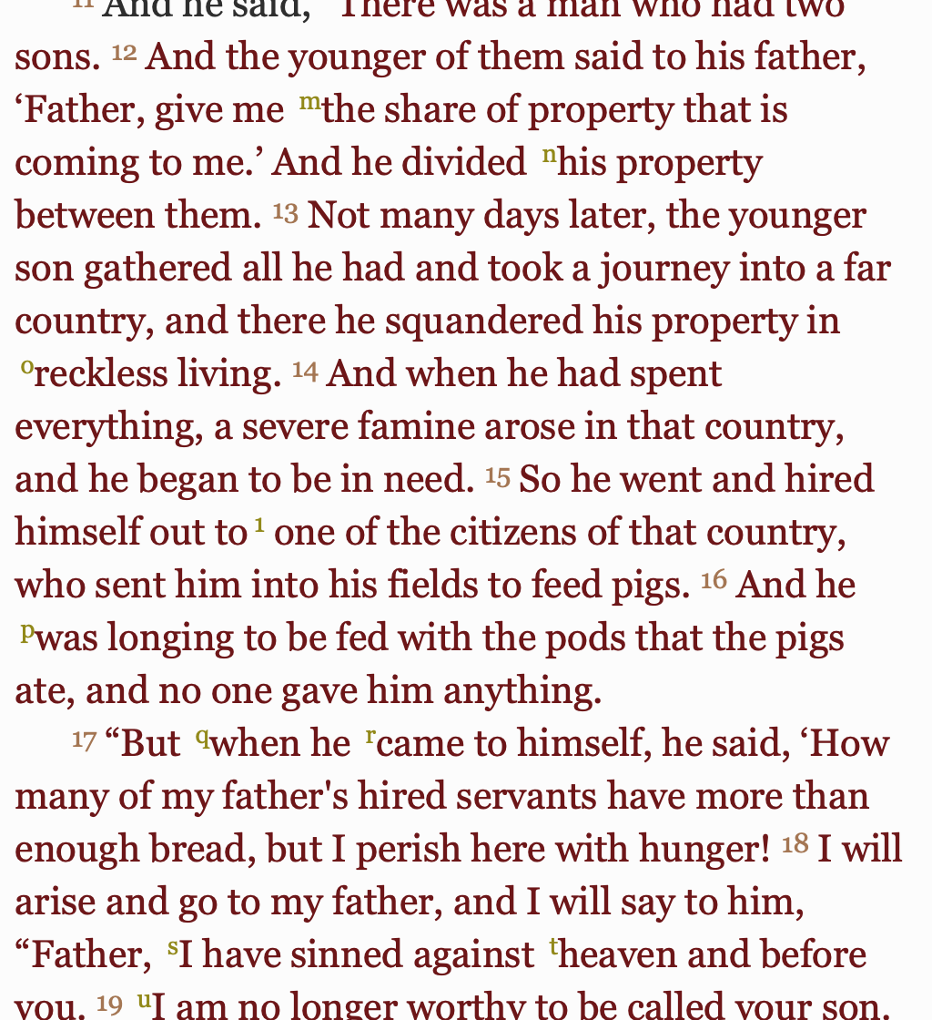
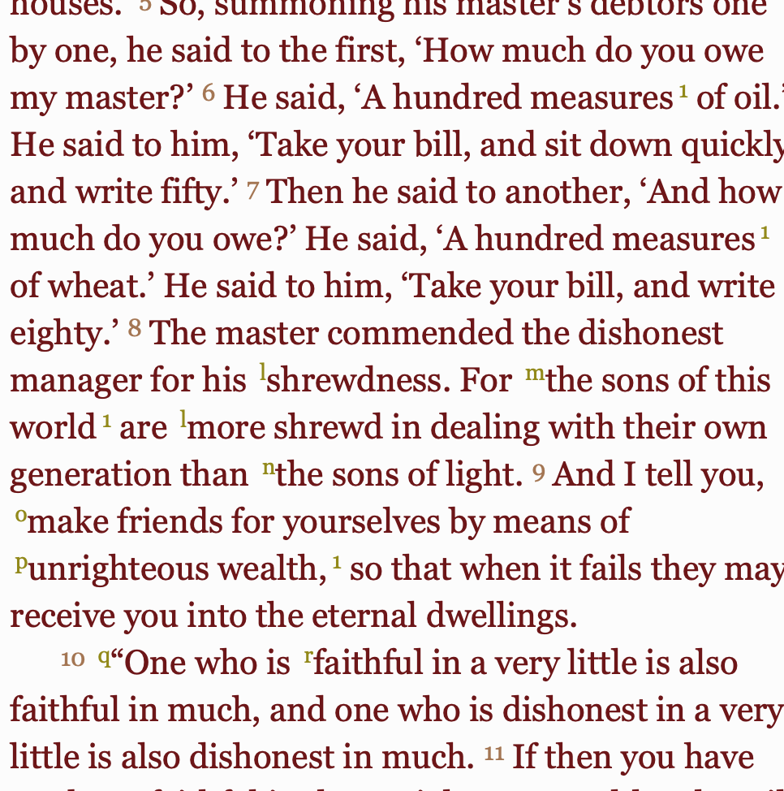
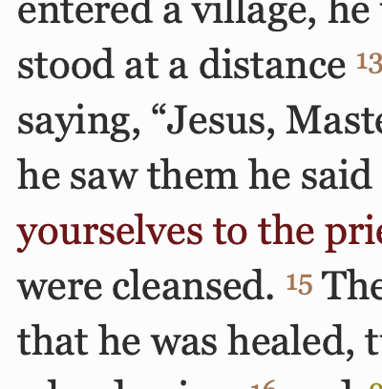
The Gospel Of Luke
COMPASSION
FORGIVENESS
JUSTICE
REDEMPTION
GENEROSITY

