Slide 1

Week II

Slide 2



Two-week Outline
Saving & investing
Treasures
in
Heaven
Heart
Desires
tithing
Budgeting

Slide 3
Outline
Parable of Talents – Ben
Saving & Investing – Joel
Budgeting – Ben
Closing – Joel

Slide 4
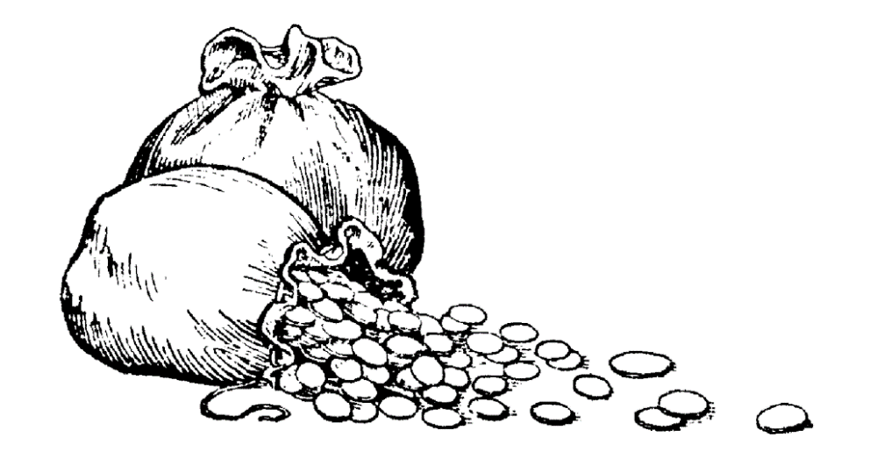
The Parable of the Bags of Gold
14 “Again, it will be like a man going on a journey, who called his servants and entrusted his wealth to them. 15 To one he gave five bags of gold, to another two bags, and to another one bag, each according to his ability. Then he went on his journey.
Notes:
This is the corollary to a passage in Luke Ben will show later…
The next foundational truth I want to discuss is found in this passage: Read this passage
So basically there are two opposing masters Jesus seems particularly concerned with:
Next slide

Slide 5
The Parable of the Bags of Gold
16 The man who had received five bags of gold went at once and put his money to work and gained five bags more. 17 So also, the one with two bags of gold gained two more. 18 But the man who had received one bag went off, dug a hole in the ground and hid his master’s money.
Notes:
This is the corollary to a passage in Luke Ben will show later…
The next foundational truth I want to discuss is found in this passage: Read this passage
So basically there are two opposing masters Jesus seems particularly concerned with:
Next slide

Slide 6

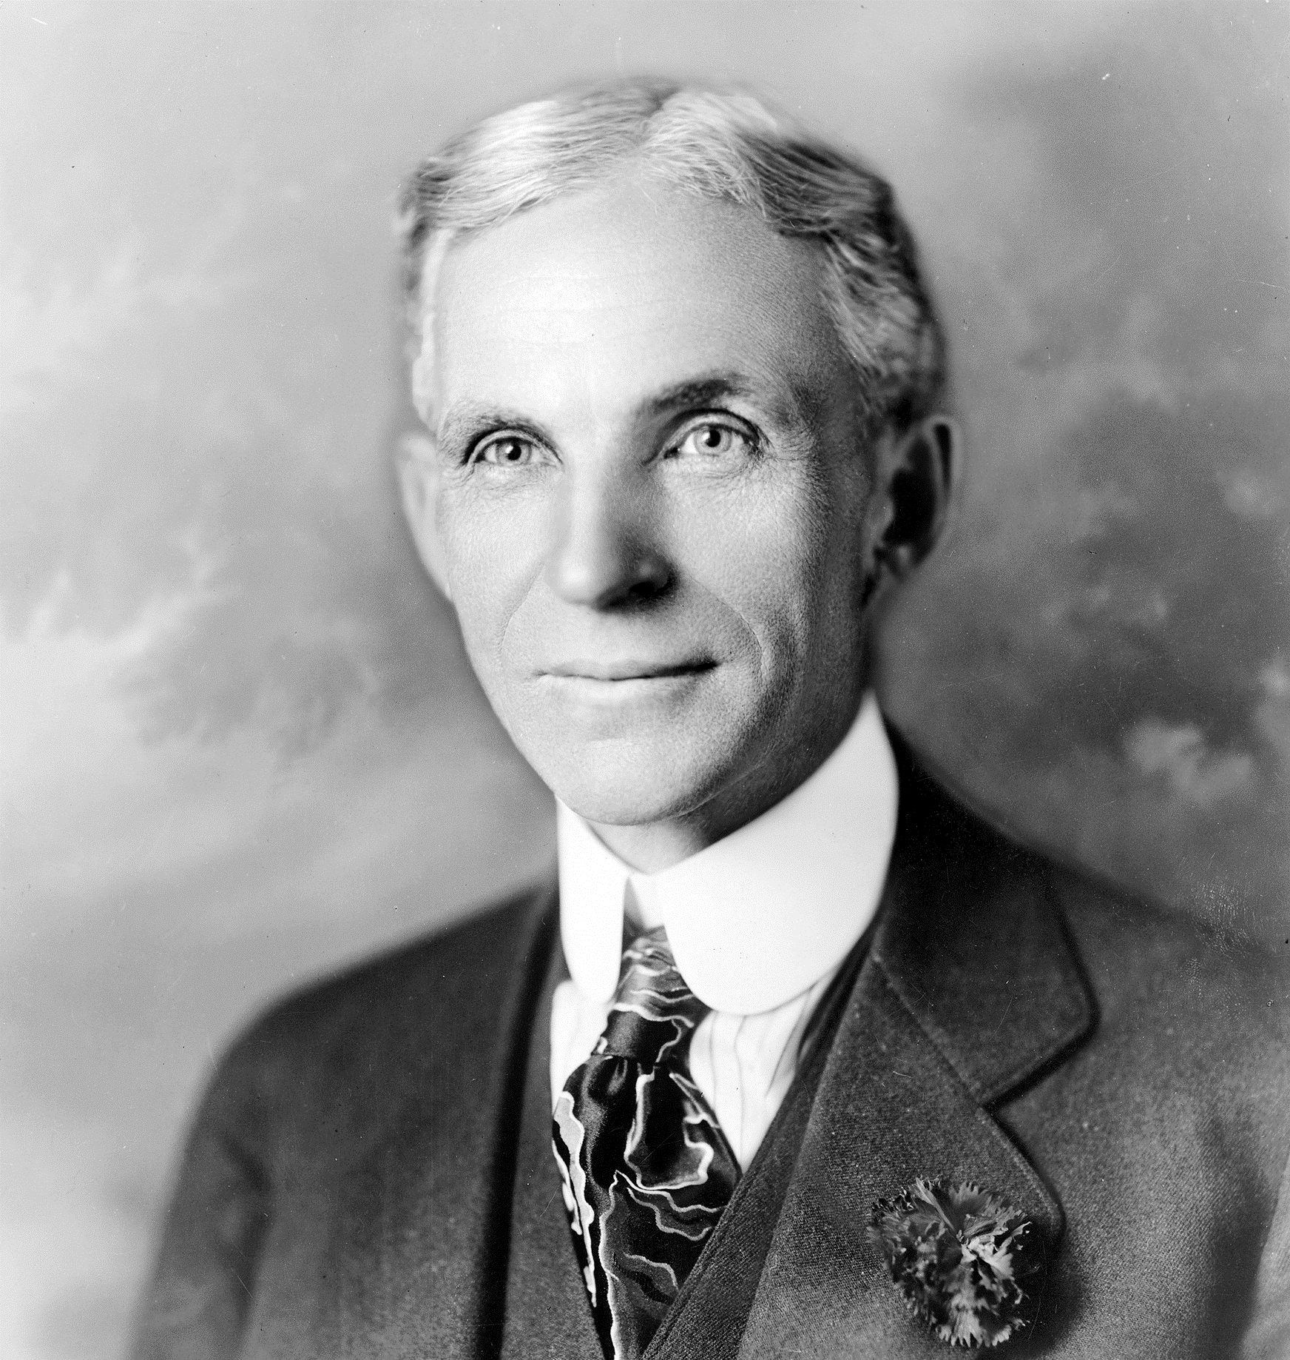


Slide 7
Notes:
This is the corollary to a passage in Luke Ben will show later…
The next foundational truth I want to discuss is found in this passage: Read this passage
So basically there are two opposing masters Jesus seems particularly concerned with:
Next slide

Slide 8

19 “After a long time the master of those servants returned and settled accounts with them. 20 The man who had received five bags of gold brought the other five. ‘Master,’ he said, ‘you entrusted me with five bags of gold. See, I have gained five more.’
21 “His master replied, ‘Well done, good and faithful servant! You have been faithful with a few things; I will put you in charge of many things. Come and share your master’s happiness!’
Notes:
This is the corollary to a passage in Luke Ben will show later…
The next foundational truth I want to discuss is found in this passage: Read this passage
So basically there are two opposing masters Jesus seems particularly concerned with:
Next slide

Slide 9
22 “The man with two bags of gold also came. ‘Master,’ he said, ‘you entrusted me with two bags of gold; see, I have gained two more.’
23 “His master replied, ‘Well done, good and faithful servant! You have been faithful with a few things; I will put you in charge of many things. Come and share your master’s happiness!’
Notes:
This is the corollary to a passage in Luke Ben will show later…
The next foundational truth I want to discuss is found in this passage: Read this passage
So basically there are two opposing masters Jesus seems particularly concerned with:
Next slide

Slide 10
24 “Then the man who had received one bag of gold came. ‘Master,’ he said, ‘I knew that you are a hard man, harvesting where you have not sown and gathering where you have not scattered seed. 25 So I was afraid and went out and hid your gold in the ground. See, here is what belongs to you.’
26 “His master replied, ‘You wicked, lazy servant! So you knew that I harvest where I have not sown and gather where I have not scattered seed? 27 Well then, you should have put my money on deposit with the bankers, so that when I returned I would have received it back with interest.
28 “‘So take the bag of gold from him and give it to the one who has ten bags. 29 For whoever has will be given more, and they will have an abundance. Whoever does not have, even what they have will be taken from them. 30 And throw that worthless servant outside, into the darkness, where there will be weeping and gnashing of teeth.’
Notes:
This is the corollary to a passage in Luke Ben will show later…
The next foundational truth I want to discuss is found in this passage: Read this passage
So basically there are two opposing masters Jesus seems particularly concerned with:
Next slide

Slide 11
Outline
Parable of Talents – Ben
Saving & Investing – Joel
Budgeting – Ben
Closing – Joel

Slide 12


Slide 13

How Should we Manage our Finance?
Savings:
Income not spent or consumption deferred.
setting aside money you don’t spend now for emergencies or for a future purchase.
  "Let Pharaoh proceed to appoint overseers over the land and take one-fifth of the produce of the land of Egypt during the seven plentiful years. And let them gather all the food of these good years that are coming and store up grain under the authority of Pharaoh for food in the cities, and let them keep it. That food shall be a reserve for the land against the seven years of famine that are to occur in the land of Egypt, so that the land may not perish through the famine.” (Gen 41:34-36)
  “A slack hand causes poverty, but the hand of the diligent makes the rich . He who gathers in summer is a prudent son, but he who sleeps in harvest is a son who brings shame.” (Prov. 10:4-5)
  "On the first day of every week, each of you is to put something aside and store it up, as he may prosper, so that there will be no collecting when I come.“ (1Cor.16:2)

Slide 14

How Should we Manage our Finance?
Investment:
Purchase of goods for future consumption to create wealth.
buying assets such as stocks, bonds, mutual funds or real estate with the expectation that your investment will make money for you
  “Sell your possessions, and give to the needy. Provide yourselves with moneybags that do not grow old, with a treasure in the heavens that does not fail, where no thief approaches and no moth destroys. For where your treasure is, there will your heart be also.” (Luke 12:33-34)

Slide 15
How Should we Manage our Finance?
Seek Professional advice when investing:
"The way of a fool is right in his own eyes, but a wise man listens to advice.“ (Prov. 12:15)
Beware of “Ponzi” Schemes:
"A faithful man will abound with blessings, but whoever hastens to be rich will not go unpunished.” (Prov. 18:20)
Diversify Your Investments：
“Give a portion to seven, or even to eight, for you know not what disaster may happen on earth.” (Ecc. 11:2)
Glorify God in your investments:
Is there anything about your investment considered sinful by the Bible (2 Tim. 3:16)?
Is there deception involved with your investment (Prov. 11:1)

Slide 16
Outline
Parable of Talents – Ben
Saving & Investing – Joel
Budgeting – Ben
Closing – Joel

Slide 17







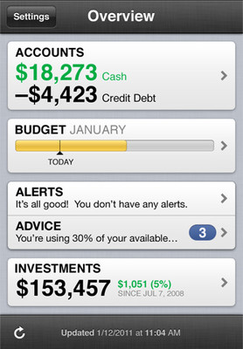


Slide 18
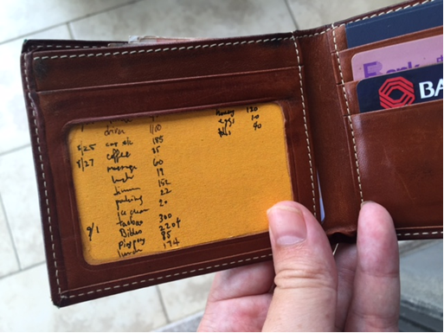

Slide 19
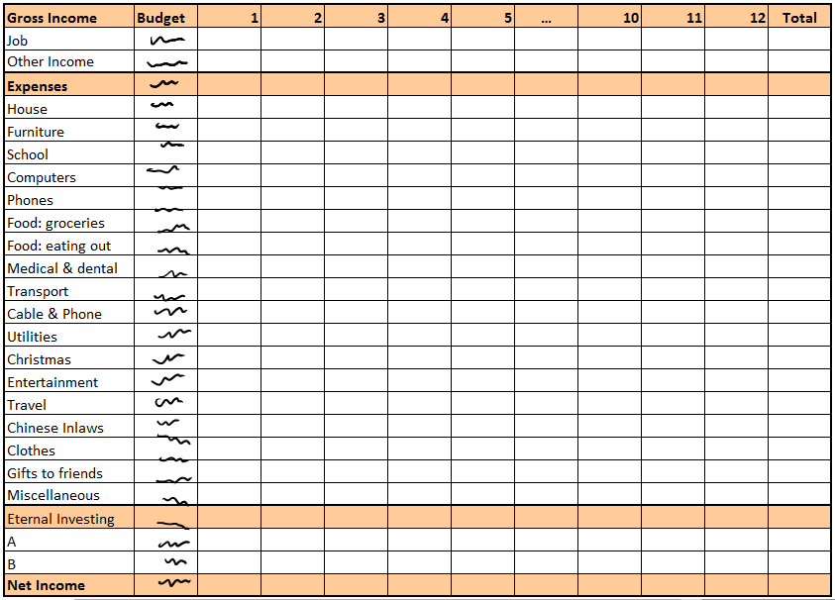

Income Statement
Did we spend more than we earned this month?

Slide 20

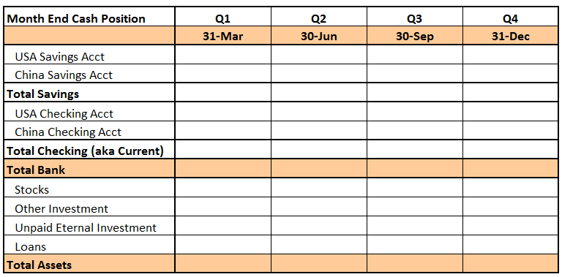
Balance Sheet
How much do we currently have on this earth?

Slide 21


Slide 22
Outline
Parable of Talents – Ben
Saving & Investing – Joel
Budgeting – Ben
Closing – Joel

Slide 23


