Slide 1
Seek His Kingdom
Luke 12:31

Slide 2
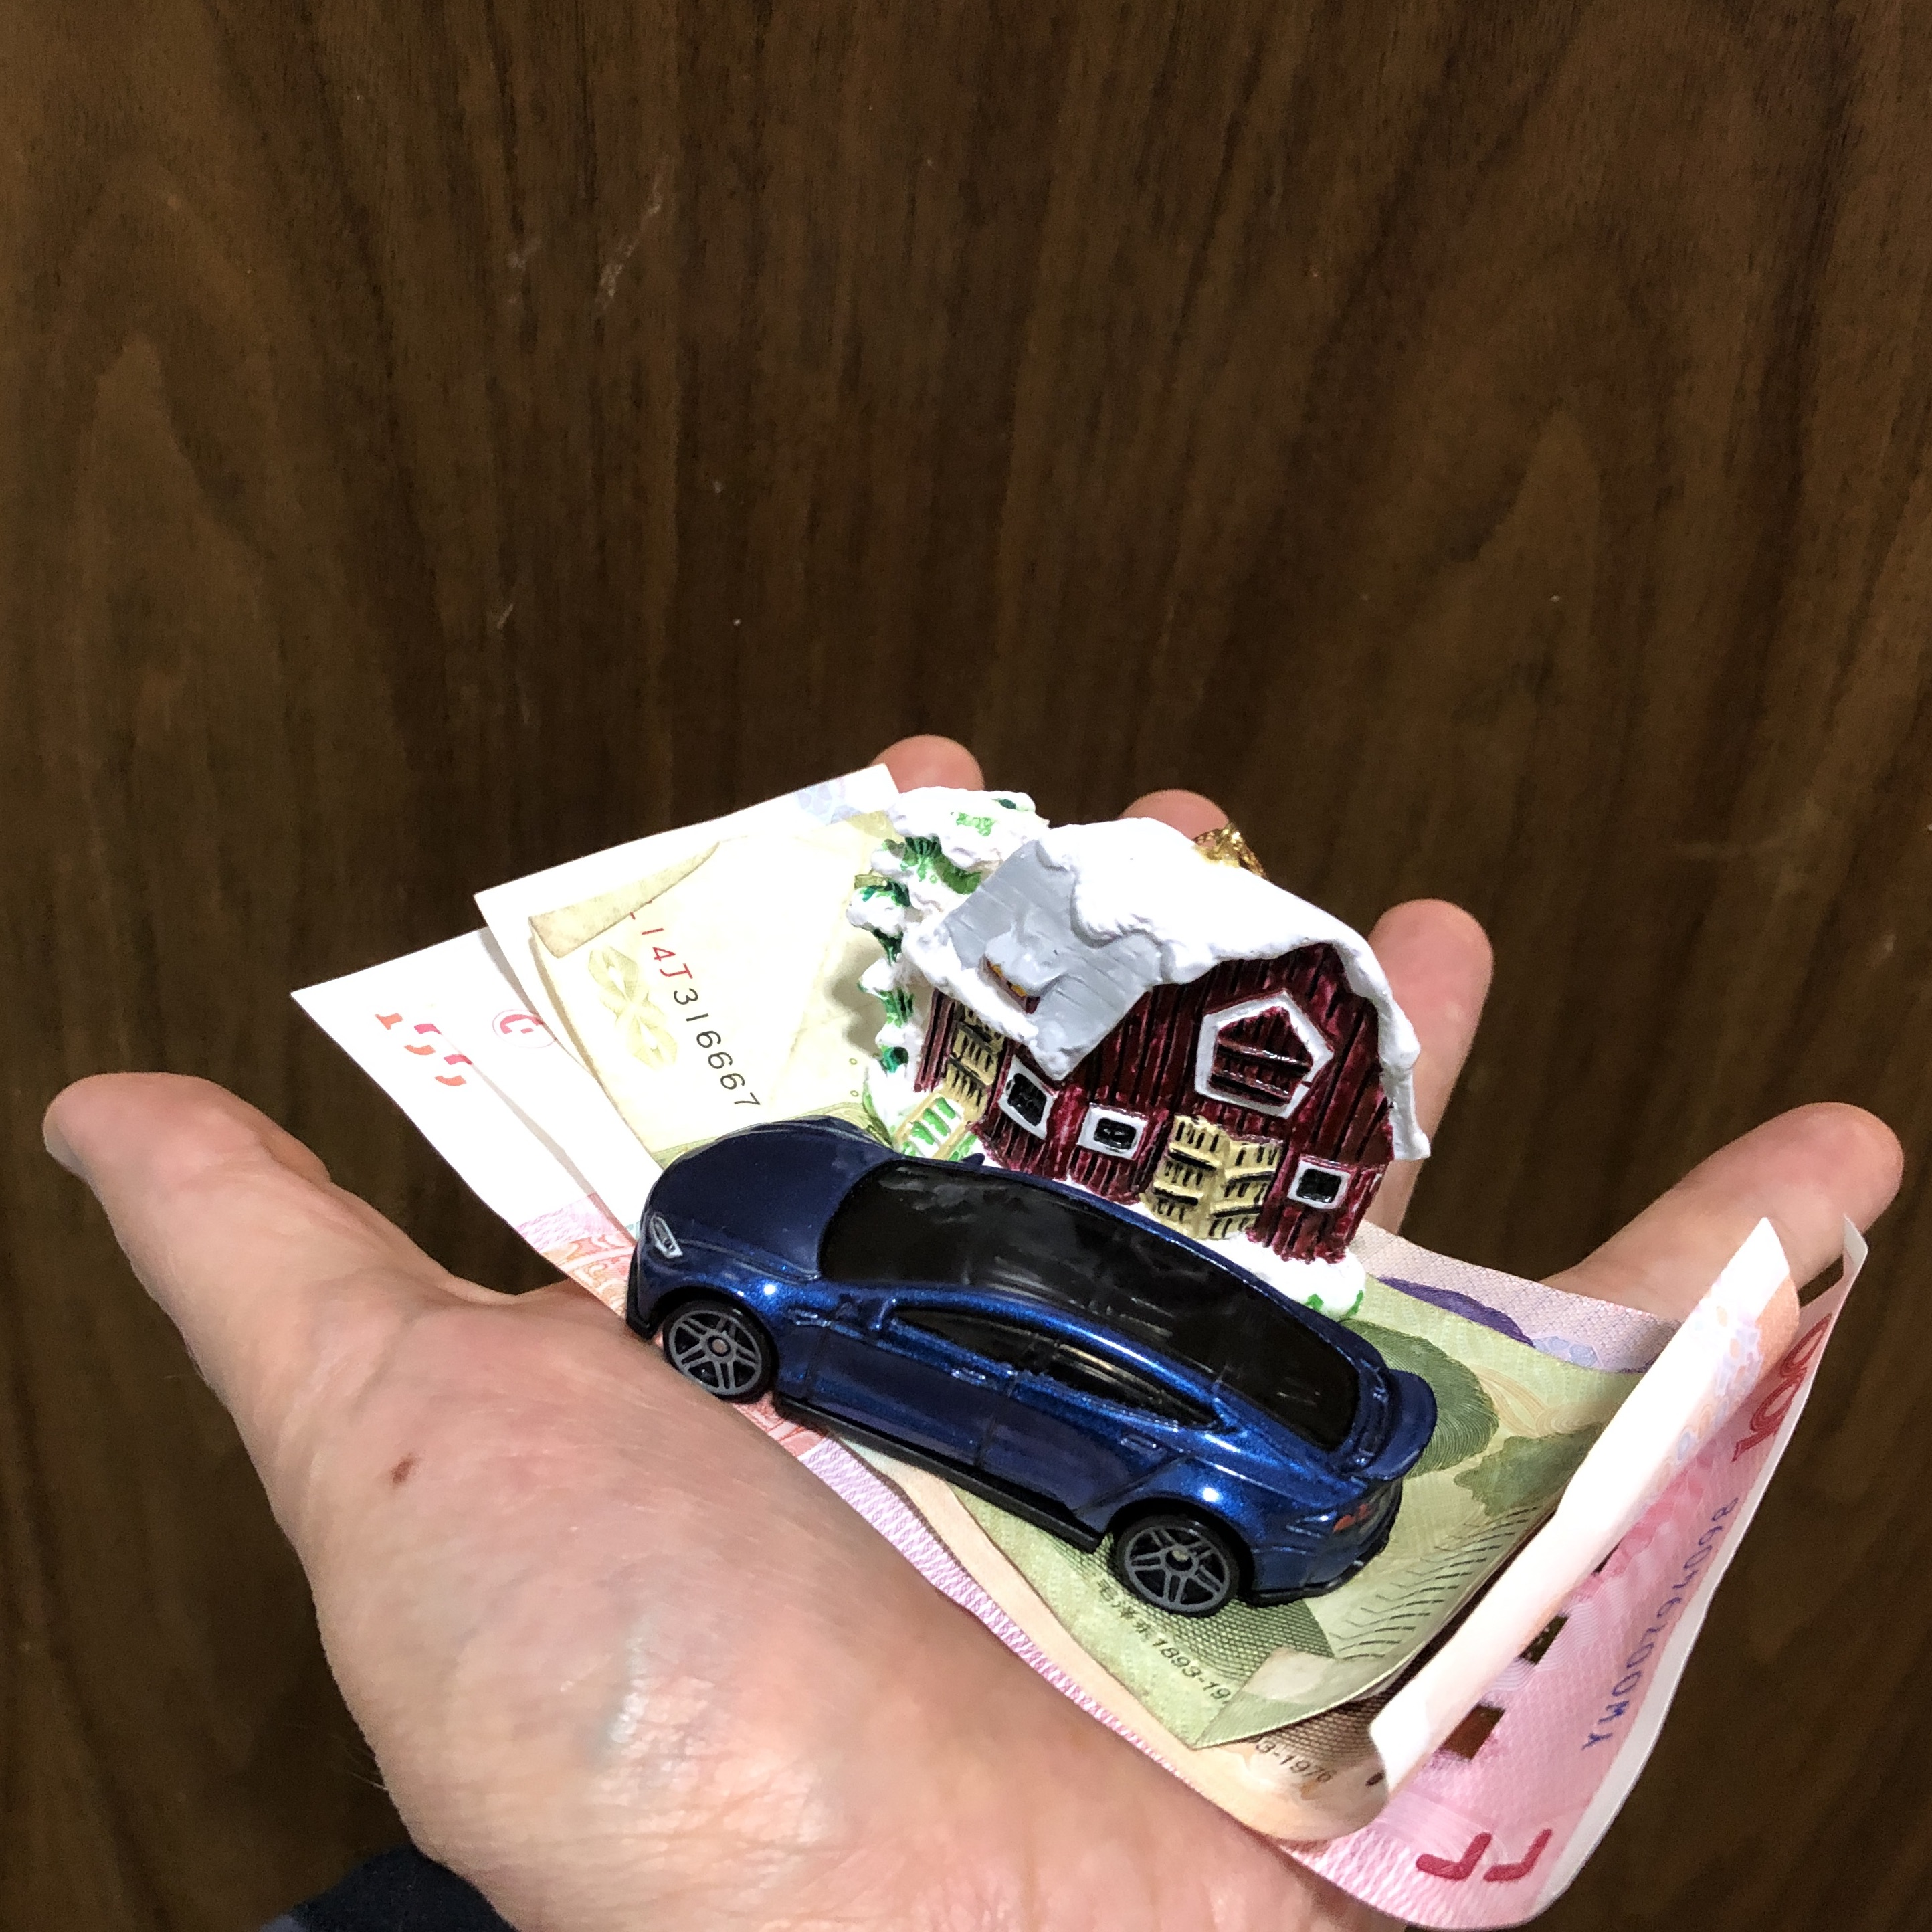
I Surrender All
All to Jesus I surrender,
All to Him I freely give;
I will ever love and trust Him,
In His presence daily live.
I surrender all, I surrender all;
All to Thee, my blessed Savior,
I surrender all.

Slide 3
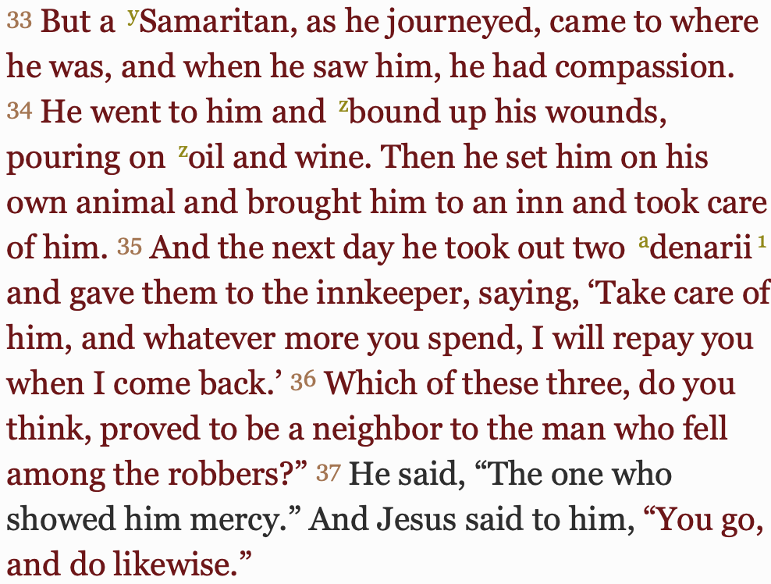
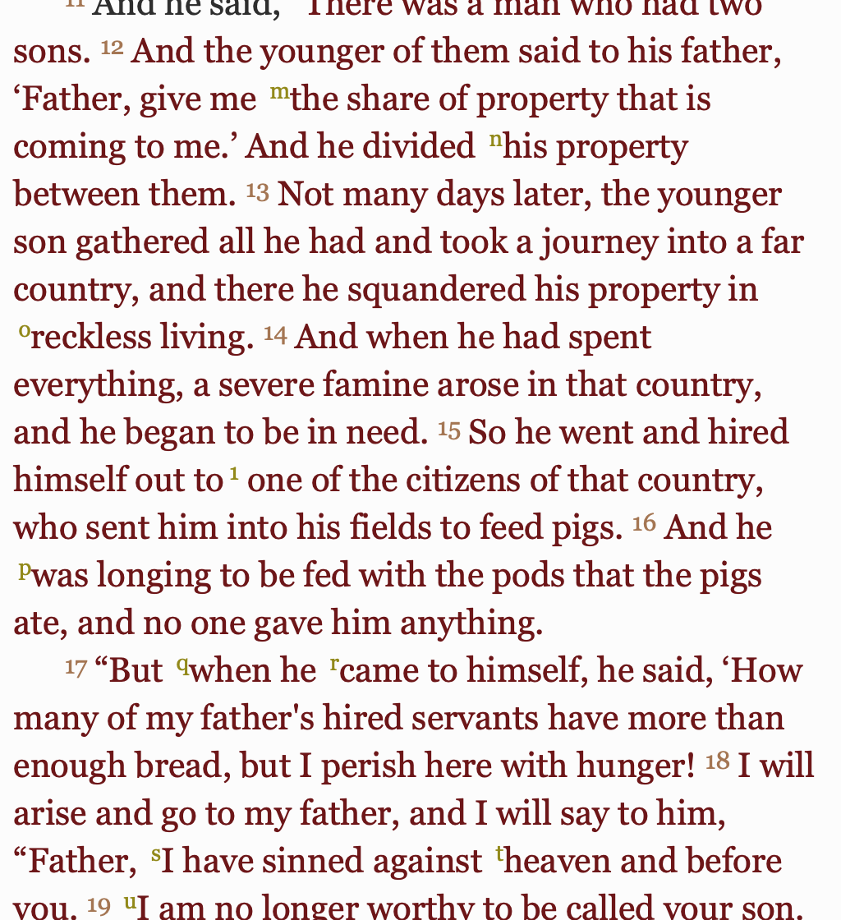
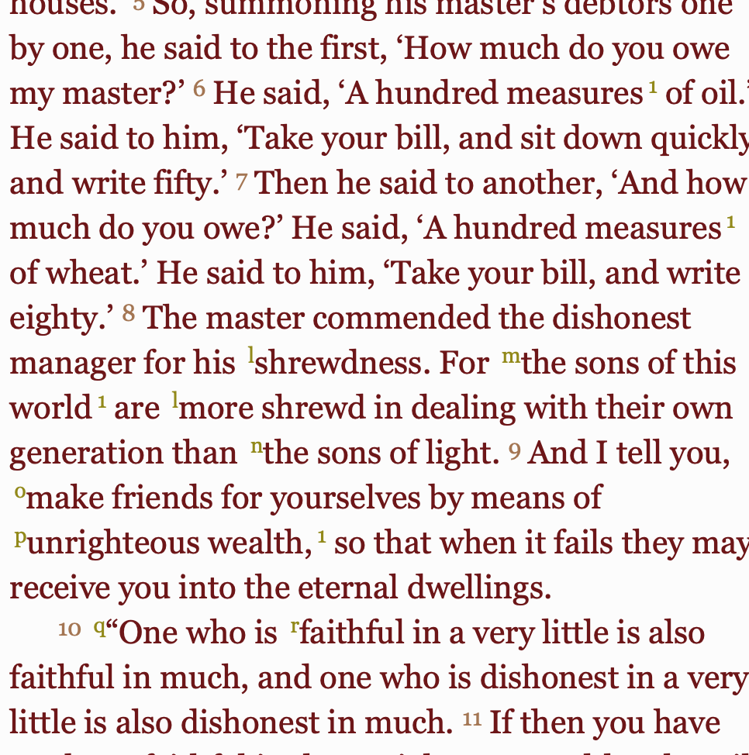
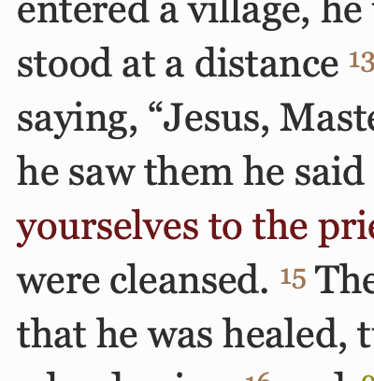
The Gospel Of Luke
COMPASSION
FORGIVENESS
JUSTICE
REDEMPTION
GENEROSITY

Slide 4
Tough Teachings in the Gospel of Luke
“So therefore, any one of you who does not renounce all that he has cannot be my disciple.”
(Luke 14:33, English Standard Version)

Slide 5
Tough Teachings in the Gospel of Luke
“And I tell you [learn from this], make friends for yourselves [for eternity] by means of the wealth of unrighteousness [that is, use material resources as a way to further the work of God], so that when it runs out, they will welcome you into the eternal dwellings.”
(Luke 16:9, Amplified Bible)

Slide 6
Tough Teachings in the Gospel of Luke
“Why do you call me ‘Lord, Lord,’ and not do what I tell you?”
(Luke 6:46)

Slide 7
Grace as seen in the Gospel of Luke
The Prodigal Son (Luke 15:11-32)
The Penitent Tax Collector (Luke 18:9-14)
“standing far off [from the temple], would not even lift up his eyes to heaven, but beat his breast, saying, ‘God, be merciful to me, a sinner!’”
“justified”
The Thief on the Other Cross (Luke 23:39-43)
Honesty, pleas “Jesus, remember me when you come into your kingdom.”
Notes:
People with NOTHING to offer come humbly before God, and God saves them.

Slide 8
Jesus’ Fitness Center
“A disciple is not above his teacher, but everyone when he is fully trained will be like his teacher.”
(Luke 6:40)
Notes:
Jesus is owner, coach, personal trainer, and he's giving away free memberships. Jesus sets the growth goals very high - be like him Luke 6:40 A disciple is not above his teacher, but everyone when he is fully trained will be like his teacher.

Slide 9
Luke 12:22-34 (English Standard Version)
And he said to his disciples, “Therefore I tell you, do not be anxious about your life, what you will eat, nor about your body, what you will put on. For life is more than food, and the body more than clothing. Consider the ravens: they neither sow nor reap, they have neither storehouse nor barn, and yet God feeds them. Of how much more value are you than the birds! And which of you by being anxious can add a single hour to his span of life? If then you are not able to do as small a thing as that, why are you anxious about the rest? Consider the lilies, how they grow: they neither toil nor spin, yet I tell you, even Solomon in all his glory was not arrayed like one of these. But if God so clothes the grass, which is alive in the field today, and tomorrow is thrown into the oven, how much more will he clothe you, O you of little faith! And do not seek what you are to eat and what you are to drink, nor be worried. For all the nations of the world seek after these things, and your Father knows that you need them. Instead, seek his kingdom, and these things will be added to you.
“Fear not, little flock, for it is your Father's good pleasure to give you the kingdom. Sell your possessions, and give to the needy. Provide yourselves with moneybags that do not grow old, with a treasure in the heavens that does not fail, where no thief approaches and no moth destroys. For where your treasure is, there will your heart be also.

Slide 10
Luke 12:22-34 (English Standard Version)
And he said to his disciples, “Therefore I tell you, do not be anxious about your life, what you will eat, nor about your body, what you will put on. For life is more than food, and the body more than clothing. Consider the ravens: they neither sow nor reap, they have neither storehouse nor barn, and yet God feeds them. Of how much more value are you than the birds! And which of you by being anxious can add a single hour to his span of life? If then you are not able to do as small a thing as that, why are you anxious about the rest? Consider the lilies, how they grow: they neither toil nor spin, yet I tell you, even Solomon in all his glory was not arrayed like one of these. But if God so clothes the grass, which is alive in the field today, and tomorrow is thrown into the oven, how much more will he clothe you, O you of little faith! And do not seek what you are to eat and what you are to drink, nor be worried. For all the nations of the world seek after these things, and your Father knows that you need them. Instead, seek his kingdom, and these things will be added to you.
“Fear not, little flock, for it is your Father's good pleasure to give you the kingdom. Sell your possessions, and give to the needy. Provide yourselves with moneybags that do not grow old, with a treasure in the heavens that does not fail, where no thief approaches and no moth destroys. For where your treasure is, there will your heart be also.
Notes:
Therefore = right after the parable of the Rich Fool who pursued great wealth and a life of ease
Value = People are valuable
Sell and give = Release our grip on money and material possessions
To the needy = things are worth giving, people are worth helping, people > things

Slide 11
Luke 12:28-31 (English Standard Version)
But if God so clothes the grass, which is alive in the field today, and tomorrow is thrown into the oven, how much more will he clothe you, O you of little faith! And do not seek what you are to eat and what you are to drink, nor be worried. For all the nations of the world seek after these things, and your Father knows that you need them. Instead, seek his kingdom, and these things will be added to you.
seek = to aim at, to strive after (Thayer’s Greek Lexicon)
Notes:
Go to SM and see people are still very preoccupied with food and clothing. And they have more, if you’re fed up with food and clothing.
Need = there are needs and there are wants
Don’t worry, God will provide for your needs (food and clothing).

Slide 12
Seek His Kingdom
What is the Kingdom of God?
King + dom (dominion or jurisdiction)
Wherever people acknowledge and obey the rule of God, God’s kingdom is there.
Visible
Invisible
How do we seek it?

Slide 13
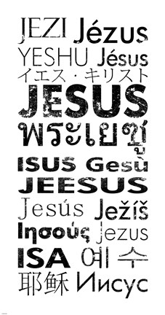
What is the Kingdom?
It’s all about the king
KING JESUS!

Slide 14
What is the Kingdom
Visible
He said therefore, “What is the kingdom of God like? And to what shall I compare it? It is like a grain of mustard seed that a man took and sowed in his garden, and it grew and became a tree, and the birds of the air made nests in its branches.”
(Luke 13:18-19)

Slide 15
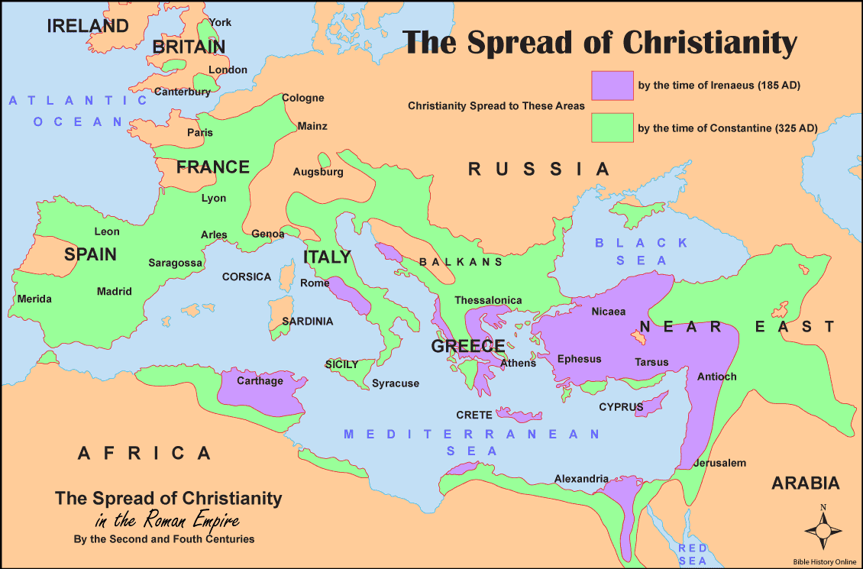

Slide 16
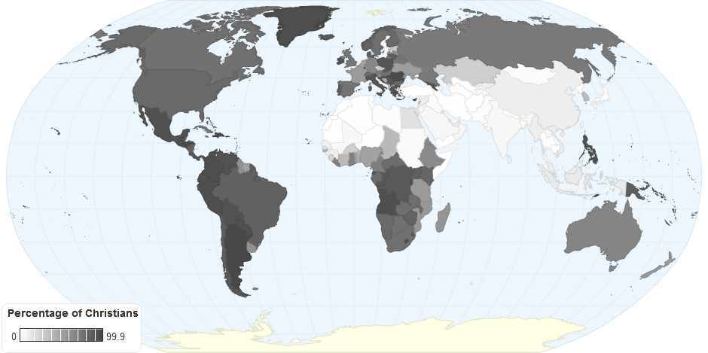
Notes:
Mention countries represented in our fellowship
Growth of the church is somewhat visible growth
Franciscans built cathedrals in Zayton in 1326 (Zayton = Quanzhou)
Xiamen 1848 Xinjie, Zhushu, Jinmen

Slide 17
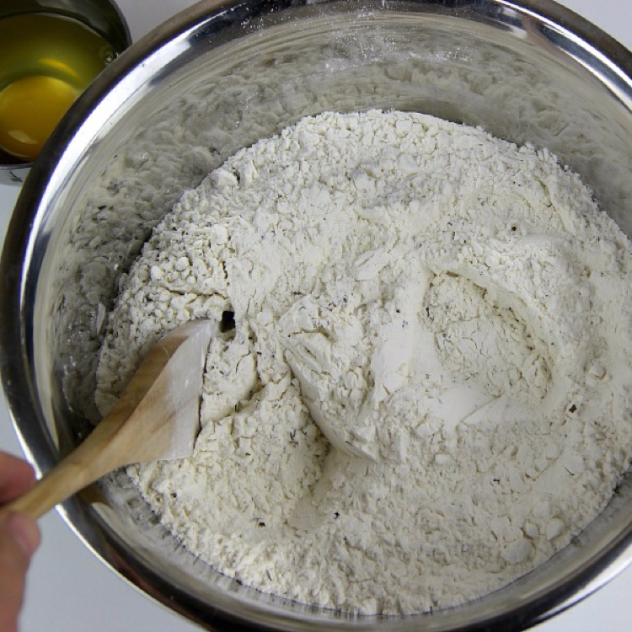
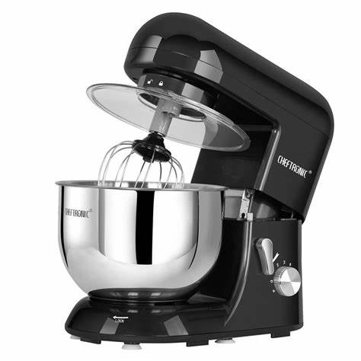
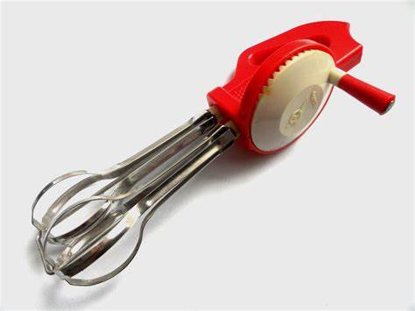
What is the Kingdom
Invisible
And again he said, “To what shall I compare the kingdom of God? It is like leaven that a woman took and hid in three measures of flour, until it was all leavened.”
(Luke 13:20-21)
Notes:
Spread of belief – can’t see what someone believes
How does the yeast work through all that flour? Mixing!
Advances in transportation and communication have sped up the mixing (spoon, hand mixer, electric mixer)

Slide 18
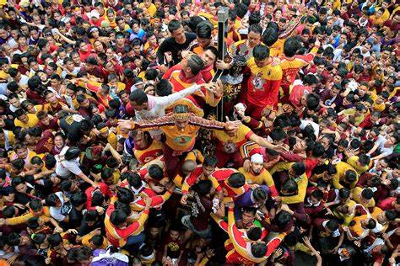
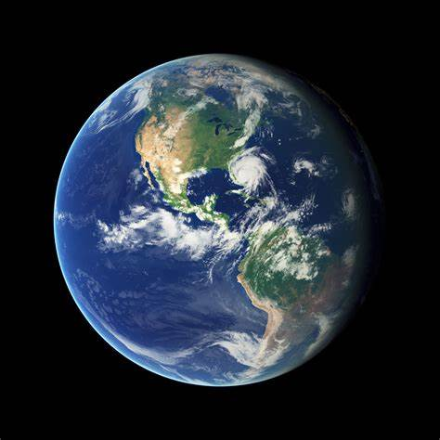
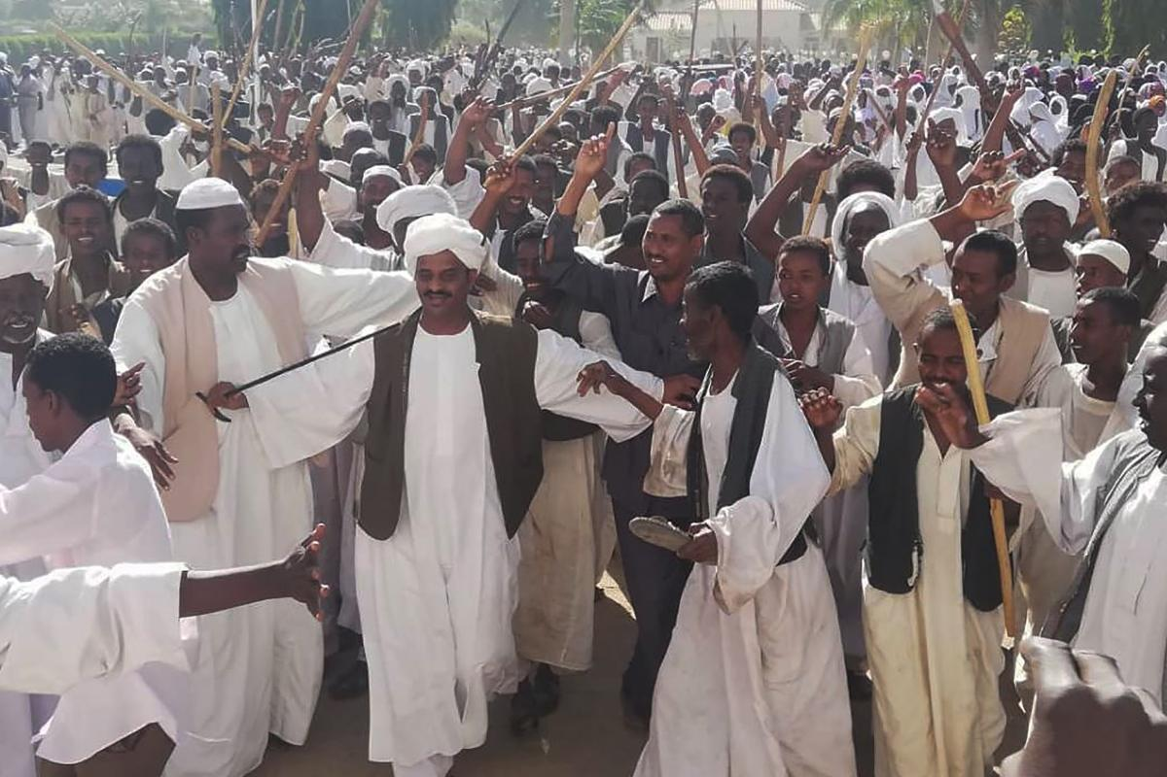
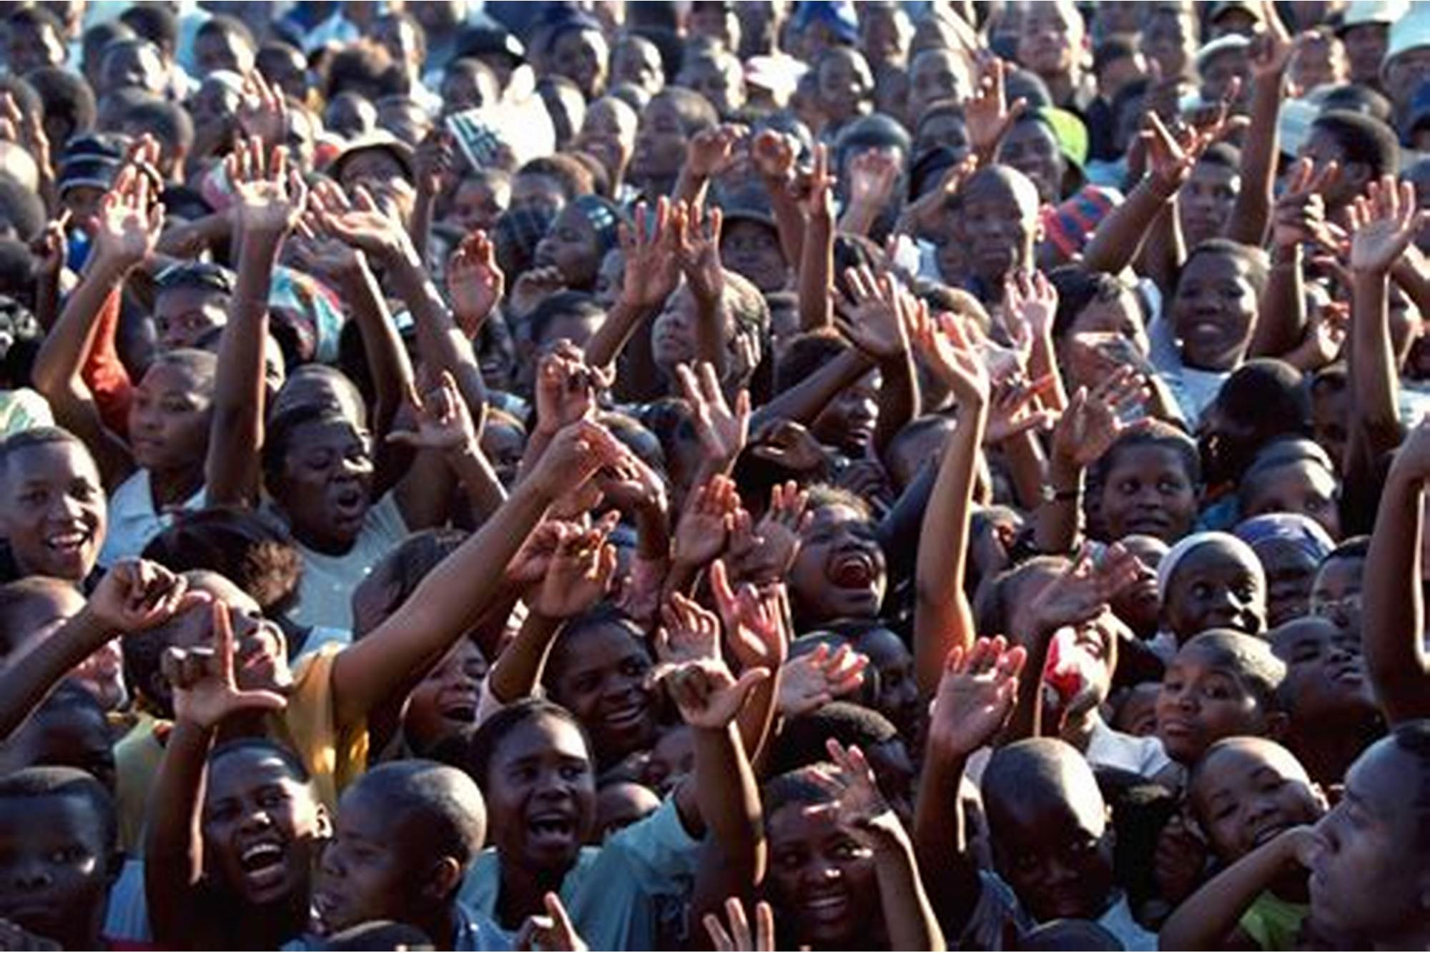
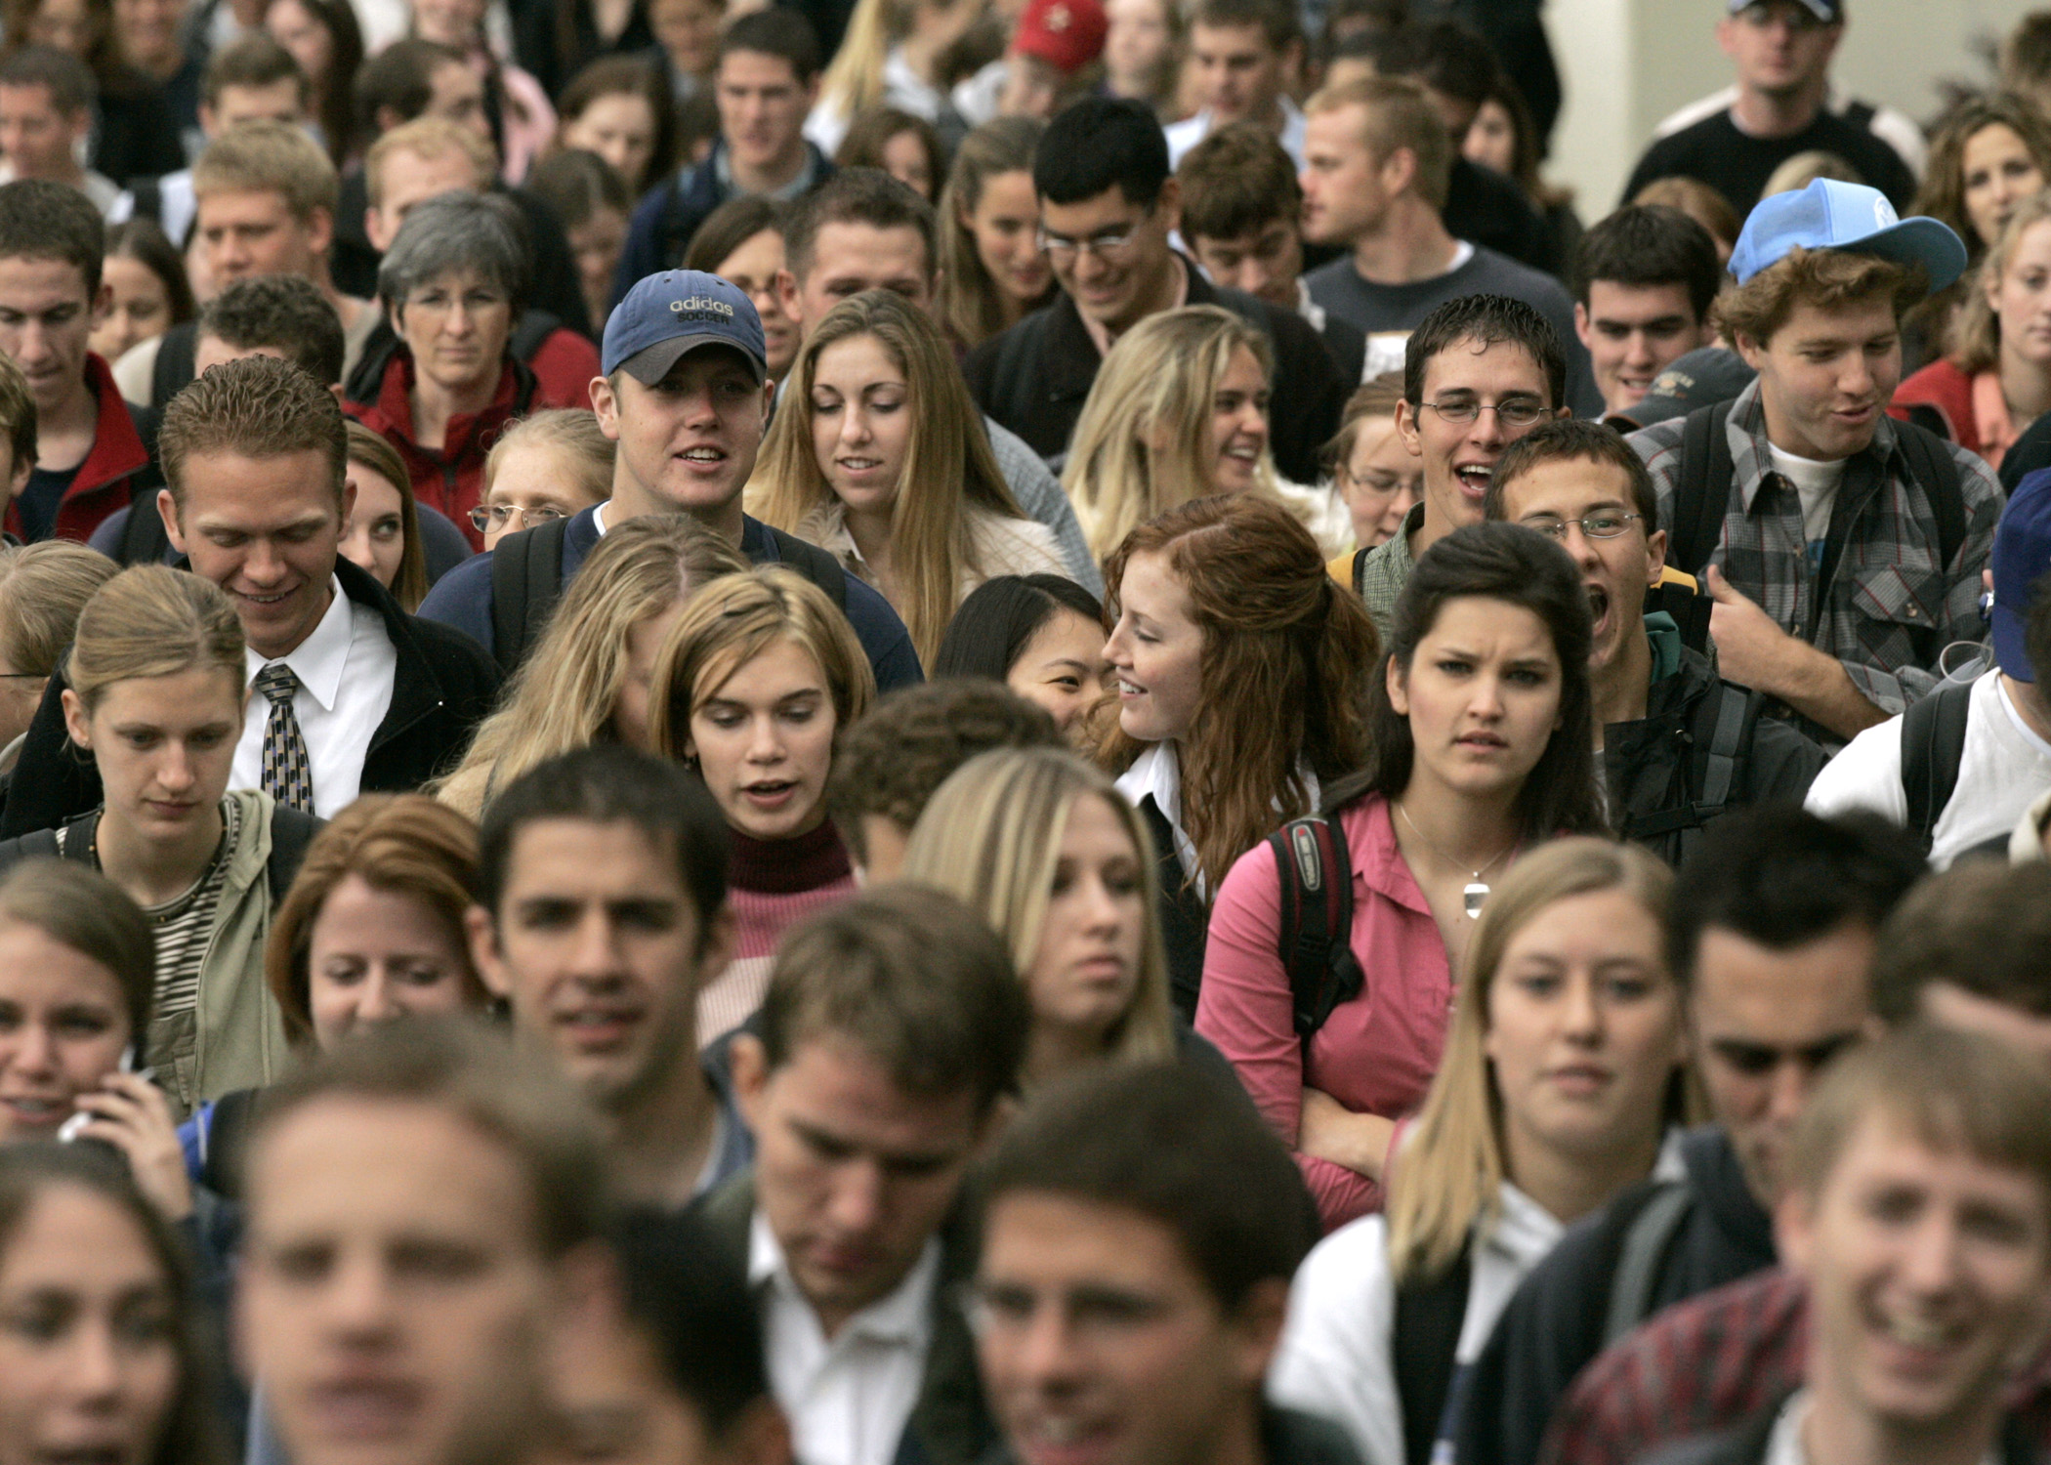
Notes:
Persecution

Slide 19
Seek His Kingdom
How do we seek it?
Seek the King. Get to know Jesus.
A New Ambition
Holding our money and possessions (things) in open hands, our Lord, King Jesus, is in charge
People > things
Rule of King Jesus in people’s hearts is top priority
Notes:
Jesus is gentle, humble. Your personal faith trainer in his faith fitness club. Invitation to believe the gospel.
Tie the Luke lessons together
Somehow the good news about Jesus made it to you. Think about that. All the people over many centuries passing on the truth again and again. Now you have it. Don’t let it stop with you. It’s time to pass it on.
How? Jesus will lead you. Use the resources at your disposal. Here’s an idea. Maybe one of your Chinese co-workers can’t go home for Chinese New Year. Or maybe one of your foreign acquaintances is lonely during the holiday break (can’t travel). Invite them over and prepare tons of food. Or take the food to their house. Show them you think they are valuable.

Slide 20
The Gospel Of Luke
COMPASSION
FORGIVENESS
JUSTICE
REDEMPTION
GENEROSITY

