Slide 1
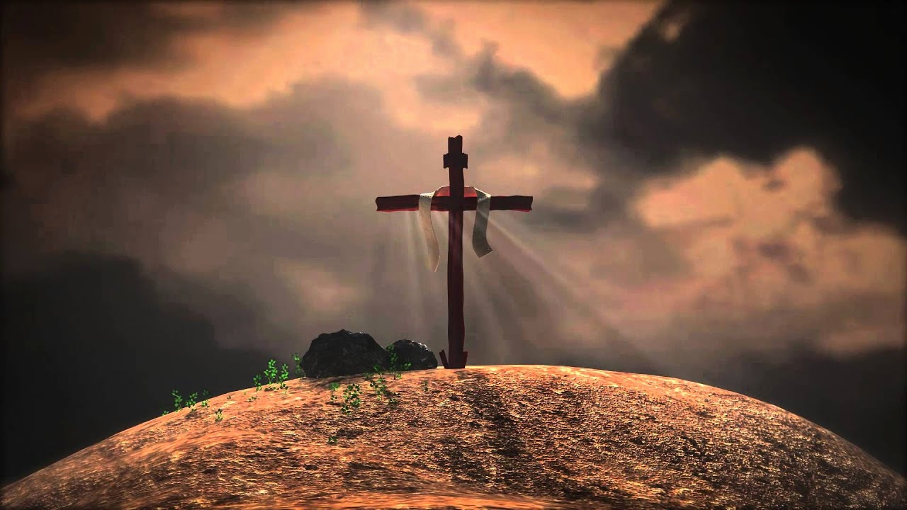
CHRIST OUR HOPE!!!
Bro Perry

Slide 2
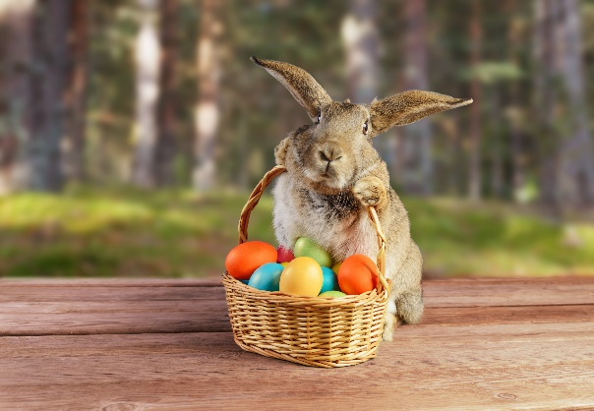
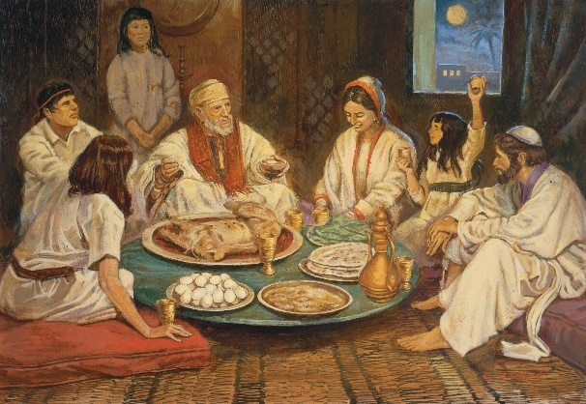
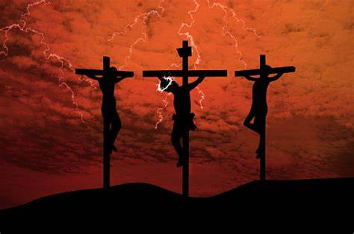
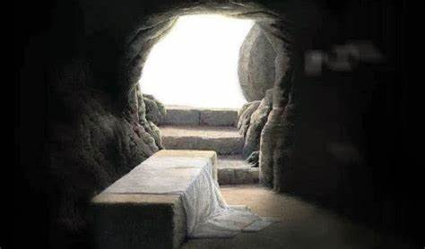
CELEBRATION OF EASTER!!
Easter bunny and eggs
The Passover festival
Exodus from Egypt
Last Supper, sufferings, crucifixion of Jesus and resurrection
30 AD

Slide 3
EVENTS LEADING TO THE RESURRECTION!!
His Birth
1. Virgin birth of the Holy Spirit (Matt 1:23)
2. Not of a corruptible seed (1Peter 1:23)
His Life
1. Lived as fully man (John 1:14)
2. Fully empowered by the Holy Spirit (Luke 4:1)
His Death
1. Died for all sinners (Romans 5:8)
2. Died innocent with no sin (1Peter 2:22)

Slide 4
DISCREDITING THE RESURRECTION!!
The theory of the twin
The theory of theft by the disciples
The theory of pretense
The theory of deception
The theory of mass hallucination

Slide 5
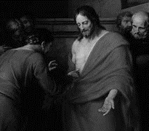
IMPORTANCE OF HIS RESURRECTION!!
Revelations 1:18 “And the living one. I died, and behold I am alive forevermore, and I have the keys of Death and Hades”.
Colossians 1:18 “And he is the head of the body, the church. He is the beginning, the firstborn from the dead, that in everything he might be preeminent”.
1Corinthians 15:17 “And if Christ has not been raised, your faith is futile and you are still in your sins”.

Slide 6
WHAT DOES THIS MEAN TO US!!!
Jesus is the Son of God!! (Matt 12:39-40)
Sins forgiven and righteousness imputed. (Romans 4:22-25)
Relationship with the Father restored. (Romans 3:25)
Receiving of the Ministry of reconciliation. (2Corinthians 5:18)
Hope of glory. (Colossians 1:27)

Slide 7
TAKEAWAY!!!
Let us live by faith!!! Right knowledge is key…
Commemoration of Jesus’ death & resurrection.
Let us go deeper in our walk in love.
Just as Christ brought us hope so must we give others hope!!
Maranatha!! Christ returns quickly..

Slide 8
LET US PRAY!!!

