Slide 1
THIS IS TRUE RELIGION!! A conclusion to the study of James.
Bro Perry Ackon

Slide 2
False Religion | True Religion
1. Focuses on routines with no form of relationship with God in Christ | 1. Emphasizes a good relationship with God through the word of God and prayer
2. Stresses on actions and a form of godliness | 2. Teaches spirituality and right motives that result in Godly living
3. Highlights self and often leads to the degrading of others | 3. Christ is the center. We are alive in Him and His love flows to others through us
Lets read James 1:27

Slide 3
Religion that is pure and undefiled before God the Father is this: to visit orphans and widows in their affliction, and to keep oneself unstained from the world

Slide 4
The focus of the book of James.
FIRST
As believers we are called to a life of fellowship with the Father by the Son through the Holy Spirit!!!
SECOND
This continuous fellowship must result in the dying to self and the formation of Christ in us!!!
THIRD
From this foundation of love that has shaped our mindset and every desire, we must show love in every deed!!
Our Christian walk is a journey of Love.
Let’s read Ephesians 4:13-16.

Slide 5
^{13.} until we all attain to the unity of the faith and of the knowledge of the Son of God, to mature manhood, to the measure of the stature of the fullness of Christ, ^{14.} so that we may no longer be children, tossed to and fro by the waves and carried about by every wind of doctrine, by human cunning, by craftiness in deceitful schemes. ^{15.} Rather, speaking the truth in love, we are to grow up in every way into him who is the head, into Christ, ^{16.} from whom the whole body, joined and held together by every joint with which it is equipped, when each part is working properly, makes the body grow so that it builds itself up in love.

Slide 6
The bible highlights standards with regards to our journey in Christ!!
1. Self
Fellowshipping with Christ (Philippians 3:10)
Revealing Christ to the world (Matthew 5)
2. Situations
How do we respond to situations
Is Christ glorified (1Peter 4:11)
3. Others
Doing to others what God has done to us
Being gracious and loving to others

Slide 7
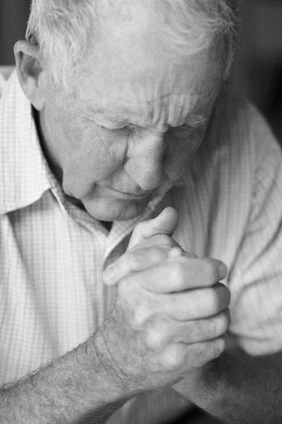
The place of prayer in our journey of love in Christ!!
Prayer is a must for all believers
Exposure to God’s word will lead to consistency and depths in Prayer
Prayer ensures a fixed focus on Christ
Let’s read James 5:13-18.

Slide 8
^{13.} Is anyone among you suffering? Let him pray. Is anyone cheerful? Let him sing praise. ^{14.} Is anyone among you sick? Let him call for the elders of the church, and let them pray over him, anointing him with oil in the name of the Lord. ^{15.} And the prayer of faith will save the one who is sick, and the Lord will raise him up. And if he has committed sins, he will be forgiven. ^{16.} Therefore, confess your sins to one another and pray for one another, that you may be healed. The prayer of a righteous person has great power as it is working. ^{17.} Elijah was a man with a nature like ours, and he prayed fervently that it might not rain, and for three years and six months it did not rain on the earth. ^{18.} Then he prayed again, and heaven gave rain, and the earth bore its fruit.

Slide 9
Key points from James 5:13-18.
Prayer is key in all situations
The place of Elders and others praying for you
Pray for others
The prayer of faith

Slide 10
In summary
The beginning of true religion and an impactful life is Jesus Christ
God will save you from the deepest pit but will not carry you out of your chair to study His word: Fellowship is important and requires discipline
Be intentional about how you respond to situations and be gracious and loving to others
Be light and hope to a dying world

Slide 11
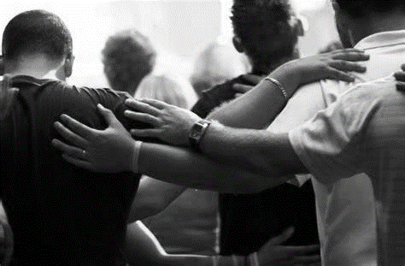
LET US PRAY!!

