Slide 1
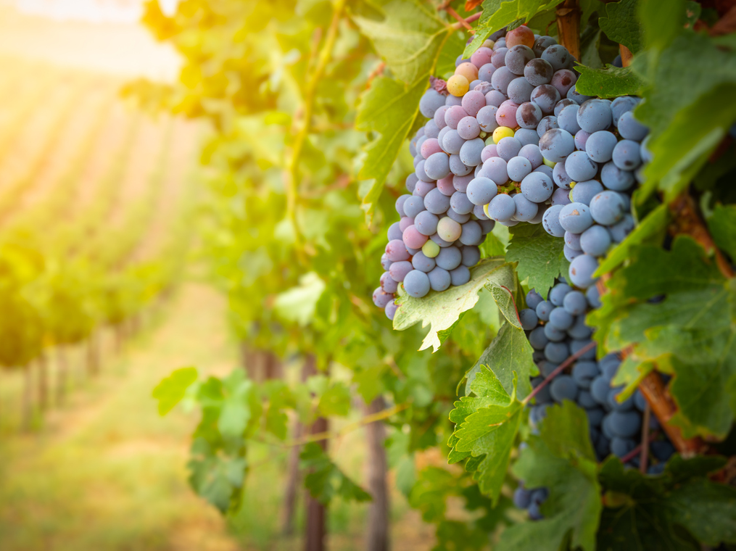
John 15
A Personal & Effective Walk with the Lord

Slide 2
OUTLINE
Introduction
What is fruitfulness?
How to become fruitful?

Slide 5
OUTLINE
Introduction
What is fruitfulness?
How to become fruitful?

