Slide 1
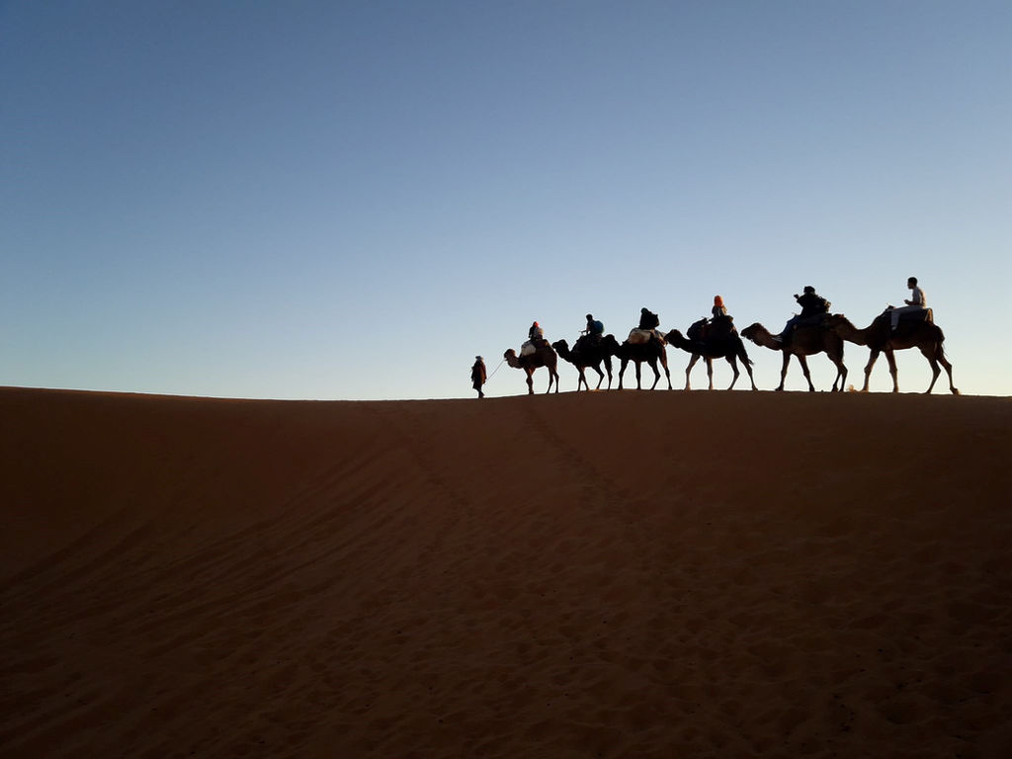
CHRISMAS CHARACTERS
THE WISE MEN
“Where is he who has been born king of the Jews? For we have seen his star in the east, and are come to worship him.” Mat. 2:2 (kjv)

Slide 2
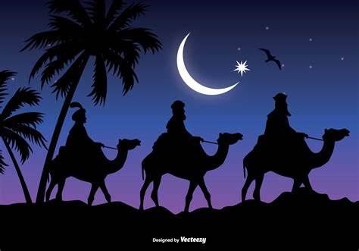
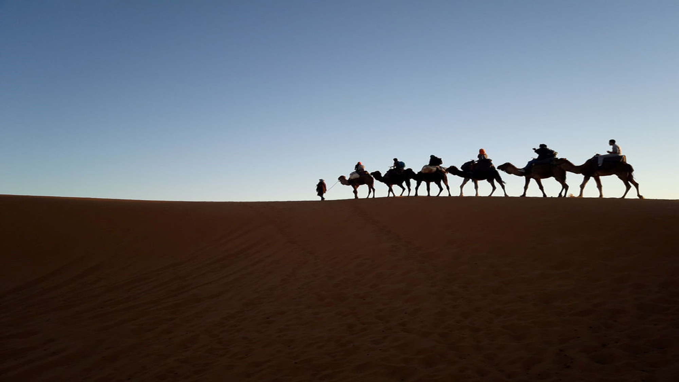
WHO WERE THEY?
¹Now after Jesus was born in Bethlehem of Judea in the days of Herod the king, behold, wise men from the east came to Jerusalem, saying ² “where is he who has been born king of the Jews? For we saw his star when it rose and have come to worship him. (Mat. 2:1)

Slide 3
WHAT’S THEIR MISSION?
² “where is he who has been born king of the Jews? For we saw his star when it rose and have come to worship him”. ⁸And he sent them to Bethlehem, saying, “Go and search diligently for the child, and when you found him, bring me word, that I too may come and worship him.” ¹¹ And going into the house, they saw the child with Mary his mother, and they fell down and worship him. Then, opening their treasures, they offered him gifts, gold and frankincense and myrrh. (Mat. 2:2, 8, 11)
To seek the new born king (v 2, 8)
To worship him (v 2)
To present him with gifts (v 11)

Slide 4
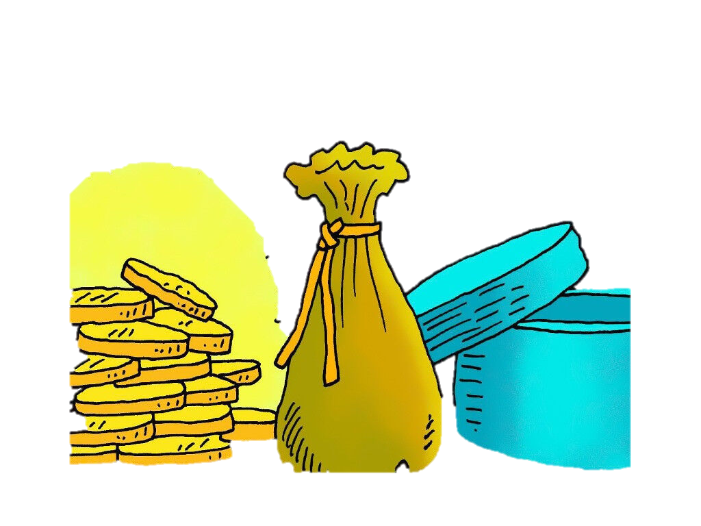
WHY THESE GIFTS?
¹¹ And going into the house, they saw the child with Mary his mother, and they fell down and worship him. Then, opening their treasures, they offered him gifts, gold and frankincense and myrrh. (Mat. 2:11)
Gold: To proclaim His kingship, and acknowledge His royalty (King of kings): For to us a child is born, to us a son is given; and the government shall be upon his shoulder, and his name shall be called Wonderful counselor, Mighty God, Everlasting Father, Prince of Peace. (Isa 9:6)

Slide 5
WHY THESE GIFTS?
Frankincense: For his priesthood (The High Priest) Therefore holy brothers, you who share in a heavenly calling, consider Jesus, the apostle and High Priest of our confession, who was faithful to Him who appointed him, just as Moses also was faithful in all God’s house. (Heb. 3:1-2)
Myrrh: (embalming oil & anointing oil) To proclaim his suffering and death. Nicodemus also, who earlier had come to Jesus by night, came bringing a mixture of myrrh and aloes, about seventy-five pounds in weight. So they took the body of Jesus and bound it in linen cloths with the spices, as is the burial custom of the Jews. (Jn 19:39-40)

Slide 6
TAKE AWAY!!!
Let’s endeavor to seek the Lord diligently, for he who seeks shall find.
Let’s all try to use this festive period to present Christ to others and let others see in Christ through our way of life.
We should try as much as possible to overcome any barriers or blockages that hinder our search for the Lord.
Finally, we should strive to be a blessing to others.

Slide 7
Small group discussions
Discuss the significance of the wise men’s gifts presented to the new born king, Jesus Christ as in Mat. 2:11
The world today focuses more on the gifting side of the wise men than the finding and worshipping side. As Christians, how do we change this "new norm"?
Discuss plans to present Christ to people around us, as our Christmas gifts to them.

