Slide 1
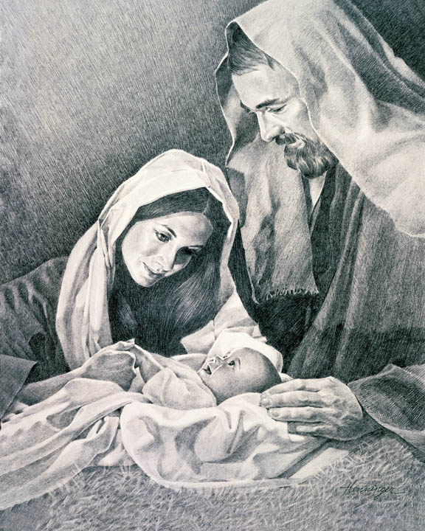
THE BIRTH OF A KING & THE FALL OF ANOTHER.
Bro Perry

Slide 2
Biblical presentation.
The visit of the wise men – Matthew 2:1-12
The flight to Egypt – Matthew 2:13-15
Herod kills children – Matthew 2:16-18
The return to Nazareth – Matthew 2:19-23
“‘And you, O Bethlehem, in the land of Judah, are by no means least among the rulers of Judah; for from you shall come a ruler who will shepherd my people Israel.’” Matthew 2:6

Slide 3
The prophetic life of Jesus Christ.
1. The birth of Jesus
2. The ministry of Jesus
3. The death and resurrection of Jesus
4. The role of Jesus in the Church
All the prophecies about Jesus in the Old testament spoken of by the prophets and highlighted in the turn of events are all fulfilled in the life of Jesus Christ. Not even one will be left out.

Slide 4
The prophetic birth of Jesus Christ.
Therefore the Lord himself will give you a sign. Behold, the virgin shall conceive and bear a son, and shall call his name Immanuel – Isaiah 7:14
But you, O Bethlehem Ephrata, who are too little to be among the clans of Judah, from you shall come forth for me one who is to be ruler in Israel, whose coming forth is from of old, from ancient days – Micah 5:2
even as the Son of Man came not to be served but to serve, and to give his life as a ransom for many.” – Matthew 20:28

Slide 5
The fear and fall of king Herod.
1. Herod the great (37 – 4 BC)
2. Allegiance to Rome
3. Political and brutal ruler
4. Pride, Deception & Fear
5. Fulfilled prophecy
The life of king Herod brings to bear the consequence of a life driven by the thirst for power. By this very thirst his character and heart was corrupted. However, his very decisions led to the fulfillment of prophecy.

Slide 6
The fear and fall of king Herod.
When Herod the king heard this, he was troubled, and all Jerusalem with him;– Matthew 2:3
Then Herod, when he saw that he had been tricked by the wise men, became furious, and he sent and killed all the male children in Bethlehem and in all that region who were two years old or under, according to the time that he had ascertained from the wise men – Matthew 2:16
But when Herod died, behold, an angel of the Lord appeared in a dream to Joseph in Egypt– Matthew 2:19

Slide 7
The intervention of Heaven.
1. The sovereign and all powerful God
2. The divine counsel and will of God
3. The Heavenly host
4. Trust & obey
5. All things shall work for our good
We are but passers by in this world. In Christ our citizenship is of Heaven and Heaven delights in our affairs watching to perform the exact counsel of God.

Slide 8
The intervention of Heaven.
saying, “Where is he who has been born king of the Jews? For we saw his star when it rose2 and have come to worship him.” – Matthew 2:2
And being warned in a dream not to return to Herod, they departed to their own country by another way – Matthew 2:12
Now when they had departed, behold, an angel of the Lord appeared to Joseph in a dream and said, “Rise, take the child and his mother, and flee to Egypt, and remain there until I tell you, for Herod is about to search for the child, to destroy him.” – Matthew 2:13

Slide 9
What does this mean to us today?
1. God has a plan for your life.
2. Challenges shall arise.
3. Trust & obey.
4. Our strength shall always fail us.
5. Be encouraged.
LET US PRAY!!

Slide 10
Small group discussion!
1. Spend time together as a family sharing testimonies while enjoying some well fried spicy chicken.
2. Which part of the story of Christ’s birth touches you the most?
3. What major lessons do we derive from the story of the birth of Christ?
4. Think of ways the group can be a blessing in this season of love.
God bless you!!

