Slide 1
Practicing Gospel Life Together
Titus 2

Slide 2
Introduction (1:1-4) | Chapter 1 Taking charge | Chapter 2 Giving advice | Chapter 3 Doing right
Issues | Setting up the right leadership | Instructions for a particular people | Attitude & conduct toward good & bad
People | Elders Rebellious people | Specific groups: - Older men & women - Young men & women - Titus & Leaders - Slaves & masters | Christians in general - What to do - What not to do
The Church | Good order (Titus 1:5) | Good doctrine (Titus 2:1) | Good works (Titus 3:1)
Theme | Titus’ role of encouraging good works through sound doctrine
Key verses | Titus 1:5, 2:10 & 3:8
Christ in Titus | Jesus the great God and Savior who redeems and purifies His people (Titus 2:13-14)
Notes:
Two Sundays ago – perry gave a great overview of Titus – from which I plagiarized this chart.
Then last Sunday, Ben shared from Titus 1
gave guidelines for Elders
Talked about rebellious people in the community – the Cretans – people living for short term pleasure.
Great two great analogies that stuck with me
The owner of a big house house that was entertaining royalty – it was all lit up because they were entertaining Royalty – and it lit up the hill (Matt 1:6 – let your light shine…)
Little girl standing on her brother to keep the lamp in the lighthouse - it hurts to shine the light.
It means sacrificing; not living for short-term returns. (this is a theme we’ll see run through the book too)
One of the key themes in Titus is the idea that our beliefs about the world (our Doctrine) directly impacts how we live. Which Paul starts to bring in at the end of Chapter 1

Slide 3
Titus 1: 15-16
15 To the pure, all things are pure; but to those who are defiled and unbelieving, nothing is pure, but both their mind and their conscience are defiled. 16 They profess to know God, but by their deeds they deny Him, being detestable and disobedient and worthless for any good deed.
Notes:
See the filter through which we look at the world
- touches our lives and
- the lives of people around us. (our community)
Jesus says in Matthew 6: 22 “The eye is the lamp of the body; so then if your eye is clear, your whole body will be full of light. 23 But if your eye is bad, your whole body will be full of darkness. If then the light that is in you is darkness, how great is the darkness!
Another way to look at it is with a Calvin and Hobbes
Anybody like Calvin and Hobbs?
I love Calvin and Hobbes because I have two boys who literally do what we read in these comics.
this is a classic – boy yelling from outside the door…

Slide 4
Notes:
READ CARTOON
It illustrates Paul’s point perfectly – we’re when we’re impure, we’re contaminated, we contaminate our environment.
when our hearts are unclean, they
contaminate our perspective of the world and impact our experience of everything
Anybody play a team sport?
Anybody play street sports?
How does street football compare to league football (Soccer?)
League basketball is very different from pickup basketball…
Rub off on others and impact their lives as well.
Parents we care deeply who our children are friends with
1 Corinthians 15:33 Do not be deceived: “Bad company corrupts good morals.
He’s talking about living amongst people who don’t believe in the resurrection of the dead – people who merely live life for the here and now

Slide 5
Titus 1: 15-16
15 To the pure, all things are pure; but to those who are defiled and unbelieving, nothing is pure, but both their mind and their conscience are defiled. 16 They profess to know God, but by their deeds they deny Him, being detestable and disobedient and worthless for any good deed.
Notes:
What does it mean to be pure here?
To know God, and thereby be changed, and see the world clearly
Read about a counselor from Celebrate Recovery taking to a group of addicts, and a guy was justifying his addiction
Counselor says, “don’t you want to be free to think interesting thoughts”
Don’t we want to be free from those ideas that taint us and hold us back?
Manager of a company
See market analysis properly,
not overreact to a threat or problem
See opportunities and take them
See problems in the company between staff, and address them
Create a pure environment so peoples work is meaningful
Father of a family
Faithful steward of his role,
faithful to his wife
Engaged with his kids
Won’t be perfect
Brother or Sister who is trying to follow abide in God
Will forgive quickly
Will not retaliate when hurt
Will think how to get along instead of causing conflict.
Question: how do we know if someone is pure.
By their deeds, and this is why Titus talks about how we should act in community.
Impure profess what? To know God.. But their deeds deny him – being worthless for good deeds.
Again, it’s our deeds that tell us who we are.

Slide 6
Titus 2 Outline
Doctrine
Results in Behavior:
Older Men:
Older Women
Younger Women
Slaves (Employees)
Doctrine Thesis
Younger Men
Notes:
So in Ch 2, Paul lays out what deeds we should be seeing from Core Christian doctrine

Slide 7
1 But as for you, speak the things which are fitting for sound doctrine. 2 Older men are to be temperate, dignified, sensible, sound in faith, in love, in perseverance.
3 Older women likewise are to be reverent in their behavior, not malicious gossips nor enslaved to much wine, teaching what is good, 4 so that they may encourage the young women to love their husbands, to love their children, 5 to be sensible, pure, workers at home, kind, being subject to their own husbands, so that the word of God will not be dishonored.
6 Likewise urge the young men to be sensible; 7 in all things show yourself to be an example of good deeds, with purity in doctrine, dignified, 8 sound in speech which is beyond reproach, so that the opponent will be put to shame, having nothing bad to say about us.
Notes:
Let’s read together
1 But as for you, speak the things which are fitting for sound doctrine. 2 Older men are to be temperate, dignified, sensible, sound in faith, in love, in perseverance.
3 Older women likewise are to be reverent in their behavior, not malicious gossips nor enslaved to much wine, teaching what is good, 4 so that they may encourage the young women to love their husbands, to love their children, 5 to be sensible, pure, workers at home, kind, being subject to their own husbands, so that the word of God will not be dishonored.
6 Likewise urge the young men to be sensible; 7 in all things show yourself to be an example of good deeds, with purity in doctrine, dignified, 8 sound in speech which is beyond reproach, so that the opponent will be put to shame, having nothing bad to say about us.

Slide 8
9 Urge bondslaves to be subject to their own masters in everything, to be well-pleasing, not argumentative, 10 not pilfering, but showing all good faith so that they will adorn the doctrine of God our Savior in every respect.
11 For the grace of God has appeared, bringing salvation to all men, 12 instructing us to deny ungodliness and worldly desires and to live sensibly, righteously and godly in the present age, 13 looking for the blessed hope and the appearing of the glory of our great God and Savior, Christ Jesus, 14 who gave Himself for us to redeem us from every lawless deed, and to purify for Himself a people for His own possession, zealous for good deeds.
15 These things speak and exhort and reprove with all authority. Let no one disregard you.
Notes:
9 Urge bondslaves to be subject to their own masters in everything, to be well-pleasing, not argumentative, 10 not pilfering, but showing all good faith so that they will adorn the doctrine of God our Savior in every respect.
11 For the grace of God has appeared, bringing salvation to all men, 12 instructing us to deny ungodliness and worldly desires and to live sensibly, righteously and godly in the present age, 13 looking for the blessed hope and the appearing of the glory of our great God and Savior, Christ Jesus, 14 who gave Himself for us to redeem us from every lawless deed, and to purify for Himself a people for His own possession, zealous for good deeds.
15 These things speak and exhort and reprove with all authority. Let no one disregard you.

Slide 9
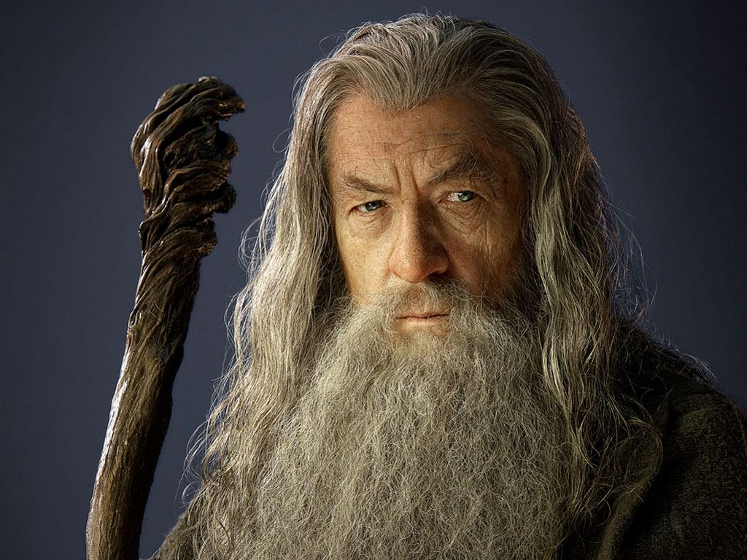
Older Men
temperate,
dignified,
sensible,
sound
in faith,
in love,
in perseverance.
Notes:
Lord of the Rings – Gandalf
Love lord of the Rings
But Gandalf kind of modeled a lot of what Paul’s saying here.
Temperate
Been around and know what over indulgence can do
Dignified
Worthy of our respect
Seen disrespect and corruption and the fruit
Chosen the path of honor and dignity
Sensible
They’ve experienced life and are able to accurately understand how to interact with the big issues in life
Sound – Faith is sound, Love is Sound, Perseverance is Sound
5198 hygiaínō (the root of the English term, "hygiene") – properly, in good working order – hence, "healthy," in sound condition (in-balance).
Trustworthy, solid, stable working properly
Free from disability, working together holistically

Slide 10
Older Women
Reverent in their behavior,
Not
malicious gossips
enslaved to much wine,
Teaching what is good,
SO THAT they may encourage the young women
Notes:
The idea here is that Good doctrine will result in the older generation is to be a source of strength, stability, life, and wisdom to the younger generation.
John Piper sermon 10 years ago I want to read from:
Three weeks ago, we got news at our church that Ruby Eliason and Laura Edwards were killed in Cameroon. Ruby Eliason—over 80, single all her life, a nurse. Poured her life out for one thing: to make Jesus Christ known among the sick and the poor in the hardest and most unreached places.
Laura Edwards, a medical doctor in the Twin Cities, and in her retirement, partnering up with Ruby. [She was] also pushing 80, and going from village to village in Cameroon. The brakes give way, over a cliff they go, and they’re dead instantly. And I asked my people, “Is this a tragedy?”
Two women, in their 80s almost, a whole life devoted to one idea—Jesus Christ magnified among the poor and the sick in the hardest places. And 20 years after most of their American counterparts had begun to throw their lives away on trivialities in Florida and New Mexico, [they] fly into eternity with a death in moment. “Is this a tragedy?” I asked.
The crowd knew the answer, calling out, “No!”
“It is not a tragedy,” Piper affirmed. “I’ll read you what a tragedy is.”
He pulled out a page from Reader’s Digest.
He read it to them:
‘Bob and Penny . . . took early retirement from their jobs in the Northeast five years ago when he was 59 and she was 51. Now they live in Punta Gorda, Florida, where they cruise on their 30-foot trawler, play softball, and collect shells.’
“That’s a tragedy,” he told the crowd.
And there are people in this country that are spending billions of dollars to get you to buy it. And I get 40 minutes to plead with you—don’t buy it. With all my heart I plead with you—don’t buy that dream. . . . As the last chapter before you stand before the Creator of the universe to give an account with what you did: “Here it is, Lord—my shell collection. And I’ve got a good swing. And look at my boat.”
“Don’t waste your life,” he said, the words quietly tucked in before he barreled into another memorable anecdote, this one about a plaque in his home featuring C. T. Studd’s poem, “Only one life, twill soon be past / Only what’s done for Christ will last.”
God made us to be a community – and the people with white hair are not to sit back drinking alcohol having meaningless or hurtful discussion, but rather to be nvesting in the younger generation.
So older women are to invest in the lives of younger women.

Slide 11
Younger Women
love their husbands,
love their children,
sensible,
pure,
workers at home,
kind,
subject to their own husbands
SO THAT the word of God will not be dishonored.
Notes:
For younger women, we see
This description comes under the mentorship of older women. Not supposed to do it alone.
Husbands are a priority
Children are a priority
And there’s that word sensible and pure
Younger women are most fulfilled when they contribute – here’ it’s working at home in their context, but now it could be at a job or in the home.
Kindness
We homeschool, and when you ask your child to do their classwork and they don’t do it, the temptation is not to be kind.
when you're a dad and you've put together a checklist and it doesn't get done...
When we live in the home day in and day out with broken people we get on eachother’s nerves.. The natural way of the world is to be unkind.
Subject to their husbands
Theme of complementarianism carried through scripture of Christ and the Church representing the husband/wife relationship - See Ephesians 5
This is not natural
Submitting to one another in Love is not natural.
And the Goal – to honor God’s word (through obedience) (obedience is for all of us)

Slide 12
Young Men
sensible;
in all things be an example
of good deeds,
with purity in doctrine,
dignified,
sound in speech
beyond reproach
SO THAT the opponent will be put to shame, having nothing bad to say about us.
Notes:
Young men are to be sensible – self controlled in the Greek
Behave in accordance with reality
Danger - sensible thing is to run away (flee from sexual temptation)
Opportunity for growth – sensible thing is to take it
Rebuke – sensible thing is to accept it.
Example to our world (like the analogy Ben gave of the house with the lights on entertaining royalty)
Good deeds – should reflect what we believe
Doctrine should be pure, Young men need to be reading the bible.
The verses I memorized in college are still with me now.
Scripture memory is one of the best disciplines you can have: ANKI
Dignified (modeled by older men) they should have Integrity
Speech should be sound
– rooted in truth
– and we shouldn’t be talking about things we’d be ashamed to talk about around Pastor Perry
Shouldn’t be posting things on social media we wouldn’t want our Pastor to see, or our wives, or our children…
Goal: so that the accuser’s lies are shown as lies.
Opponent – may be accusers in community, but ultimately it’s the accuser of the betheren.
It is freeing to lay down at night and not be haunted by lies or sins we made during the day – or ones we made long ago that we’re still afraied will come back to haunt us.

Slide 13
Bond Slaves (δοῦλος)
subject to their own masters
in everything,
well-pleasing,
not argumentative
Not pilfering,
but showing all good faith
Notes:
Types of Servants in the Bible:
Financial Manager in Matthew 18: the one who was forgiven 10000 talents – $200-300million!
Parable of Talents – Matthew 25- three servants entrusted with money to grow
Luke 2 – centurion who asked Jesus to heal his servant
Luke 12: 42 And the Lord said, “Who then is the faithful and sensible steward, whom his master will put in charge of his servants, to give them their rations at the proper time? 43 Blessed is that slave whom his master finds so doing when he comes. 44 Truly I say to you that he will put him in charge of all his possessions.
Luke 17 - 7 “Which of you, having a slave plowing or tending sheep, will say to him when he has come in from the field, ‘Come immediately and sit down to eat’? 8 But will he not say to him, ‘Prepare something for me to eat, and properly clothe yourself and serve me while I eat and drink; and afterward you may eat and drink’? So here it means someone who is indentured to another
Jesus Says no Servant is above his master – we’re to be servants
For us as Christians,
I think the proper definition in this context – is someone who works for someone else
Jesus says we should all be considered as servants

Slide 14
SO THAT
Older Women Vs 4
they may encourage younger women
Younger Women Vs 5
the word of God will not be dishonored.
Young Men Vs 8
the opponent will be put to shame, having nothing bad to say about us.
Bondslaves Vs 9
they will adorn the doctrine of God our Savior in every respect.
Notes:
When you do business planning, you have tactical goals, milestones and then your mission statement
These are tactical goals – the direct effect you want to accomplish from these guidelines.
But then there’s the bigger why – what’s the goal? What’s the game-plan and the drive behind all this?
Before we do this – let’s go back and look at a summary

Slide 15
Overview
Older Men
temperate,
dignified,
sensible,
sound
in faith,
in love,
in perseverance.
Older Women
Reverent in their behavior,
Teaching what is good,
encourage the young women
Young Women
love their husbands,
love their children,
sensible,
pure,
workers at home,
kind,
subject to their own husbands
Young Men
sensible;
in all things be an example
good deeds,
purity in doctrine,
dignified,
sound in speech
beyond reproach
Servants
subject to their own masters
in everything,
well-pleasing,
not argumentative
Not pilfering,
but showing all good faith
Notes:
What’s the most common word here?
click

Slide 16
Σώφρονας sensible, self controlled
Older Men
temperate,
dignified,
sensible,
sound
in faith,
in love,
in perseverance.
Older Women
Reverent in their behavior,
Teaching what is good,
encourage the young women
(sensible)
Young Women
love their husbands,
love their children,
sensible,
pure,
workers at home,
kind,
subject to their own husbands
Young Men
sensible;
in all things be an example
good deeds,
purity in doctrine,
dignified,
sound in speech
beyond reproach
Servants
subject to their own masters
in everything,
well-pleasing,
not argumentative
Not pilfering,
but showing all good faith
Notes:
Sensible.
Mentioned
In description of Elders
later in the doctrine section at the end as well.
It Means
Self controlled
Chaste
Restraining yourself to accomplish something because you have a goal in mind.
Exercising your will in accordance with what you really believe about the world.
Compare the lists – highlight discipline
Paul 1 Corinthians 9:24-27:
24 Do you not know that those who run in a race all run, but only one receives the prize? Run in such a way that you may win. 25 Everyone who competes in the games exercises self-control in all things. They then do it to receive a perishable wreath, but we an imperishable. 26 Therefore I run in such a way, as not without aim; I box in such a way, as not beating the air; 27 but I discipline my body and make it my slave, so that, after I have preached to others, I myself will not be disqualified.

Slide 17
Notes:
Around 1979 I have one of my deepest memories of what it means to have true belief and it directly impact my life.
Anybody into super-heroes? Marvel movies? DC Movies? Spiderman, Thor, Hulk…
Anybody go trick-or-treating as a kid?
Superman costume 1 week before Halloween CICK
Put it on, and test it.
Again, again, again
Small town neighbors that would sit on their porch across the street.
Neighbors were entertained for at least 20-30 minutes
Funniest part of this is after a good half our of this – I took off the costume gave it to my mom and told her we need to return it and get another, because it’s obviously broken.
One hand – hilarious story
Other hand – really shows that what we believe matters. I really believed I could fly
So what are the Doctrines, the teachings that are the foundations of these guidelines for our community?

Slide 18
Notes:
Now if I came out today after 6 months of working out in a $1000 RMB superman costume and ran up and down the isles diving in the air 50 times in a row, believing I could fly…
What would you think?
Rob, you’re not sensible. In fact – you’re crazy. You might look kinda like superman – but you’re not superman. That’s not who you are…
We are living “nonsensibly” when we do not live out of who we are.

Slide 19
Doctrine
GRACE of God has Appeared
Brings Salvation
Instructs us
Instructs US:
Deny our fallen nature
Live Sensibly
Look forward to the return of “God, Savior, and Christ” Jesus
Notes:
11 For the grace of God has appeared, bringing salvation to all men, 12 instructing us to deny ungodliness and worldly desires and to live sensibly, righteously and godly in the present age, 13 looking for the blessed hope and the appearing of the glory of our great God and Savior, Christ Jesus, 14 who gave Himself for us to redeem us from every lawless deed, and to purify for Himself a people for His own possession, zealous for good deeds.
Why do we exercise self-control, why should we take Paul’s list on how we should behave together seriously?
GRACE!!!
Does two things – see above
What does it instruct us?
Sounds like Romans 6: 8 Now if we have died with Christ, we believe that we shall also live with Him, 9 knowing that Christ, having been raised from the dead, is never to die again; death no longer is master over Him. 10 For the death that He died, He died to sin once for all; but the life that He lives, He lives to God. 11 Even so consider yourselves to be dead to sin, but alive to God in Christ Jesus.
Look forward – what are we looking forward to? Why the Return of our God and Savior
You were made for life together with God.
When he returns, all that crap you’re so weary of in yourself will be over.
Free to think more interesting thoughts…

Slide 20
Living Sensibly
Romans 12: 1 Therefore I urge you, brethren, by the mercies of God, to present your bodies a living and holy sacrifice, acceptable to God, which is your spiritual service of worship. 2 And do not be conformed to this world, but be transformed by the renewing of your mind, so that you may prove what the will of God is, that which is good and acceptable and perfect.
2 Corinthians 10:3 For though we walk in the flesh, we do not war according to the flesh, 4 for the weapons of our warfare are not of the flesh, but divinely powerful for the destruction of fortresses. 5 We are destroying speculations and every lofty thing raised up against the knowledge of God, and we are taking every thought captive to the obedience of Christ,
Notes:
If Paul’s doctrine is true – We have been saved from our sins and given a new heart.

Slide 21
Dallas Willard:
The main thing God gets out of your life is the person you become. The main thing you get out of your life is the person you become. Therefore the purpose of life is to become the most we can become, in God’s eyes, before we die.
Titus 2:14 who gave Himself for us to redeem us from every lawless deed, and to purify for Himself a people for His own possession, zealous for good deeds.
Notes:
Discussion in our Men’s group:
Tempted to complain about hypocrites in the church
Who do you expect to be attracted to the Gospel:
2 Corinthians 6:9 Or do you not know that the unrighteous will not inherit the kingdom of God? Do not be deceived; neither fornicators, nor idolaters, nor adulterers, nor effeminate, nor homosexuals, 10 nor thieves, nor the covetous, nor drunkards, nor revilers, nor swindlers, will inherit the kingdom of God. 11 Such were some of you;
BROKEN PEOPLE
We’re in progress – these guidelines are reasonable principles to live by, ones that we’ll fail at, but ones that God will empower us to grow into together.
Dallas Willard quote – read
But it’s also what my wife and children gets out or me is who I become today. What You get out of me is who I’m becoming, and what I get out of you is who you’re becoming – and if we do this together - we experience more of God’s Kingdom now.
CLICK! Titus 2:14 who gave Himself for us to redeem us from every lawless deed, and to purify for Himself a people for His own possession, zealous for good deeds.
Invitation
If you have been born again, surrendered your life to God, and are now a Child of God, part of His family, part of Jesus’s body – and you will life forever with God and will eventually rule with him for eternity – this is the sensible way to live.

Slide 22
Small Group Questions
What are some good ways to remind yourself of the truths taught in God’s word daily?
What are some of the areas of your life that God is using or can use to bless our community?
Do you identify with the issues Paul brings up for you to be aware of in your gender/age group in Titus 2?
How can you live more sensibly, assuming the core doctrines Paul listed at the end of Titus 2?
Notes:
IINVITATION:
BENEDICTION:
May you deny ungodliness and worldly desires and to live sensibly, righteously and godly in the present age, 13 looking for the blessed hope and the appearing of the glory of our great God and Savior, Christ Jesus, 14 who gave Himself for us to redeem us from every lawless deed, and to purify for Himself a people for His own possession, zealous for good deeds.

