Slide 1
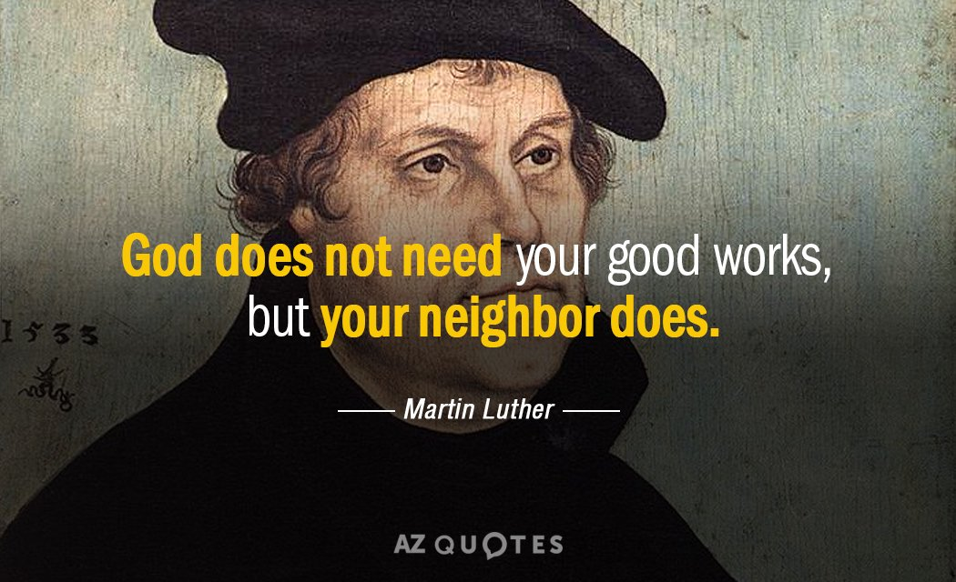
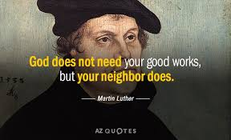

Slide 2
TITUS 3

Slide 3
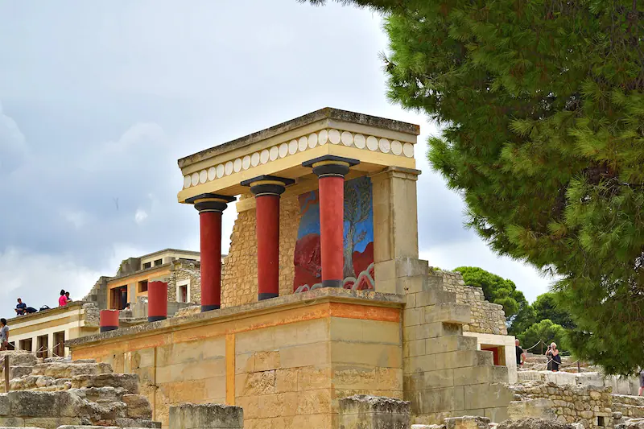
OUTLINE
Ancient Crete
I. Introduction
II. Good Citizens–expression of good works
III. Our identity—the Pillar of Believers’ good works
IV. Handling doctrinal division in church
V. Fruitfulness by Good works
VI. Conclusion

Slide 4
I. introduction
Recap
1. Overview of book of Titus
2.Titus 1, Leadership
Need for Godly exemplary authority in the church
Shinning as light in messed up society
3. Titus 2, Practical Gospel Life
Sound(hygienic) doctrine
Appearing of God’s grace for salvation—basis for Godly living

Slide 5
Titus 2 (ESV)
¹¹ For the grace of God has appeared, bringing salvation for all people, ¹² training us to renounce ungodliness and worldly passions, and to live self-controlled, upright, and godly lives in the present age, ¹³ waiting for our blessed hope, the appearing of the glory of our great God and Savior Jesus Christ, ¹⁴ who gave himself for us to redeem us from all lawlessness and to purify for himself a people for his own possession who are zealous for good works.
Ephesian 2(ESV)
⁸ For by grace you have been saved through faith. And this is not your own doing; it is the gift of God, ⁹ not a result of works, so that no one may boast. ¹⁰ For we are his workmanship, created in Christ Jesus for good works, which God prepared beforehand, that we should walk in them.

Slide 6
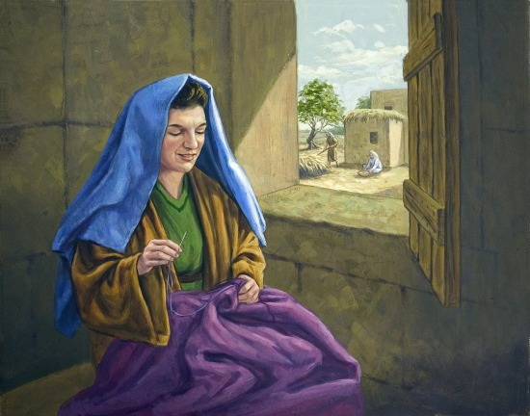
What is Good works ?
GOOD(Kalos)—valuable, virtuous, excellent, good
WORKS(ergo)—act—deed, doing, labour, work
Titus 2:14; 3:1,14
Illustration—ACT 9:36-43,Acts 10
bad work—works of the flesh
Galatians 5:19
Dead works—works that are not bad in itself but spring from corrupt motives, which does not please God
Hebrews 6:1, 9:14,1Cor 3:10-15

Slide 7
MAIN TEXT
Titus 3 Lexham English Bible
3 Remind them to be subject to the rulers and to the authorities, to obey, to be prepared for every good work, ² to speak evil of no one, to be peaceable, gentle, showing all courtesy to all people. ³ For we also were once foolish, disobedient, led astray, enslaved to various desires and pleasures, spending our lives in wickedness and envy, despicable, hating one another. ⁴ But when the kindness and love for mankind of God our Savior appeared, ⁵ he saved us, not by deeds of righteousness that we have done, but because of his mercy, through the washing of regeneration and renewal by the Holy Spirit, ⁶ whom he poured out on us abundantly through Jesus Christ our Savior, ⁷ so that, having been justified by his grace, we may become heirs according to the hope of eternal life.

Slide 8
MAIN TEXT
Titus 3 Lexham English Bible
⁸ The saying is trustworthy, and I want you to insist concerning these things, so that those who have believed in God may be careful to engage in good deeds. These things are good and beneficial for people. ⁹ But avoid foolish controversies and genealogies and contentions and quarrels about the law, for they are useless and fruitless. ¹⁰ Reject a divisive person after a first and second admonition, ¹¹ knowing that such a person is perverted and is sinning, being self-condemned.
¹² When I send Artemas or Tychicus to you, make haste to come to me in Nicopolis, for I have decided to spend the winter there. ¹³ Diligently send on their way Zenas the lawyer and Apollos, so that they may lack nothing. ¹⁴ But also our people must learn to engage in good deeds for necessary needs, so that they will not be unfruitful. ¹⁵ All those with me greet you. Greet those who love us in the faith. Grace be with all of you.

Slide 9
II. Good Citizens
Titus 3
3 Remind them to be subject to the rulers and to the authorities, to obey, to be prepared for every good work,
² to speak evil of no one, to be peaceable, gentle, showing all courtesy to all people.
Christian are to rightly conduct themselves with earthly authority and rule(1 Peter 2:13-17)
We must be intentional about doing good works
Pray should replace complains (1Tim 2:1-4)

Slide 10
III. Our identity in Christ
Titus 3
³ For we also were once foolish, disobedient, led astray, enslaved to various desires and pleasures, spending our lives in wickedness and envy, despicable, hating one another. ⁴ But when the kindness and love for mankind of God our Savior appeared, ⁵ he saved us, not by deeds of righteousness that we have done, but because of his mercy, through the washing of regeneration and renewal by the Holy Spirit, ⁶ whom he poured out on us abundantly through Jesus Christ our Savior, ⁷ so that, having been justified by his grace, we may become heirs according to the hope of eternal life.(cf. Eph 2:1-10)

Slide 11
What we learn
The foundation of Christian good works is our identity in Christ(Eph 2:10)
Our identity in Christ should make us express love and extend mercy to all
The power(Grace) to do acceptable good works flows from our identity in Christ

Slide 12
III. Our identity in Christ
Titus 3
⁸ The saying is trustworthy, and I want you to insist concerning these things, so that those who have believed in God may be careful to engage in good deeds. These things are good and beneficial for people
The church should not be weary of the gospel message, for it is the power of God to salvation and every good work(Rom 1:16)

Slide 13
IV. Handling doctrinal division in Church
Titus 3
⁹ But avoid foolish controversies and genealogies and contentions and quarrels about the law, for they are useless and fruitless. ¹⁰ Reject a divisive person after a first and second admonition, ¹¹ knowing that such a person is perverted and is sinning, being self-condemned.
Doctrinal contention is the not a healthy tool for building up the local church
All Church discipline should aim at restoration
Divisive people are best rejected if all warning fails

Slide 14
# V. Fruitfulness by Good works
Titus 3
¹² When I send Artemas or Tychicus to you, make haste to come to me in Nicopolis, for I have decided to spend the winter there. ¹³ Diligently send on their way Zenas the lawyer and Apollos, so that they may lack nothing. ¹⁴ But also our people must learn to engage in good deeds for necessary needs, so that they will not be unfruitful. ¹⁵ All those with me greet you. Greet those who love us in the faith. Grace be with all of you.

Slide 15
# VI. Conclusion
The Christian is charged to be good citizens in crooked world
We are called to be zealous and ready do good works
Good works must show in our way of life and service to others
Our identity in Christ, sound doctrine and power of ongoing work of grace is the anchor
It is worthy to remind ourselves of these things.
We must do all we can to preserve our doctrine so we can continue in good works unto fruitfulness

