Slide 1
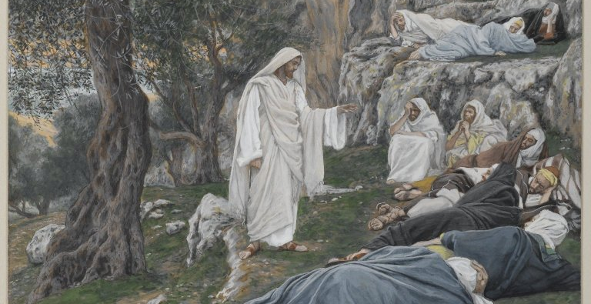
Encounters with Jesus
Mark 6:31 – Jesus commands the apostles to rest
Sermon Series Introduction 2022

Slide 2
OUTLINE
Introduction
Stories
Who, What, Why, Where, When, How
The Essence of an Encounter
KNOWS
ACCEPTS
REVEALS
PLAN
How do we respond?

Slide 3
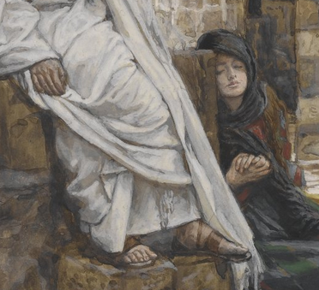
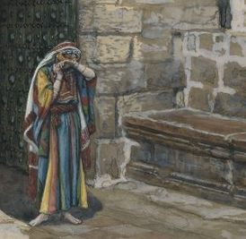
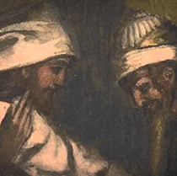
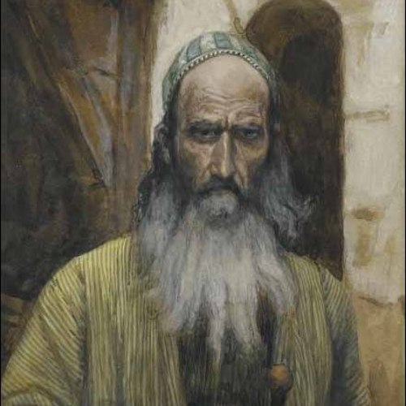
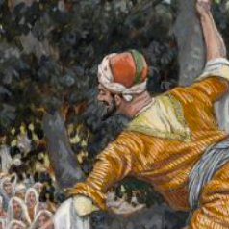
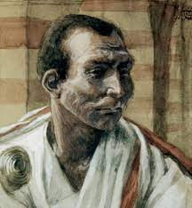
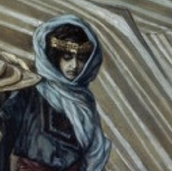
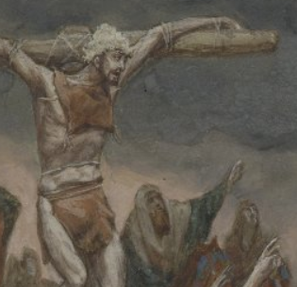
STORIES
Qs
 | Mary and Martha Luke 10 |  | Adulterous woman John 8
 | Nicodemus John 3 |  | Saul Acts 9
 | Zacchaeus Luke 19 |  | Pontius Pilate John 18-19, Matt 27
 | Woman at the well John 4 |  | Dying thief Luke 23:39ff
Who?
What?
Why?
Where?
When?
How?

Slide 4
OUTLINE
Introduction
Stories
Who, What, Why, Where, When, How
The Essence of an Encounter
KNOWS
ACCEPTS
REVEALS
PLAN
How do we respond?

