Slide 1
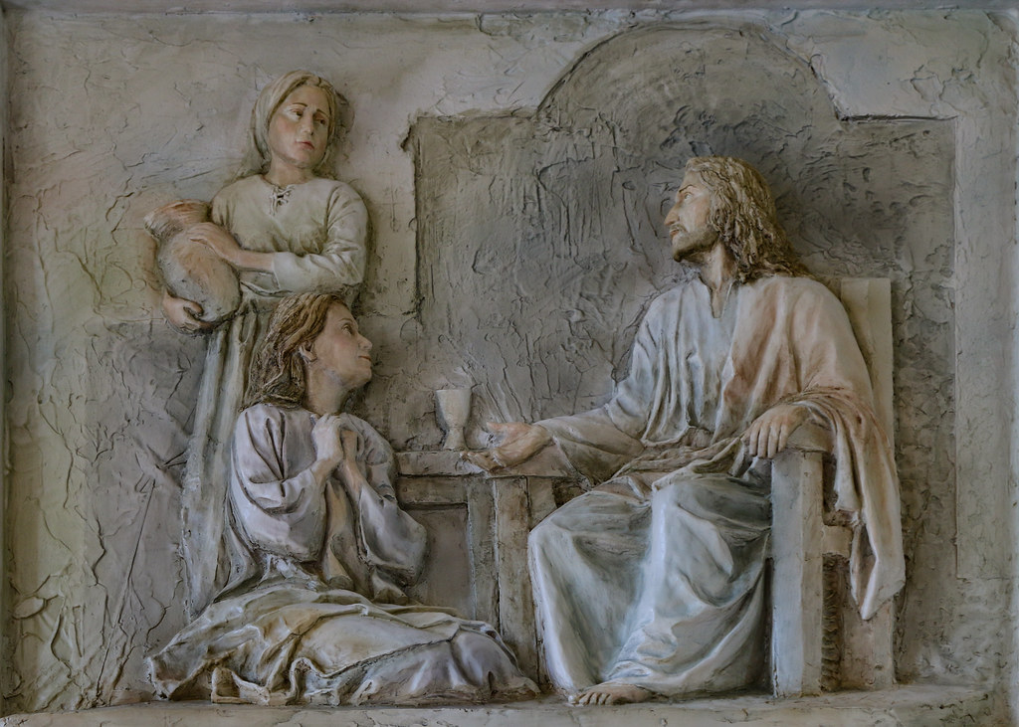
The One Necessary Thing
Mary & Martha

Slide 2
Luke 10
38 Now as they were traveling along, He entered a village; and a woman named Martha welcomed Him into her home. 39 She had a sister called Mary, who was seated at the Lord’s feet, listening to His word. 40 But Martha was distracted with all her preparations; and she came up to Him and said, “Lord, do You not care that my sister has left me to do all the serving alone? Then tell her to help me.” 41 But the Lord answered and said to her, “Martha, Martha, you are worried and bothered about so many things; 42 but only one thing is necessary, for Mary has chosen the good part, which shall not be taken away from her.”

Slide 3
Martha
Distracted
περισπάω (perispáō)
- Drawn off from around, diverted by her surroundings
40 But Martha was distracted with all her preparations;
Notes:
Martha
So let’s start with Martha: Martha was the the lady who made things happen, the proactive person – She was the one who invited Jesus in in the first place.
BUT - she’s the one who gets reprimanded in this story? Why?
CLICK
περισπάω perispáō
drawn off from from around, diverted by her surroundings
CLICK
Because she was the one distracted.
was distracted by what she was supposed to be doing.
And her distractions (WRONG-FOCUS)resulted in feelings, decisions and actions that were out of touch with reality.

Slide 4
Martha
Worried and Bothered
Victim Mentality
Accused Jesus of Not Caring
Commanded Jesus to Obey Her
A > C
A > B > C
Notes:
See Martha was operating form a normal way of thinking.
CLICK
A causes C model of thinking
Outside events cause us to do things.
Anyone with an infant? What’s your natural inclination when your baby yells for 30 minutes straight? The baby drives you nuts – it makes you angry right? So what do you do? Shake the baby right?
Anybody drive in Xiamen? What was your first response when someone did the “I’m driving into you move”? KP - it's the People's lane
Your 10 year old gets out of bed after bedtime for the 3rd night in a row – you automatically yell at them
Anybody ever read comments on a contravertial Youtube Video – that’s a whole page of A-C thinking right there.
So for Martha, this thinking resulted in feelings and beliefs that were out of touch with reality:
Was worried and bothered by so many things CLICK
Victim Mentality - was focused on herself and “justice” CLICK
Accusational - accused the Lord as not caring
Demanding - Commanded Jesus - told him to make Martha help
The Problem here is that A doesn’t Cause C.
CLICK
There’s something in the middle called a “B” and that’s our thoughts, and that B – is a worldview of interacting with the world naturally, without being Grounded in a relationship with God.

Slide 5
Martha
A > B > C
D > E
Notes:
See Martha was operating form an A B C model of thinking.
So What Martha needs to do, is get rid of
The B – lie
That leads to
C – bad feelings, actions, and decisions
CLICK
And replace it with
True beliefs
That result in
Good actions, healthy emotions, and wise decisions
NEXT PAGE
THE BOTTOM OF LIFE Words and music by Billy Crockett I gotta question Mr. Jesus I'm wonderin' What's at the bottom of life I got a worry Mr. Jesus What's at the bottom of life I got a preacher just told me there's fire Fire at the bottom of life I'm scared for my family Frightented for the Mrs. and me I'm scared for my children Frightened as I can be Won't you please tell me Jesus What's at the bottom for me I gotta know A little peak I'm scared to death what I might find if might seek What's at the bottom of life If it's fire dear Jesus please save me from the bottom of life What Lord, what you sayin' There is love at the bottom of life Oh Lord, that's just like you Puttin' love at the bottom of life You know what it makes me wanna do It makes me wanna sink my feet Real, real, deep Right down in the bottom of life

Slide 6
The Bottom of Life – Billy Crockett
What Lord, what you sayin' There is love at the bottom of life Oh Lord, that's just like you Puttin' love at the bottom of life You know what it makes me wanna do It makes me wanna sink my feet Real, real, deep Right down in the bottom of life
Notes:
THE BOTTOM OF LIFE Words and music by Billy Crockett I gotta question Mr. Jesus I'm wonderin' What's at the bottom of life I got a worry Mr. Jesus What's at the bottom of life I got a preacher just told me there's fire Fire at the bottom of life I'm scared for my family Frightented for the Mrs. and me I'm scared for my children Frightened as I can be Won't you please tell me Jesus What's at the bottom for me I gotta know A little peak I'm scared to death what I might find if might seek What's at the bottom of life If it's fire dear Jesus please save me from the bottom of life
CLICK What Lord, what you sayin' There is love at the bottom of life Oh Lord, that's just like you Puttin' love at the bottom of life You know what it makes me wanna do It makes me wanna sink my feet Real, real, deep Right down in the bottom of life

Slide 7
3 Forces We Struggle Against:
The World
Col 2:20 If you have died with Christ to the elementary principles of the world, why, as if you were living in the world, do you submit yourself to decrees, such as, 21 “Do not handle, do not taste, do not touch!” 22 (which all refer to things destined to perish with use)—in accordance with the commandments and teachings of men? 23 These are matters which have, to be sure, the appearance of wisdom in self-made religion and self-abasement and severe treatment of the body, but are of no value against fleshly indulgence.
The Devil
1 Peter 5:8 Be of sober spirit, be on the alert. Your adversary, the devil, prowls around like a roaring lion, seeking someone to devour.
The Flesh
Romans 8:6 For the mind set on the flesh is death, but the mind set on the Spirit is life and peace, 7 because the mind set on the flesh is hostile toward God; for it does not subject itself to the law of God, for it is not even able to do so, 8 and those who are in the flesh cannot please God.
Notes:
See, when we’re not Listening to the Lord to tell us what’s our foundation for life – we’re getting a message from
The world, the devil, or our flesh.
And we’re fearful, anxious – missing out on a foundation of security for life
The world and the Devil, in General are from without pulling us away from our relationship with God,
but the Flesh pulls us inward.
Vs 40 – Martha says, “Lord, do You not care that my sister has left me to do all the serving alone?

Slide 8
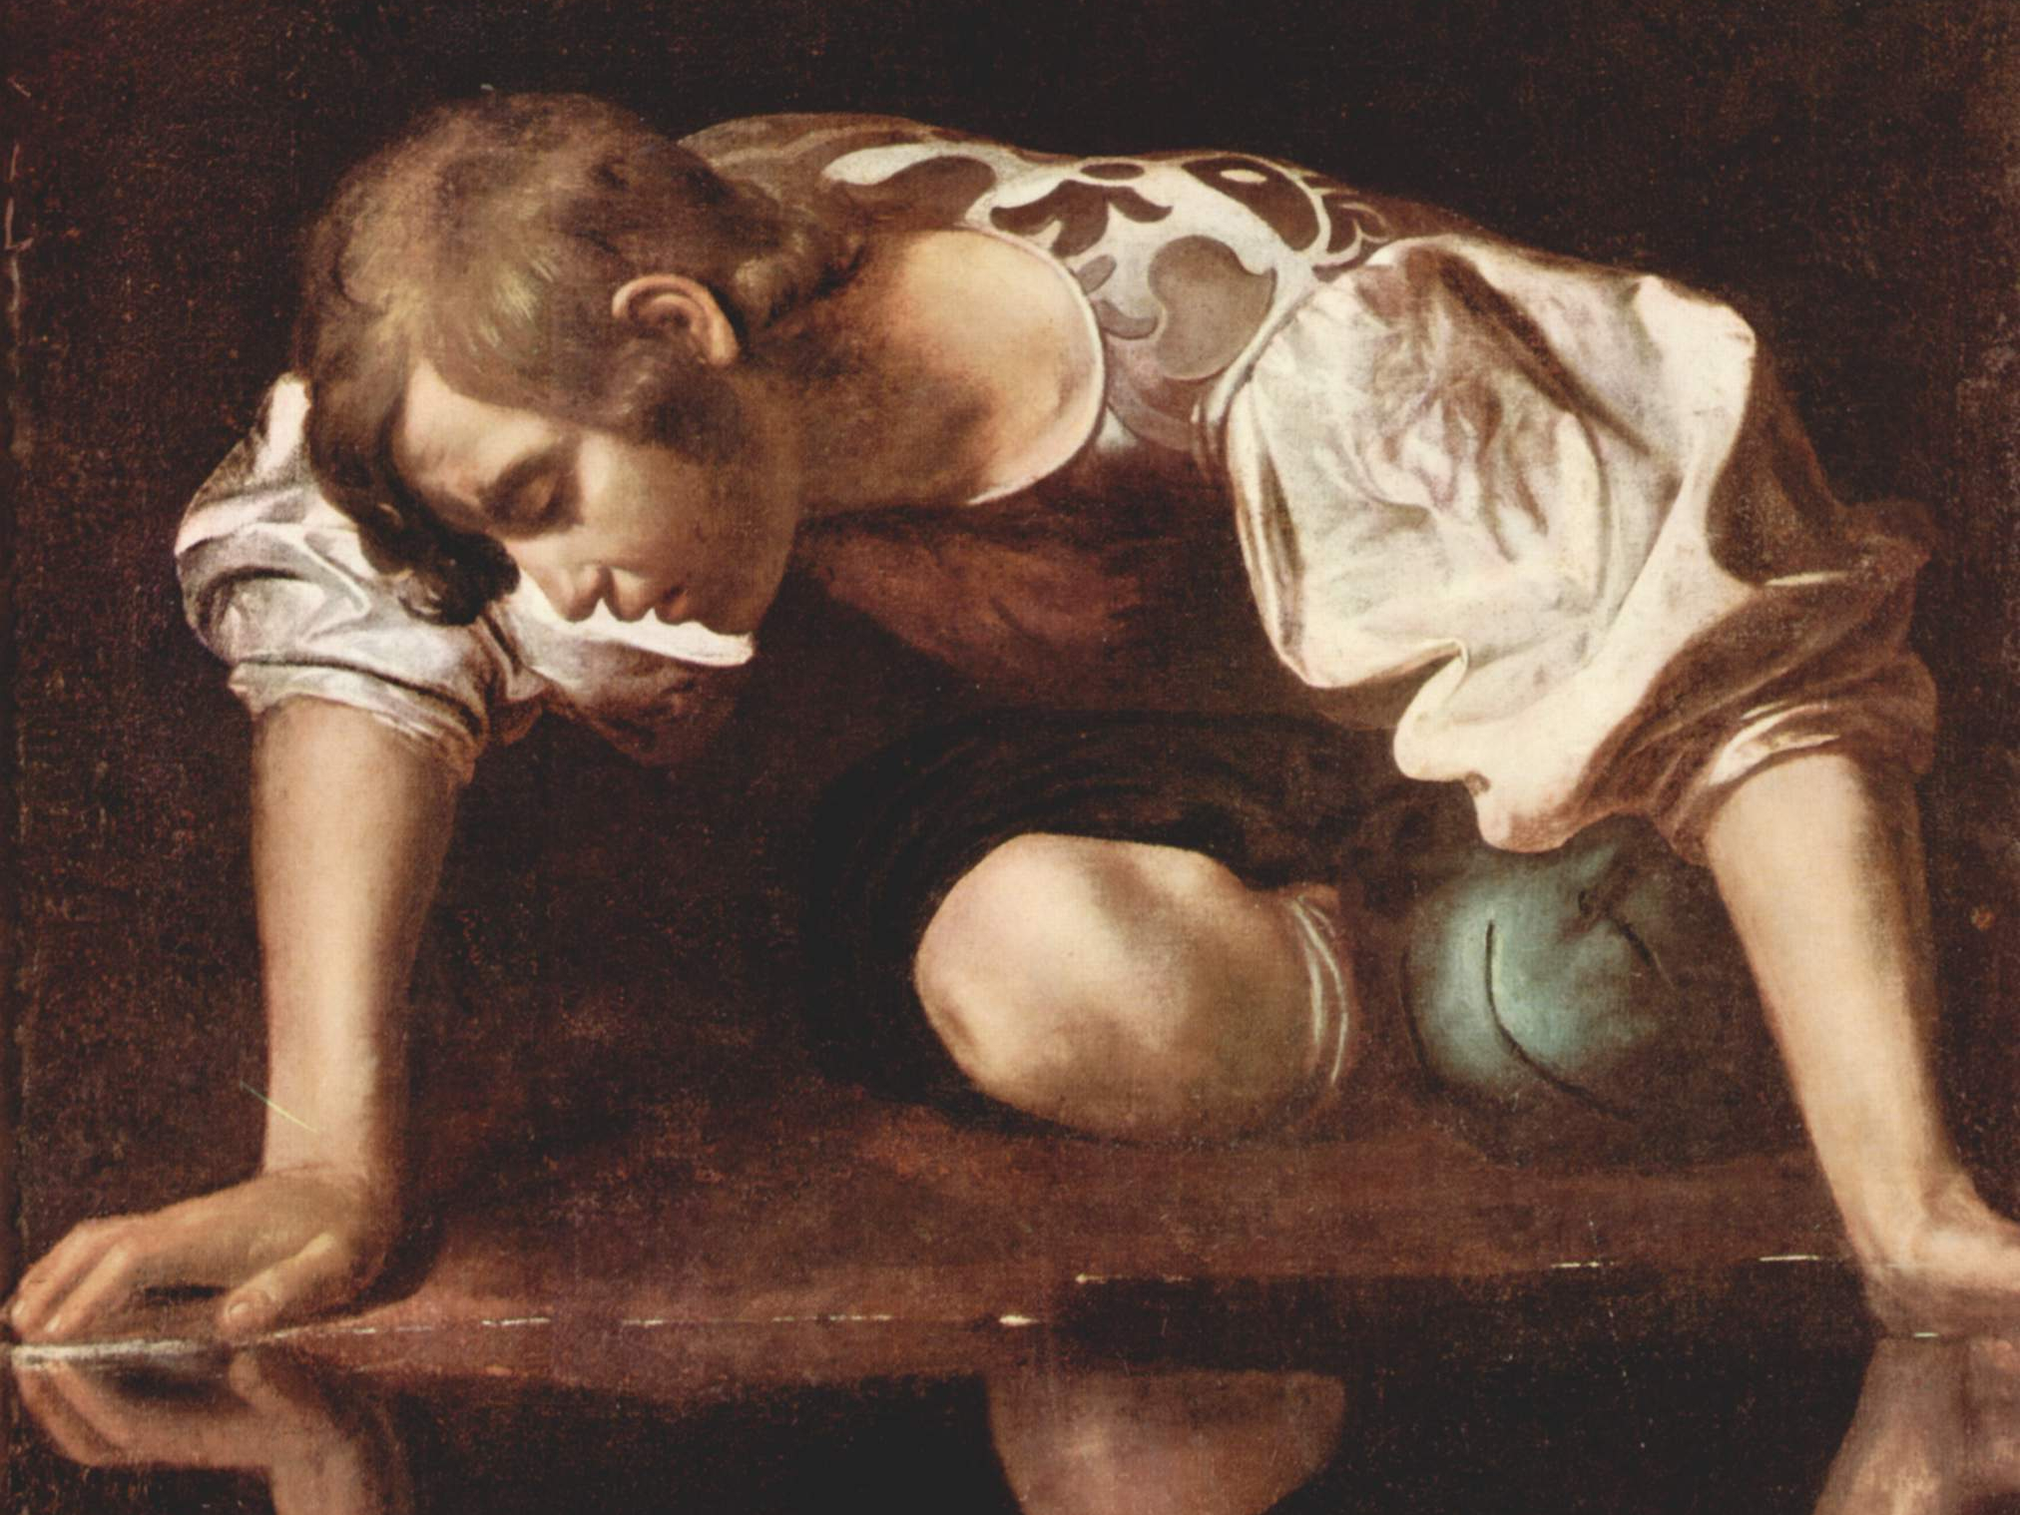
Narcissus
Notes:
Myth of Narcissus
Narcissus was a hunter in Greek mythology, son of the river god Cephissus and the nymph Liriope. He was a very beautiful young man, and many fell in love with him, but he only showed them disdain and contempt.
When he was born, there was a prophecy that he would live a long and glorious life so long as he never saw his reflection.
One day, while he was hunting in the woods, a nymph (Echo spotted him and immediately fell for him, but Narcissus pushed her off and told her not to disturb him. Echo, in despair, roamed around the woods for the rest of her life, and wilted away until all it remained of her was an echo sound.
Nemesis, the goddess of retribution and revenge, learned what had happened and decided to punish Narcissus for his behaviour. She led him to a pool; there, the man saw his reflection in the water and fell in love with it. Although he did not realise in the beginning that it was just a reflection, when he understood it, he fell in despair that his love could not materialise and committed suicide.
Nacrissus is a picture of an inward-turned soul. Every culture knows that when we turn in to ourselves, the result is death.
Romans 8:6 For the mind set on the flesh is death, but the mind set on the Spirit is life and peace, 7 because the mind set on the flesh is hostile toward God; for it does not subject itself to the law of God, for it is not even able to do so, 8 and those who are in the flesh cannot please God.
So we see from Martha:
1. when we turn our minds outward, we’re (περισπάω (perispáō)) pulled apart and distracted from the source of life when it’s around us.
2. And when we turn our gaze inward, we die as well
So now we turn to Mary

Slide 9
Mary
Beholding: Sitting at the Lord’s Feet
Being Transformed: Listening to His Word
A > B > C
D > E
Notes:
And so we come to Mary
What was Mary doing?
CLICK
Sitting at the Lord’s feet .
Look at her gaze – where is it? Where is her attention?
CLICK
Listening to His word
What is she putting in her mind?
Mary was revolving her world around the center of the Universe – who was right there in her living room.
She saw the source of life and strength and like Billy Crockett was sinking her fee deep into the bottom of life
CLICK
ABCDE - She was Replacing the Lies with Truth so she can respond from the basis of truth and live rightly
Growing like the tree in Jeremiah 17
Jeremiah 17:
7 “Blessed is the man who trusts in the LORD
And whose trust is the LORD.
8 “For he will be like a tree planted by the water,
That extends its roots by a stream
And will not fear when the heat comes;
But its leaves will be green,
And it will not be anxious in a year of drought
Nor cease to yield fruit.
Drinking from the Spring that Jesus describes to the woman at the well
John 4 – the woman at the well
13 Jesus answered and said to her, “Everyone who drinks of this water will thirst again; 14 but whoever drinks of the water that I will give him shall never thirst; but the water that I will give him will become in him a well of water springing up to eternal life.”

Slide 10
What about Martha?
Good and Bad
Better and Best
What’s the Best thing Martha could have been doing at that time?
Vs 41 “Martha, Martha, you are worried and bothered about so many things; 42 but only one thing is necessary, for Mary has chosen the good part, which shall not be taken away from her.”
Notes:
CICK
We tend to think of life in terms of Good/Bad decisions – so we’re puzzled when it comes to Mary/Martha
Wait a minute, someone needs to set the table, cook the food, serve the guest… That’s good right?
CLICK
But maybe our natural framework is wrong here. Maybe we need to be thinking about Better vs Best
CLICK
So What should Martha have been doing?
She should have been making the most of her time doing what is best while the King of the Universe was in her home.
Maybe she should ask Jesus what he wanted before she started preparing?
Preparing food, doing it with joy, knowing who she was serving
5 min quick snack, wash the dishes later
If Jesus wanted an elaborate meal that took hours, that’s what she should have done.
BUT whatever it was, we know that Jesus wants what’s best for Mary and Martha – and he takes into account how he made them and what activities give them life.
“Martha, Martha, you are worried and bothered about so many things; 42 but only one thing is necessary, for Mary has chosen the good part, which shall not be taken away from her.”
So we know:
1. God wants to be with us
2. God doesn’t withhold good things when we chose them.
So what is the one thing needed?

Slide 11
The One Thing Needed?
We Need our Minds Transformed.
Romans 12:1Therefore I urge you, brethren, by the mercies of God, to present your bodies a living and holy sacrifice, acceptable to God, which is your spiritual service of worship. 2 And do not be conformed to this world, but be transformed by the renewing of your mind, so that you may prove what the will of God is, that which is good and acceptable and perfect.
We become what we behold.
2 Corinthians 3:18 But we all, with unveiled face, beholding as in a mirror the glory of the Lord, are being transformed into the same image from glory to glory, just as from the Lord, the Spirit.
Notes:
So what is the one thing?
If there’s garbage surrounding us, distracting us from every direction, what do we expect our lives to look lie?
Garbage in – Garbage… ?
We Need our Minds Transformed – Mary shows this, - hearing from the Master, the right way to look at the world.
Romans 12:1Therefore I urge you, brethren, by the mercies of God, to present your bodies a living and holy sacrifice, acceptable to God, which is your spiritual service of worship. 2 And do not be conformed to this world, but be transformed by the renewing of your mind, so that you may prove what the will of God is, that which is good and acceptable and perfect.
We become what we behold.
MARY Shows this – she had her gaze on Jesus, sitting at his feet.
2 Corinthians 3:18 But we all, with unveiled face, beholding as in a mirror the glory of the Lord, are being transformed into the same image from glory to glory, just as from the Lord, the Spirit.
Col 3: Set your mind on the things above, not on the things that are on earth. 3 For you have died and your life is hidden with Christ in God. 4 When Christ, who is our life, is revealed, then you also will be revealed with Him in glory.
John 15: 4 Abide in Me, and I in you. As the branch cannot bear fruit of itself unless it abides in the vine, so neither can you unless you abide in Me. 5 I am the vine, you are the branches; he who abides in Me and I in him, he bears much fruit, for apart from Me you can do nothing.

Slide 12
Behold and Be Transformed
Notes:
John 15: 4 Abide in Me, and I in you. As the branch cannot bear fruit of itself unless it abides in the vine, so neither can you unless you abide in Me. 5 I am the vine, you are the branches; he who abides in Me and I in him, he bears much fruit, for apart from Me you can do nothing.
So the one thing needed, is an abiding relationship with Jesus, which we get by beholding and being transformed
Call up Panel
- Now is the time to take notes
QT Questions:
What are the ways that you find helpful to be refreshed in the Lord or grow your relationship with Him? (not limited to just a quiet time)
How has this changed over the seasons in your life? (especially discuss single life and season with young children)
What does your quiet time look like now, and how has it changed over the years (if you haven’t shared this in a previous answer)?
Do you (and those around you) notice a difference when you’re having a consistent time with the Lord vs being sporadic or neglectful?
If someone wanted to start having a quiet time for the first time, what would you say would be the core parts of a healthy quiet time? And do you have any suggestions on how to make it easier or more fruitful?
Are there any other words of wisdom you’d like to share?

Slide 13
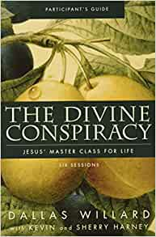
Notes:
Oswald Chambers
Jonathan Edwards
John Owen
CS Lewis
Kierkigard
Thomas Aquianas

