Slide 1
Caught (With a Smelly House)!
2 Samuel 12/Psalm 51

Slide 2
Rules for Addressing a Smelly House
Who do you call?
What do you say?
What’s the secret sauce?

Slide 3
Psalm 32:3-4
When I kept silent, my bones wasted away through my groaning all day long. For day and night your hand was heavy upon me; my strength was sapped as in the heat of summer.

Slide 4
Nathan’s Story
The Lord sent Nathan to David. When he came to him, he said, “There were two men in a certain town, one rich and the other poor. The rich man had a very large number of sheep and cattle, but the poor man had nothing except one little ewe lamb he had bought. He raised it, and it grew up with him and his children. It shared his food, drank from his cup and even slept in his arms. It was like a daughter to him.
Now a traveler came to the rich man, but the rich man refrained from taking one of his own sheep or cattle to prepare a meal for the traveler who had come to him. Instead, he took the ewe lamb that belonged to the poor man and prepared it for the one who had come to him.”
- 2 Samuel 12:1-4

Slide 5
What do the actions of the rich man reveal about
his character? How would you react to someone like this?

Slide 7
God’s Strategy
He spoke David’s language by using a shepherd scenario.
He chose an example that was sure to arouse David’s “righteous indignation”.
He caused David to pass judgment before receiving his own judgment.

Slide 8
2 Samuel 12:7-10
Then Nathan said to David, “You are the man! This is what the Lord, the God of Israel, says: ‘I anointed you king over Israel, and I delivered you from the hand of Saul. I gave your master’s house to you, and your master’s wives into your arms. I gave you all Israel and Judah. And if all this had been too little, I would have given you even more. Why did you despise the word of the Lord by doing what is evil in his eyes? You struck down Uriah the Hittite with the sword and took his wife to be your own. You killed him with the sword of the Ammonites. Now, therefore, the sword will never depart from your house, because you despised me and took the wife of Uriah the Hittite to be your own.’

Slide 9
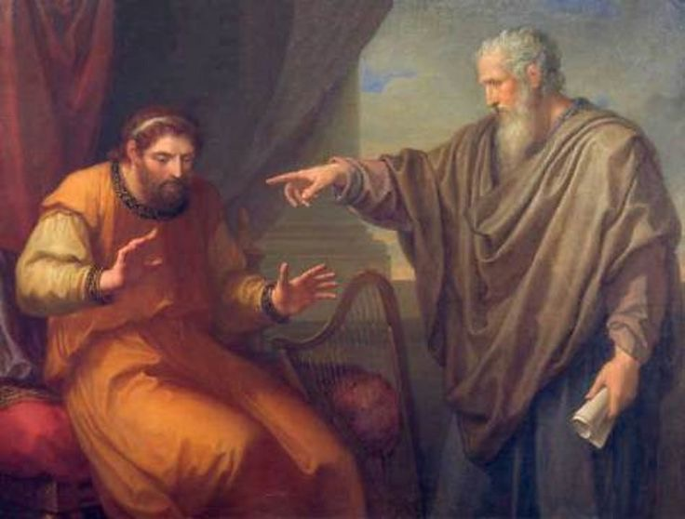
“You are the man!”
2 Samuel 12:7

Slide 10
I John 1:8
We ALL are the man!
If we say we have no sin, we deceive ourselves and the truth is not in us.

Slide 11
2 Samuel 12:11-12
“This is what the Lord says: ‘Out of your own household I am going to bring calamity on you. Before your very eyes I will take your wives and give them to one who is close to you, and he will sleep with your wives in broad daylight. You did it in secret, but I will do this thing in broad daylight before all Israel.”

Slide 12
2 Samuel 12:13a
Then David said to Nathan, “I have sinned against the Lord.”

Slide 13
2 Samuel 12:13b
Nathan replied, “The Lord has taken away your sin. You are not going to die.”

Slide 14
2 Samuel 12:14
“But because by doing this you have made the enemies of the Lord show utter contempt, the son born to you will die.”

Slide 15
Try to recall a time when you needed to confront or be confronted. How did it feel? How did you or the other person respond?

Slide 16
Forgiveness, But Still Consequences
The sword will never leave your house.
Your wife will be given to another and everyone will know.
The child born out of this adulterous tryst with Bathseba will die.

Slide 17
Psalm 51:1-2
Have mercy on me, O God, according to your unfailing love; according to your great compassion blot out my transgressions.
Wash away all my iniquity and cleanse me from my sin.

Slide 18
I Have Sinned…!
<a href='https://www.freepik.com/photos/love'>Love photo created by jcomp - www.freepik.com</a>

Slide 19
Psalm 51:3-6
For I know my transgressions, and my sin is always before me.
Against you, you only, have I sinned and done what is evil in your sight; so you are proved right when you speak and justified when you judge.
Surely I was sinful at birth, sinful from the time my mother conceived me.
Surely you desire truth in the inner parts; you teach me wisdom in the inmost place.

Slide 20
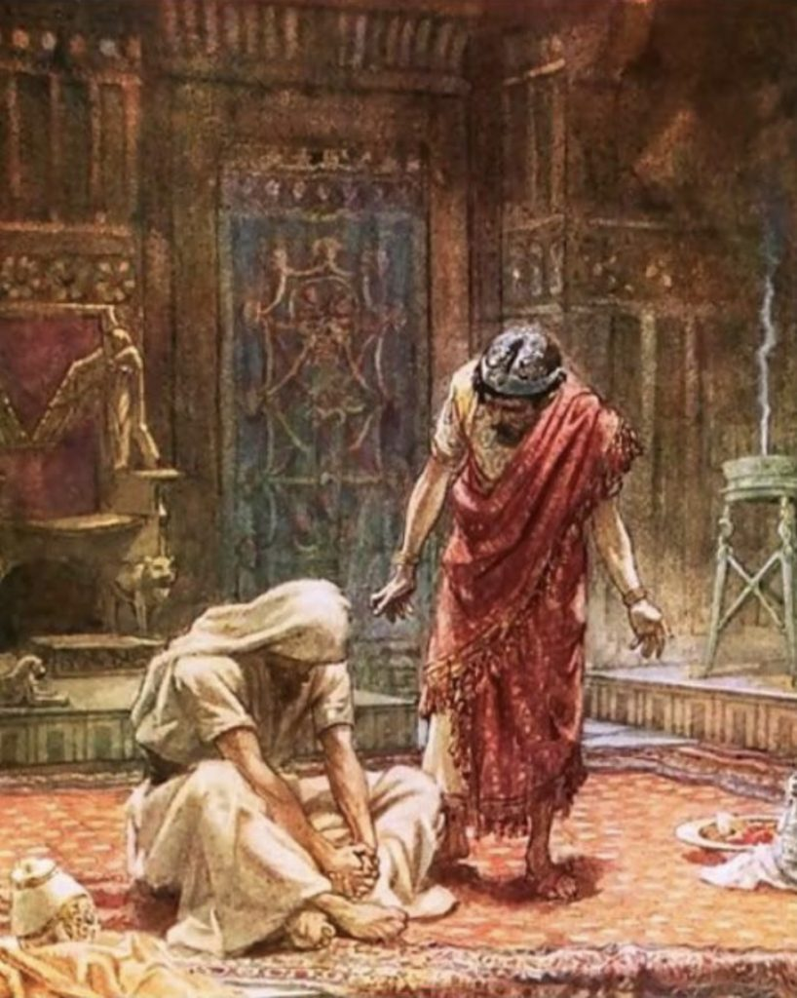
Against YOU!

Slide 21
Psalm 51:7-9
Cleanse me with hyssop, and I will be clean; wash me, and I will be whiter than snow.
Let me hear joy and gladness; let the bones you have crushed rejoice.
Hide your face from my sins and blot out all my iniquity.
Photo by Jan Dommerholt on Unsplash

Slide 22
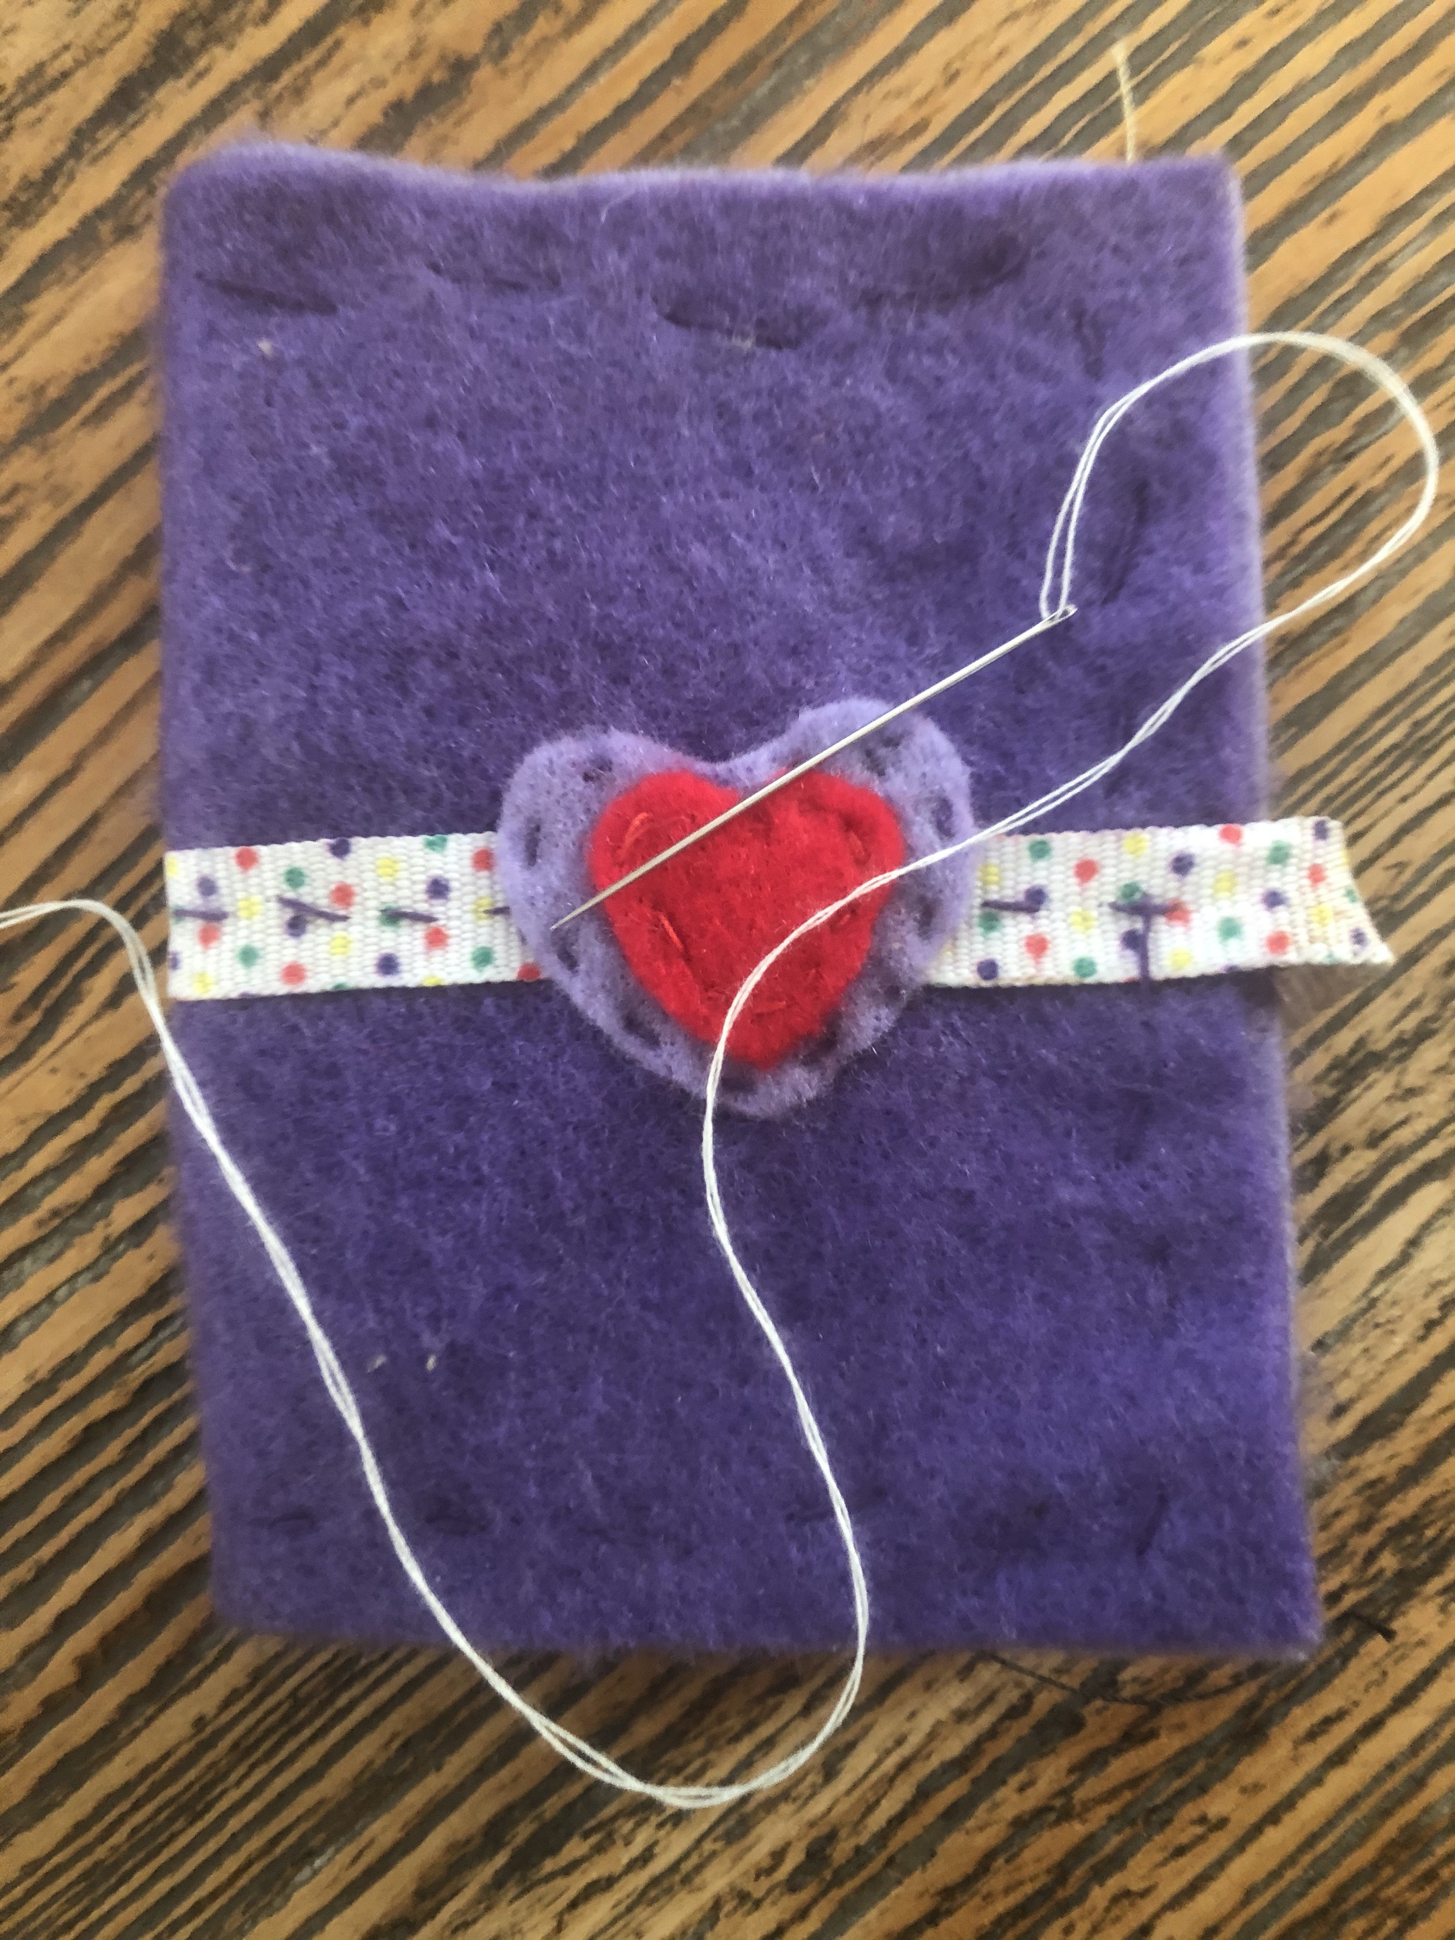
Only YOU Can Restore Me!

Slide 23
Psalm 51:10-12
Create in me a pure heart, O God, and renew a steadfast spirit within me.
Do not cast me from your presence or take your Holy Spirit from me.
Restore to me the joy of your salvation and grant me a willing spirit, to sustain me.

Slide 24
Please Don’t Leave Me!
Photo by iccup on Unsplash

Slide 25
Psalm 51:13-17
Then I will teach transgressors your ways, so that sinners will turn back to you.
Deliver me from the guilt of bloodguilt, O God, the God who saves me, and my tongue will sing of your righteousness.
O Lord, open my lips, and my mouth will declare your praise.
You do not delight in sacrifice, or I would bring it; you do not take pleasure in burnt offerings.
My sacrifices of God, are a broken spirit; a broken and contrite heart, O God, you will not despise.

Slide 26
I Give You My Brokenness!
Photo by CHUTTERSNAP on Unsplash

Slide 27
Psalm 51:17-19
In your good pleasure, make Zion prosper; build up the walls of Jerusalem.
Then you there will be righteous sacrifices, whole burnt offerings to delight you; then bulls will be offered on your altar.

Slide 28
Then Our Sacrifices Will be for Your Glory Alone!
Photo by Michael und Maartje on Unsplash

Slide 29
Rules for Addressing a Smelly House
Who do you call? Call on the only one who can restore us - Jesus.
What do you say? Say “I have sinned.”
What’s the secret sauce? Jesus’ blood, shed for us on the cross, has gone before us to redeem our brokenness and make us new. Ask Him to grant you a willing spirit.
Secret Sauce Ingredients - The first moment you become aware of a bad smell apply the following: Repentance + Jesus’ work on the cross + a willing spirit=Restoration

Slide 30
Get Caught by God!
You will never be the same.

Slide 31
“The Lord has taken away your sin. You are not going to die.”
–2 Samuel 12:13b
Photo by Jason Blackeye on Unsplash

