Slide 1
SERMON:
NECODEMUS ENCOUNTERS JESUS

Slide 2
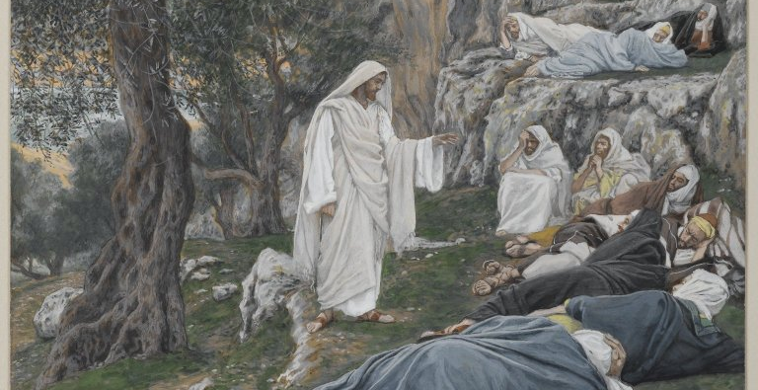
Encounters with Jesus
Mark 6:31 – Jesus commands the apostles to rest
Sermon Series Introduction 2022

Slide 3
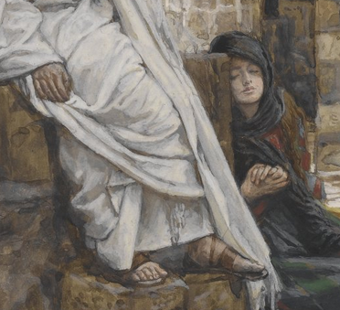
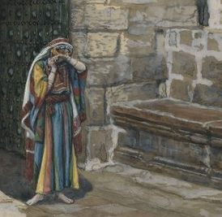
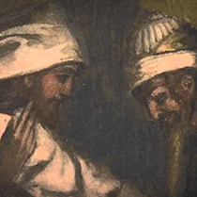
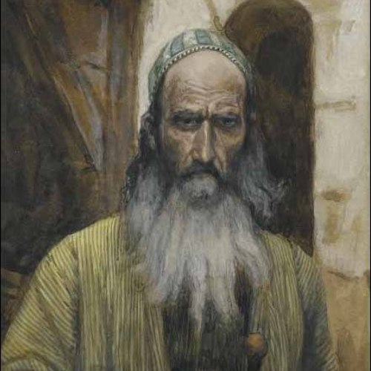
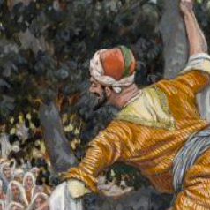
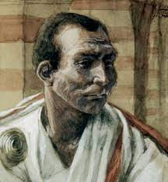
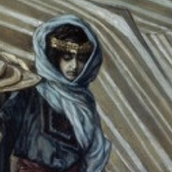
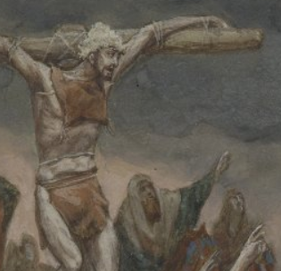
STORIES
Qs
 | Mary and Martha Luke 10 |  | Adulterous woman John 8
 | Nicodemus John 3 |  | Saul Acts 9
 | Zacchaeus Luke 19 |  | Pontius Pilate John 18-19, Matt 27
 | Woman at the well John 4 |  | Dying thief Luke 23:39ff
Who?
What?
Why?
Where?
When?
How?

Slide 4
NICODEMUS ENCOUNTERS JESUS
OUTLINE
Introduction
Stories
Who, What, Why, Where, When, How
The Essence of an Encounter
KNOWS
ACCEPTS
REVEALS
PLAN
How do we respond?

Slide 5
MAIN TEXT: JOHN 3:1-21
OBSERVATIONS
A Pharisee(Nicodemus) came to Jesus by night)
He affirms Jesus identity as teacher from God on basis of signs
But that falls short of the whole truth
Jesus’ response steers discussion into deeper realms
Jesus corrects through misunderstanding
New understanding reveals Jesus more fully
And invitation is made to Nicodemus
Jesus use the occasion to talk about the Love of God to the world
I-INTRODUCTION

Slide 6
II-EXPOSITION AND EXULTATION
NICODEMUS’ ENCOUNTER WITH JESUS
John 3,ESV
3 Now there was a man of the Pharisees named Nicodemus, a ruler of the Jews. ² This man came to Jesus^{[a]} by night and said to him, “Rabbi, we know that you are a teacher come from God, for no one can do these signs that you do unless God is with him.”
Jesus is receptive to all irrespective of how we come to him.
He is the light that gives hope to every darkness(cf. Jn 8:12;9:4;11:10)
We all have our perspective of Jesus until we encounter him (cf. John 20:28-31)
But that falls short of the whole truth (Matt 16:13-20)
Man is in need of truth of Jesus but How is this need met?

Slide 7
II-EXPOSITION AND EXULATION
WHY OUR NEED FOR CHRIST ?
John 3,ESV
³ Jesus answered him, “Truly, truly, I say to you, unless one is born again^{[b]} he cannot see the kingdom of God.” ⁴ Nicodemus said to him, “How can a man be born when he is old? Can he enter a second time into his mother's womb and be born?” ⁵ Jesus answered, “Truly, truly, I say to you, unless one is born of water and the Spirit, he cannot enter the kingdom of God. ⁶ That which is born of the flesh is flesh, and that which is born of the Spirit is spirit.^{[c]}
True awareness, appreciation and access to God’s kingdom begins with our New Birth—Spiritual birth
(cf. Isa 32:15;44:3;Ezek.36:25-27)
Cf. Gen 1:26-27; 2:7; 1 Thess 5:23; 1 Pet 1:3,23

Slide 8
II-EXPOSITION AND EXULATION
HOW GOD ANSWERS OUR NEED FOR CHRIST
John 3,ESV
⁹ Nicodemus said to him, “How can these things be?” ¹⁰ Jesus answered him, “Are you the teacher of Israel and yet you do not understand these things? ¹¹ Truly, truly, I say to you, we speak of what we know, and bear witness to what we have seen, but you^{[f]} do not receive our testimony. ¹² If I have told you earthly things and you do not believe, how can you believe if I tell you heavenly things? ¹³ No one has ascended into heaven except he who descended from heaven, the Son of Man.^{[g]} ¹⁴ And as Moses lifted up the serpent in the wilderness, so must the Son of Man be lifted up, ¹⁵ that whoever believes in him may have eternal life.^{[h] 7} Do not marvel that I said to you, ‘You^{[d]} must be born again.’ ⁸ The wind^{[e]} blows where it wishes, and you hear its sound, but you do not know where it comes from or where it goes. So it is with everyone who is born of the Spirit.”

Slide 9
II-EXPOSITION AND EXULTATION
HOW GOD ANSWERS OUR NEED FOR CHRIST
As the Israelites looked to the bronze serpent for healing so our healing from spiritual death when we looked to the cross
cf. Num 21:4-11; 1 Peter 2:24; Gal 3:11-14
The natural man cannot understand the new birth. We have to first accepts God’s condition for New Birth 1 Cor 2:14-16
God answers by our faith in Jesus Christ as God’s provision for judgment of our sins for our forgiveness, Justification and our sanctification
God grants us eternal life when we accept His LOVE demonstrated as free Gift of Jesus into our hearts by faith (cf. John 3:16-21;Rom 10:9-10)

Slide 10
III-THE ENSENSE OF THE ENCOUNTER
The encounter opens Nicodemus to the true identity of Jesus
His misunderstanding of the scriptures was corrected
The New Understanding reveals Jesus more fully
And invitation was made to Nicodemus with the gospel
Jesus use the occasion to talk about the Father’s Love to the world
and invites all to free Gift of salvation
Nicodemus becomes a partaker of Jesus’s burial
(John 7:50-52; 19:38-40)

Slide 11
IV-OUR RESPONSE
Like Nicodemus we must seek and open our heart to the truth
We must acknowledge the Spiritual essence of our born again identity
We must be willing to believe God for who HE is and what HE says (Heb 12:6)
We must accept the love of God demonstrated to world through Jesus for eternal life.
We should not forget there is also condemnation to all who reject this free gift of God’s mercy, grace and love.

Slide 12
HOW WILL YOU RESPOND TO JESUS TODAY?

