Slide 1
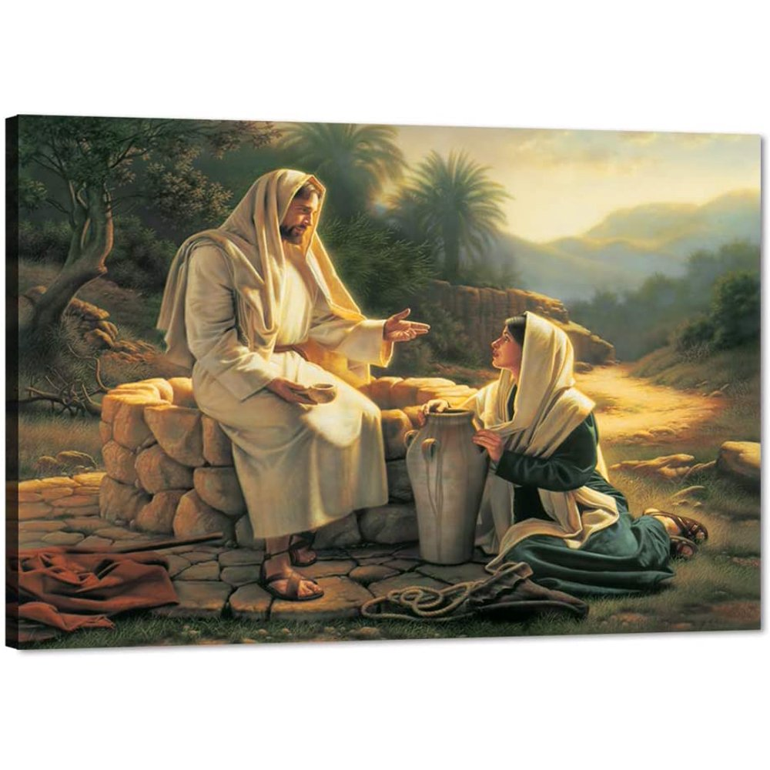
Encounters with Jesus: The woman at the well.
Bro Perry

Slide 2
God’s plan and purpose.
God
Angels
Satan
Demons
Human beings
Jesus
The bible provides the accounts of many encounters. In fact the bible can be called the book of encounters.
These encounters reveal the sovereignty and divine council of God in establishing His will for His creation.

Slide 3
Our encounter with Jesus should be seen beyond an event and birth a consistent process of transformation as we behold the person of Christ and the power of the Holy Spirit by receiving the engrafted word of God.
There is eternal life in Christ.
And this is the testimony, that God gave us eternal life, and this life is in his Son. Whoever has the Son has life; whoever does not have the Son of God does not have life. 1 John 5:11-12
There is truth and grace in Christ.
For the law was given through Moses; grace and truth came through Jesus Christ. John 1:17
There is freedom in Christ.
So if the Son sets you free, you will be free indeed. John 8:36

Slide 4
Jesus said to her, “Everyone who drinks of this water will be thirsty again, but whoever drinks of the water that I will give him will never be thirsty again. The water that I will give him will become in him a spring of water welling up to eternal life.” John 4:13-14
The woman at the well. An encounter that reveals that Jesus Christ is the only true satisfaction we can ever have.

Slide 5
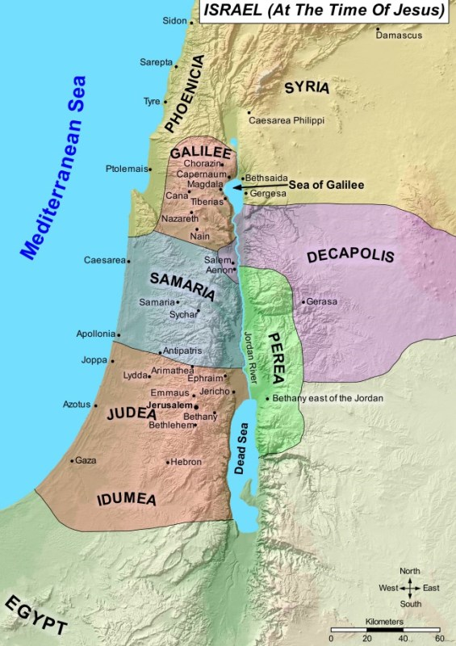
1. Geographic barrier 2. Ethnic barrier – Ezra 4 3. Religious barrier – 1 Kings 12 4. Gender barrier 5. Social barrier
The encounter of Jesus with the woman at the well was far from chance. It was a divinely orchestrated meeting that would change an outcast into a beacon of hope for her community!!

Slide 6
1. Now when Jesus learned that the Pharisees had heard that Jesus was making and baptizing more disciples than John 2. (although Jesus himself did not baptize, but only his disciples), 3. he left Judea and departed again for Galilee. 4. And he had to pass through Samaria. 5. So he came to a town of Samaria called Sychar, near the field that Jacob had given to his son Joseph. 6. Jacob's well was there; so Jesus, wearied as he was from his journey, was sitting beside the well. It was about the sixth hour.
Beyond the challenge of a detour, Jesus understood the need to pass through Samaria. Obedience is critical.
For the Samaritan woman to visit the well about 12 noon in the heat of the day, it means she intentionally wanted to avoid being condemned and looked down by people.

Slide 7
7. A woman from Samaria came to draw water. Jesus said to her, “Give me a drink.” 8. (For his disciples had gone away into the city to buy food.) 9. The Samaritan woman said to him, “How is it that you, a Jew, ask for a drink from me, a woman of Samaria?” (For Jews have no dealings with Samaritans.) 10. Jesus answered her, “If you knew the gift of God, and who it is that is saying to you, ‘Give me a drink,’ you would have asked him, and he would have given you living water.” 11. The woman said to him, “Sir, you have nothing to draw water with, and the well is deep. Where do you get that living water? 12. Are you greater than our father Jacob? He gave us the well and drank from it himself, as did his sons and his livestock.” 13. Jesus said to her, “Everyone who drinks of this water will be thirsty again, 14 but whoever drinks of the water that I will give him will never be thirsty again. The water that I will give him will become in him a spring of water welling up to eternal life.” 15. The woman said to him, “Sir, give me this water, so that I will not be thirsty or have to come here to draw water.”
Jesus knew the woman was empty, heavy laden and needed eternal life.
Matthew 11:28, Jeremiah 2:13.
Jesus presented to her the remedy; Eternal life, Fountain of life.
John 10:10, Jeremiah 17:13.

Slide 8
16. Jesus said to her, “Go, call your husband, and come here.” 17. The woman answered him, “I have no husband.” Jesus said to her, “You are right in saying, ‘I have no husband’; 18. for you have had five husbands, and the one you now have is not your husband. What you have said is true.” 19. The woman said to him, “Sir, I perceive that you are a prophet. 20. Our fathers worshiped on this mountain, but you say that in Jerusalem is the place where people ought to worship.” 21. Jesus said to her, “Woman, believe me, the hour is coming when neither on this mountain nor in Jerusalem will you worship the Father. 22. You worship what you do not know; we worship what we know, for salvation is from the Jews. 23. But the hour is coming, and is now here, when the true worshipers will worship the Father in spirit and truth, for the Father is seeking such people to worship him. 24. God is spirit, and those who worship him must worship in spirit and truth.” 25. The woman said to him, “I know that Messiah is coming (he who is called Christ). When he comes, he will tell us all things.” 26. Jesus said to her, “I who speak to you am he.”
She believed when Jesus told her about her life and revealed himself.
Luke 7:39, Deuteronomy 18:18
Worship in truth & in spirit is worship via Christ not bound to a place.
Romans 8:15, Psalm 86:9.

Slide 9
27. Just then his disciples came back. They marveled that he was talking with a woman, but no one said, “What do you seek?” or, “Why are you talking with her?” 28. So the woman left her water jar and went away into town and said to the people, 29. “Come, see a man who told me all that I ever did. Can this be the Christ?” 30. They went out of the town and were coming to him.
It is beautiful to see how she immediately thought about others when she realized she had encountered the Messiah.
Even more beautiful was how the people believed her when she told them and came out of the town to meet Christ.

Slide 10
31. Meanwhile the disciples were urging him, saying, “Rabbi, eat.” 32. But he said to them, “I have food to eat that you do not know about.” 33. So the disciples said to one another, “Has anyone brought him something to eat?” 34. Jesus said to them, “My food is to do the will of him who sent me and to accomplish his work. 35. Do you not say, ‘There are yet four months, then comes the harvest’? Look, I tell you, lift up your eyes, and see that the fields are white for harvest. 36. Already the one who reaps is receiving wages and gathering fruit for eternal life, so that sower and reaper may rejoice together. 37. For here the saying holds true, ‘One sows and another reaps.’ 38. I sent you to reap that for which you did not labor. Others have labored, and you have entered into their labor.”
Jesus emphasized that the reason for His coming was to save the lost.
Luke 19:10.
He further reminded the disciples that the harvest is ready!!
Matthew 9:37.

Slide 11
39. Many Samaritans from that town believed in him because of the woman's testimony, “He told me all that I ever did.” 40. So when the Samaritans came to him, they asked him to stay with them, and he stayed there two days. 41. And many more believed because of his word. 42. They said to the woman, “It is no longer because of what you said that we believe, for we have heard for ourselves, and we know that this is indeed the Savior of the world.”
Our testimonies have the power to draw many unto Christ.
Luke 8:39, Revelations 12:11.
Discipleship and teaching of the word is very important.
Matthew 28:19, 1Peter 2:2.

Slide 12
Key pointers!!!
It was ordained for Jesus to meet the woman at the well.
Jesus did not condemn her.
Jesus knew and understood her situation.
Jesus was willing to quench her thirst and satisfy her with the fountain of life that never runs dry.
At the apex of her encounter she overflows with life and joy and proclaims Christ to the whole community.

Slide 13
Introspective questions!!
What is the reality of your life?
Have you spoken to Christ about it?
Are you willing to let go and receive of Christ?
How is your walk with the Lord?
Are you sharing the goodness of Christ with others?

Slide 14
God bless you!!
Let us pray!!

