Slide 1
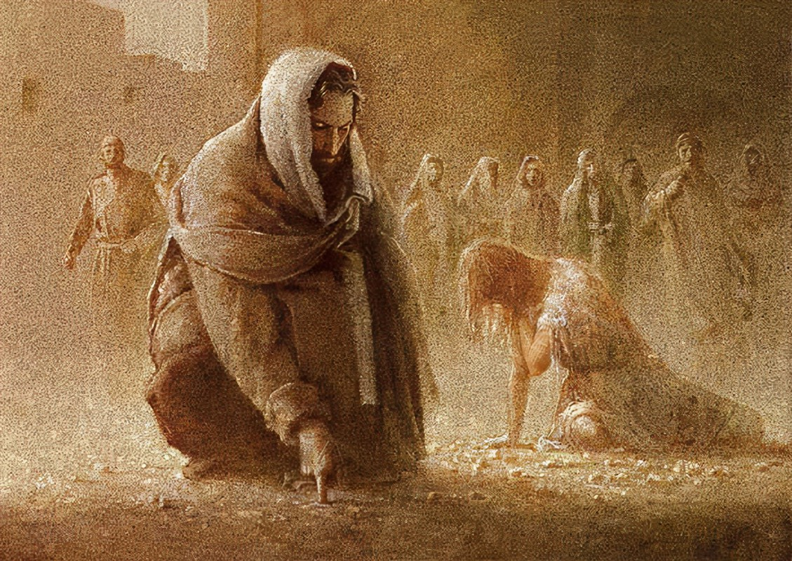
Encounters with Jesus: The woman caught in adultery.
Bro Perry

Slide 2
Our encounter with Jesus should be seen beyond an event and birth a consistent process of transformation as we behold the person of Christ and the power of the Holy Spirit by receiving the engrafted word of God.
There is eternal life in Christ.
And this is the testimony, that God gave us eternal life, and this life is in his Son. Whoever has the Son has life; whoever does not have the Son of God does not have life. 1 John 5:11-12
There is truth and grace in Christ.
For the law was given through Moses; grace and truth came through Jesus Christ. John 1:17
There is freedom in Christ.
So if the Son sets you free, you will be free indeed. John 8:36

Slide 3
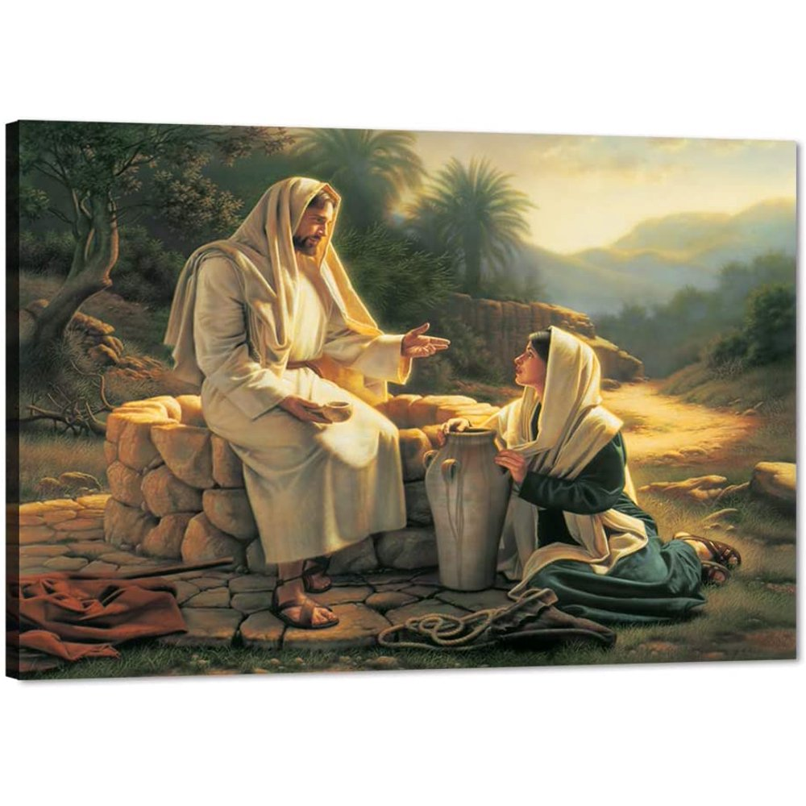
Jesus said to her, “Everyone who drinks of this water will be thirsty again, but whoever drinks of the water that I will give him will never be thirsty again. The water that I will give him will become in him a spring of water welling up to eternal life.” John 4:13-14
The woman at the well. An encounter that reveals that Jesus Christ is the only true satisfaction we can ever have.

Slide 4
Jesus stood up and said to her, “Woman, where are they? Has no one condemned you?” She said, “No one, Lord.” And Jesus said, “Neither do I condemn you; go, and from now on sin no more.” John 8:10-11
The encounter of the woman caught in adultery with Jesus is the revelation of how love and righteousness overcomes hypocrisy and condemnation.

Slide 5
1. She was guilty. 2. She was disgraced. 3. The societal set up was against her. 4. Knowing the strict standards of the scribes and Pharisees she had no hope of life .
The adulterous woman I believe thought it was all over for her. But as grace would have it she would be given another chance after her encounter with Jesus.

Slide 6
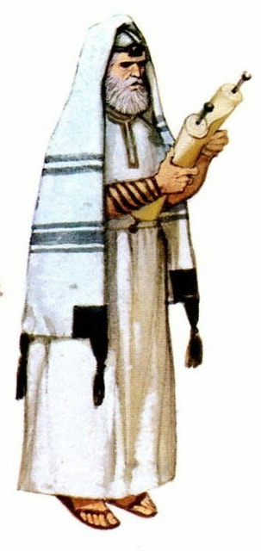
1. They were jealous of Jesus because to them the crowd meant power and control. 2. They were hypocrites. Jesus describes them as whitewashed tombs. Matthew 23:27-28 3. They condemned and were judgmental. Seeking to keep people in bondage and exploit them.
The scribes and Pharisees presented themselves as the keepers of the law of Moses and were against Jesus, as He continuously exposed them for who they really were.

Slide 7
1. But Jesus went to the Mount of Olives. 2. Early in the morning he came again to the temple. All the people came to him, and he sat down and taught them.
It was the custom of Jesus to be in the temple.
Luke 2:49, Luke 4:16.
Jesus drew a crowd everywhere He went and He often taught them.
Luke 21:38.

Slide 8
3. The scribes and the Pharisees brought a woman who had been caught in adultery, and placing her in the midst 4. they said to him, “Teacher, this woman has been caught in the act of adultery.
It was a norm for the scribes and Pharisees to oversee issues like this and they would use this opportunity to reinforce their high sense of moral standards which was usually shrouded in hypocrisy.
Matthew 23:27-28.
Where is the man who was also caught in the act of adultery??

Slide 9
5. Now in the Law, Moses commanded us to stone such women. So what do you say?” 6. This they said to test him, that they might have some charge to bring against him. Jesus bent down and wrote with his finger on the ground.
As hypocritical as they could be, the scribes and Pharisees made a habit of manipulating the laws to suit them.
“If a man commits adultery with the wife of his neighbor, both the adulterer and the adulteress shall surely be put to death”. Lev 20:10
This was a test by the scribes and Pharisees to either get Jesus to affirm their ungodly stance on morality or seemingly to disregard the laws of Moses, but the Lord knew their motives and their deeds.
Matt 16:1, Luke 5:22, Isaiah 11:2

Slide 10
7. And as they continued to ask him, he stood up and said to them, “Let him who is without sin among you be the first to throw a stone at her.” 8. And once more he bent down and wrote on the ground. 9. But when they heard it, they went away one by one, beginning with the older ones, and Jesus was left alone with the woman standing before him.
The statement of Jesus revealed that those who claimed to be the keepers of the Law were breaking this very Law.
22. You who say that one must not commit adultery, do you commit adultery? You who abhor idols, do you rob temples? 23. You who boast in the law dishonor God by breaking the law. Romans 2:22-23
It was not mentioned what Jesus wrote, but it was clear that the Holy Spirit had convicted the accusers to leave in guilt.
John 16:8.

Slide 11
10. Jesus stood up and said to her, “Woman, where are they? Has no one condemned you?” 11. She said, “No one, Lord.” And Jesus said, “Neither do I condemn you; go, and from now on sin no more.”
The only one fit to have condemned her didn’t, but rather decided to show her love at her lowest point.
John 8:15-16.
Rather than condemnation Jesus wanted her liberation, because He knew sin would destroy her.
Afterward Jesus found him in the temple and said to him, “See, you are well! Sin no more, that nothing worse may happen to you.” John 5:14.

Slide 12
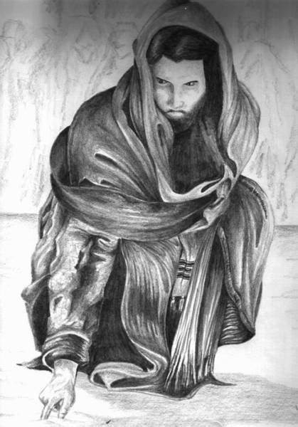
- Jesus did not come to condemn the world!!
For God did not send his Son into the world to condemn the world, but in order that the world might be saved through him. John 3:17
- Jesus came to give life!!
I came that they may have life and have it abundantly. John 10:10
- There is no condemnation for us in Jesus!!
There is therefore now no condemnation for those who are in Christ Jesus. Romans 8:1

Slide 13
Introspective questions!!
How do you see yourself in your own eyes?
Have you ever thought about how God actually sees you?
What is your reaction to people who have fallen?
How do you treat yourself when you fall?
Are you opening yourself to receive the love of God?
Are you reciprocating this love to others?

Slide 14
God bless you!!
Let us pray!!

