Slide 1
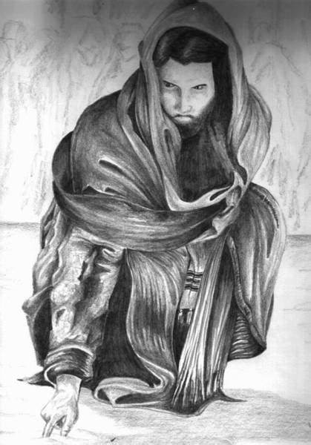
Encounters with Jesus!!
Bro Perry

Slide 2
Our encounter with Jesus should be seen beyond an event and birth a consistent process of transformation as we behold the person of Christ and the power of the Holy Spirit by receiving the engrafted word of God.
There is eternal life in Christ.
And this is the testimony, that God gave us eternal life, and this life is in his Son. Whoever has the Son has life; whoever does not have the Son of God does not have life. 1 John 5:11-12
There is truth and grace in Christ.
For the law was given through Moses; grace and truth came through Jesus Christ. John 1:17
There is freedom in Christ.
So if the Son sets you free, you will be free indeed. John 8:36

Slide 3
And we all, with unveiled face, beholding the glory of the Lord, are being transformed into the same image from one degree of glory to another. For this comes from the Lord who is the Spirit. 2Corinthians 3:18
The life of a believer is a life of beholding our Lord via the word of God.
It is the Spirit who gives life; the flesh is no help at all. The words that I have spoken to you are spirit and life. John 6:63
True transformation only comes by the word of God.
Do not be conformed to this world, but be transformed by the renewal of your mind, that by testing you may discern what is the will of God, what is good and acceptable and perfect. Romans 12:2
The Holy Spirit is the source of this transformation.
For this comes from the Lord who is the Spirit.
2Corinthians 3:18

Slide 4
Discussion questions!!
Which character was your favorite and what do you remember from the sermon on that particular character?
How did these stories of biblical encounters with Jesus relate with you? How do you see yourself in the various characters?
How can we encounter Jesus ourselves in our various lives today?

Slide 5
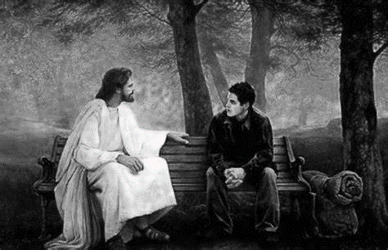
God bless you!!
Let us pray!!

