Slide 1
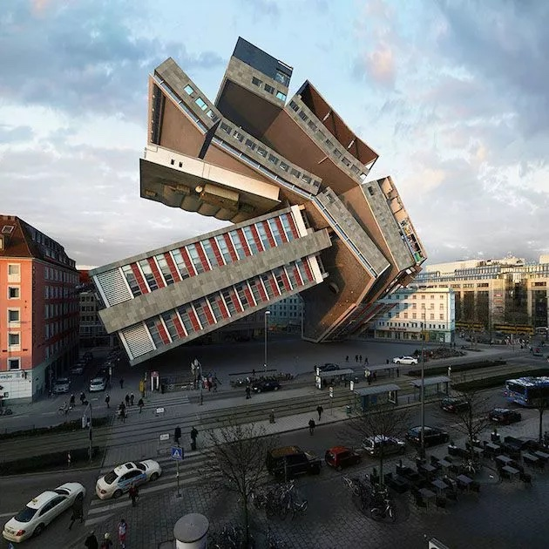
Building Our House
Reflections on Psalm 127
Notes:
This was originally going to be a talk about health and rest, but the more I thought about it – these aren’t isolated topics. See I don’t know about you, but I can’t rest well unless in general, I have alignment in my life – things are coherent – so today we’re going to turn to Psalm 127 as a blueprint for a life of Shalom – peace and meaning
Barcelona-based photographer Víctor Enrich challenged himself to digitally reconfigure the same building in Munich, Germany in 88 different configurations.
I selected this photo because it illustrates one of the main challenges of living as post-moderns.
This is a really cool building to look at – even if it were real.
But is it livable?
What's a building for?

Slide 2
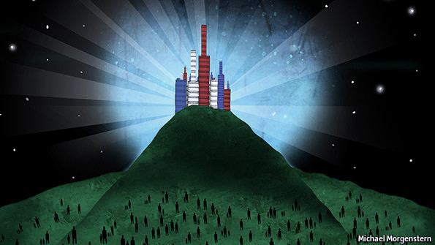
Jesus’s Wisdom on Building a Life
“You are the light of the world. A city set on a hill cannot be hidden” - Jesus (Matt 5:14)
Luke 14:28 For which one of you, when he wants to build a tower, does not first sit down and calculate the cost to see if he has enough to complete it? 29 Otherwise, when he has laid a foundation and is not able to finish, all who observe it begin to ridicule him, 30 saying, ‘This man began to build and was not able to finish.’
“26 Everyone who hears these words of Mine and does not act on them, will be like a foolish man who built his house on the sand. 27 The rain fell, and the floods came, and the winds blew and slammed against that house; and it fell—and great was its fall.” - Jesus (Matthew 8:26-27)
Notes:
1. A Wise Person thinks about it, and understands there are costs – investments, trade-offs:
Luke 14:28 For which one of you, when he wants to build a tower, does not first sit down and calculate the cost to see if he has enough to complete it? 29 Otherwise, when he has laid a foundation and is not able to finish, all who observe it begin to ridicule him, 30 saying, ‘This man began to build and was not able to finish.’
If you only have $500,000 to build your home, you’re not going to spend $300,000 on curtains and custom floors
2. A Wise Person understands hard times will come, and what they have built will be tested. Following Jesus gives us the best foundation in our lives.
“26 Everyone who hears these words of Mine and does not act on them, will be like a foolish man who built his house on the sand. 27 The rain fell, and the floods came, and the winds blew and slammed against that house; and it fell—and great was its fall.” - Jesus (Matthew 8:26-27)
3. A Wise Person, understands we are meant to shine – we are not meant to just survive a storm, but to point others to the source of stability in life.
“You are the light of the world. A city set on a hill cannot be hidden” - Jesus (Matt 5:14)
The reason I start with a few seminal quotes from Jesus is this:
we’re about to read a Psalm, and there are different types of Psalms
Joyful celebration
Lament
Venting
Struggling
Teaching Truth – sections of Psalms
The key to understanding Psalms, is to reference clear pieces of teaching on instruction so we can discern which is which.

Slide 3
Psalm 127:
1 Unless the LORD builds the house,
They labor in vain who build it;
Unless the LORD guards the city,
The watchman keeps awake in vain.
2 It is vain for you to rise up early, to retire late, To eat the bread of painful labors; for He gives to His beloved even in his sleep.
3 Behold, children are a gift of the LORD, The fruit of the womb is a reward.
4 Like arrows in the hand of a warrior, So are the children of one’s youth.
5 How blessed is the man whose quiver is full of them;
They will not be ashamed when they speak with their enemies in the gate.
Notes:
This is one of my favorite Psalms
it shows that a Christian is not building a life alone
it shows how to invest
it goes against a lot of the lies of modern societies
You only live once
Children are a risk, a nusiance, inconvenient
There is a batttle in life
It's better to live by faith
you will meet challenges, better to build your life for it

Slide 4
1. God is Your Builder and Protector
1 Unless the LORD builds the house,
They labor in vain who build it;
Unless the LORD guards the city,
The watchman keeps awake in vain.
Come to Him To Build &
Sustain Your Life
Notes:
We're going to break the Psalm into 3 main parts
First: God is the Builder and Provider
The Sovereignty of God is clear as day here
it’s foolishness to think we can meaningfully build our own lives
It’s foolishness to think we can significantly protect whatever we build.
Nobody want's to live life in vain.

Slide 5
The Builder and Cornerstone
Hebrews 11: “By faith he (Abraham) lived as an alien in the land of promise, as in a foreign land, dwelling in tents with Isaac and Jacob, fellow heirs of the same promise; 10 for he was looking for the city which has foundations, whose architect and builder is God.”
Ephesians 2:19 So then you are no longer strangers and aliens, but you are fellow citizens with the saints, and are of God’s household, 20 having been built on the foundation of the apostles and prophets, Christ Jesus Himself being the corner stone, 21 in whom the whole building, being fitted together, is growing into a holy temple in the Lord, 22 in whom you also are being built together into a dwelling of God in the Spirit.
Ephesians 4: 11 And He gave some as apostles, and some as prophets, and some as evangelists, and some as pastors and teachers, 12 for the equipping of the saints for the work of service, to the building up of the body of Christ;
Notes:
As Followers of Christ - our builder Builder:
The Chief Architect is Christ
CLICK
This was why God Chose Abraham – who was the first person in Biblical History to show us what a life of Faith Means:
Hebrews 11: “By faith he (Abraham) lived as an alien in the land of promise, as in a foreign land, dwelling in tents with Isaac and Jacob, fellow heirs of the same promise; 10 for he was looking for the city which has foundations, whose architect and builder is God.”
Throughout Scripture, Christ is called our Cornerstone:
In relation to architecture, a cornerstone is traditionally the first stone laid for a structure, with all other stones laid in reference. .
This is what it means to build our life on Christ – to have him as the thing that Supports our Lives, and gives us our ultimate direction – he sets the course, not us
CLICK:
Ephesians 2:19 So then you are no longer strangers and aliens, but you are fellow citizens with the saints, and are of God’s household, 20 having been built on the foundation of the apostles and prophets, Christ Jesus Himself being the corner stone, 21 in whom the whole building, being fitted together, is growing into a holy temple in the Lord, 22 in whom you also are being built together into a dwelling of God in the Spirit.
Ephesians 2:10 We are his workmanship
And we’re not just an individual building – our lives are built together:
CLICK:
Ephesians 4: 11 And He gave some as apostles, and some as prophets, and some as evangelists, and some as pastors and teachers, 12 for the equipping of the saints for the work of service, to the building up of the body of Christ;

Slide 6
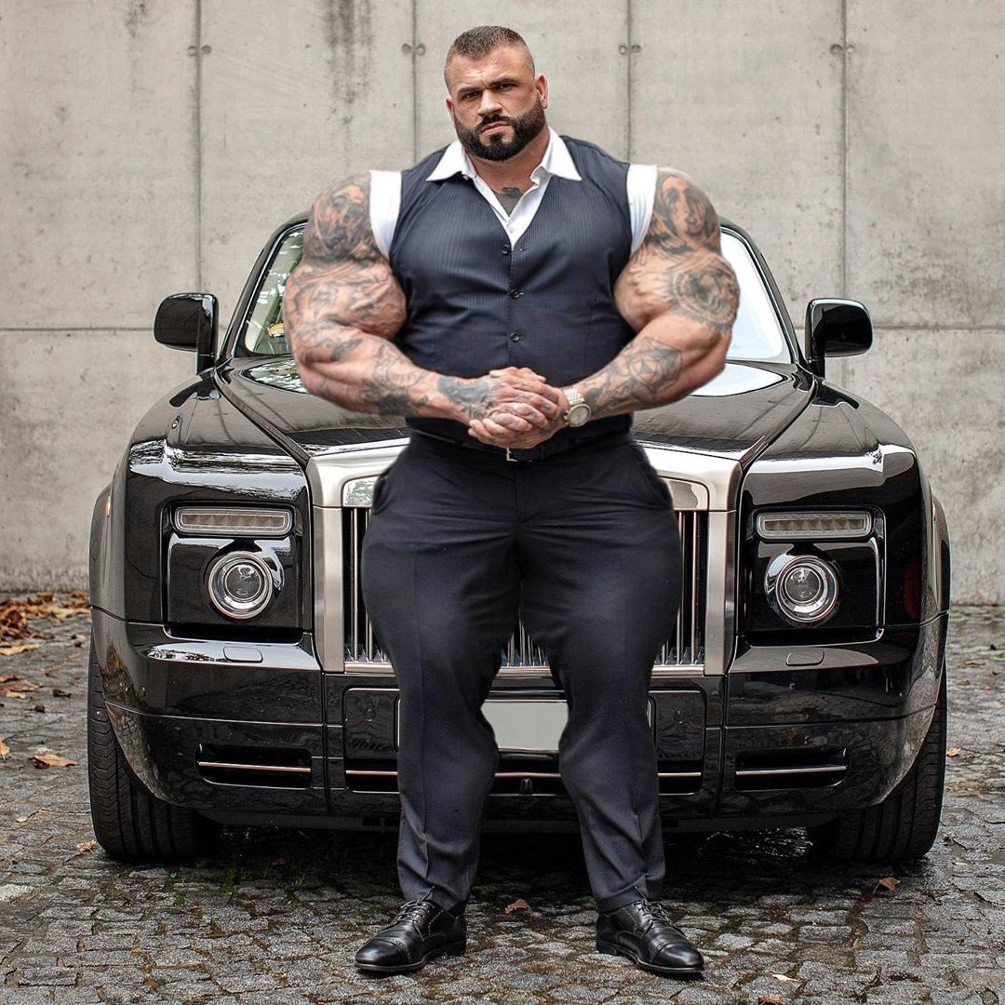
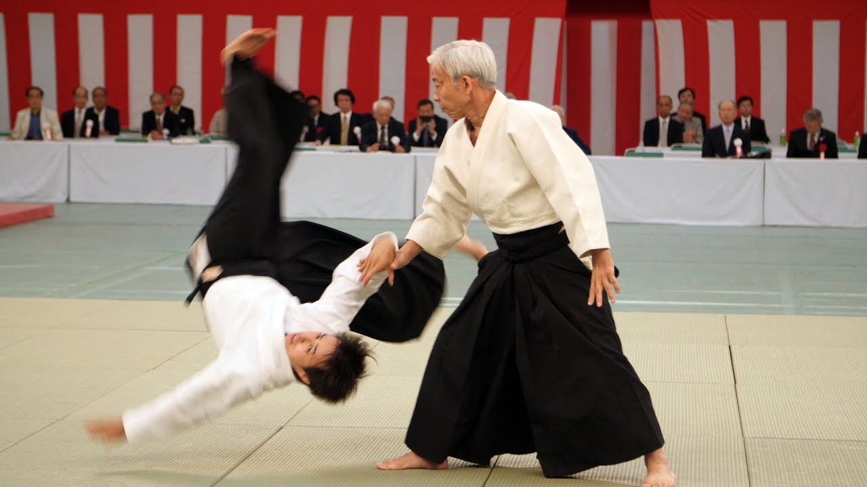
Our Safe Keeper
Romans 8:37 But in all these things we overwhelmingly conquer through Him who loved us. 38 For I am convinced that neither death, nor life, nor angels, nor principalities, nor things present, nor things to come, nor powers, 39 nor height, nor depth, nor any other created thing, will be able to separate us from the love of God, which is in Christ Jesus our Lord.
Notes:
Unless the Lord Guards the City, the watchman keeps awake in vain.
1 Thes 3: 3 But the Lord is faithful, and He will strengthen and protect you from the evil one.
Phil 1. 6 For I am confident of this very thing, that He who began a good work in you will perfect it until the day of Christ Jesus.
So as believers, we live our lives knowing that God is our protector – but not in the way we think if we’re looking at this from a secular perspective…
CLICK
Romans 8:37 But in all these things we overwhelmingly conquer through Him who loved us. 38 For I am convinced that neither death, nor life, nor angels, nor principalities, nor things present, nor things to come, nor powers, 39 nor height, nor depth, nor any other created thing, will be able to separate us from the love of God, which is in Christ Jesus our Lord.
Now some may say – Rob – I’ve read a few books, I’ve studied History, I know some horrible things that have happened to Christians. God didn’t protect them from these things.
You are absolutely correct.
The Purpose of a Meaningful Christian Life is not the avoidance of pain and the pursuit of pleasure.
As a Christian, we can have confidence that
these things will come our way.., but they won’t separate us from God.
If he is our foundation, God will work these things protect His Investment in US for Eternity
Death will happen to us – but it won’t separate us.
If we are following God, we can be confident that all that enters our life can be used to Glorify God, and grow us in Him for an eternity of faithful stewardship….
CLICK
It’s like Aikido – Satan is a brute, the world is brutish, but God is able to take the attacks of the Evil one and turn them around for our good.
Like After Joseph revealed himself fully to his brothers and they fell down in fear and he said in Genesis 50:
20 As for you, you meant evil against me, but God meant it for good in order to bring about this present result, to preserve many people alive. 21 So therefore, do not be afraid; I will provide for you and your little ones.” So he comforted them and spoke kindly to them.

Slide 7
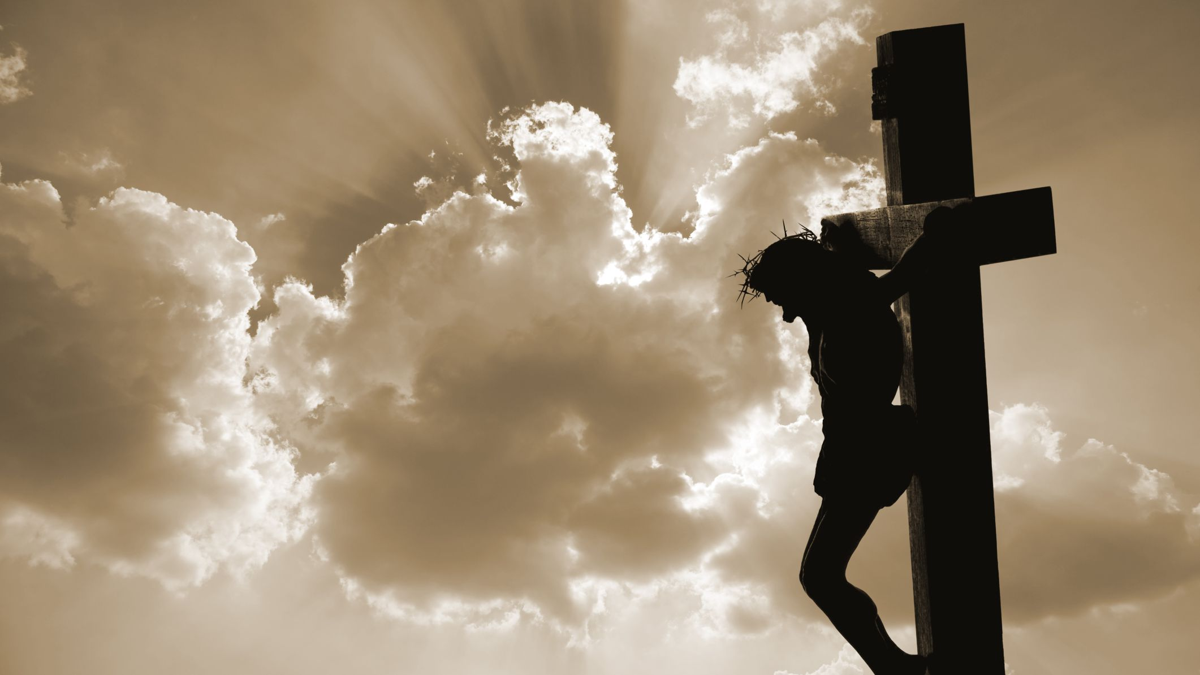
Col 3: 9 For in Him all the fullness of Deity dwells in bodily form, 10 and in Him you have been made complete, and He is the head over all rule and authority; …14 having canceled out the certificate of debt consisting of decrees against us, which was hostile to us; and He has taken it out of the way, having nailed it to the cross. 15 When He had disarmed the rulers and authorities, He made a public display of them, having triumphed over them through Him.
Notes:
And what better picture do we have of this than the Cross?
Joseph was an Archatype of Christ in a limited way (READ NOW)
Christ not only overcame death
He overcame it for us all
Cancelling the claims and power of sin against us

Slide 8
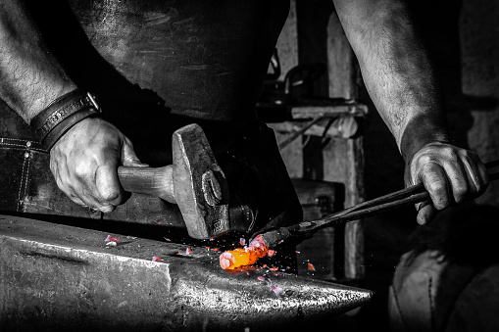
2. Don’t Labor On Your Own
2 Cor 9
8 And God is able to make all grace abound to you, so that always having all sufficiency in everything, you may have an abundance for every good deed; 9 as it is written,
“HE SCATTERED ABROAD, HE GAVE TO THE POOR,
HIS RIGHTEOUSNESS ENDURES FOREVER.”
10 Now He who supplies seed to the sower and bread for food will supply and multiply your seed for sowing and increase the harvest of your righteousness; 11 you will be enriched in everything for all liberality, which through us is producing thanksgiving to God.
2 It is vain for you to rise up early,
To retire late,
To eat the bread of painful labors;
For He gives to His beloved even in his sleep.
Serve as a Steward with His Provisions
Notes:
Which sets us for the second point: We don't labor on our own
We're free from Laboring in our own strength, fearful of what may come.
Work no longer becomes a frantic race, but we approach our work and challenges from a foundation of peace and abundance and provision.
1 Cor 15: 10 But by the grace of God I am what I am, and His grace toward me did not prove vain; but I labored even more than all of them, yet not I, but the grace of God with me.
CLICK
2 Cor 9:
8 And God is able to make all grace abound to you, so that always having all sufficiency in everything, you may have an abundance for every good deed; 9 as it is written,
“HE SCATTERED ABROAD, HE GAVE TO THE POOR,
HIS RIGHTEOUSNESS ENDURES FOREVER.”
10 Now He who supplies seed to the sower and bread for food will supply and multiply your seed for sowing and increase the harvest of your righteousness; 11 you will be enriched in everything for all liberality, which through us is producing thanksgiving to God.

Slide 9
Think Through Your Stewardships
Personal Walk with God
Family
Core Community
Career/Vocation/Education
Physical Health
Interests/Gifts/Talents
My Natural Temptations
Who do you want to be in 20 Years? 10 Years? 5 years
Notes:
Now I’m going to switch Gears, and this is getting pretty practical.
I have one staff who is a junior partner and we frequently have a discussion where we say “Let’s put on our owner hats, let’s put on our Employer/employee hats, let’s put on our husband or Father hats”
So this is a great time to take notes.
Have a Personal Mission statement that I review yearly, this part of the talk is basically the format I use to evaluate how I'm stewarding my life, so I'll share it with you today.

Slide 10
1. Personal Walk With the Lord
Personal Spiritual Disciplines
Prayer
Mastering the Word
Fasting
Personal Retreat
Serving
Giving
Sharing
Mentoring
Listening & Obeying
Notes:
Prayer – if you want to see your prayers answered, write them down. Journal about them
Mastering the Word – what does someone who masters the word of God look like to you:
Scripture memory
Deep Bible Study
God Calling you to study seminary courses
Fundamental worldview of the seminary
Fasting
Fasting as a discipline something you should have as a goal
Screen time fasting
Personal Retreat
Quiet time is actually a mini personal retreat
Do you have a time where you take all your activities to the lord?
Serving (bleed into other topics, but serving is as much for your spiritual growth as it is to bless the others)
Giving
Sharing
Mentoring
Listening & Obeying: St Ignatius Examin is an excellent tool for reflection and listening for obedience.

Slide 11
2. Family & 3. Close Community
Your Spouse
Your Children
Close Neighbors, Colleagues and Friends
Someone God has brought in your life for a season
Notes:
You must invest in these relatinships: Investing means not selfishly consuming your time, money, and focus on one thing, but putting it on another for growth in that area.
Spouse:
What do you want your relationship to be like in 20 years?
Do you date your spouse?
Learn together?
Help him or her invest in what if life-giving to them?
Wife and I lead or go through Marriage Course every 2 years
Children:
Andy Stanley: Two rules: honor your mother, and don’t lie. What kind of relationship do you want to have with your children 20-30 years from now? you need to cultivate that now.
Pass on core truths and disciplines. Practice having fun together, give them your attention. Delight in them
Prov 22:6 Train up a child in the way he should go, Even when he is old he will not depart from it.
What are the gifts and temperaments God has given your child? How can you equip them to be who God made them to be?
Josiah and I are about to do a right of passage into Manhood talk – list of core truths he needs to know as a man.
Close Neighbors, Colleagues, Friends
God put the people you run into every day into your life for a reason.
If you don’t have a prayer list, this is a great place to start.
Colleague you click with, maybe a Neighbor you can’t stand that God wants you to serve.
People God put into your life for a Season – Young college student who moved in next door with no family here, visiting scholar, the family here in Xiamen for a month

Slide 12
4. Vocation/Career/Education
Industry Knowledge or Technical Skills
Teamwork or Leadership Skills
Goals Or Achievements God’s Put on Your Heart
Work Environment Improvement
Operational Improvement
Business or Expansion
Notes:
Each of us here has been given gifts
Ephesians 2:10 - God has good works for you to walk in.
There is no wall of separation between your work and your spiritual life.
Work is spiritual

Slide 13
5. Health
Hebrews 12:
1 Therefore, since we have so great a cloud of witnesses surrounding us, let us also lay aside every encumbrance and the sin which so easily entangles us, and let us run with endurance the race that is set before us,
1 Corinthians 6:
19 Or do you not know that your body is a temple of the Holy Spirit who is in you, whom you have from God, and that you are not your own? 20 For you have been bought with a price: therefore glorify God in your body.
1 Corinthians 6:19 Or do you not know that your body is a temple of the Holy Spirit who is in you, whom you have from God, and that you are not your own? 20 For you have been bought with a price: therefore glorify God in your body.
1 Timothy 5
24 The sins of some men are quite evident, going before them to judgment; for others, their sins follow after. 25 Likewise also, deeds that are good are quite evident, and those which are otherwise cannot be concealed.
Exercise
Diet
Healthy Rhythm of Rest and Work
Sleep
Psychological Health
Forgiveness
Running from fears and problems
Not Dealing with Sin
Notes:
CLICK
Hebrews 12:
1 Therefore, since we have so great a cloud of witnesses surrounding us, let us also lay aside every encumbrance and the sin which so easily entangles us, and let us run with endurance the race that is set before us,
CLICK
1 Corinthians 6:19 Or do you not know that your body is a temple of the Holy Spirit who is in you, whom you have from God, and that you are not your own? 20 For you have been bought with a price: therefore glorify God in your body.
So as we think through our health, what disciplines do you need to have with:
How you eat?
How you exercise? (20 minutes a day is enough to keep you properly fit)
- I’ve found it helpful to create exercise habits along with my other stewardships – play sports with my kids, hike with my friends, run with my dog
How is my balance of work/rest
Does not mean there aren’t seasons of intesnse work in life. But if your entire life is characterized by workaholism, that’s outside God’s design.
How is your sleep rhythm?
Tomorrow morning starts tonight
Unforgiveness
Being at Peace with all People
Running from fears
CLICK
1 Timothy 5
24 The sins of some men are quite evident, going before them to judgment; for others, their sins follow after. 25 Likewise also, deeds that are good are quite evident, and those which are otherwise cannot be concealed. – this will show up later in the temptation section too.
Sin can impact us long term and it can show up in our health. Holy people are happy people and happier people are healthier people.
CLICK
1 Corinthians 6:19 Or do you not know that your body is a temple of the Holy Spirit who is in you, whom you have from God, and that you are not your own? 20 For you have been bought with a price: therefore glorify God in your body.
Your Body is not Yours – You belong to God, and so does your body. So we need to steward this just like the other areas of our lives.

Slide 14
6. Talents, Gifts, Interests
Justice Issue or Community Need
Technology or skill
Public Speaking
Instrument
Sport
Organization
Art
Solving Puzzles
Photography
Field of Knowledge: History, Theology, Politics, Math
Notes:
All of us have things we’re drawn to:
Josiah – legos, building things, bent toward Philosophy like me
Ella – loves baking, art, creating things
Gabriel - loves aggression
Most of the people in my life, I can talk with them for around 30 minutes and find out what gets them excited.
The people who usually make a career of this are the ones who frequently excel the most. Especially when they see it as a stewardship
So what are the things you can invest here:
Daily schedule for
writing?
Playing an instrument
Field of knowledge
Inventing things
Creating something

Slide 15
7. My Weaknesses/Temptations
My Shadow Mission? (Idol)
My Temptations & Weaknesses?
Social Media?
Shopping?
Fame?
Being Right/Having the Last Word?
Gossip or News?
Food, Alcohol, Substances?
What is Distracting You?
What are you afraid of?
Notes:
Have I thought about dealing with my temptations strategically?
What is Your Kryptonite?
John Ortberg - A mission is the highest purpose to which God calls us; a shadow mission is an authentic mission that has been derailed, often in imperceptible ways. Ortberg writes, “Part of what makes the shadow mission so tempting is that it’s usually so closely related to our gifts and passions. It’s not 180 degrees off track; it is just 10 degrees off track, but that 10 degrees is in the direction of hell.” Every leader has a mission—and a shadow mission. Even Jesus had to battle a shadow mission; it was to be a leader without suffering—to be the Messiah without the cross. Ortberg writes, “If we fail to embrace our true mission, we will live out our shadow mission. We will let our lives center around things that are unworthy, selfish and dark.”
Pulls you away from productively engaging your calling:
Nehemiah 6:1 Now when it was reported to Sanballat, Tobiah, to Geshem the Arab and to the rest of our enemies that I had rebuilt the wall, and that no breach remained in it, although at that time I had not set up the doors in the gates, 2 then Sanballat and Geshem sent a message to me, saying, “Come, let us meet together at Chephirim in the plain of Ono.” But they were planning to harm me. 3 So I sent messengers to them, saying, “I am doing a great work and I cannot come down. Why should the work stop while I leave it and come down to you?”
What do you need to deal with in faith?

Slide 16
3. You were made to multiply
3 Behold, children are a gift of the LORD,
The fruit of the womb is a reward.
4 Like arrows in the hand of a warrior,
So are the children of one’s youth.
5 How blessed is the man whose quiver is full of them;
They will not be ashamed
When they speak with their enemies in the gate.
Live a life of faith and plan to flourish

Slide 17
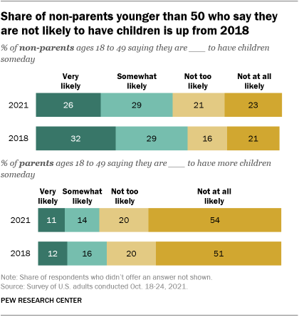
Pew Research Data on Potential Parents
Notes:
We live in an increasingly fear-motivated world, most people when they’re afraid – run away or freeze – this especially comes to children.
Pew data shows that in 2021 43% of Adults don’t want children, vs 37% in 2018
“This is a trend we have been seeing for years; the birth rate is declining. It was declining before the pandemic. We did not see a pandemic baby boom, like some people expected,” Christine Whelan, director of the Money, Relationships and Equality (MORE) center at the University of Wisconsin, Madison, told TODAY Parents. “Instead we saw a further decline during the pandemic, which makes sense because when you are concerned about your future — especially from a health perspective — then you don’t really want to bring children into the world.”
Why Don’t they want to have children?
-19% Medical Reasons
17% Financial Reasons
15% No Partner
10% Age
9% State of the World
The Main cause for this is a worldview issue – More than half of those not wanting children are motivated by fear. It’s a Godless worldview.
Was there any father here not fearful during the birth of their first child?
Children are not a burden – they’re a blessing!
In the grand scheme of the universe, Children of Godly parents advance God’s kingdom

Slide 18
A Godly Legacy
3 Behold, children are a gift of the LORD,
The fruit of the womb is a reward.
4 Like arrows in the hand of a warrior,
So are the children of one’s youth.
5 How blessed is the man whose quiver is full of them;
They will not be ashamed
When they speak with their enemies in the gate.
Notes:
3 Behold, children are a gift of the LORD,
The fruit of the womb is a reward.
4 Like arrows in the hand of a warrior,
So are the children of one’s youth.
5 How blessed is the man whose quiver is full of them;
They will not be ashamed
When they speak with their enemies in the gate.
We are made to be salt and light, to build his Kingdom. One of the Biggest Impacts you will make in this life is through the lives of those with whom you most intimately connect. - your family
- you'll set them up to pass the light to others
- you'll set them up for success in the battle and business of life
- arrows in the hands of a warrior
- advocates in a legal dispute
- advocates against the lies of the Enemy on what is real.

Slide 19
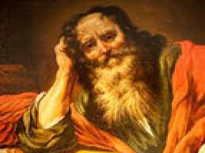
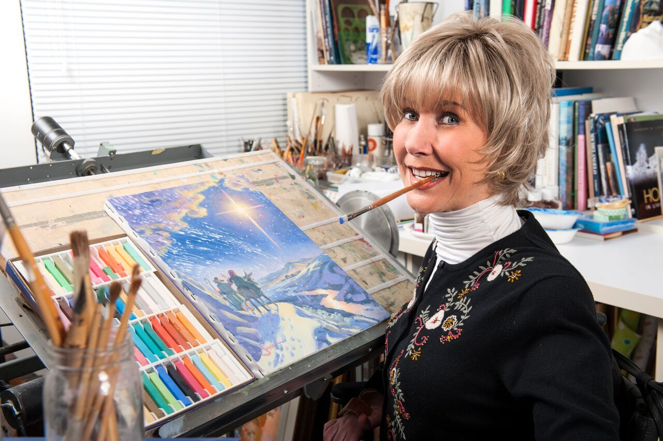
Legacies Are For Everyone
Notes:
The Apostle Paul
Single
Wrote 13 books of the Bible
Preached in Sinagogues
Most influential Missionary and Theologian since Christ
You and I are here today
Joni Erikson Tada
Paralyzed from the age of 17, 72 years old now
She founded Joni and Friends in 1979, an organization to "accelerate Christian ministry in the disability community
The longest-running program is "Joni and Friends Radio", a five-minute radio program begun in 1982. It now runs four minutes in length and can be heard each weekday on over 1,000 broadcast outlets.
- Founder of many other projects and organizations to help disabled people hear the gospel
Wrtten 48 books
2 Movies
Artist
Cliff and Delores
- married Emily and Me
International Student Ministry Directory
1996-2016 Full Time International Student Ministry
Now doing Part time
2-3 Small Groups a week, seen consistently 5-10 students come to the Lord
I bet there are 50-100 students who call them mom and dad
Fed them meals
Celebrated holidays
Took them camping
Taught them to drive
Helped them with medical and housing
Lived out the Gospel – not just a social gospel, but a personal relationship with God.
Transformed the lives of 100’s
Not a contest – not to compare.
2 Corinthians 9: 12 For we are not bold to class or compare ourselves with some of those who commend themselves; but when they measure themselves by themselves and compare themselves with themselves, they are without understanding.
Each of us here has different Gifts, different Stewardships, different responsibilities, we’re to live them for the Lord

Slide 20
Summary & Application: 3 Truths, 7 Stewardships
God is Your Builder and Protector – Build Your Life with Him
Don’t Labor with Your Own Strength, Steward with His Provision
You Were Made To Multiply – Live in Faith to Flourish
Personal Walk with God
Family
Core Community
Career/Vocation/Education
Physical Health
Interests/Gifts/Talents
My Natural Temptations

