Slide 1
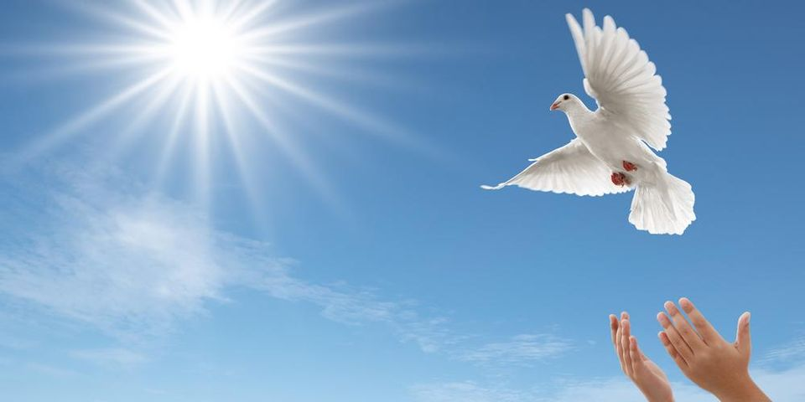
Blessed are the peacemakers!!
“Blessed are the peacemakers, for they shall be called sons of God – Matthew 5:9
Bro Perry

Slide 2
The world is getting darker!!
News and rumors of wars and conflicts. – Matthew 24:6
The hearts of people have grown cold. – Matthew 24:12
Just as heaven rejoices when a soul is won, Hell also rejoices when relationships build up conflict because of pride!!! – Ephesians 2:2
14. “You are the light of the world. A city set on a hill cannot be hidden. 15. Nor do people light a lamp and put it under a basket, but on a stand, and it gives light to all in the house. 16. In the same way, let your light shine before others, so that they may see your good works and give glory to your Father who is in heaven.
Matthew 5:14-16

Slide 3
“Blessed are the peacemakers, for they shall be called sons of God – Matthew 5:9
Peacemaker in the NT-Greek translates into “Becoming an ambassador to bring peace”.
Jesus is our prime example. – Luke 23:24
Our walk in the love of Christ is strongly affirmed by how we treat others!!
Make every effort to live in peace with everyone and to be holy; without holiness no one will see the Lord – Hebrews 12:14

Slide 4
4 G’s of peace making!!!
Glorifying God – 1 Corinthians 10:31
Get the log out of your eye – Matthew 7:3-5
Gently restore – 2 Timothy 2:24-26
Genuine reconciliation - Ephesians 4:1-3
If possible, so far as it depends on you, live peaceably with all. Romans 12:18

Slide 5
Therefore, let’s keep on pursuing those things that bring peace and that lead to building up one another. – Romans 14:19
7 A’s of genuine apology!!
1. Avoid but!!
2. Admit specifically.
3. Acknowledge the hurt.
4. Accept the consequences.
5. Alter your behavior.
6. Ask for forgiveness.
7. Ask the Lord for help.
4 Promises of forgiveness!!
1. I will not dwell on this incident.
2. I will not bring this incident up and use it against you.
3. I will not gossip to others about this incident.
4. I will not allow this incident to hinder our relationship.

Slide 6
Takeaways!!!
As believers we must desire to live peaceably with all people.
It takes humility and strength to live a peaceable life.
Just as heaven rejoices when a soul is won, Hell also rejoices when relationships build up conflict because of pride!!!
Pray for grace and intentionally work at being a peacemaker.

Slide 7
Let us pray!!!

Slide 8
Small group discussions!!
What can we learn from Jesus as a peacemaker?
Have you ever struggled with asking for forgiveness or forgiving someone? Share your story.
How do we overcome the pride of not genuinely forgiving others or genuinely asking for forgiveness?
Take turns to pray for one another to live peaceably with all.

