Slide 1
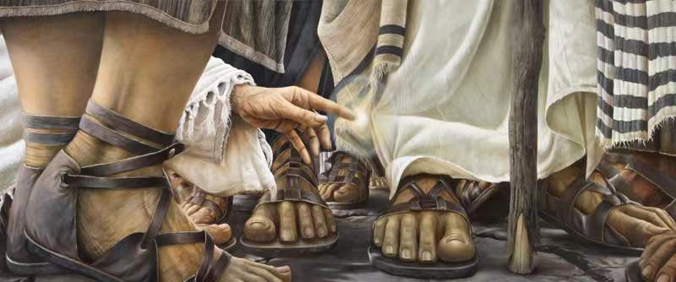
The woman healed from the issue of blood.
For she said, “If I touch even his garments, I will be made well.”
Mark 5:28
Bro Perry

Slide 2
Importance of the Miracles of Jesus!!
To reveal the glory of God!! – Psalm 77:14
To draw many unto believing in Christ Jesus. – John 10:37-38
To break the oppression of the devil. – Acts 10:38
To show the Love of God for His Children.
Takeaways from the last sermon: 1. God is still working miracles in the lives of His children today. 2. Faith deals with doubt and unbelief, and is a key to a miraculous life. 3. Let us live with full awareness of God’s miraculous ability.

Slide 3
Mark 5:25-34
25. And there was a woman who had had a discharge of blood for twelve years, 26. and who had suffered much under many physicians, and had spent all that she had, and was no better but rather grew worse. 27. She had heard the reports about Jesus and came up behind him in the crowd and touched his garment. 28. For she said, “If I touch even his garments, I will be made well.” 29. And immediately the flow of blood dried up, and she felt in her body that she was healed of her disease. 30. And Jesus, perceiving in himself that power had gone out from him, immediately turned about in the crowd and said, “Who touched my garments?” 31. And his disciples said to him, “You see the crowd pressing around you, and yet you say, ‘Who touched me?’” 32. And he looked around to see who had done it. 33. But the woman, knowing what had happened to her, came in fear and trembling and fell down before him and told him the whole truth. 34. And he said to her, “Daughter, your faith has made you well; go in peace, and be healed of your disease.”

Slide 4
Facts about this amazing woman of Faith!!
Because of her illness she was regarded as unclean and also felt unclean. – Leviticus 15:25-27
She had tried to get healing and it only resulted in her health and financial situation getting worse.
She was tired, worn out and intensely lonely.
She was desperate. – Mark 5:31

Slide 5
28. For she said, “If I touch even his garments, I will be made well.”
What she had heard about Jesus built up faith in her.
Her convictions fueled her action.
She valued her healing more than her worries!!!

Slide 6
29. And immediately the flow of blood dried up, and she felt in her body that she was healed of her disease.
Her healing was instant. It took place immediately…
Her faith in Christ birthed the results she hoped for.
Our focus must be on the unseen conviction.

Slide 7
30. And Jesus, perceiving in himself that power had gone out from him, immediately turned about in the crowd and said, “Who touched my garments?”
Jesus was anointed with the Holy Spirit and with power.
The presence of the crowd confirms that our faith is key in our relationship with Christ.
I believe it was not an inquiry born of anger but of great surprise at the level of faith expressed.

Slide 8
34. And he said to her, “Daughter, your faith has made you well; go in peace, and be healed of your disease.”
Jesus commended her faith.
Her obedience made her whole.
Jesus confirmed what she knew and felt had happened to her.

Slide 9
Testimony Time!!

Slide 10
Takeaways!!!
What we hear and open our minds to is important.
We must not give up.
Lets desire to be like the woman of faith healed from the issue of blood.
Let’s pray!!!

Slide 11
Small Group Discussions!!
Read thoroughly Mark 5:25-34.
Have a verse by verse discussion of the miraculous story.
Share your major takeaway from the testimony of the woman healed from the issue of blood.

