Slide 1
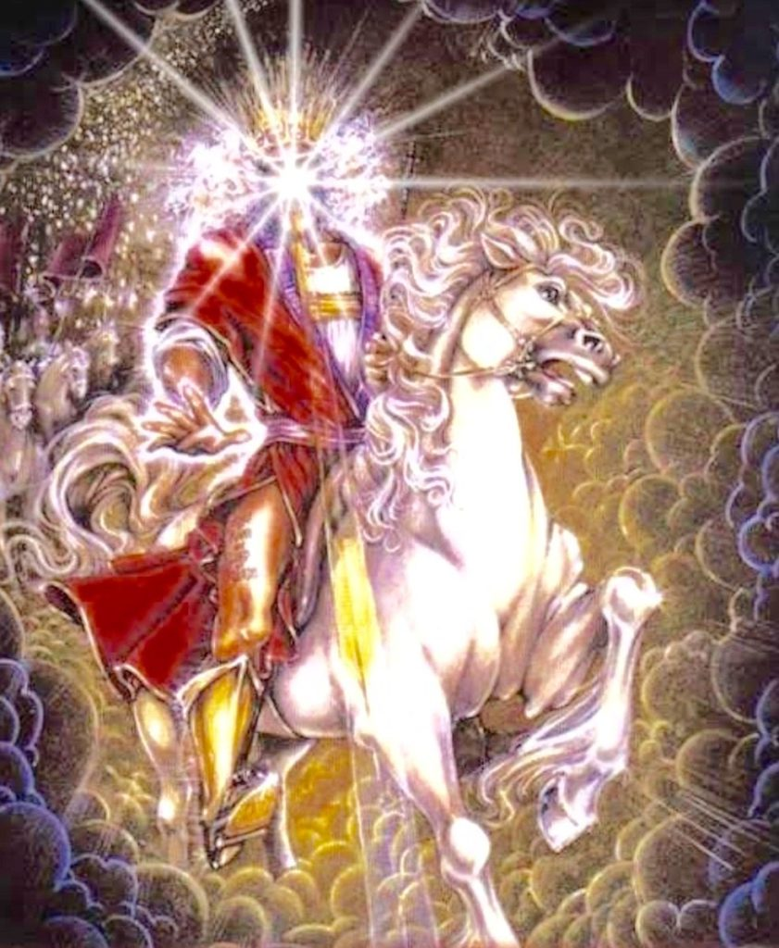
The Bridegroom Comes!!
Revelation 22:12
“Behold, I am coming soon, bringing my recompense with me, to repay each one for what he has done
Bro Perry!!

Slide 2
Death of man and death of a Savior!!
Hebrews 9:27-28
[27] And just as it is appointed for man to die once, and after that comes judgment, [28] so Christ, having been offered once to bear the sins of many, will appear a second time, not to deal with sin but to save those who are eagerly waiting for him.
Death is not the end!!
The death of Christ is salvation and life unto us.
We die unto judgment but Christ died to become our righteous judge.

Slide 3
The Coming of the Lord!!
1 Thessalonians 4:13-18
[13] But we do not want you to be uninformed, brothers, about those who are asleep, that you may not grieve as others do who have no hope. [14] For since we believe that Jesus died and rose again, even so, through Jesus, God will bring with him those who have fallen asleep. [15] For this we declare to you by a word from the Lord, that we who are alive, who are left until the coming of the Lord, will not precede those who have fallen asleep. [16] For the Lord himself will descend from heaven with a cry of command, with the voice of an archangel, and with the sound of the trumpet of God. And the dead in Christ will rise first. [17] Then we who are alive, who are left, will be caught up together with them in the clouds to meet the Lord in the air, and so we will always be with the Lord. [18] Therefore encourage one another with these words.

Slide 4
The Day of the Lord!!
1 Thessalonians 5:1-11
[1] Now concerning the times and the seasons, brothers, you have no need to have anything written to you. [2] For you yourselves are fully aware that the day of the Lord will come like a thief in the night. [3] While people are saying, “There is peace and security,” then sudden destruction will come upon them as labor pains come upon a pregnant woman, and they will not escape. [4] But you are not in darkness, brothers, for that day to surprise you like a thief. [5] For you are all children of light, children of the day. We are not of the night or of the darkness. [6] So then let us not sleep, as others do, but let us keep awake and be sober. [7] For those who sleep, sleep at night, and those who get drunk, are drunk at night. [8] But since we belong to the day, let us be sober, having put on the breastplate of faith and love, and for a helmet the hope of salvation. [9] For God has not destined us for wrath, but to obtain salvation through our Lord Jesus Christ, [10] who died for us so that whether we are awake or asleep we might live with him. [11] Therefore encourage one another and build one another up, just as you are doing.

Slide 5
Revelation 19:11-21
[11] Then I saw heaven opened, and behold, a white horse! The one sitting on it is called Faithful and True, and in righteousness he judges and makes war. [12] His eyes are like a flame of fire, and on his head are many diadems, and he has a name written that no one knows but himself. [13] He is clothed in a robe dipped in blood, and the name by which he is called is The Word of God. [14] And the armies of heaven, arrayed in fine linen, white and pure, were following him on white horses. [15] From his mouth comes a sharp sword with which to strike down the nations, and he will rule them with a rod of iron. He will tread the winepress of the fury of the wrath of God the Almighty. [16] On his robe and on his thigh he has a name written, King of kings and Lord of lords. [17] Then I saw an angel standing in the sun, and with a loud voice he called to all the birds that fly directly overhead, “Come, gather for the great supper of God, [18] to eat the flesh of kings, the flesh of captains, the flesh of mighty men, the flesh of horses and their riders, and the flesh of all men, both free and slave, both small and great.” [19] And I saw the beast and the kings of the earth with their armies gathered to make war against him who was sitting on the horse and against his army. [20] And the beast was captured, and with it the false prophet who in its presence had done the signs by which he deceived those who had received the mark of the beast and those who worshiped its image. These two were thrown alive into the lake of fire that burns with sulfur. [21] And the rest were slain by the sword that came from the mouth of him who was sitting on the horse, and all the birds were gorged with their flesh.

Slide 6
His First Coming | His Second Coming
He rode a donkey. | He will ride a white horse.
He came as the Suffering Servant. | He will come as the triumphant King
He came in humility and meekness. | He will come in majesty and power.
He came to suffer the wrath of God for sinners. | He will come to establish the kingdom of God for His saints.
He was rejected by many as the Messiah. | He will be recognized by all as Lord.
He came to seek and save the lost. | He will come to judge and rule as King.
He came as God in the flesh | He will come as God in all His splendor

Slide 7
Revelation 22:12
“Behold, I am coming soon, bringing my recompense with me, to repay each one for what he has done.
The types of judgement
The judgement of believers: Psalm 1:5, 1Pet4:17-18, Matt12:36-37
The Bema seat judgement: 2Cor5:10, 1Cor3:13-15
Intra Judgement: Matt12:41-42
Judgment of the nations: Matthew 25:31-46
Revelation 3:11
I am coming soon. Hold fast what you have, so that no one may seize your crown.

Slide 8
Crown of Righteousness - Henceforth there is laid up for me a crown of righteousness, which the Lord, the righteous judge, shall give me at that day: and not to me only, but unto all them also that love his appearing. 2Tim 4:8
Incorruptible crown - And every man that strives for the mastery is temperate in all things. Now they do it to obtain a corruptible crown; but we an incorruptible. 1Cor 9:25
Crown of life - Blessed is the man that endures temptation: for when he is tried, he shall receive the crown of life, which the Lord hath promised to them that love him. Jas 1:12
Crown of glory - Feed the flock of God which is among you, taking the oversight thereof, not by constraint, but willingly; not for filthy lucre, but of a ready mind. Neither as being lords over God’s heritage, but being ensamples to the flock. And when the chief Shepherd shall appear, ye shall receive a crown of glory that fades not away. 1Pet 5:2–4
Crown of Rejoicing - For what is our hope, or joy, or crown of rejoicing? Are not even ye in the presence of our Lord Jesus Christ at his coming? 1Thess 2:19

Slide 9
Revelation 3:11
I am coming soon. Hold fast what you have, so that no one may seize your crown.
READY YOURSELF FOR OUR BRIDE GROO COMES!!!
WE HAVE NO TIME…

