Slide 1
A Conclusion On The Book Of Genesis!!
And God said, “Let there be light,” and there was light!
Genesis 1:3

Slide 2
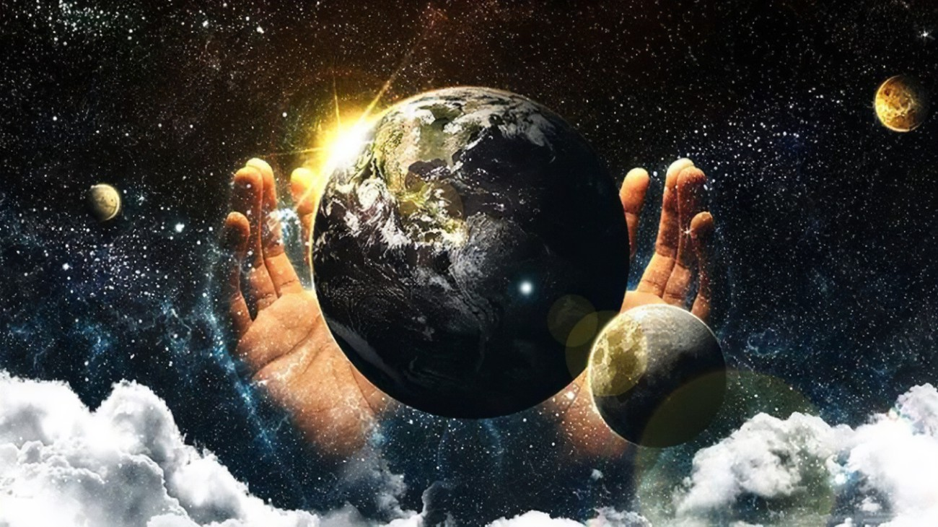
God & Creation!!
These are the generations of the heavens and the earth when they were created, in the day that the Lord God made the earth and the heavens. Genesis 2:4

Slide 3
Who is the God of all creations…. Jehovah Elohim!!!
The God of heaven and earth created all things by His word!! With His very word he declared and spoke all that we see and know into existence. His word is power… His word is life.
Jesus Christ is the center of all creation!! He is the beginning and the end… He is the definition of life; that which is seen and that which is unseen. In Him is all the Fathers purpose and plan revealed. (John 1:1-3, Colossians 1:15-17)
‘Ah, Lord God! It is you who have made the heavens and the earth by your great power and by your outstretched arm! Nothing is too hard for you… Jeremiah 32:17

Slide 4
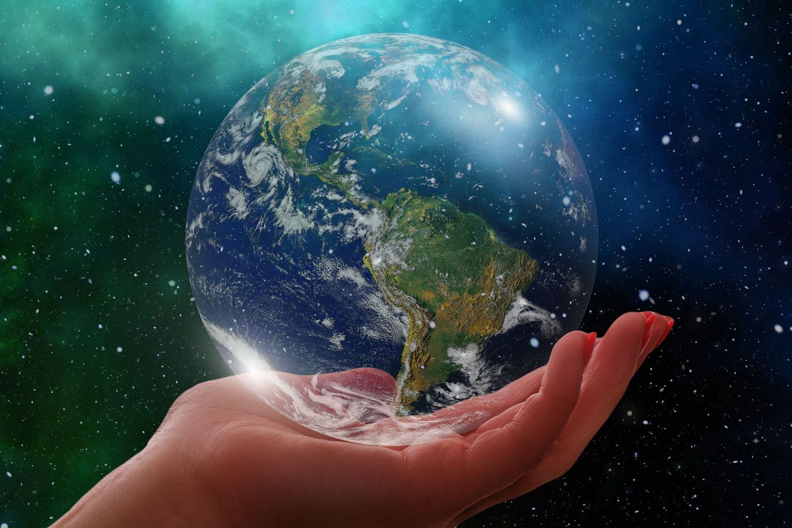
God Centeredness in Creation!!
These are the generations of the heavens and the earth when they were created, in the day that the Lord God made the earth and the heavens. Genesis 2:4

Slide 5
I will say to the north, Give up, and to the south, Do not withhold; bring my sons from afar and my daughters from the end of the earth, everyone who is called by my name, whom I created for my glory, whom I formed and made.” Isaiah 43:6-7
Concluding Remarks
Creations tells of the glory and works of God
Man was created and made for His glory and pleasure
Marriage is symbolism of the union between Jesus and the church which is intended to reveal the glory of the son Jesus through the gospel
God is the center of His creation but in His love, He has chosen to extend His glory to us

Slide 6
God & Humanity!!
And God blessed them. And God said to them, “Be fruitful and multiply and fill the earth and subdue it, and have dominion over the fish of the sea and over the birds of the heavens and over every living thing that moves on the earth.”… Genesis 1:28

Slide 7
1. The Aseity of God – Acts 17:24-25 2. There is no randomness in God – Psalm 19:1 3. God’s love for humanity – 2Peter 1:3-4
We are God’s representatives on earth
To be fruitful and multiply
To dominate the earth and establish the will of God
To reveal His glory and let all of creation give praise to God
Genesis Chapter 3
The deceptive ability and intent of the devil (John 8:44)….The commandment and the place of freewill (Deuteronomy 30:19)… The temptation (1John 2:16)…
Adam and Eve (1John 4:18)… The impact of the fall…
The fall of Adam and Eve was the birth of the nature of sin, the manifestation of death and the advent of suffering in the perfect creation of God. This Fall resulted in the conception of wickedness, hatred, pride and all the fruits of unrighteousness born of the dominion of the flesh over humanity. (Romans 5:12, Romans 7:18, Galatians 5:19-21)
I will put enmity between you and the woman, and between your offspring and her offspring; he shall bruise your head, and you shall bruise his heel.” Genesis 3:15

Slide 8
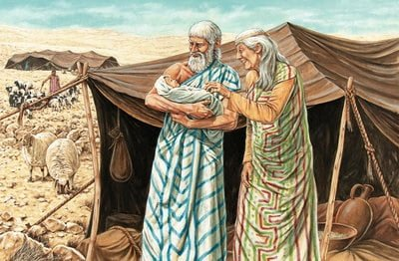
Children of Promise!!
Now the LORD said to Abram, "Go forth from your country, And from your relatives And from your father's house, To the land which I will show you; And I will make you a great nation, And I will bless you, And make your name great; And so you shall be a blessing; And I will bless those who bless you, And the one who curses you I will curse. And in you all the families of the earth will be blessed.“… Gen 12:1-3 (NASB)

Slide 9
The Adamic Covenant… Genesis 1,2,3
Established the relationship between God and humans
Set the conditions of the covenant
Resulted in
expulsion from the Garden of Eden
loss of direct relationship with God
physical death
pain and hardship
Promised restoration
The Abramic Covenant… Genesis 12, 15
Made between one man (Abraham) and his descendants
God promised Abraham
Make him a great nation
Bless those who bless; curse those who curse
Give him the land
Bless all families through him
Children of Promise
But [it is] not as though the word of God has failed. For they are not all Israel who are [descended] from Israel; nor are they all children because they are Abraham's descendants, but: "THROUGH ISAAC YOUR DESCENDANTS WILL BE NAMED." That is, it is not the children of the flesh who are children of God, but the children of the promise are regarded as descendants. Rom 9:6-8 (NASB)
The Noahic Covenant… Genesis 9
Unconditional promise
Established protection for all living creatures
Gave the rainbow as a sign

Slide 10
But as for you, teach what accords with sound doctrine… Titus 2:1
Healthy teaching that promotes healthy spirituality
and nurtures a good relationship with the Father.
Fundamental doctrines highlighted in the Book of Genesis…
Doctrine about God – Theology
Doctrine about humanity – Anthropology
Doctrine about Sin – Hamartiology
Doctrine about Salvation – Soteriology
Doctrine about the Church - Ecclesiology
At the core of every sound doctrine is Christ: His word, His Life, His love…..
For I decided to know nothing among you except Jesus Christ and him crucified…
1Corinthians 2:2

Slide 11
LET US PRAY!!

