Slide 1
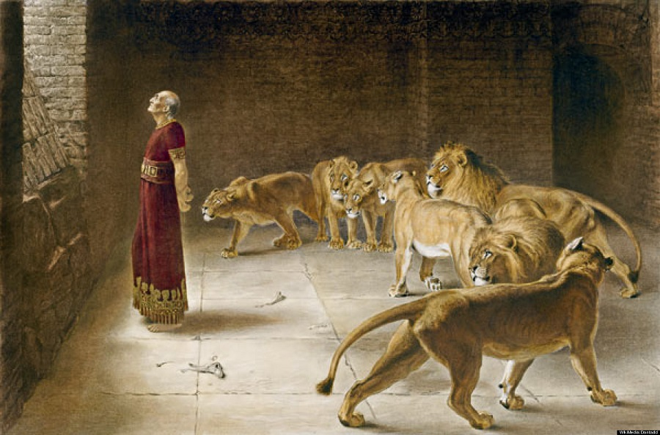
Daniel, a man greatly loved
12 February, 2023. XICF

Slide 2
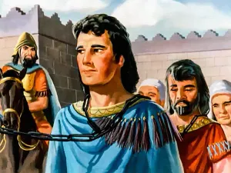
The beginning of the exile
Daniel 1: 2 And the Lord gave Jehoiakim king of Judah into his hand, with some of the vessels of the house of God. And he brought them to the land of Shinar, to the house of his god, and placed the vessels in the treasury of his god. 3 Then the king commanded Ashpenaz, his chief eunuch, to bring some of the people of Israel, both of the royal family and of the nobility, 4 youths without blemish, of good appearance and skillful in all wisdom, endowed with knowledge, understanding learning, and competent to stand in the king's palace, and to teach them the literature and language of the Chaldeans.

Slide 3
Faithful in a foreign land
Daniel 1
8 But Daniel resolved that he would not defile himself with the king’s food, or with the wine that he drank. Therefore he asked the chief of the eunuchs to allow him not to defile himself...
10 and the chief of the eunuchs said to Daniel, “I fear my lord the king, who assigned your food and your drink; for why should he see that you were in worse condition than the youths who are of your own age? So you would endanger my head with the king.”
11 Then Daniel said to the steward whom the chief of the eunuchs had assigned over Daniel, Hananiah, Mishael, and Azariah, 12 “Test your servants for ten days; let us be given vegetables to eat and water to drink.
13 Then let our appearance and the appearance of the youths who eat the king’s food be observed by you, and deal with your servants according to what you see.”
Faithfulness
Exodus 2
Genesis 39

Slide 4
Disgrace for Christ’s sake is of greater value
Hebrews 11:
24 By faith Moses, when he was grown up, refused to be called the son of Pharaoh's daughter, 25 choosing rather to be mistreated with the people of God than to enjoy the fleeting pleasures of sin. 26 He considered the reproach of Christ greater wealth than the treasures of Egypt, for he was looking to the reward. 27 By faith he left Egypt, not being afraid of the anger of the king, for he endured as seeing him who is invisible.

Slide 5
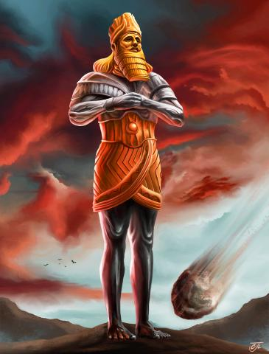
Daniel 2: 31 “You saw, O king, and behold, a great image. This image, mighty and of exceeding brightness, stood before you, and its appearance was frightening. 32 The head of this image was of fine gold, its chest and arms of silver, its middle and thighs of bronze, 33 its legs of iron, its feet partly of iron and partly of clay. 34 As you looked, a stone was cut out by no human hand, and it struck the image on its feet of iron and clay, and broke them in pieces. 35 Then the iron, the clay, the bronze, the silver, and the gold, all together were broken in pieces, and became like the chaff of the summer threshing floors; and the wind carried them away, so that not a trace of them could be found. But the stone that struck the image became a great mountain and filled the whole earth.
Bold in the Lord

Slide 6
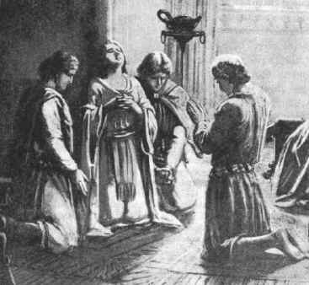
Where did Daniel’s boldness come from?
Daniel 2: 17 Then Daniel went to his house and made the matter known to Hananiah, Mishael, and Azariah, his companions, 18 and told them to seek mercy from the God of heaven concerning this mystery, so that Daniel and his companions might not be destroyed with the rest of the wise men of Babylon. 19 Then the mystery was revealed to Daniel in a vision of the night. Then Daniel blessed the God of heaven.
Ephesians 6: 19

Slide 7
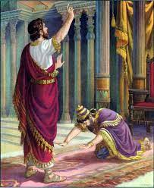
Proverbs 3: 5 Trust in the Lord with all your heart, and do not lean on your own understanding. 6 In all your ways acknowledge him, and he will make straight your paths.

Slide 8
Not a victim, but an ambassador of truth
Daniel 6: 3 Then this Daniel became distinguished above all the other high officials and satraps, because an excellent spirit was in him. And the king planned to set him over the whole kingdom. 4 Then the high officials and the satraps sought to find a ground for complaint against Daniel with regard to the kingdom, but they could find no ground for complaint or any fault, because he was faithful, and no error or fault was found in him.
Jeremiah 29: 4 “Thus says the Lord of hosts, the God of Israel, to all the exiles whom I have sent into exile from Jerusalem to Babylon: 5 Build houses and live in them; plant gardens and eat their produce. 6 Take wives and have sons and daughters; take wives for your sons, and give your daughters in marriage, that they may bear sons and daughters; multiply there, and do not decrease. 7 But seek the welfare of the city where I have sent you into exile, and pray to the Lord on its behalf, for in its welfare you will find your welfare.

Slide 9
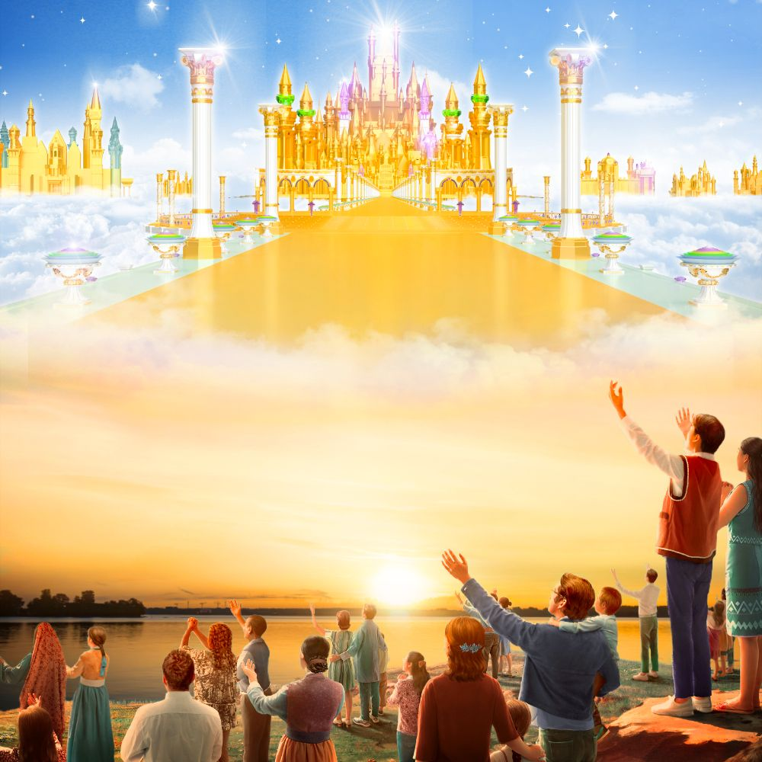
We belong to a different kingdom
John 15: 18 “If the world hates you, know that it has hated me before it hated you. 19 If you were of the world, the world would love you as its own; but because you are not of the world, but I chose you out of the world, therefore the world hates you.
Philippians 3: 20 20 But our citizenship is in heaven, and from it we await a Savior, the Lord Jesus Christ

Slide 10
No longer captives:
Captives: Jerusalem.
Oppressor: Babylon
Freedom: came after 70 years
Jeremiah 25: 11-12
Captives: Christians
Oppressor: Sin and shame
Freedom: came with Jesus
Dan 7: 13 “I saw in the night visions, and behold, with the clouds of heaven there came one like a son of man, and he came to the Ancient of Days and was presented before him. 14 And to him was given dominion and glory and a kingdom, that all peoples, nations, and languages should serve him; his dominion is an everlasting dominion, which shall not pass away, and his kingdom one that shall not be destroyed.
Lk 4: 18 “The Spirit of the Lord is upon me, because he has anointed me to proclaim good news to the poor. He has sent me to proclaim liberty to the captives and recovering of sight to the blind, to set at liberty those who are oppressed, 19 to proclaim the year of the Lord’s favor.”

Slide 11
The life of Daniel inspires us:
To hold firm to our identity:
Be faithful in adversity
Lk 10: 33 Go your way; behold, I am sending you out as lambs in the midst of wolves.
Stand boldly for the truth
2Tim: 1: 7 for God gave us a spirit not of fear but of power and love and self-control.
Lead honest lives
1Pet.2: 12 Keep your conduct among the Gentiles honorable, so that when they speak against you as evildoers, they may see your good deeds and glorify God on the day of visitation.

Slide 12
Let’s pray...

