Slide 1
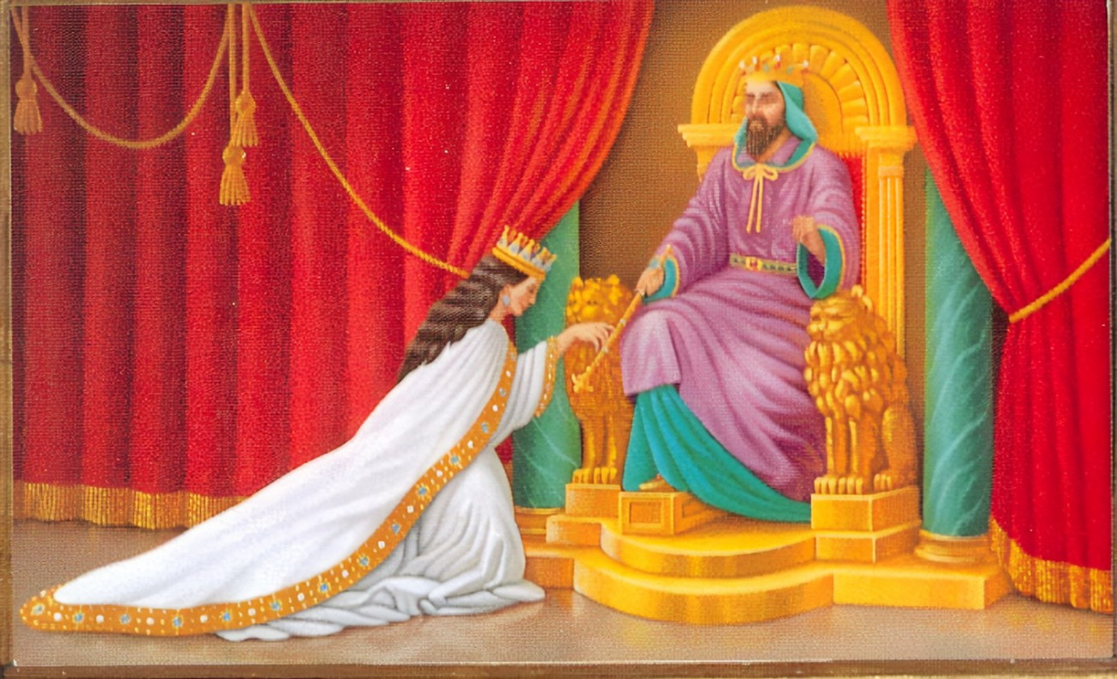
Living a life of purpose!!
For if you keep silent at this time, relief and deliverance will rise for the Jews from another place, but you and your father's house will perish. And who knows whether you have not come to the kingdom for such a time as this?”
Esther 4:14

Slide 2
The book of Esther…
1. The kings banquet - 1:1-9
2. Queen Vashti’s refusal - 1:10-22
3. Esther chosen queen - 2:1-18
4. Mordecai discovers a plot - 2:19-23
5. Haman plots against the Jews - 3
6. Esther agrees to help the Jews - 4
7. Esther prepares a banquet - 5:1-8
8. Haman plans to hang Mordecai - 5:9-14
9. The king honours Mordecai - 6:1-13
10. Esther reveals Haman’s plot - 6:14-7:6
11. Haman is hanged - 7:7-10
12. Esther saves the Jews - 8
13. The Jews destroy their enemies - 9:1-19
14. The feast of Purim inaugurated - 9:20-32
15. The greatness of Mordecai - 10:1-3
Esther 9:1
Now in the twelfth month, which is the month of Adar, on the thirteenth day of the same, when the king’s command and edict were about to be carried out, on the very day when the enemies of the Jews hoped to gain the mastery over them, the reverse occurred: the Jews gained mastery over those who hated them.
And I tell you, you are Peter, and on this rock[a] I will build my church, and the gates of hell shall not prevail against it… Matthew 16:18

Slide 3
Key Characters in the book of Esther…
1. King Ahasuerus
Esther 1:1-2 Now in the days of Ahasuerus, the Ahasuerus who reigned from India to Ethiopia over 127 provinces, in those days when King Ahasuerus sat on his royal throne in Susa, the citadel,
2. Queen Vashti
Esther 1:12 But Queen Vashti refused to come at the king’s command delivered by the eunuchs. At this the king became enraged, and his anger burned within him.
3. Haman
Esther 3:1 After these things King Ahasuerus promoted Haman the Agagite, the son of Hammedatha, and advanced him and set his throne above all the officials who were with him.
4. Zeresh
Esther 5:14 Then his wife Zeresh and all his friends said to him, “Let a gallows fifty cubits high be made, and in the morning tell the king to have Mordecai hanged upon it. Then go joyfully with the king to the feast.” This idea pleased Haman, and he had the gallows made.
5. Mordecai
Esther 2:23 When the affair was investigated and found to be so, the men were both hanged on the gallows. And it was recorded in the book of the chronicles in the presence of the king.

Slide 4
A review of Esther: The Jew and Queen….
Esther was an orphan…
(Esther 2:7)
2. Esther understood authority and listened to Mordecai…
(Esther 2:15, 4:14)
3. Esther had understanding to her assignment and sought the help of the Lord..
(Esther 4:16) “Go, gather all the Jews to be found in Susa, and hold a fast on my behalf, and do not eat or drink for three days, night or day. I and my young women will also fast as you do. Then I will go to the king, though it is against the law, and if I perish, I perish.”
4. Esther utilized her opportunities…
5. Esther played a role in the celebration of Purim…
(Esther 9:29)

Slide 5
Living a life of purpose….
For if you keep silent at this time, relief and deliverance will rise for the Jews from another place, but you and your father’s house will perish. And who knows whether you have not come to the kingdom for such a time as this?” Esther 4:14
1. A life of purpose is a life submitted to the plans and will of God…
2. A life of purpose understands the place of challenges and the need to overcome them…
3. A life of purpose thinks about others and is not selfish…
4. A life of purpose understands the power of decisions and it’s implications…
5. A life of purpose brings glory to God…

Slide 6
Let us pray….

