Slide 1
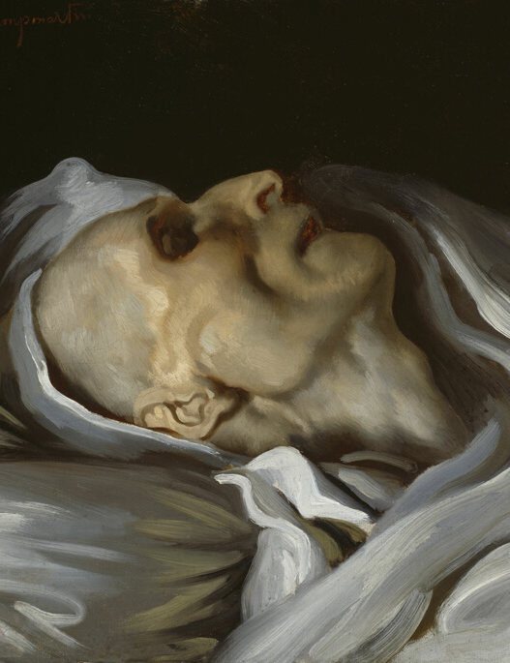
Sin - We're Dying to Talk About It
Notes:
Today we’re going to talk about Sin. Now I know you guys have all been wondering – when can we get together and hear someone remind us of how broken and hopeless we are on our own?
Few of us – maybe thinking of a friend or spouse – oh no, you’re definitely going to church this Sunday – you need to hear this talk.
I labeled the talk “Sin- we’re dying to talk about it” - because
Spoiler alert: Sin leads to death, which we’ll elaborate on more
It’s so hard for us as proud humans to admint our shortcomings (especially when we’re responsible for them) that it usually takes something on the level of DEATH before we’re willing to talk ot or discuss it.
Théodore Géricault French painter on his deathbed. Because it gives picture of death that won’t freak out small children too much.

Slide 2
Part 1: What is Sin (Sin in the Old and Tew Testament)
Notes:
First in a series on the main themes of Romans:
Romans series - Sin
Romans series - Salvation
Romans series - Sanctification
Romans series - GOD's sovereignty
Trend in modern popular preachers to take a historical critical approach to scripture that pits the old testament against the new testament.
– so what I’m going to do initially is lay a clear foundation to show how coherent the bible is as a whole on the concept of Sin
Ans in how it depicts sin and it’s implications on us as individuals

Slide 3
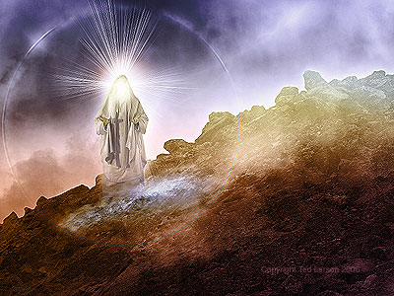
Exodus 34 (NASB)
5The LORD descended in the cloud and stood there with him as he called upon the name of the LORD. 6 Then the LORD passed by in front of him and proclaimed, “The LORD, the LORD God, compassionate and gracious, slow to anger, and abounding in lovingkindness and truth; 7 who keeps lovingkindness for thousands, who forgives iniquity, transgression and sin; yet He will by no means leave the guilty unpunished, visiting the iniquity of fathers on the children and on the grandchildren to the third and fourth generations.” 8 Moses made haste to bow low toward the earth and worship.
Notes:
- Passage where Moses Meets God the second time after the first tablets were destroyed, the golden calf idol was destroyed ground up into powder and they drank it, and many people died.
Moses meets up with God and when he comes down Moses has to literally wear a veal because the people are afraid of the radiance of his face.
And we hear how God describes himself and his relationship with us.
There’s a lot to unpack in this, but for today, we’re focusing on Sin – three words used here, and they carry through the entire Bible:
Iniquity
Transgression
Sin

Slide 4
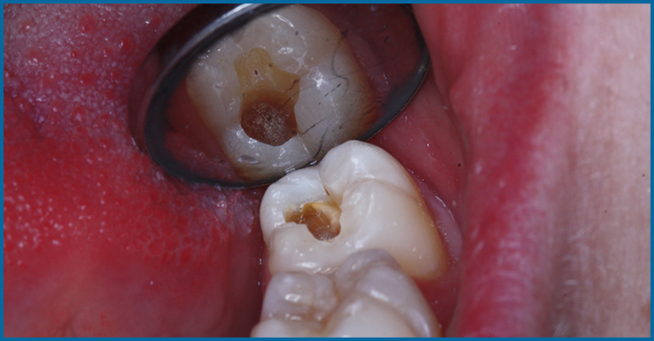
Iniquity עָווֹן (Avon)
wickedness, bentness, crookedness, corrupt
Notes:
Lamentations 3: crooked paths
Isaiah 59: corrupt leaders
To Punish – means to visit someone’s avon upon them: let them sit in the consequences of their crookedness.
In Reformed lingo – it’s what we mean by “The Depravity of People” Original Sin.
It’s a word you’d used to describe a cracked foundation that would destroy a house
CLICK
Systemic corruption in government
CLICK
A tooth that’s decaying
Click
A skeletal structure that renders one feeling helpless or useless
Iniquity is something that not just disfigures or diminishes us, it’s a corruption spreads into every area of our lives

Slide 5
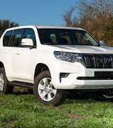
Jesus - Iniquity κοινῶσαι (עָווֹן. Avon) Κοινῶσαι – make common
Mark 7: For from within, out of the heart of men, proceed the evil thoughts, fornications, thefts, murders, adulteries, 22 deeds of coveting and wickedness, as well as deceit, sensuality, envy, slander, pride and foolishness. 23 All these evil things proceed from within and defile the man.”
Notes:
If you’re into overlanding – off-roading to go camping, and you’re going to go hundreds of miles off road – you’re going to be looking at only a few brands of vehicles
Number one is Toyota – and what’s the main characteristic you’re looking for? Durability – incorruptibility.
It’s the same idea Jesus talks about when he describes when someone is defiled.
READ TEXT
Defiled – Koinoosai (Koinae Greek) – the common Greek, in Latin we use the word Vulgar - normal
Strange that Jesus says that these evil things proceeding from our heart make us normal
So in Jesus’s mind – Corruption is the normal state of people left to their own device.
Rick Laymon once told me - Apart from Jesus - Everything breaks, everything changes.
Even that Toyota Prado - it's going to become normal - it's going to break and decay.

Slide 6
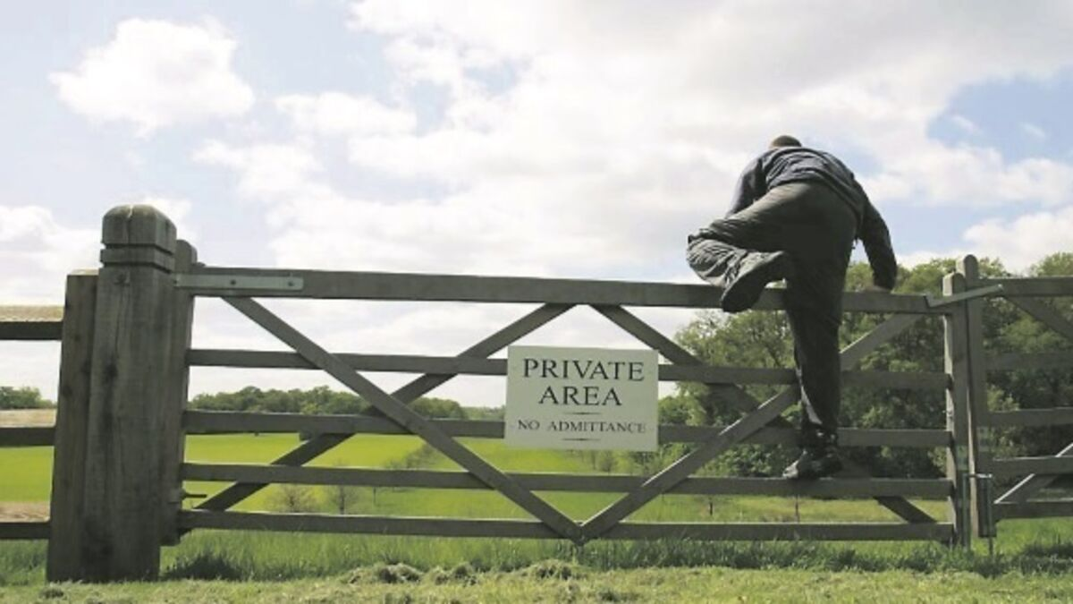
Transgression Pesha פֶּשַׁע
Transgression, Rebellion, Trespass
Violate the trust or honor of others
Notes:
Transgression, Rebellion, Trespass
Violates the trust or honor of another person
Transgression happens happens in a relationship context.
If someone robs a house, it’s robbery, but if a neighbor robs a house it would be Pesha –
If you break a contract,
If a nation breaks a treaty with another, they’ve transgressed
Idolatry is transgression against god – we’re violating our proper relationship with him
Amos – accuses Israel of Pesha
Against God - for idolatry
Against people – for selling innocent people into slavery.
Violation of the natural way a relationship should be
Between people – dignity and love between equals made in the image of God
Between us and God – he’s to be adored as our greatest pleasure and good, and not anything else.

Slide 7
Jesus – ἀνομίαν Transgression/Lawlessness
Matthew 22:37 And He said to him, “ ‘YOU SHALL LOVE THE LORD YOUR GOD WITH ALL YOUR HEART, AND WITH ALL YOUR SOUL, AND WITH ALL YOUR MIND.’ …, ‘YOU SHALL LOVE YOUR NEIGHBOR AS YOURSELF.’
Matthew 13:41 The Son of Man will send forth His angels, and they will gather out of His kingdom all stumbling blocks, and those who commit lawlessness,
Luke 11: “Teacher, tell my brother to divide the family inheritance with me.”
Notes:
In the new Testament, the word Lawlessness is used:
Matthew 22:37 And He said to him, “ ‘YOU SHALL LOVE THE LORD YOUR GOD WITH ALL YOUR HEART, AND WITH ALL YOUR SOUL, AND WITH ALL YOUR MIND.’ …, ‘YOU SHALL LOVE YOUR NEIGHBOR AS YOURSELF.’
- Jesus expounded on the purpose of the law
- Implied that behavior towards another that's not rooted in Love towards another or God, is a form of Transgression
Matthew 13:41 The Son of Man will send forth His angels, and they will gather out of His kingdom all stumbling blocks, and those who commit lawlessness,
Parable of the wheat and weeds sown by the enemy
Those among us who are still unrepentant and bent are sinners to be dealt with at the final judgment
Luke 11 -
Luke 11: “Teacher, tell my brother to divide the family inheritance with me.”
- Jesus tells this guy, his attitude is wrong – his relationship with his brother is not merely transactional – it should be loving.

Slide 8
Sin Khata חטא
Matthew 22: “Teacher, which is the great commandment in the Law?” 37 And He said to him, “ ‘YOU SHALL LOVE THE LORD YOUR GOD WITH ALL YOUR HEART, AND WITH ALL YOUR SOUL, AND WITH ALL YOUR MIND.’ 38 This is the great and foremost commandment. 39 The second is like it, ‘YOU SHALL LOVE YOUR NEIGHBOR AS YOURSELF.’ 40 On these two commandments depend the whole Law and the Prophets.”
Notes:
Fail or miss the goal
Make hasty decisions in travel – miss your way
Pilgrims Progress: The same idea is visited again when Christian and his friend Hopeful stray from the path, resulting in their capture by the ruthless Giant Despair (a literal giant) who dwells in Doubting Castle. This part of the story highlights how there is only one true path: all other paths leads to despair and doubt.
Failure to fulfill your goal:
What’s the Goal? What is the mark we’re supposed to Hit?
Love. We were made to Love.
CLICK
1 Timothy 3:5 – The goal of our instruction is love from a pure heart, clean conscience, sincere faith.
CLICK
Matthew 22: “Teacher, which is the great commandment in the Law?” 37 And He said to him, “ ‘YOU SHALL LOVE THE LORD YOUR GOD WITH ALL YOUR HEART, AND WITH ALL YOUR SOUL, AND WITH ALL YOUR MIND.’ 38 This is the great and foremost commandment. 39 The second is like it, ‘YOU SHALL LOVE YOUR NEIGHBOR AS YOURSELF.’ 40 On these two commandments depend the whole Law and the Prophets.”
CLICK
10 commandments – 1st 5 deal with loving God, 2nd 5 deal with loving eachother.
So life at its core is about love - and we miss the mark of Love when we sin.

Slide 9
Jesus – Sin ἁμαρτίαις (Khata חטא)
John 8:23 And He was saying to them, “You are from below, I am from above; you are of this world, I am not of this world. 24 Therefore I said to you that you will die in your sins; for unless you believe that I am He, you will die in your sins.
Harmartia: a – not, meros – part of
Loss resulting from missing a mark
Notes:
Harmartia: a – not, meros – part of of something
Loss resulting from missing a mark
So Jesus uses this idea,
If we life without belief in Him, we’ll die not just having a life that missed the mark, but a life in a state of missing the mark.
If sin were merely consequential in this life, Jesus wouldn’t be warning about the loss to be experienced on our deathbed that comes from a life of sinning.

Slide 10
Romans 3: Everyone Is Sinful
9 What then? Are we better than they? Not at all; for we have already charged that both Jews and Greeks are all under sin; 10 as it is written,
“THERE IS NONE RIGHTEOUS, NOT EVEN ONE;
11 THERE IS NONE WHO UNDERSTANDS,
THERE IS NONE WHO SEEKS FOR GOD;
12 ALL HAVE TURNED ASIDE, TOGETHER THEY HAVE BECOME USELESS;
THERE IS NONE WHO DOES GOOD,
THERE IS NOT EVEN ONE.”
(Psalm 53)
Notes:
The context of Chapter 2,
Everyone who makes a Judgment - you're guilty becuase for the most part - most of what you judge others for - you're guilty of that yourself.
Paul basically says – Jews, you have the Law and you’ll be judged by it.
Gentiles (us) you have a law of your conscience and you’ll be judged by it.
Paul in Romans makes it clear everyone - regardless your culture and religion, is guilty of sin.
9 What then? Are we better than they? Not at all; for we have already charged that both Jews and Greeks are all under sin; 10 as it is written,
“THERE IS NONE RIGHTEOUS, NOT EVEN ONE;
11 THERE IS NONE WHO UNDERSTANDS,
THERE IS NONE WHO SEEKS FOR GOD;
12 ALL HAVE TURNED ASIDE, TOGETHER THEY HAVE BECOME USELESS;
THERE IS NONE WHO DOES GOOD,
THERE IS NOT EVEN ONE.”
(Psalm 53)
I think one of the most challenging things to sharing the gospel now is we live in a global culture of standpoint epistemology
- “we Live our own truth”
- everyone has their own story and own truth and that’s equally valid (valid until it encroaches on my story, or the story of someone I care about, right)

Slide 11
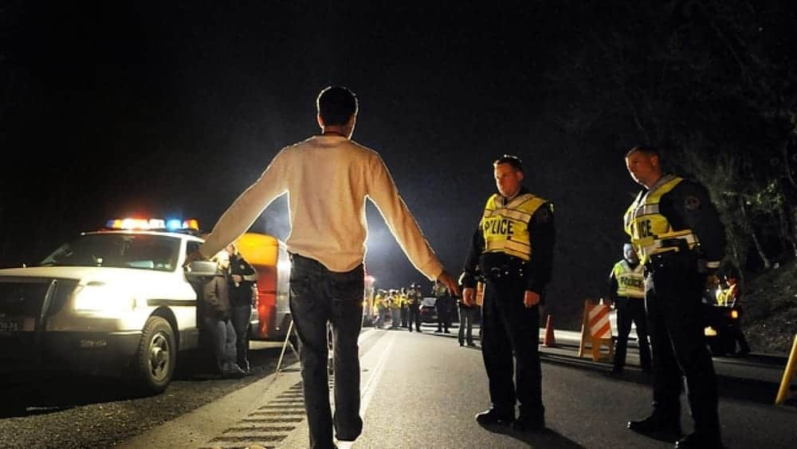
By What Standard?
2 Corinthians 10:10 12 For we are not bold to class or compare ourselves with some of those who commend themselves; but when they measure themselves by themselves and compare themselves with themselves, they are without understanding.
Notes:
So the question for us naturally : Who determines what’s sinful? Who has the authority?
Click
2 Corinthians 10:10 12 For we are not bold to class or compare ourselves with some of those who commend themselves; but when they measure themselves by themselves and compare themselves with themselves, they are without understanding.
I can find someone I’m better than, I’m probably that person of which someone else is doing the same – see I’m better than Rob.
And the same goes for you.
So what is the standard? Can we have the standard?
If I’m pulled over for drunk driving in Xiamen, if the Law is 0% alcohol when Driving - I can’t tell a cop that for me My standard of alcohol level is 2%, so he doesn’t get to send me to jail.
I don’t get to make the standard, because I’m not the ruler of the universe. God is and he’s revealed to me and you some standard of goodness to which we’re accountable.
The Standard has him as the reference point, not me.
So the person who makes the rules makes the standard – and if we’re honest, the important rules, we all really know, right?
Everyone here has at some point in their life said something or done something, that when we're thinking clearly and not trying to protect ourselves - something we know was sinful.
Anyone here:
intentionally say something passive aggressively to harm or manipulate another person?
Waste time on Taobao?
Not disciplined in what you eat? when you go to bed?
Misrepresent yourself (lie about your past) to advance a relationship with someone with whom you’re attracted to?
Misrepresent the numbers in your work report?
Exaggerate or lie on your resume?
So that means you’re normal. But normal is one thing to us and another thing to God

Slide 12
Review: Sin Is
Missing the Mark: Sin – doing something that makes us less than what we were made to be
ἁμαρτίαις
Khata חטא
Transgression/Lawlessness – violating/betraying a relationship
ἀνομίαν
Pesha פֶּשַׁע
Iniquity – Corruption,
κοινῶσαι - to make common
(עָווֹן. (Avon))
Not merely something we do, but something that has corrupted or infected us
Everyone is Guilty of Sin

Slide 13
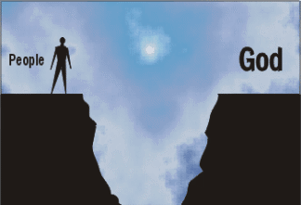
Part II: The Consequences of Sin

Slide 14
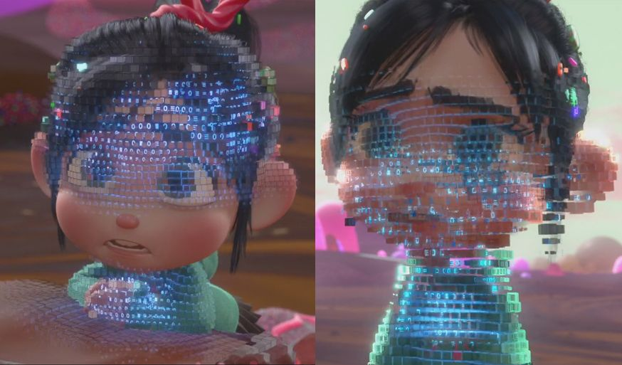
Sin: Corrupts and Perverts US to serving degraded pleasures
Romans 1:23 and exchanged the glory of the incorruptible God for an image in the form of corruptible man and of birds and four-footed animals and crawling creatures. 24 Therefore God gave them over in the lusts of their hearts to impurity, so that their bodies would be dishonored among them. 25 For they exchanged the truth of God for a lie, and worshiped and served the creature rather than the Creator, who is blessed forever. Amen.
Notes:
Anybody see Wreck-it Ralph
There’s this character called Glitch who makes the game unplayable – and she glitches because the code of the game is corrupted, and it becomes more unplayable as the game goes on. One character's sin and deception spreads through the whole game and threatens to destroy everything.
It’s a great picture of the corruption of sin. When we sin, we’re trying to re-allign the world around ourselves and life gets buggy and perverted.
Per Version – means another ILLEGETIMATE version – a lesser version
We create identities for ourselves apart from the reference point of God,
and claim a right to those identities.
This is basically idolatry – it’s the consequence of the sin of transgression – It’s the result of is Saying to God – I don’t’ want to submit to your order of the universe. I want to create my own version – my PER version.
CLICK – read Romans
In Romans 1 – we down-grade our lives:
Exchange a relationship with a glorious beautiful God…. For a limited finite physical practical world
In stead of submitting and wrestling through our desires that tempt us – we give into them, and they then rule over us.
Our bodies become dishonored
We live for a lie ( the lie of our own world revolving around us) and lose the ability to perceive the truth.
We still worship- we were made to worship – but we worship that which is inferior, inadequate, and unsatisfying.

Slide 15
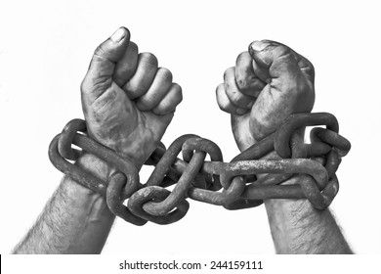
Sin: Enslaves Us
John 8: 34 Jesus answered them, “Truly, truly, I say to you, everyone who commits sin is the slave of sin.
Romans 6:12 Therefore do not let sin reign in your mortal body so that you obey its lusts, 13 and do not go on presenting the members of your body to sin as instruments of unrighteousness;
Notes:
And after we’re perverted and degraded, we find ourselves enslaved.
We see this all around us
- Those things in our life we struggle desperately to overcome, that at first were easy to stop when we wanted to
but now – we can’t stop
Alcohol
Online media
Shopping
Nagging
Bringing up an offense
Complex puzzle of lies we tell to those around us that we have to maintain because we feel they won’t love us if they knew how fallen we are.
And it ends up
READ TEXT

Slide 16
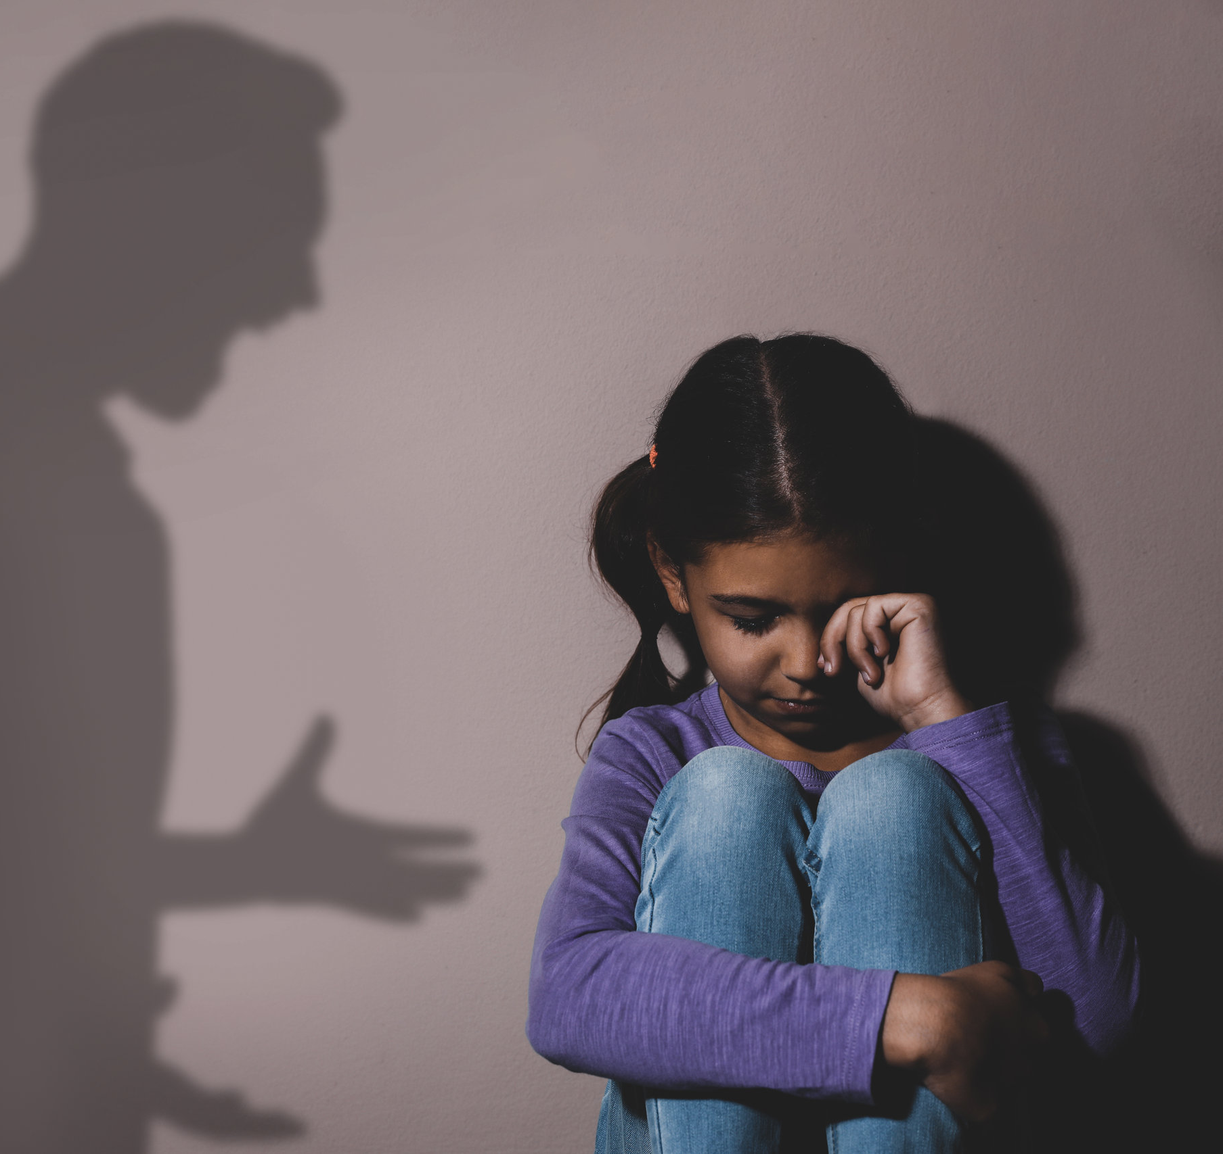
Sin: Harms Others Around us
Exodus 34: visiting the iniquity of fathers on the children and on the grandchildren to the third and fourth generations.”
Romans 6: 12 Therefore do not let sin reign in your mortal body so that you obey its lusts, 13 and do not go on presenting the members of your body to sin as instruments of unrighteousness
Instruments=weapons
Notes:
Ans as we’re enslaved to our sins – we find we hurt those around us
Exodus 34 Used to always bother me till I understood that it’s a necessary consequence for our decisions to have real meaning in life.
For my choice to sin or obey to be significant – it must have a consequence, and in so far as I live with others – theyre’ affected.
My children – and their children… are all impacted by my iniquity.
Hurt people hurt people
Children of Alcoholics tend to be what…?
Parents with abusive tempers…
Romans 6: our members are instruments of urighteousness – WEAPONS
- Weapons can be used both ways – to advance a godly kingdom in our lives and the lives of those around us – or to tear down and hurt those around us.

Slide 17
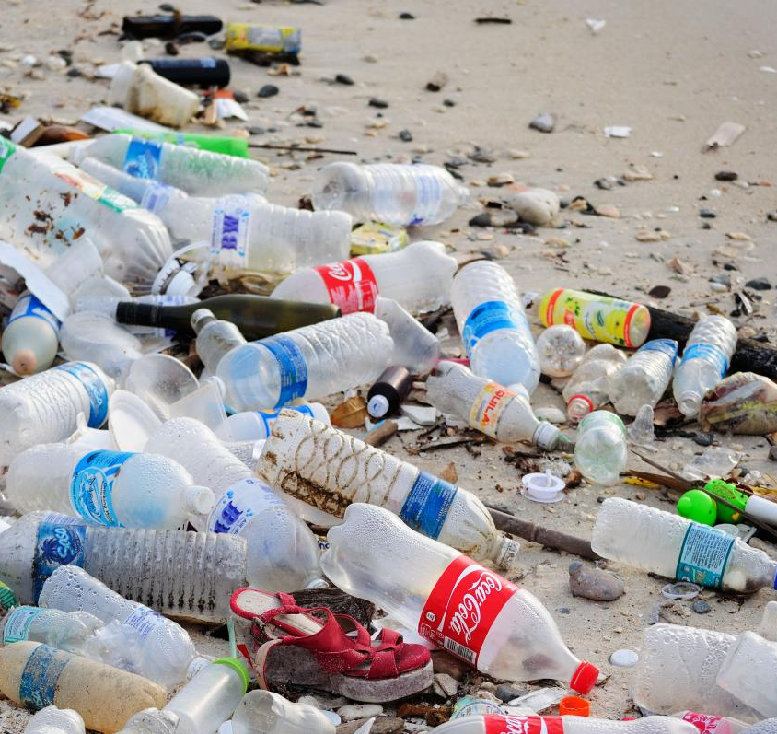
Sin: Harms Nature
19 For the anxious longing of the creation waits eagerly for the revealing of the sons of God. 20 For the creation was subjected to futility, not willingly, but because of Him who subjected it, in hope 21 that the creation itself also will be set free from its slavery to corruption into the freedom of the glory of the children of God.
Notes:
Christians care about the invironment not because they're fearful about a worldwide climate catastrophe
Regardless of that.
We as Christians were created to Rule and steward this world - we're supposed to take care of it, manage it well, help it flourish. Adam before the fall had a relationship with the animals. Caring about the environment and animals is a thoroughly Christian idea.

Slide 18
Sin: Brings Death & God’s Wrath Now
Romans 1: 18 For the wrath of God is revealed from heaven against all ungodliness and unrighteousness of men who suppress the truth in unrighteousness, 19 because that which is known about God is evident within them; for God made it evident to them. 20 For since the creation of the world His invisible attributes, His eternal power and divine nature, have been clearly seen, being understood through what has been made, so that they are without excuse.
Romans 6:23 For the wages of sin is death
Notes:
Romans 1:18 – talks about the fallenness of the world now – which is judgment for our sin and the systemic sinfulness around us.
READ
There’s a lot of talk about systemic racism, or systemic injustice – with the hope that we tear down these structures and build anew.
So naïve – Rousseau is wrong – we’re not messed up because of our structures in society. WE MADE THESE STRUCTURES – they’re from us.
The God’s Wrath is giving us the consequences that naturallry follow from crafting a life apart from him.
And the ultimate result is death.
ROMANS 6:23 Death is the ultimate trajectory and consequence of sin. Death means separation from life and flourishing.

Slide 19
Sin Brings a Day of Judgement
John 5:28 Do not marvel at this; for an hour is coming, in which all who are in the tombs will hear His voice, 29 and will come forth; those who did the good deeds to a resurrection of life, those who committed the evil deeds to a resurrection of judgment.
Romans 2:14 For when Gentiles who do not have the Law do instinctively the things of the Law, these, not having the Law, are a law to themselves, 15 in that they show the work of the Law written in their hearts, their conscience bearing witness and their thoughts alternately accusing or else defending them, 16 on the day when, according to my gospel, God will judge the secrets of men through Christ Jesus.
Romans 6:23 For the wages of sin is death
Notes:
Which comes to my last point:
There are a lot of things I’m uncertain about in my eschatology.
But one thing I’m sure of:
There will be a time of Judgment and Reconning:
Jesus: John 5:28 Do not marvel at this; for an hour is coming, in which all who are in the tombs will hear His voice, 29 and will come forth; those who did the good deeds to a resurrection of life, those who committed the evil deeds to a resurrection of judgment.
Paul: Romans 2:14 For when Gentiles who do not have the Law do instinctively the things of the Law, these, not having the Law, are a law to themselves, 15 in that they show the work of the Law written in their hearts, their conscience bearing witness and their thoughts alternately accusing or else defending them, 16 on the day when, according to my gospel, God will judge the secrets of men through Christ Jesus.
There will come a day when the Stories we tell, the Truth we try to spin – if it is a truth that’s fabricated – we will unable to escape from it.

Slide 20
Romans 5:8 But God demonstrates His own love toward us, in that while we were yet sinners, Christ died for us. 9 Much more then, having now been justified by His blood, we shall be saved from the wrath of God through Him. 10 For if while we were enemies we were reconciled to God through the death of His Son, much more, having been reconciled, we shall be saved by His life.
Notes:
The seriousness of sin is revealed by the seriousness of the punishment that it necessitates.
Wages of Sin is? … Death
Your sin, my sin, necessitates this.
You deserve death, I deserve death -
I put this iconic picture of the crucifixion here, but I wanted to take something from Mel Gibson’s movie the Passion of the Christ.
It’s important that we reflect on this.
Your Sin My Sin is so serious and so reprehensible to God. The Cost is so high - we cannot pay it. We cannot atone for the guilt of our sin.
Only a perfect and holy God can. It took the only good person who ever lived - the only completely beautiful person - the King of the Universe. it took him, humbling himself to die for you and me. It took this to deal with my sin - this is the only way we can be able to have a relationship with God.
CLICK!!!
8 But God demonstrates His own love toward us, in that while we were yet sinners, Christ died for us. 9 Much more then, having now been justified by His blood, we shall be saved from the wrath of God through Him. 10 For if while we were enemies we were reconciled to God through the death of His Son, much more, having been reconciled, we shall be saved by His life.
CLICK
Our joy as Christians is proportional to the degree to which we understand the depth of our guilt, and the height of His grace for us.

Slide 21
Grace and Forgiveness Foreshadowed
Isaiah 53: He was crushed for our iniquities; The chastening for our well-being fell upon Him, And by His scourging we are healed.6 All of us like sheep have gone astray, Each of us has turned to his own way; But the LORD has caused the iniquity of us all To fall on Him.
Psalm 32:How blessed is he whose transgression is forgiven, Whose sin is covered!
…
5 I acknowledged my sin to You, And my iniquity I did not hide; I said, “I will confess my transgressions to the LORD”; And You forgave the guilt of my sin.
Notes:
And this Grace is a central theme of the entire Bible - not just the New Testament. the New Testament completes the hope for redemption in the old testament.
This Isaiah 53 passage was translated into the Septuagent 300 years before the birth of Jesus (written about 6-700 years before)
This hope of the forgiveness of sin in the Psalms and the prophets – all hinges upon the death and resurrection of Christ and his atonement for our sin.

Slide 22
Notes:
We’re Separated from God
CLICK
Our Sin results in death and separation from God in this life and it continues on into the next.
We separate people from us in our society
CLICK
But is’ in the Cross of Christ that we find Grace.

Slide 23
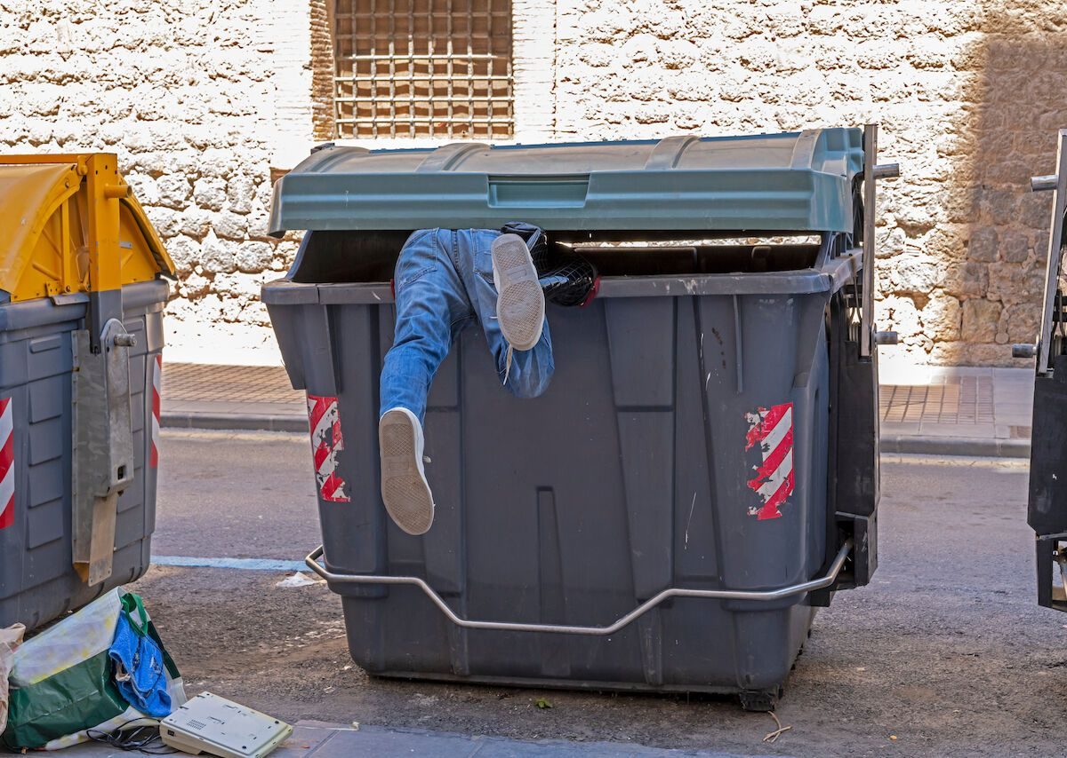
Dumpster Pastor
Notes:
Brent Hanson Tells the story about a Pastor who was struggling with looking at inappropriate magazines. (probably 20 years ago)
Struggled with an addiction to this:
- look and feel guilty – look and feel guilty
- wife went away on business trip so he decided to finally throw them away
- took them down to the dumpster and threw them away
- back in his house, he had second thoughts – tempted again.
- went back to get them out of the dumpster – dove in, broke his arm and was stuck there.
- a pastor stuck there in a dumpster with his dirty magazines.
No where to hide, and his wife had to help pull him out.
Brent goes on to talk about what would it be like if we had a church full of dumpster pastors?
I like this story because it’s a great metaphor of all of us.
We are all just like this dumpster pastor.
Totally busted, with no escape – our sin must be dealt with, and Grace is the only solution.

Slide 24
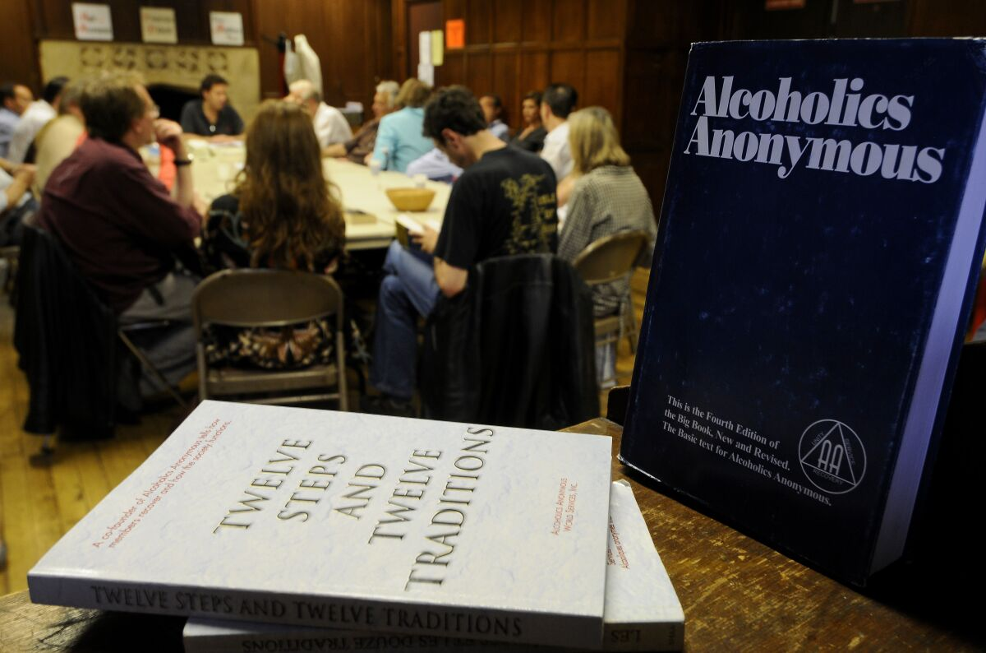
Notes:
What if our church really was like a bunch of dumpster pastors? It’s probably be one of the most freeing places in the world to be.
Probably like an Alcoholics anonymous group where someone walks in and says – I know what you did! You’re an alcoholic!
The group would probably stare for a minute, and then bust out laughint. Yes – this is the place alcoholics go and we’re all in the recovery process.

Slide 25
Grace and a New Heart
Romans 6:23 For the wages of sin is death, but the free gift of God is eternal life in Christ Jesus our Lord.
Romans 10:9 if you confess with your mouth Jesus as Lord, and believe in your heart that God raised Him from the dead, you will be saved
Acts 2:38 “Repent, and each of you be baptized in the name of Jesus Christ for the forgiveness of your sins; and you will receive the gift of the Holy Spirit.
Notes:
I’ve studied most of the major world religions, and most of the modern philosophies.
The difference between Christianity and all of them is this:
Brutal honesty about my sin
Hope for real grace – rooted in a historical fact of the death and resurrection of Jesus Christ
Here in the East philosophies of Buddism and Taoism are popular (in the west as well)
Buddhism tells me my solution is desire – end my desire and I find unity and peace.
But Jesus tells me my problem is not in my having desire, but in the bentness and crookendness and perversion of my desire. What I need is not to end that desire but to have a new heart.
Jesus satisfies what we know most about ourselves: We’re sinful and need help, it’s messing us up and everything around us - and we can’t fix ourselves.
Romans 6:23 For the wages of sin is death, but the free gift of God is eternal life in Christ Jesus our Lord.
Romans 10:9 if you confess with your mouth Jesus as Lord, and believe in your heart that God raised Him from the dead, you will be saved
Acts 2:38 “Repent, and each of you be baptized in the name of Jesus Christ for the forgiveness of your sins; and you will receive the gift of the Holy Spirit.

Slide 26
Lord, I admit I am a sinner. I need and want Your forgiveness. I accept Your death as the penalty for my sin, and recognize that Your mercy and grace is a gift You offer to me because of Your great love, not based on anything I have done. Cleanse me and make me Your child. By faith I receive You into my heart as the Son of God and as Savior and Lord of my life. From now on, help me live for You, with You in control.
In Your precious name, Amen
Notes:
Sinner’s prayer here
“It’s not the prayer that saves; it’s the repentance and faith behind the prayer that lays hold of salvation.

Slide 27
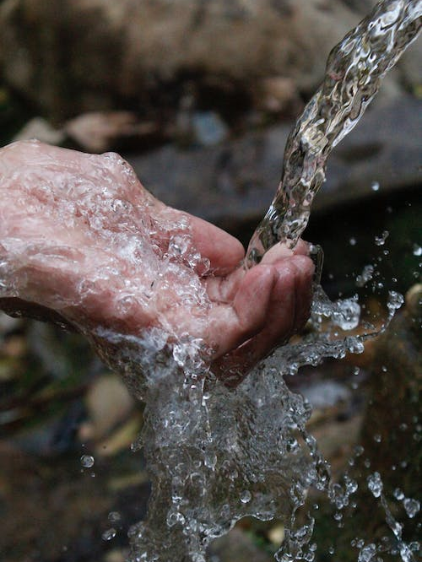
Repent and Enter Fellowship with the Lord and US
Acts 3:19 19 Therefore repent and return, so that your sins may be wiped away, in order that times of refreshing may come from the presence of the Lord;

Slide 28
Small Group Questions
Which aspect of sin did you find worrying for you? Sin, Transgression, Iniquity
In what ways to you see yourself minimizing the seriousness of sin in your own life or in the lives of others?
Read Exodus 34:6-8. How do you see God’s heart toward us? Why do you think God takes sin so seriously?
Have you seen sinful decisions make someone’s life glitchy, complicated, and weary?
Are there any sins you feel are enslaving you, or could have the potential to do so?
Take a minute to pray and ask God if there’s anything in your life that is hindering, diminishing, or enslaving you? Take time to confess, ask forgiveness, and repent. Share with a close friend if you can.
Notes:
Take a minute to pray and ask God if there’s anything in your life that is hindering, diminishing, or enslaving you? Take time to confess, ask forgiveness, and repent. Share with a close friend if you can.

