Slide 1
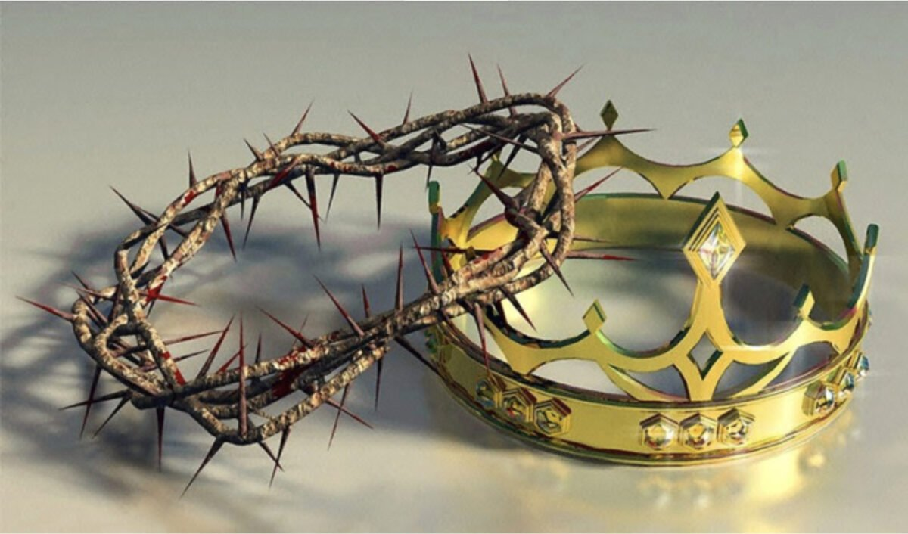
God our Sovereign Lord and King!!
Has the potter no right over the clay, to make out of the same lump one vessel for honorable use and another for dishonorable use?
Romans 9:21

Slide 2
Romans 12:1-2… I appeal to you therefore, brothers, by the mercies of God, to present your bodies as a living sacrifice, holy and acceptable to God, which is your spiritual worship. Do not be conformed to this world, but be transformed by the renewal of your mind, that by testing you may discern what is the will of God, what is good and acceptable and perfect.
Romans 6:1-2… What shall we say then? Are we to continue in sin that grace may abound? By no means! How can we who died to sin still live in it?
4 steps to restoration
1. Self examination - 2Corinthians 13:5
2. Brokenness and humility - Psalm 51:17
3. Knowledge - Proverbs 11:9
4. Being ready to do it. - James 2:26

Slide 3
The sovereignty of God….
Romans 8:28… And we know that for those who love God all things work together for good, for those who are called according to his purpose.
“God’s sovereignty is his right and power to do all that he decides to do.” - John Piper.
Romans 9:21…. Has the potter no right over the clay, to make out of the same lump one vessel for honorable use and another for dishonorable use?

Slide 4
1. Omnipotent - All powerful
Romans 8:37-39… No, in all these things we are more than conquerors through him who loved us. For I am sure that neither death nor life, nor angels nor rulers, nor things present nor things to come, nor powers, nor height nor depth, nor anything else in all creation, will be able to separate us from the love of God in Christ Jesus our Lord.
2. Omniscient - All knowing
Romans 11:33… Oh, the depth of the riches and wisdom and knowledge of God! How unsearchable are his judgments and how inscrutable his ways!
3. Omnipresent - Everywhere & Not bound my time
Romans 16:25-26… Now to him who is able to strengthen you according to my gospel and the preaching of Jesus Christ, according to the revelation of the mystery that was kept secret for long ages but has now been disclosed and through the prophetic writings has been made known to all nations, according to the command of the eternal God, to bring about the obedience of faith.

Slide 5
The expressions of God’s sovereignty…
1. Plan & purposes for His creation
Isaiah 46:9-10… remember the former things of old; for I am God, and there is no other; I am God, and there is none like me, declaring the end from the beginning and from ancient times things not yet done, saying, ‘My counsel shall stand, and I will accomplish all my purpose,’
2. Hearts and decisions of humans
Proverbs 21:1… The king’s heart is a stream of water in the hand of the LORD; he turns it wherever he will.
3. Sufferings of life
Daniel 4:35… all the inhabitants of the earth are accounted as nothing, and he does according to his will among the host of heaven and among the inhabitants of the earth; and none can stay his hand or say to him, “What have you done?”

Slide 6
The expressions of God’s sovereignty…
4. Nations & Kingdoms
Psalm 33:10-11… The LORD brings the counsel of the nations to nothing; he frustrates the plans of the peoples. The counsel of the LORD stands forever, the plans of his heart to all generations.
5. Seemingly random events
Proverbs 16:33… The lot is cast into the lap, but its every decision is from the LORD.
6. Salvation of humanity
Ephesians 1:11… In him we have obtained an inheritance, having been predestined according to the purpose of him who works all things according to the counsel of his will,

Slide 7
The sovereignty of God in the salvation of humanity….
First, then, DIVINE SOVEREIGNTY AS EXEMPLIFIED IN SALVATION. If any man be saved, he is saved by divine grace and by divine grace alone; the reason of his salvation is not to be found in him, but in God. We are not saved as the result of anything that we do or that we will, but we will and do as the result of God’s good pleasure and the work of His grace in our hearts. No sinner can prevent God; that is, he cannot go before Him, cannot anticipate Him. God is always first in the matter of salvation. He is before our convictions, before our desires, before our fears, and before our hopes. All that is good or ever will be good in us is preceded by the grace of God and is the effect of a divine cause within.” - Charles H. Spurgeon
A review of Romans 9 presents a clear picture of how the sovereignty of God is at play in the salvation of all who call on Him…

Slide 8
Key references from Romans 9….
Romans 9:7-8… and not all are children of Abraham because they are his offspring, but “Through Isaac shall your offspring be named.” This means that it is not the children of the flesh who are the children of God, but the children of the promise are counted as offspring.
Romans 9:15-16… For he says to Moses, “I will have mercy on whom I have mercy, and I will have compassion on whom I have compassion.” So then it depends not on human will or exertion, but on God, who has mercy.
Romans 9:21… Has the potter no right over the clay, to make out of the same lump one vessel for honorable use and another for dishonorable use?

Slide 9
Conclusion….
We must live a life of total submission to God as our sovereign Lord & King.
Our knowledge of the sovereignty of God helps deal with our fears & worries!!
We must learn to trust God through every turn of Life…
God has a plan of salvation and we must be ready to play our part, we are His workmanship in Christ.
Let us pray….

