Slide 1
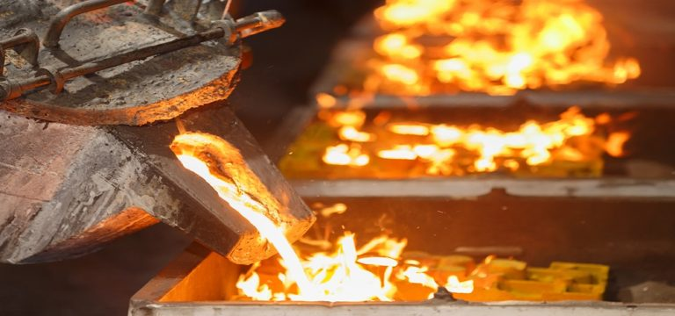
Sanctification: A review of Romans chapter 6.
What shall we say then? Are we to continue in sin that grace may abound? By no means! How can we who died to sin still live in it?
Romans 6:1-2

Slide 2
for all have sinned and fall short of the glory of God… Romans 3:23 For if, because of one man's trespass, death reigned through that one man, much more will those who receive the abundance of grace and the free gift of righteousness reign in life through the one man Jesus Christ… Romans 5:17 because, if you confess with your mouth that Jesus is Lord and believe in your heart that God raised him from the dead, you will be saved… Romans 10:9 Therefore, since we have been justified by faith, we have peace with God through our Lord Jesus Christ... Romans 5:1
Justification is the Process whereby God declares a person to be righteous on the basis of faith in the Person and work of Christ. By so doing God liberates a person from the guilt of sin and imputes His righteousness through the sacrifice of Jesus Christ.

Slide 3
1. Positional sanctification is that state of holiness imputed to the Christian at the moment of their conversion to Christ… 1Corinthians 1:2 2. Progressive sanctification refers to the process in our daily lives by which we are being conformed to the image of Christ… Colossians 3:1-10 3. Ultimate sanctification is that state of holiness that we will not attain to in this life, but will realize when we are finally in the presence of God… 1John 3:2
Sanctification is the activity of God which liberates the Christian from the power of sin. Sanctification imparts the righteousness of God through man.

Slide 4
The argument of the apostle Paul in Romans 6 is that we are obligated to experience progressive sanctification because of our positional sanctification accomplished on the cross of Calvary. In this chapter the apostle Paul provides valid ground for believers to pursue Holiness!!
A review of Romans Chapter 6….
What shall we say then? Are we to continue in sin that grace may abound? By no means! How can we who died to sin still live in it? Romans 6:1-2

Slide 5
Romans 6:1-2 1. What shall we say then? Are we to continue in sin that grace may abound? 2. By no means! How can we who died to sin still live in it? - Grace is not an excuse to sin…
1. God provided His grace to deal with our sins… Romans 5:20 2. We are dead to sin and must live for Christ… Romans 6:2 3. Living a life of sin is inconsistency with our position in Christ!!

Slide 6
Romans 6:3-14 3. Do you not know that all of us who have been baptized into Christ Jesus were baptized into his death? 4. We were buried therefore with him by baptism into death, in order that, just as Christ was raised from the dead by the glory of the Father, we too might walk in newness of life. 5. For if we have been united with him in a death like his, we shall certainly be united with him in a resurrection like his. 6. We know that our old self was crucified with him in order that the body of sin might be brought to nothing, so that we would no longer be enslaved to sin. 7. For one who has died has been set free from sin. 8. Now if we have died with Christ, we believe that we will also live with him. 9. We know that Christ, being raised from the dead, will never die again; death no longer has dominion over him. 10. For the death he died he died to sin, once for all, but the life he lives he lives to God. 11. So you also must consider yourselves dead to sin and alive to God in Christ Jesus. 12. Let not sin therefore reign in your mortal body, to make you obey its passions. 13. Do not present your members to sin as instruments for unrighteousness, but present yourselves to God as those who have been brought from death to life, and your members to God as instruments for righteousness. 14. For sin will have no dominion over you, since you are not under law but under grace - We are dead in Christ; sin must die in us…

Slide 7
Romans 6:3-14 - We are dead in Christ; sin must die in us…
1. By our baptism into Christ we died with Christ to sin… Romans 6:3 2. Baptism is not just a church ceremony. It is important and symbolic. 3. Do not make way for sin in your life… Roman 6:12-13

Slide 8
Romans 6:15-23 15. What then? Are we to sin because we are not under law but under grace? By no means! 16. Do you not know that if you present yourselves to anyone as obedient slaves, you are slaves of the one whom you obey, either of sin, which leads to death, or of obedience, which leads to righteousness? 17. But thanks be to God, that you who were once slaves of sin have become obedient from the heart to the standard of teaching to which you were committed, 18. and, having been set free from sin, have become slaves of righteousness. 19. I am speaking in human terms, because of your natural limitations. For just as you once presented your members as slaves to impurity and to lawlessness leading to more lawlessness, so now present your members as slaves to righteousness leading to sanctification. 20. For when you were slaves of sin, you were free in regard to righteousness. 21. But what fruit were you getting at that time from the things of which you are now ashamed? For the end of those things is death. 22. But now that you have been set free from sin and have become slaves of God, the fruit you get leads to sanctification and its end, eternal life. 23. For the wages of sin is death, but the free gift of God is eternal life in Christ Jesus our Lord. - Slaves of Sin or slaves of God?

Slide 9
Romans 6:15-23 - Slaves of Sin or slaves of God?
1. Our salvation by grace is not a license to sin!!... Romans 6:15 2. Obedience to God’s will is non-negotiable!! 3. Sin begets death and Holiness begets life… Romans 6:21

Slide 10
Conclusion…
1. A life given to Christ must be a life radically transformed.
2. Our actions must conform to our position in Christ.
3. Let us be motivated to engage the Holy Spirit through the word of God to live a sanctified life!!
Let us pray!!

Slide 11
Small group meetings…
Men’s small group…
Jimei small group…
Xiada small group…
Salt and light small group…
Sunday morning small group…

