Slide 1
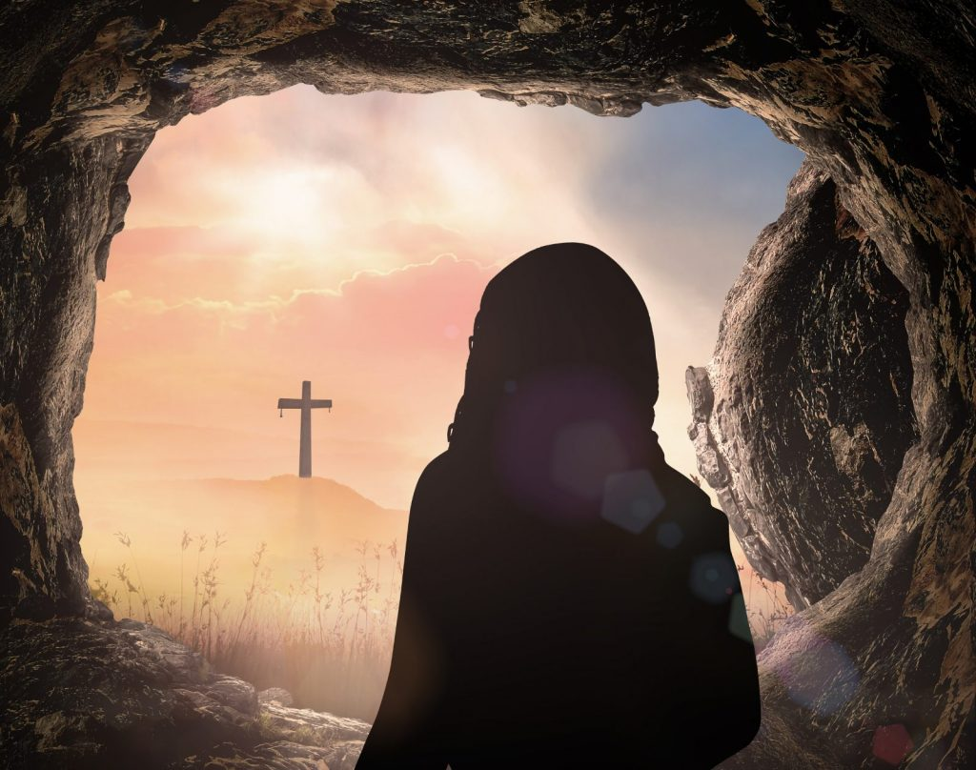
The Resurrection
Notes:
Happy Easter!
This is the most exciting Sunday of all Sundays.
It’s the Sunday that the linchpin of our faith is the focus of our Attention
- The Resurrection of Christ.

Slide 2
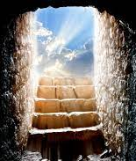
4 Main Sections
The Resurrection and History
The Resurrection and The Gospel
The Resurrection and Our Daily Life
The Resurrection and Our Future

Slide 3
Part 1 The Resurrection and History
The Historical Fact of the Resurrection
Notes:
Christians are Stewards of the Truth
We live in a time of Narrative Truth. Where we tell our stories – “Live our Truth”
However, we can’t have our own realities, there must be a common one that unites us.
And as Christians, we believe at the center of this objective reality is a God who loves us, and the clearest place he revealed his love is in the death and resurrection of Jesus.
I’m going to give a 10 minuts short apologetic on the historical reality of the resurrection.

Slide 4
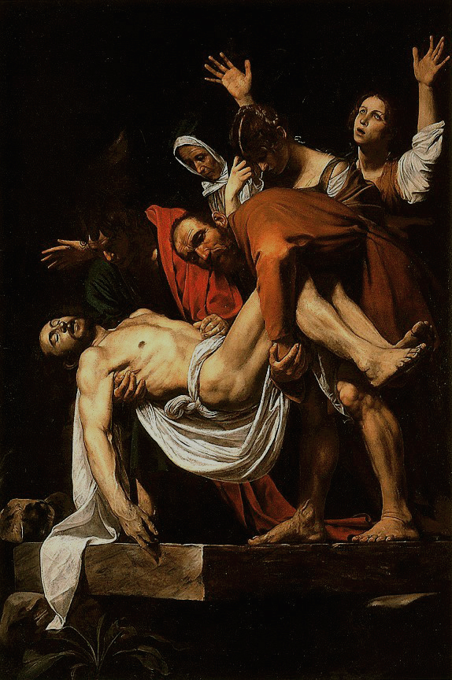
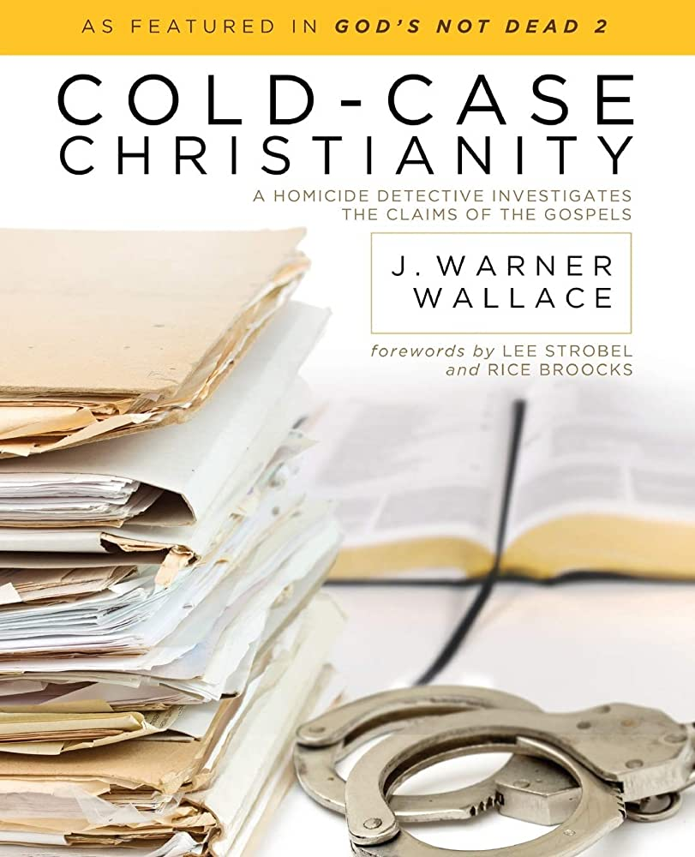
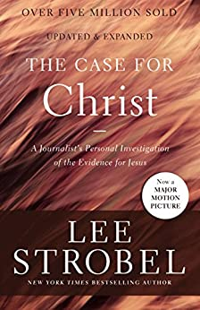
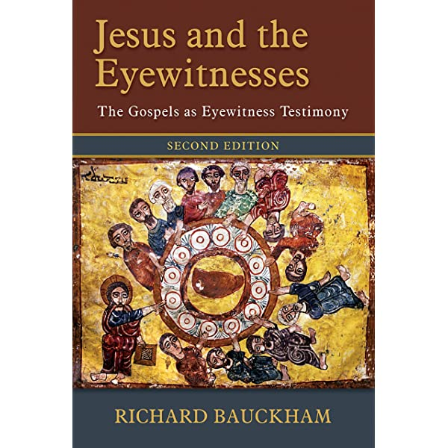
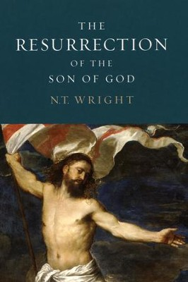
Swoon Theory
Stolen Body Theory
Mass Hallucination
Notes:
This would be a 2 hour lecture if I were to do it justice.
If you’re keen to read on this topic in detail: Recommend 4 books: Cold case Christianity, The Case for Christ – accessible to all. Jesus and the Eyewitnesses, The Resurrection of the Son of God.
There’ve been some popular attempts over the years to explain away the resurrection
Swoon Theory:
The “swoon theory” argues that Jesus never really died, only appeared to have died, and then came back to life while buried in the tomb.
German Karl Friedrich Bahrdt, who suggested in around 1780
- the physician Luke gave him drugs to make him appear to be dead to appear as a spiritual messiah and get Israel to abandon the idea of a political messiah.
Heinrich E.G. Paulus in The Life of Jesus (1828)
Hugh Schonfeld in 1960’s
Pastor Greg Laurie tells a story about a reader’s writing to a local newspaper - asking about “swoon theory”
The writer writes: “Our preacher on Easter said that Jesus just swooned on the cross and that His disciples nursed Him back to health. What do you think? Sincerely signed, Bewildered.”
So somebody at the newspaper wrote back, “Dear Bewildered, beat your preacher with a cat o’ nine tails with 39 heavy strokes. Nail him to a cross, hang him out in the sun for six hours, run a spear through his heart, and embalm him, and put him in an airless tomb for 36 hours and see what happens.”
This is the most elegant rebuttal to this theory I can find.
Those who were flogged would often go into hypovolemic shock, a term that refers to low blood volume. In other words, the person would have lost so much blood he would go into shock. The results of this would be: 1) The heart would race to pump blood that was not there. 2) The victim would collapse or faint due to low blood pressure. 3) The kidneys would shut down to preserve body fluids. 4) The person would experience extreme thirst as the body desired to replenish lost fluids.
There is evidence from Scripture that Jesus experienced hypovolemic shock as a result of
being flogged.
carried His own cross to Golgotha (John 19:17), he collapsed
Simon was forced to either carry the cross or help Jesus carry the cross the rest of the way to the hill (Matthew 27:32–33; Mark 15:21–22; Luke 23:26).
This collapse indicates Jesus had low blood pressure. Another indicator that Jesus suffered from hypovolemic shock was that He declared He was thirsty as He hung on the cross (John 19:28), indicating His body’s desire to replenish fluids. Prior to death, the sustained rapid heartbeat caused by hypovolemic shock also causes fluid to gather in the sack around the heart and around the lungs. This gathering of fluid in the membrane around the heart is called pericardial effusion, and the fluid gathering around the lungs is called pleural effusion.
Medically, the only explanation of the water and blood flowing – is death.

Slide 5
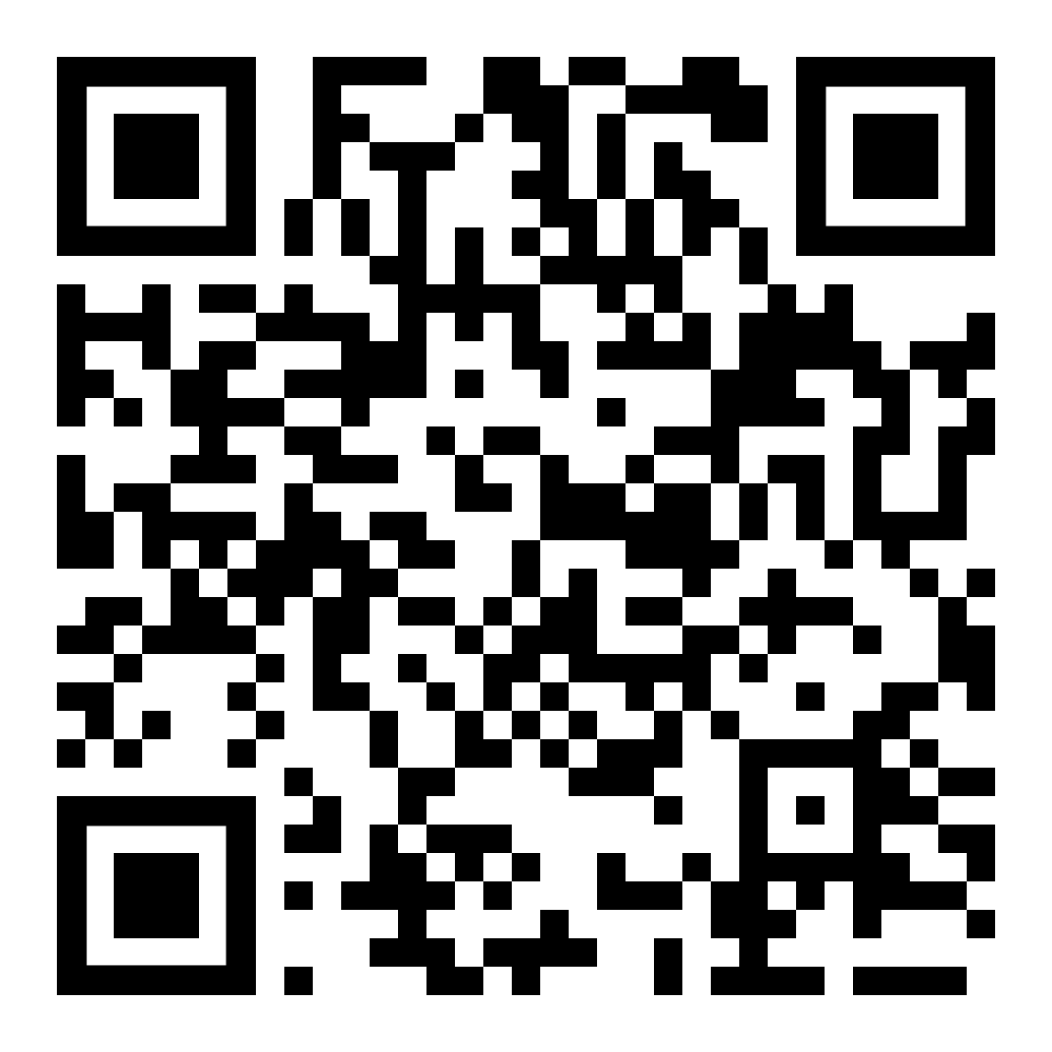
Swoon Theory
Stolen Body Theory
Mass Hallucination
Babylon Bee Satire Video
Notes:
The stolen body hypothesis posits that the body of Jesus Christ was stolen from his burial place. His tomb was found empty not because he was resurrected, but because the body had been hidden somewhere else by the apostles.
Main objections to this
Guarded by Roman Soldiers – who get killed if they lie
Jesus’s teaching obviously preclude this kind of a crime – no doubt their consciences would be driving them nuts. 1 out of 12 would have broken.
People act in their own interest. People don’t die for a lie. All the apostles died as martyrs – John exiled on Isle of Patmos.
Hilarious Babylon Bee Youtube Video
Peter is trying to convince the disciples to steal the body of Jesus so they can die as martyrs.

Slide 6
Swoon Theory
Stolen Body Theory
Mass Hallucination
Notes:
Finally there’s the mass hallucination
Which just sounds like grasping for straws
Eyewitness accounts
Road To Emmaeus
Cooks fish for them
Shows up with them at beach cooking fish
Visits in the upper room
To me it simply takes more faith to believe this than any of the other theories.

Slide 7
1 Corinthians 15: 1-8 (AD 50-53)
1 Corinthians 15: 1 Now I make known to you, brethren, the gospel which I preached to you, which also you received, in which also you stand, 2 by which also you are saved, if you hold fast the word which I preached to you, unless you believed in vain.
3 For I delivered to you as of first importance what I also received, that Christ died for our sins according to the Scriptures, 4 and that He was buried, and that He was raised on the third day according to the Scriptures, 5 and that He appeared to Cephas, then to the twelve. 6 After that He appeared to more than five hundred brethren at one time, most of whom remain until now, but some have fallen asleep; 7 then He appeared to James, then to all the apostles; 8 and last of all, as to one untimely born, He appeared to me also. …
Notes:
Finally, there’s 1 Corinthians 15:
As I’ve read the most accomplished skeptics, this is the passage that brings the fact of the resurrection home.
Written in 50-53AD (about 20 years after Christ’s ascension) This was common knowledge in the Christian community. Paul was writing what her received from the apostles, and what was common knowledge in the early church.
Most scholars believe that Paul is reciting an early Christian creed or tradition that begins with verse 3
1 Corinthians 15: 1 Now I make known to you, brethren, the gospel which I preached to you, which also you received, in which also you stand, 2 by which also you are saved, if you hold fast the word which I preached to you, unless you believed in vain.
3 For I delivered to you as of first importance what I also received, that Christ died for our sins according to the Scriptures, 4 and that He was buried, and that He was raised on the third day according to the Scriptures, 5 and that He appeared to Cephas, then to the twelve. 6 After that He appeared to more than five hundred brethren at one time, most of whom remain until now, but some have fallen asleep; 7 then He appeared to James, then to all the apostles; 8 and last of all, as to one untimely born, He appeared to me also. …

Slide 8
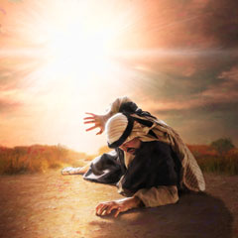
1 Corinthians 15 Key Points
Died for our sins (according to Scripture),
He was buried,
He was raised on 3rd day (according to Scripture),
He appeared to Peter,
He appeared to 12 disciples
He appeared to more than 500 brothers at one time
Paul’s Conversion
Notes:
The Key Points of the Gospel are here:
Died for our sins (according to Scripture),
Isaiah 53
4 Surely our griefs He Himself bore,
And our sorrows He carried;
Yet we ourselves esteemed Him stricken,
Smitten of God, and afflicted.
5 But He was pierced through for our transgressions,
He was crushed for our iniquities;
The chastening for our well-being fell upon Him,
And by His scourging we are healed.
6 All of us like sheep have gone astray,
Each of us has turned to his own way;
But the LORD has caused the iniquity of us all
To fall on Him.
he was buried,
They knew the people who buried him! They were still alive when this was written.
he was raised on 3rd day(according to Scripture),
Referring to Gospels as scripture – God’s word.
appeared to Peter,
(later crucified upside down)
Head of the Church – still alive (didn’t die )AD64)
Appeared to 12 disciples
All around teaching and leading
Appeared to more than 500 brothers at one time (most alive at the time of this letter)
Huge community of people growing day by day – thousands at a time.
Paul’s Conversion
Here we have one the most zealous persecutors of the church – going from town to town Killing Christians,
with a complete transformation.

Slide 9
Biblical Account of the Early Church
Notes:
This letter from Paul circulated around 20 years of the actual resurrection of Jesus
If this was a lie, we’d have seen documents that refuted this early on.
Paul wouldn’t be going to Rome
Crucifixion details:
Conformity of the Eyewitness accounts – Matthew, Mark, Luke, John.
External historical records (Josepheus) confirming Pilate, Herod, Ciaphas,
The Roman Soldier piercing Jesus’s side
Jesus eating food – showed it was a bodily resurrection
Apostles kept the inconvenient and embarrassing facts in these sacred texts:
Women were the first to visit the tomb – totally incredible witnesses at that time. But this was strong evidence that the account was made up
James and John wanting to Rule with Jesus above the others
Peter rebuking Jesus’s plan to die on the cross
Peter denying Jesus
Apostles not able to heal certain people
Apostles bumbling lack of understanding – second miracle of feeding the thousands – still didn’t get it.
Transformation and life-giving Community of the Early Christians:
Breaking down of barriers, racial and ethnic barriers
Galatians 3: 8 There is neither Jew nor Greek, there is neither slave nor free man, there is neither male nor female; for you are all one in Christ Jesus. 29 And if you belong to Christ, then you are Abraham’s descendants, heirs according to promise.
Dignity to Women
Dignity to singles
Equality to Slaves
Unity among Races and cultural groups
They became One in Christ.

Slide 10
Skeptics
Deny the miracle of the resurrection of Jesus and consequently make the expansion of the Early Church even more miraculous
Notes:
This is a map of the early churches by 3rd century – that’s in the 200’s. It’s prolific. Why?
The proof for the resurrection was solid
The followers of Jesus lived out their faith in an irrefutable way, infused by the power of the Holy Spirit.
Julian the Apostate, 361 to 363
Writing to a pagan priest he said:
“when it came about that the poor were neglected and overlooked by the [pagan] priests, then I think the impious Galilaeans [i.e., Christians] observed this fact and devoted themselves to philanthropy.” *
“[They] support not only their poor, but ours as well, all men see that our people lack aid from us.”
In fact, Julian proposed that pagan priests imitate the Christians’ charity in order to bring about a revival of paganism in the empire.
Julian’s program failed because, among other reasons, the polytheism of ancient Rome was unable to sustain the kind of self-sacrificial love and compassion that Eusebius observed in Caesarea.
The Main reason Skeptics deny the resurrection is because they have a philosophical framework of atheistic naturalism.
If you don’t assume naturalism, if you allow for the possibility of the supernatural – the Resurrection is not only the most rational view, but the only one that really makes any sense.
My main objection to Skeptical Biblical Scholars is that:
They deny the miracle of the resurrection of Jesus and consequently make the expansion of the Early Church even more miraculous

Slide 11
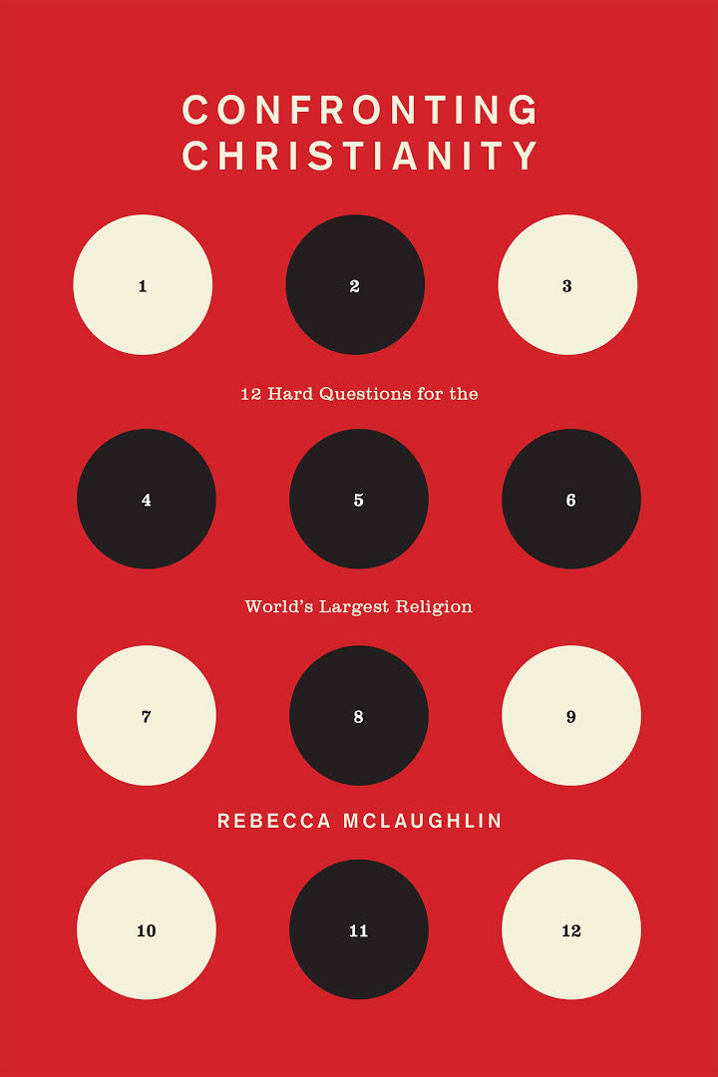
Lifeway Research
Notes:
So what does this mean for us today
Lifeway Research – 66% Of Americans believe in Christianity
Wasington times: The number roughly corresponds with the percentage of Americans who say they are Christians
The number roughly corresponds with the percentage of Americans who say they are Christians
However, only about 20% of the Population attend church.
Rebecca McLaughlin , author of Confronting Christianity (explores 12 questions that keep many modern people from considering faith in Christ.)
- she wrote an article about this Lifeway study and said:
I feel heartbroken - because the idea that someone would say they believe Jesus actually rose from the dead but that this belief would have so little impact on their life that they weren’t even part of a church is truly tragic. This exposes the danger of ‘cultural Christianity’—the vague assent to Christian beliefs without any evidence of actual faith in Christ.”
Which leads us to the next section:
The resurrection and the Gospel.

Slide 12
Part 2: The Resurrection and The Gospel
Notes:
If you recall from my last sermon on Sin, we ended in what we’d call a classical gospel presentation:
It’s the cross of Christ that bridges the way for us to have communion with a holy God

Slide 13
Review: Sin Is
Missing the Mark: Sin – doing something that makes us less than what we were made to be
ἁμαρτίαις
Khata חטא
Transgression/Lawlessness – violating/betraying a relationship
ἀνομίαν
Pesha פֶּשַׁע
Iniquity – Corruption,
κοινῶσαι - to make common
(עָווֹן. (Avon))
Not merely something we do, but something that has corrupted or infected us
Everyone is Guilty of Sin
Notes:
We also talked about sin
Enslaveing us
Harming those around us
Harming the earth
Brings God’s wrath now: Romans 1: 18 For the wrath of God is revealed from heaven against all ungodliness and unrighteousness of men who suppress the truth in unrighteousness, 19 because that which is known about God is evident within them; for God made it evident to them. 20 For since the creation of the world His invisible attributes, His eternal power and divine nature, have been clearly seen, being understood through what has been made, so that they are without excuse.

Slide 14
Sin Brings a Day of Judgement
John 5:28 Do not marvel at this; for an hour is coming, in which all who are in the tombs will hear His voice, 29 and will come forth; those who did the good deeds to a resurrection of life, those who committed the evil deeds to a resurrection of judgment.
Romans 2:14 For when Gentiles who do not have the Law do instinctively the things of the Law, these, not having the Law, are a law to themselves, 15 in that they show the work of the Law written in their hearts, their conscience bearing witness and their thoughts alternately accusing or else defending them, 16 on the day when, according to my gospel, God will judge the secrets of men through Christ Jesus.
Romans 6:23 For the wages of sin is death
Notes:
Which comes to my last point:
There are a lot of things I’m uncertain about in my eschatology.
But one thing I’m sure of:
There will be a time of Judgment and Reconning:
Jesus: John 5:28 Do not marvel at this; for an hour is coming, in which all who are in the tombs will hear His voice, 29 and will come forth; those who did the good deeds to a resurrection of life, those who committed the evil deeds to a resurrection of judgment.
Paul: Romans 2:14 For when Gentiles who do not have the Law do instinctively the things of the Law, these, not having the Law, are a law to themselves, 15 in that they show the work of the Law written in their hearts, their conscience bearing witness and their thoughts alternately accusing or else defending them, 16 on the day when, according to my gospel, God will judge the secrets of men through Christ Jesus.
There will come a day when the Stories we tell, the Truth we try to spin – if it is a truth that’s fabricated – we will unable to escape from it.

Slide 15
Romans 5:8 But God demonstrates His own love toward us, in that while we were yet sinners, Christ died for us. 9 Much more then, having now been justified by His blood, we shall be saved from the wrath of God through Him. 10 For if while we were enemies we were reconciled to God through the death of His Son, much more, having been reconciled, we shall be saved by His life.
Notes:
The seriousness of sin is revealed by the seriousness of the punishment that it necessitates.
Wages of Sin is? … Death
Your sin, my sin, necessitates this.
You deserve death, I deserve death -
I put this iconic picture of the crucifixion here, but I wanted to take something from Mel Gibson’s movie the Passion of the Christ.
It’s important that we reflect on this.
Your Sin My Sin is so serious and so reprehensible to God. The Cost is so high - we cannot pay it. We cannot atone for the guilt of our sin.
Only a perfect and holy God can. It took the only good person who ever lived - the only completely beautiful person - the King of the Universe. it took him, humbling himself to die for you and me. It took this to deal with my sin - this is the only way we can be able to have a relationship with God.
CLICK!!!
8 But God demonstrates His own love toward us, in that while we were yet sinners, Christ died for us. 9 Much more then, having now been justified by His blood, we shall be saved from the wrath of God through Him. 10 For if while we were enemies we were reconciled to God through the death of His Son, much more, having been reconciled, we shall be saved by His life.
CLICK
Our joy as Christians is proportional to the degree to which we understand the depth of our guilt, and the height of His grace for us.
So what’s the big Deal about the Resurrection??

Slide 16
1 Corinthians 15
12 Now if Christ is preached, that He has been raised from the dead, how do some among you say that there is no resurrection of the dead? 13 But if there is no resurrection of the dead, not even Christ has been raised; 14 and if Christ has not been raised, then our preaching is vain, your faith also is vain. 15 Moreover we are even found to be false witnesses of God, because we testified against God that He raised Christ, whom He did not raise, if in fact the dead are not raised. 16 For if the dead are not raised, not even Christ has been raised; 17 and if Christ has not been raised, your faith is worthless; you are still in your sins. 18 Then those also who have fallen asleep in Christ have perished. 19 If we have hoped in Christ in this life only, we are of all men most to be pitied.
Notes:
Let’s go back to 1 Corinthians 15.
READ:
12 Now if Christ is preached, that He has been raised from the dead, how do some among you say that there is no resurrection of the dead? 13 But if there is no resurrection of the dead, not even Christ has been raised; 14 and if Christ has not been raised, then our preaching is vain, your faith also is vain. 15 Moreover we are even found to be false witnesses of God, because we testified against God that He raised Christ, whom He did not raise, if in fact the dead are not raised. 16 For if the dead are not raised, not even Christ has been raised; 17 and if Christ has not been raised, your faith is worthless; you are still in your sins. 18 Then those also who have fallen asleep in Christ have perished. 19 If we have hoped in Christ in this life only, we are of all men most to be pitied.
What does Paul Say about the resurrection and it’s relationship to the good news?
CLICK

Slide 17
1 Corinthians 15
12 Now if Christ is preached, that He has been raised from the dead, how do some among you say that there is no resurrection of the dead? 13 But if there is no resurrection of the dead, not even Christ has been raised; 14 and if Christ has not been raised, then our preaching is vain, your faith also is vain. 15 Moreover we are even found to be false witnesses of God, because we testified against God that He raised Christ, whom He did not raise, if in fact the dead are not raised. 16 For if the dead are not raised, not even Christ has been raised; 17 and if Christ has not been raised, your faith is worthless; you are still in your sins. 18 Then those also who have fallen asleep in Christ have perished. 19 If we have hoped in Christ in this life only, we are of all men most to be pitied.
1. Our Preaching and Your Faith Are Meaningless
Notes:
What does Paul Say about the resurrection and it’s relationship to the good news?
CLICK
14 and if Christ has not been raised, then our preaching is vain, your faith also is vain.
1. Our Preaching and Your Faith Are Meaningless

Slide 18
1 Corinthians 15
12 Now if Christ is preached, that He has been raised from the dead, how do some among you say that there is no resurrection of the dead? 13 But if there is no resurrection of the dead, not even Christ has been raised; 14 and if Christ has not been raised, then our preaching is vain, your faith also is vain. 15 Moreover we are even found to be false witnesses of God, because we testified against God that He raised Christ, whom He did not raise, if in fact the dead are not raised. 16 For if the dead are not raised, not even Christ has been raised; 17 and if Christ has not been raised, your faith is worthless; you are still in your sins. 18 Then those also who have fallen asleep in Christ have perished. 19 If we have hoped in Christ in this life only, we are of all men most to be pitied.
2. Preachers are Lairs
Notes:
What does Paul Say about the resurrection and it’s relationship to the good news?
CLICK
15 Moreover we are even found to be false witnesses
2. Preachers are Lairs

Slide 19
1 Corinthians 15
12 Now if Christ is preached, that He has been raised from the dead, how do some among you say that there is no resurrection of the dead? 13 But if there is no resurrection of the dead, not even Christ has been raised; 14 and if Christ has not been raised, then our preaching is vain, your faith also is vain. 15 Moreover we are even found to be false witnesses of God, because we testified against God that He raised Christ, whom He did not raise, if in fact the dead are not raised. 16 For if the dead are not raised, not even Christ has been raised; 17 and if Christ has not been raised, your faith is worthless; you are still in your sins. 18 Then those also who have fallen asleep in Christ have perished. 19 If we have hoped in Christ in this life only, we are of all men most to be pitied.
3. Your Faith is Worthless,
& You’re Hopeless in Sin
Notes:
What does Paul Say about the resurrection and it’s relationship to the good news?
CLICK
your faith is worthless; you are still in your sins.
3. Your Faith is Worth Nothing & You’re hopeless in Sin

Slide 20
1 Corinthians 15
12 Now if Christ is preached, that He has been raised from the dead, how do some among you say that there is no resurrection of the dead? 13 But if there is no resurrection of the dead, not even Christ has been raised; 14 and if Christ has not been raised, then our preaching is vain, your faith also is vain. 15 Moreover we are even found to be false witnesses of God, because we testified against God that He raised Christ, whom He did not raise, if in fact the dead are not raised. 16 For if the dead are not raised, not even Christ has been raised; 17 and if Christ has not been raised, your faith is worthless; you are still in your sins. 18 Then those also who have fallen asleep in Christ have perished. 19 If we have hoped in Christ in this life only, we are of all men most to be pitied.
4. We’re Most to be Pitied
Notes:
What does Paul Say about the resurrection and it’s relationship to the good news?
CLICK
19 If we have hoped in Christ in this life only, we are of all men most to be pitied.
4. We’re Pitiful

Slide 21
Without the Resurrection
Our Preaching and Your Faith Are Meaningless
Preachers are Lairs
3. Your Faith is Worth Nothing,
& You’re Hopeless in Sin
4. We’re Most to be Pitied

Slide 22
Notes:
The Cross Shows the Love of God
The Resurrection Proves it is REAL
We as Christians, don’t look to some ceremony, or list of things we’ve done to prove ourselves to God.
We look at the finished work of Christ on the Cross.
And the Proof of the Resurrection this is real, firmly rooted in historical reality.
Which means IT MATTERS

Slide 23
Part 3: The Resurrection and Our Daily Life
Notes:
IT MATTERS
The Resurrection MATTERS FOR OUR DAILY LIVES.
We live in a world in which people are “living their own story”
Relativism
standpoint epistemology
I don’t have to root my meaning of life in reality. Worldview inquiry and debate in the west has devolved into refusing to deal with facts and logic, and merely shaming or yelling at eachother.
As Christians, we are advocates and guardians of objective truth
The objective truth that God invaded our time and space to bring us to Him.

Slide 24
Colossians 2
11 and in Him you were also circumcised with a circumcision made without hands, in the removal of the body of the flesh by the circumcision of Christ; 12 having been buried with Him in baptism, in which you were also raised up with Him through faith in the working of God, who raised Him from the dead. 13 When you were dead in your transgressions and the uncircumcision of your flesh, He made you alive together with Him, having forgiven us all our transgressions, 14 having canceled out the certificate of debt consisting of decrees against us, which was hostile to us; and He has taken it out of the way, having nailed it to the cross
Notes:
The Cross Shows the Love of God
The Resurrection Proves it.
Colossians 2 Read
See it’s the resurrection that undergirds the meaning of the Crucifixion
The Crucifixion displays God’s wrath is satisfied ( certificate of debt (debt of death) that was hostile to us)
The Resurrection shows that we’re raised to a new life with a new power
So the resurrection of Christ is a historical fact that testifies of a resurrection for you personally today.

Slide 25
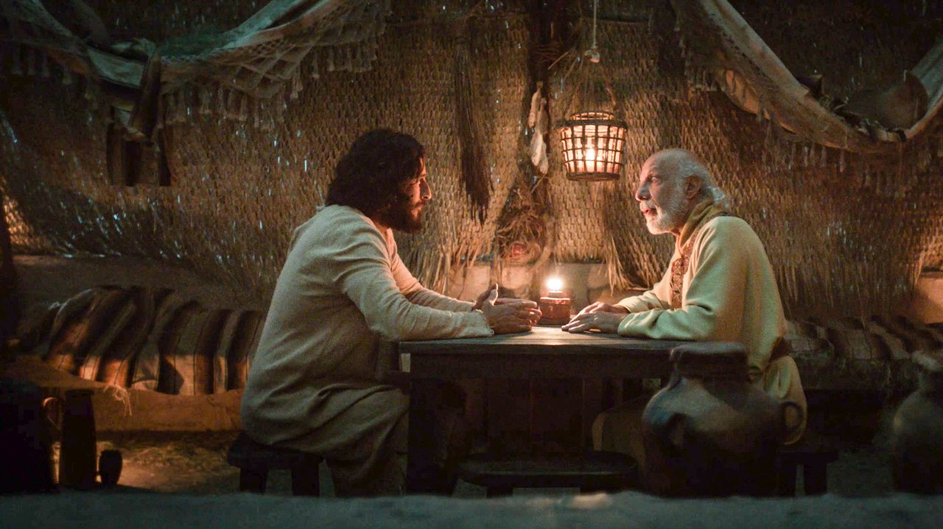
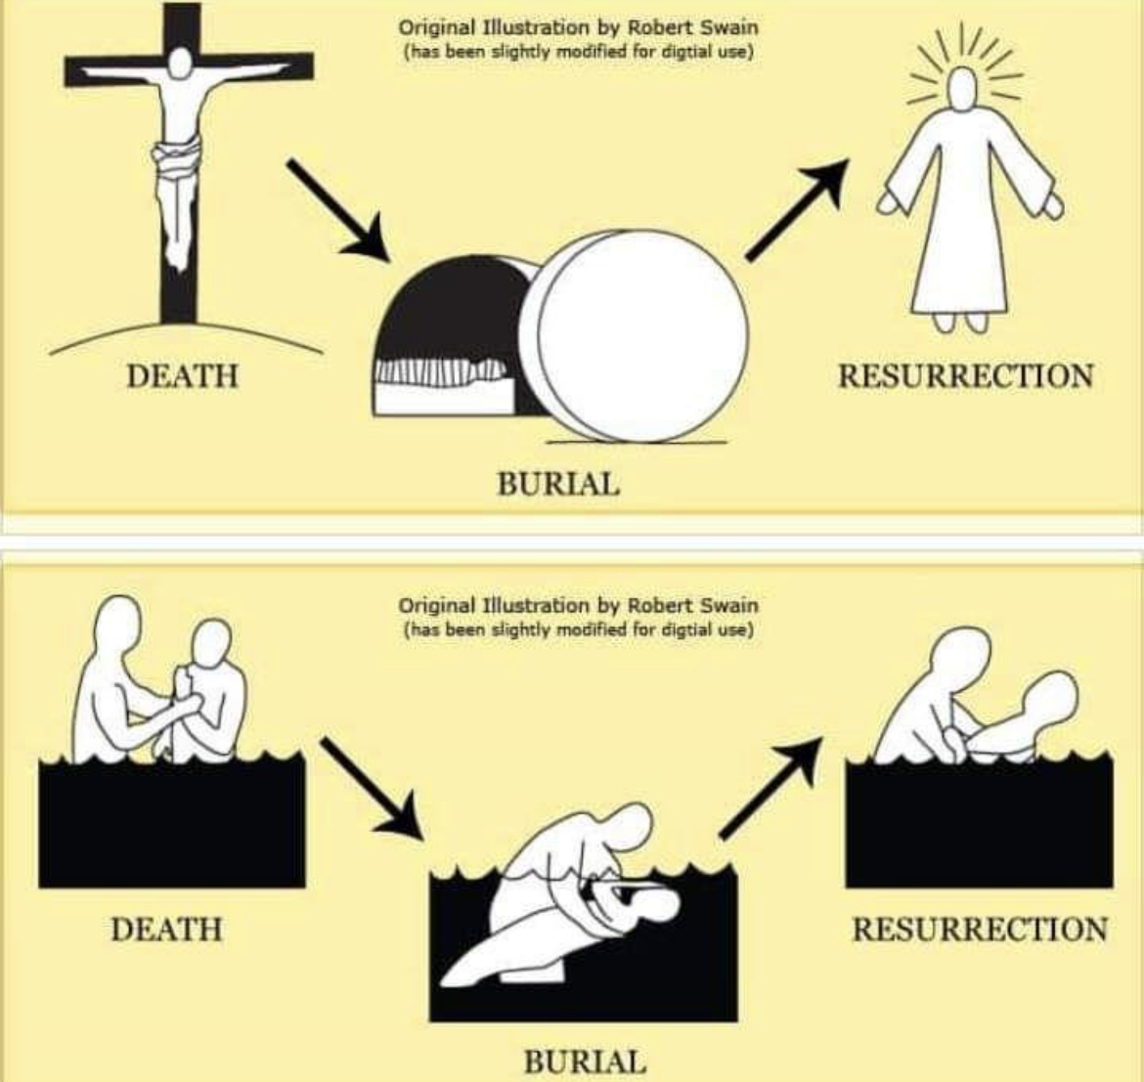
Romans 6
4 Therefore we have been buried with Him through baptism into death, so that as Christ was raised from the dead through the glory of the Father, so we too might walk in newness of life.
Notes:
This is why When Jesus talks with Nicodemus in John 3, he says “ “Truly, truly, I say to you, unless one is born again he cannot see the kingdom of God.”
In order to see and enter God’s kingdom practically on a daily basis, we must be born again
- must have a resurrection in our hearts
CLICKS
We’re about to have a Baptism Service in May, and Baptism is one of the two sacrements of Christian Faith
Communion – which is ongoing
Baptism – which is usually done once and resurrection is the key symbolism here.
It shows - The Death of Christ, The burial of Christ, and the Resurrection of Christ.
The most common passage read at a baptism service is Romans 6:4
4 Therefore we have been buried with Him through baptism into death, so that as Christ was raised from the dead through the glory of the Father, so we too might walk in newness of life.
This image of the water in baptism is a public display for us all to see the power of the resurrection, and the newness of life that is now accessible to us as believers.
The act of Baptism does nothing transformative – Peter says ” baptism now saves you—not the removal of dirt from the flesh, but an appeal to God for a good conscience—through the resurrection of Jesus Christ”
This ceremony is a public display for you and all of us to celebrate the resurrection of a new heart in you.
CLICK
This Newness of life is the only way we can live the Life God calls us to

Slide 26
Part 4: The Resurrection and our Future
Notes:
An now we're at part 4
The Resurrection and our future:
Right now - This Newness of life is the only way we can live the Life God calls us to
And for now we live out this newness of life in the midst of a corrupt fallen world. but we do so with something that others don't have.
Hope. We have hope.

Slide 27
Job
Job 19:25 “As for me, I know that my Redeemer lives,
And at the last He will take His stand on the earth.
26 “Even after my skin is destroyed,
Yet from my flesh I shall see God;
Notes:
In the Middle of Job,
-he’s at a low point: his sitting there with a body covered in boils, lost all his children, all his wealth, his wife can’t even stand his breath, feels God has abandoned him.
-his friends are now lecturing and he feels helpless
Yet in the midst of this - it’s the hope of the Resurrection that holds him together.
Job 19:25 “As for me, I know that my Redeemer lives,
And at the last He will take His stand on the earth.
26 “Even after my skin is destroyed,
Yet from my flesh I shall see God;
And this is the conclusion of Paul in 1 Corinthians 15

Slide 28
1 Corinthians 15
51 Behold, I tell you a mystery; we will not all sleep, but we will all be changed, 52 in a moment, in the twinkling of an eye, at the last trumpet; for the trumpet will sound, and the dead will be raised imperishable, and we will be changed. 53 For this perishable must put on the imperishable, and this mortal must put on immortality. 54 But when this perishable will have put on the imperishable, and this mortal will have put on immortality, then will come about the saying that is written, “DEATH IS SWALLOWED UP in victory. 55 O DEATH, WHERE IS YOUR VICTORY? O DEATH, WHERE IS YOUR STING?” 56 The sting of death is sin, and the power of sin is the law; 57 but thanks be to God, who gives us the victory through our Lord Jesus Christ.
Notes:
Which brings us back to the end of 1 Corinthians 15.
Read
51 Behold, I tell you a mystery; we will not all sleep, but we will all be changed, 52 in a moment, in the twinkling of an eye, at the last trumpet; for the trumpet will sound, and the dead will be raised imperishable, and we will be changed. 53 For this perishable must put on the imperishable, and this mortal must put on immortality.
54 But when this perishable will have put on the imperishable, and this mortal will have put on immortality, then will come about the saying that is written,
“DEATH IS SWALLOWED UP in victory. 55 O DEATH, WHERE IS YOUR VICTORY? O DEATH, WHERE IS YOUR STING?” 56 The sting of death is sin, and the power of sin is the law; 57 but thanks be to God, who gives us the victory through our Lord Jesus Christ.
Paul has this same idea in Romans 8
- Famous passage
28 And we know that God causes all things to work together for good to those who love God, to those who are called according to His purpose.
Right after that he writes
29 For those whom He foreknew, He also predestined to become conformed to the image of His Son, so that He would be the firstborn among many brethren;
Jesus is our forerunner – the first of the resurrection, we will follow
We will see God face-to-face one day.

Slide 29
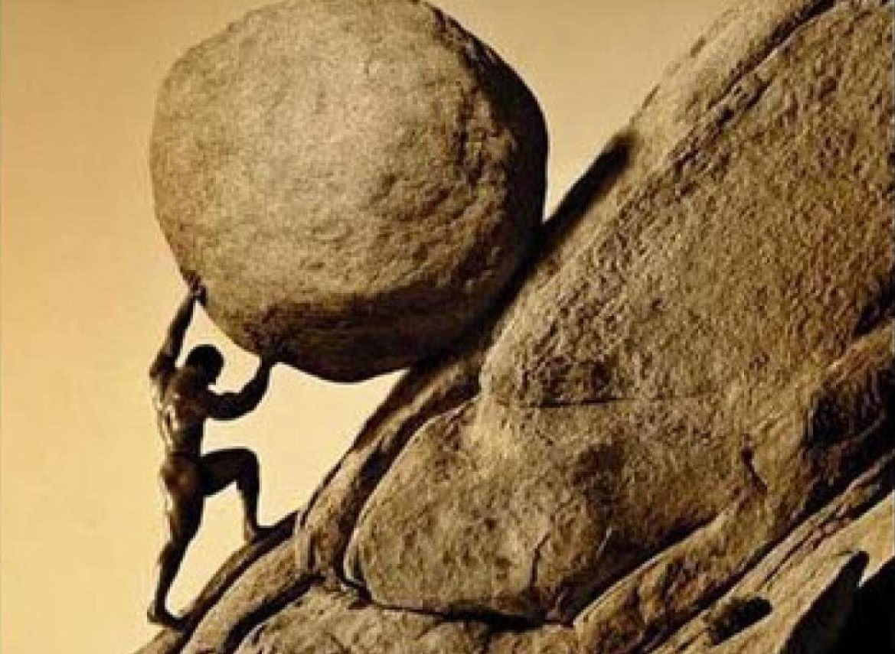
Notes:
So now we come full circle:
We’re not enslaved to a godless worldview that says life is meaningless, entropy will take its course and the universe is going to fizzle out into abyss.
You’re current problem in life is not the myth of Sisyphus
- ancient Greek King of Corinth he tricked death twice and was forced to push a bolder up a mountain inHell over and over again for eternity.
This is Godlessness – meaninglessness.

Slide 30
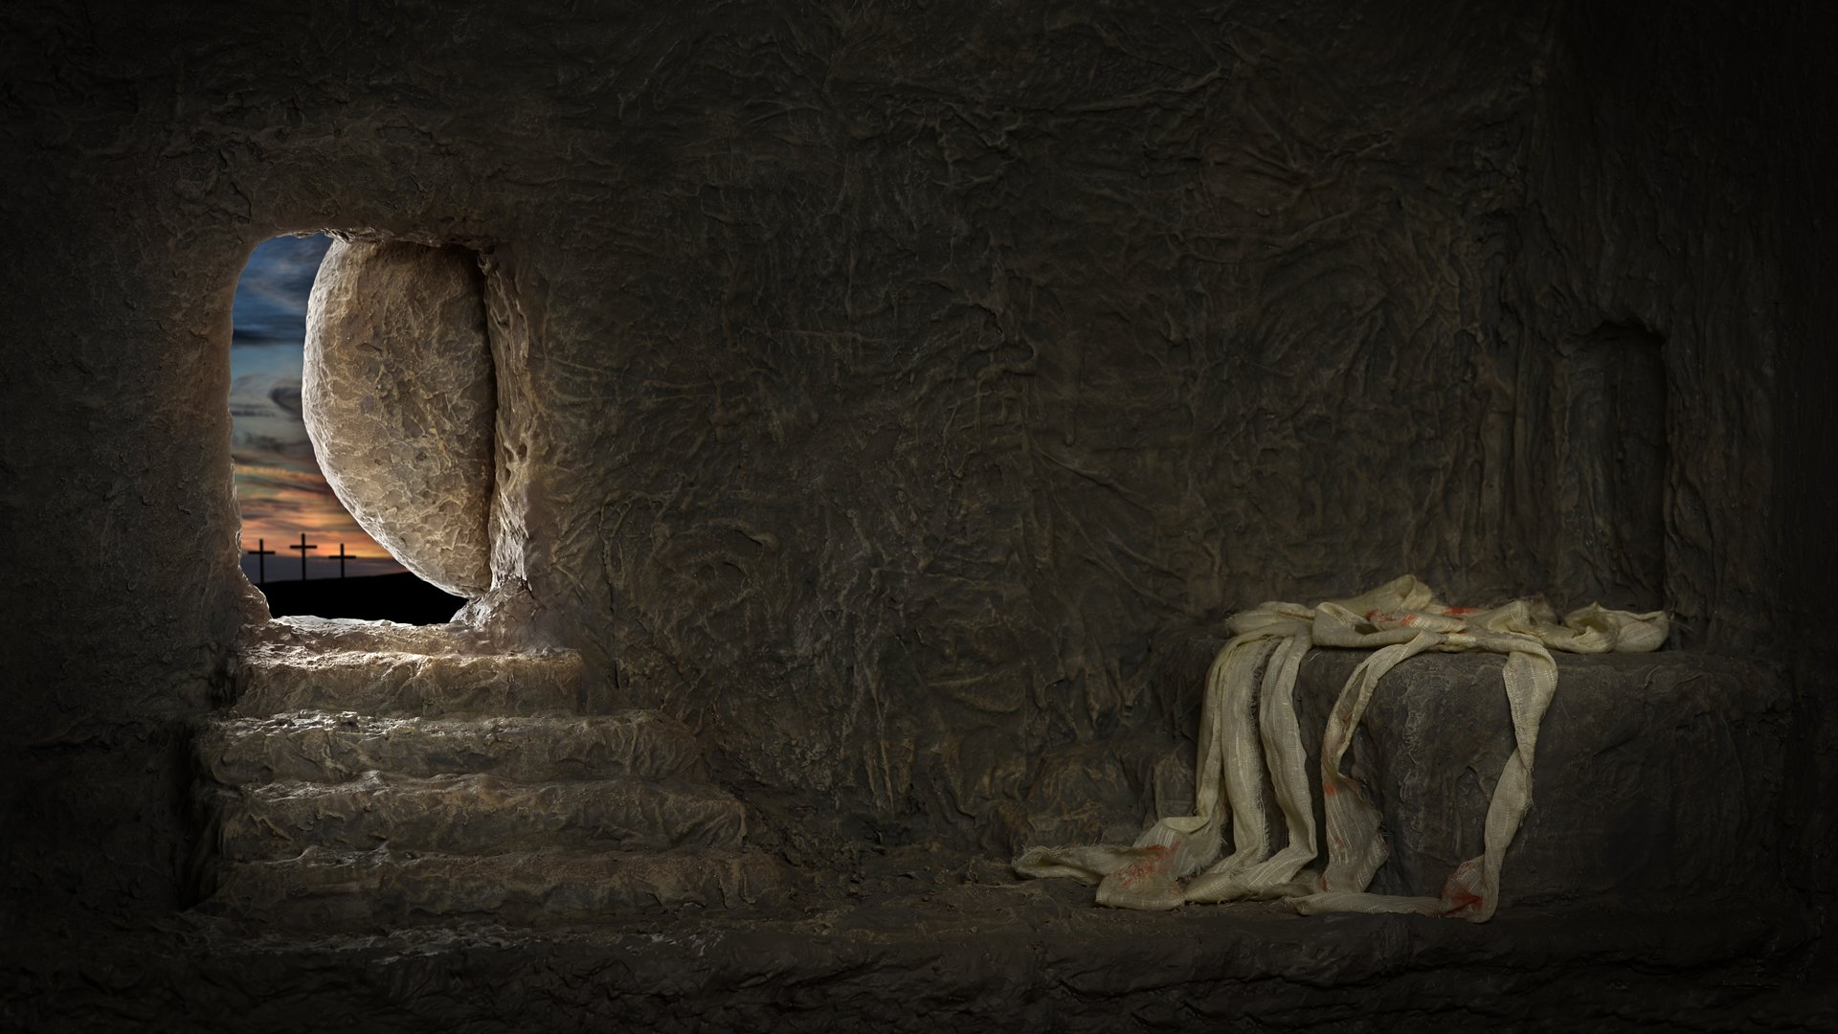
1 Corinthians 15
The Resurrection:
Is a Historical Fact
It the Heart of the Gospel
Infuses our Daily Life with Purpose
Gives Hope For Our Future
58 Therefore, my beloved brethren, be steadfast, immovable, always abounding in the work of the Lord, knowing that your toil is not in vain in the Lord.
Notes:
NO! Paul ends the theological argument in 1 Corinthians with this verse:
58 Therefore, my beloved brethren, be steadfast, immovable, always abounding in the work of the Lord, knowing that your toil is not in vain in the Lord.
And this hope for the future, circles back again to infuse every moment of our life with purpose. Your life is not in vain.
The Resurrection:
Is a Historical Fact
Has Objective Historical Meaning
Gives Meaning for Your Daily Life
Gives Hope For Our Future
Every problem and setback we have is training for a glorious future
Every gift and joy we have now, is only a fraction of what we’ll experience in our future resurrection.
Your work, your school, your family, your friends – all you have will echo into eternity
If something in you is awakened today – that you know you need this resurrection in your life.
Come forward to pray with me.
If you’re a born again child of God – rejoice with me today
Jesus’s resurrection is a fact
The Gospel Is True, and We’re free from sin
Our Life is infused with real meaning
We have hope of the ultimate resurrection.
Jude 1:24
24 Now to Him who is able to keep you from stumbling, and to make you stand in the presence of His glory blameless with great joy, 25 to the only God our Savior, through Jesus Christ our Lord, be glory, majesty, dominion and authority, before all time and now and forever. Amen.

Slide 31
Lord, I admit I am a sinner. I need and want Your forgiveness. I accept Your death as the penalty for my sin, and recognize that Your mercy and grace is a gift You offer to me because of Your great love, not based on anything I have done. Cleanse me and make me Your child. By faith I receive You into my heart as the Son of God and as Savior and Lord of my life. From now on, help me live for You, with You in control.
In Your precious name, Amen
Notes:
Sinner’s prayer here
“It’s not the prayer that saves; it’s the repentance and faith behind the prayer that lays hold of salvation.

