Slide 1
Happy Mother’s Day!
Notes:
Moms, we’re so thankful for you.
The role you play in Growing God’s love in this world is immeasurable. Encourage you to keep investing in eternity in your children’s lives.
I think of my own life, and I clearly see God used my mother’s faithfulness to shape me into a follower of Christ, which is now passed on to my children.
Moms, we love you!
Dads and Kids – bless them today!

Slide 2
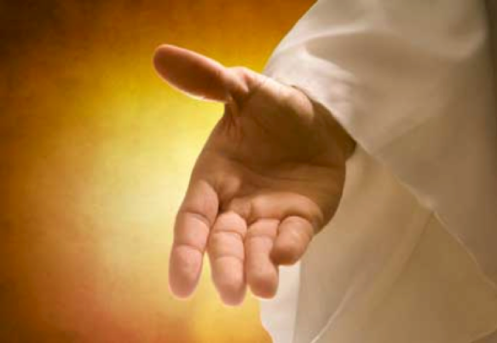
Jesus, My Righteousness

Slide 3
Notes:
Albert Einstein was traveling from Princeton on a train.
When the conductor came down the aisle punching tickets Einstein reached in his vest pocket; he could not find his ticket, so he reached in his pants pockets. It wasn’t there so he looked in his briefcase, but still could not find it.
He looked in the seat next to him, but it was not there.
The conductor kindly said, “Dr. Einstein, I know who you are, we all know who you are. I’m sure you bought a ticket, don’t worry about it.”
The conductor then continued on his way punching tickets.
Just before he went to the next car he turned around and saw the great scientist on his hands and knees looking under his seat for his ticket.
The conductor rushed back and said, “Dr. Einstein, Dr. Einstein, don’t worry. I know who you are. No problem. You don’t need a ticket.”
Einstein said, “Young man, I too know who I am. What I don’t know is where I am going.”

Slide 4
Where Are We Going?
Proverbs 14:12 There is a way which seems right to a man, but its end is the way of death. Proverbs 14:12
Notes:
Einstein’s situation is one in which we’ve all can relate at times,
But I think never in human history has it ben so hard to know where we are and we’re going.
We can literally find any position under the sun on social media Youtube with amazing video editing and halfway reasoned arguments.
I remember watching a 20 min documentary on how smoking is actually good for you because the most innovative and creative people in science all smoked. - showing Pictures of famous scientists, artists, musicians, Politicians.. Never mind the correlation/causation fallacy.
Solomon got it right when he said
Proverbs 14:12 There is a way which seems right to a man, but its end is the way of death. Proverbs 14:12
Another passage in proverbs 7 – talking about the way of the harlot
Proverbs 7: 24 Now therefore, my sons, listen to me,
And pay attention to the words of my mouth.
25 Do not let your heart turn aside to her ways,
Do not stray into her paths.
26 For many are the victims she has cast down,
And numerous are all her slain.
27 Her house is the way to Sheol,
Descending to the chambers of death.
So we live in a world wrought with deception – but there’s even a bigger problem that compounds the issue.

Slide 5
Our Diseased Hearts
Jeremiah 17:9 “The heart is more deceitful than all else, And is desperately sick; Who can understand it?
10 “I, the LORD, search the heart, I test the mind, Even to give to each man according to his ways, According to the results of his deeds.
Isaiah 64:6 For all of us have become like one who is unclean,
And all our righteous deeds are like a filthy garment;
And all of us wither like a leaf,
And our iniquities, like the wind, take us away.
Notes:
We're part of the problem
Jeremiah invokes the curse and blessing in Chapter 17,
5 Thus says the LORD, “Cursed is the man who trusts in mankind
7 “Blessed is the man who trusts in the LORD And whose trust is the LORD.
and right after the blessing and curse he says:
Jeremiah 17:9 “The heart is more deceitful than all else, And is desperately sick; Who can understand it?
10 “I, the LORD, search the heart, I test the mind, Even to give to each man according to his ways, According to the results of his deeds.
Isaiah 64:6 For all of us have become like one who is unclean,
And all our righteous deeds are like a filthy garment;
And all of us wither like a leaf,
And our iniquities, like the wind, take us away.
The Problem is Within us – our fragmented and diseased hearts.
And it's the inclination of our hearts that actually impact our ability to perceive goodness, understand the real state of affairs, and make good decisions for flourishing.

Slide 6
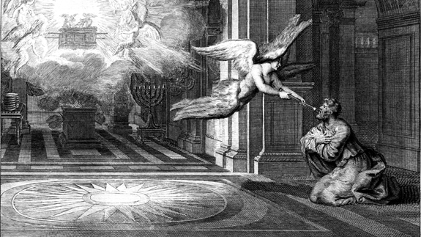
Holy, Holy, Holy
V5 “Woe is me, for I am ruined! Because I am a man of unclean lips,
And I live among a people of unclean lips; for my eyes have seen the King, the LORD of hosts.”
Isaiah 6 . 3 And one called out to another and said, “Holy, Holy, Holy, is the LORD of hosts, The whole earth is full of His glory.”
Notes:
I’ve referenced Isaiah’s vision of the Throne room of God – where the angels were calling out
Isaiah 6 :3 And one called out to another and said, “Holy, Holy, Holy, is the LORD of hosts, The whole earth is full of His glory.”
This is the only passage in scripture where any virtue of God is in the superlative.
Holiness is god’s Chief Characteristic – a primary one – the primary one
And do you recall Isaiah's response to this vision?
CLICK
“Woe is me, for I am ruined!
Because I am a man of unclean lips,
And I live among a people of unclean lips;
For my eyes have seen the King, the LORD of hosts.”
It’s not until we encounter the Holiness of God, and see the beauty of Christ that the reality of our current situation sets in.
When Isaiah saw the Purity and Holiness of God, His sin was no longer tolerable – he knew he was doomed.
He understood his goodness was a unclean rags - the actual word there in the Hebrew is menstrual rags - rags that would prevent you from entering the temple if you touched them. The picture is that our own righteousness actually separates us from God.

Slide 7
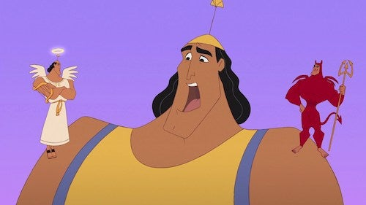
Romans 7: 21 I find then the principle that evil is present in me, the one who wants to do good. 22 For I joyfully concur with the law of God in the inner man, 23 but I see a different law in the members of my body, waging war against the law of my mind and making me a prisoner of the law of sin which is in my members. 24 Wretched man that I am! Who will set me free from the body of this death? 25
Notes:
One of Our Family’s favorite movies is the Emperor’s new Groove where Kronk, the good-natured assistant to the Villainess Yzma, is battling with a moral decision and these little shoulder angels/shoulder demons pop up on his shoulder.
This struggle is real and while positionally we as Christians are justified before a holy God (Spoiler alert)
- We can still have serious battles to the degree that we attempt to live our life on our own apart from the direction and strength of the Holy Spirit
In Romans 7 Paul writes about this battle of our natures:
CLICK
Romans 7: 21 I find then the principle that evil is present in me, the one who wants to do good. 22 For I joyfully concur with the law of God in the inner man, 23 but I see a different law in the members of my body, waging war against the law of my mind and making me a prisoner of the law of sin which is in my members. 24 Wretched man that I am! Who will set me free from the body of this death?
The degree to which we as believers are in fellowship with God is frequently the degree of this struggle.

Slide 8
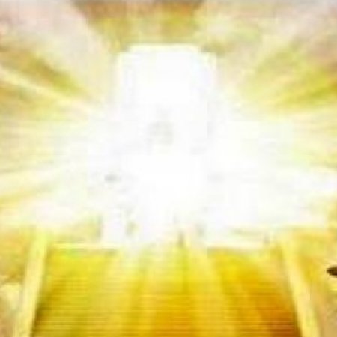
Righteousness, Holiness, & Glory
Holiness – the absolute Uniqueness and Goodness of God
Righteousness - the basic idea of conforming to a standard. When that standard is conformed to, the behavior, the thinking, the feeling is right — it’s right. ~John Piper
Isaiah 6 :3 …The whole earth is full of His glory.”
Notes:
One step back to define some terms that can help us as we bring more light to our situation.
3 terms to understand: Righteousness. Holiness, and Glory
Holiness – the absolute Uniqueness and Goodness of God – it’s what Isaiah saw in the temple, and what brought him to his knees
Righteousness - the basic idea of conforming to a standard. When that standard is conformed to, the behavior, the thinking, the feeling is right — it’s right. it's righteous ~John Piper
Isaiah 6 :3 …The whole earth is full of His glory.”
Glory is the natural radiant effect when Holiness enters an environment.
Romans 8:21 tells us that the creation itself also will be set free from its slavery to corruption into the freedom of the glory of the children of God.
A time will come when we live such lives of righteousness that the glory will spill over and set creation free from it’s slavery to abuse.
And Righteousness leads to

Slide 9
Notes:
Justice
Justice is a secondary virtue that’s contingent on the virtue of holiness.
Justice is the natural reaction that occurs with Goodness or Holiness interacts with Sin or Rebellion.
And that’s a big problem for us, because if you remember we started the talk with a reminder that we’re crooked, our hearts are untrustworthy, and we are not holy.
And when holiness comes in contact with unholiness the result is Judgment.
One of the most common symbols of Justice in scripture is that of the Sword.

Slide 10
Stories of Swords
Notes:
Throughout scripture we see the sword of Judgment as a thread that ties the entire story of the bible together.

Slide 11
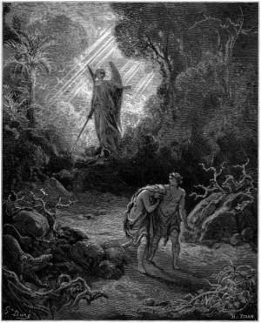
Stories of Swords – Sword Guarding The Garden
Genesis 3:22 Then the LORD God said, “Behold, the man has become like one of Us, knowing good and evil; and now, he might stretch out his hand, and take also from the tree of life, and eat, and live forever”— 23 therefore the LORD God sent him out from the garden of Eden, to cultivate the ground from which he was taken. 24 So He drove the man out; and at the east of the garden of Eden He stationed the cherubim and the flaming sword which turned every direction to guard the way to the tree of life.
Notes:
The first sword mentioned in Scripture is right after the fall:
Genesis 3:22 Then the LORD God said, “Behold, the man has become like one of Us, knowing good and evil; and now, he might stretch out his hand, and take also from the tree of life, and eat, and live forever”— 23 therefore the LORD God sent him out from the garden of Eden, to cultivate the ground from which he was taken. 24 So He drove the man out; and at the east of the garden of Eden He stationed the cherubim and the flaming sword which turned every direction to guard the way to the tree of life.
The Justice/judgment here is
that Adam and Eve are no longer holy enough to come near the Tree of Life
They’re corrupt, and not fit for the Garden any longer, and they’re in no state to enter eternal life
And this corruption has spread to us all…
Romans 5: 12 Therefore, just as through one man sin entered into the world, and death through sin, and so death spread to all men, because all sinned—

Slide 12
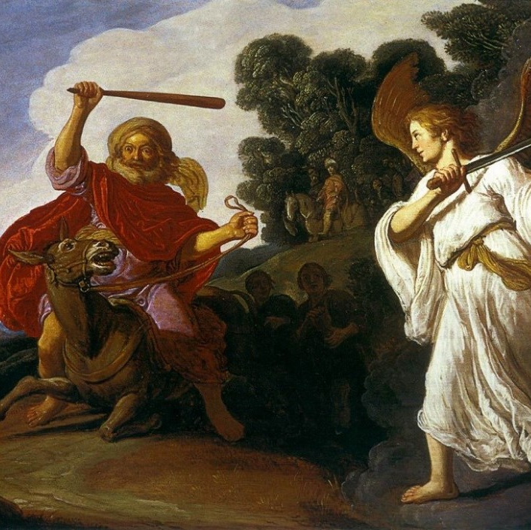
Stories of Swords – Balaam and the Angel with a Sword
Numbers 22: 1 Then the LORD opened the eyes of Balaam, and he saw the angel of the LORD standing in the way with his drawn sword in his hand; and he bowed all the way to the ground.
Notes:
Another story of a Sword is in Numbers 22:
Balak king of Moab – was pressing the Prophet Balaam to curse the Israelites, and God told Balaam not to go with the Moabites, but he saddled his donkey anyway…
Balaam was angry and struck the donkey with his stick. 28 And the LORD opened the mouth of the donkey, and she said to Balaam, “What have I done to you, that you have struck me these three times?” 29 Then Balaam said to the donkey, “Because you have made a mockery of me! If there had been a sword in my hand, I would have killed you by now.” 30 The donkey said to Balaam, “Am I not your donkey on which you have ridden all your life to this day? Have I ever been accustomed to do so to you?” And he said, “No.”
31 Then the LORD opened the eyes of Balaam, and he saw the angel of the LORD standing in the way with his drawn sword in his hand; and he bowed all the way to the ground.
So we see the sword of judgment against Balaam because he valued the money of Balaam over obedience to God.

Slide 13
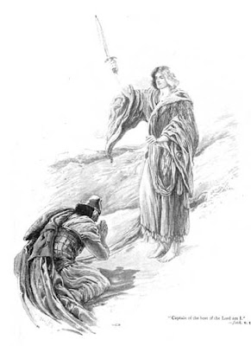
Stories of Swords – Joshua 5
13 Now it came about when Joshua was by Jericho, that he lifted up his eyes and looked, and behold, a man was standing opposite him with his sword drawn in his hand, and Joshua went to him and said to him, “Are you for us or for our adversaries?” 14 He said, “No; rather I indeed come now as captain of the host of the LORD.” And Joshua fell on his face to the earth, and bowed down, and said to him, “What has my lord to say to his servant?” 15 The captain of the LORD’S host said to Joshua, “Remove your sandals from your feet, for the place where you are standing is holy.” And Joshua did so.
Notes:
Before Joshua fought Jericho, he met the angel of God with a Drawn Sword:
13 Now it came about when Joshua was by Jericho, that he lifted up his eyes and looked, and behold, a man was standing opposite him with his sword drawn in his hand, and Joshua went to him and said to him, “Are you for us or for our adversaries?” 14 He said, “No; rather I indeed come now as captain of the host of the LORD.” And Joshua fell on his face to the earth, and bowed down, and said to him, “What has my lord to say to his servant?” 15 The captain of the LORD’S host said to Joshua, “Remove your sandals from your feet, for the place where you are standing is holy.” And Joshua did so.
Joshua’s initial analysis – just like ours:
“ you for me, or them”
His answer is “No” – I’m not even in that paradigm.
The sword was a warning – Judgment is coming and it’s not on your terms
Realign yourself – circle your world around God’s Kingdom, not yours.
God's paradigm is the standard - his way is Holy

Slide 14
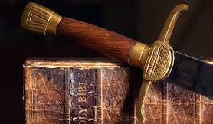
Swords in the New Testament – Sword of the Spirit
Ephesians 6:17 And take THE HELMET OF SALVATION, and the sword of the Spirit, which is the word of God.
Hebrews 4:12 For the word of God is living and active and sharper than any two-edged sword, and piercing as far as the division of soul and spirit, of both joints and marrow, and able to judge the thoughts and intentions of the heart. 13 And there is no creature hidden from His sight, but all things are open and laid bare to the eyes of Him with whom we have to do.
Notes:
The Sword is the only weapon we have – the only thing we have to attack – the only thing that helps us render right judgment.
Eph 6:13-17
to stand firm.
LOINS WITH TRUTH
BREASTPLATE OF RIGHTEOUSNESS
YOUR FEET WITH THE PREPARATION OF THE GOSPEL OF PEACE;
Shield of Faith
17 And take THE HELMET OF SALVATION,
and the sword of the Spirit, which is the word of God.
The word of God is the thing that anchors us as believers, it’s the thing that helps us find our bearings in life – a proper judgment.
Hebrews 4:12 For the word of God is living and active and sharper than any two-edged sword, and piercing as far as the division of soul and spirit, of both joints and marrow, and able to judge the thoughts and intentions of the heart. 13 And there is no creature hidden from His sight, but all things are open and laid bare to the eyes of Him with whom we have to do.
Trend in the west of deconstructing our faith – critical scholars like Bart Ehrman take postmodern skeptic presuppositions and evaluate the bible based on a set of modern values that come from Atheist thinkers like Marx, Neitzsche, Freud, Darwin, Hume, Rousseau. These thinkers have shaped a set of values by which justice has been warped from a humanistic reference point and put up as a higher standard by which the Bible is judged.
The outcome of this is that people lose their trust in the Bible and it’s no longer the defining Authority in their life.
And the practical outcome of this is that to the degree that people lose their trust in the Authority of scripture, we lose our ability to discern right from wrong, to be integrated with God, ourselves, others, and the world around us.
It’s the Sword of the spirit that helps us judge rightly,
like the Kings in the Old Testament it’s the ones who were anchored in Truth that brought proper judgment for the flourishing of the Israelites
We too, need to be anchored in his Word as the authority to help us flourish in our lives.

Slide 15
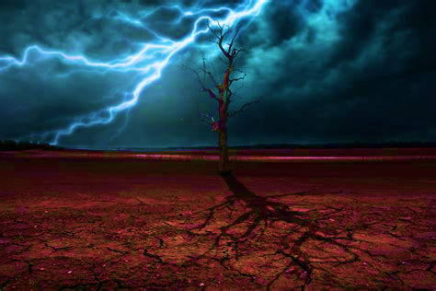
Sword of Judgment – Current Wrath
(Giving us over to sin) of men who suppress the truth in unrighteousness, 19 because that which is known about God is evident within them; for God made it evident to them.
(Slaves of Sin) 34 Jesus answered them, “Truly, truly, I say to you, everyone who commits sin is the slave of sin.
(Wrath of Government): Romans 13:4 for it is a minister of God to you for good. But if you do what is evil, be afraid; for it does not bear the sword for nothing; for it is a minister of God, an avenger who brings wrath on the one who practices evil.
(Wrath of seared consciences) 1 Tim 4: 1 But the Spirit explicitly says that in later times some will fall away from the faith, paying attention to deceitful spirits and doctrines of demons, 2 by means of the hypocrisy of liars seared in their own conscience as with a branding iron
Romans 6:23 Wages of sin is DEATH
We all have dissociative disorder (CS LEWIS)
Notes:
I’ve read Romans 1:18 multiple times from the pulpit - 18 For the wrath of God is revealed from heaven against all ungodliness and unrighteousness of men who suppress the truth in unrighteousness, 19 because that which is known about God is evident within them; for God made it evident to them.
We currently live under the wrath of God in that God gives us over to our sinful proclivities when we reject him. Such as:
(Giving us over to sin) men who suppress the truth in unrighteousness, 19 because that which is known about God is evident within them; for God made it evident to them.
(Slaves of Sin)Jn 8:34 Jesus answered them, “Truly, truly, I say to you, everyone who commits sin is the slave of sin.
(Wrath of Government): Romans 13:4 for it is a minister of God to you for good. But if you do what is evil, be afraid; for it does not bear the sword for nothing; for it is a minister of God, an avenger who brings wrath on the one who practices evil.
(Wrath of seared consciences) 1 Tim 4: 1 But the Spirit explicitly says that in later times some will fall away from the faith, paying attention to deceitful spirits and doctrines of demons, 2 by means of the hypocrisy of liars seared in their own conscience as with a branding iron
Romans 6:23 Wages of sin is DEATH
We all have dissociative disorder (CS LEWIS)

Slide 16
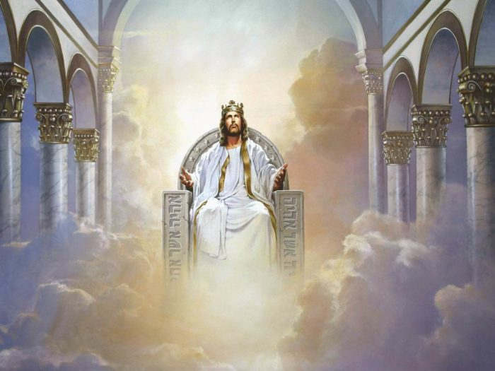
Sword of Judgment - the Coming Judgment
Matthew 12:36 But I tell you that every careless word that people speak, they shall give an accounting for it in the day of judgment. 37 For by your words you will be justified, and by your words you will be condemned.”
2 Pet 3:7 But by His word the present heavens and earth are being reserved for fire, kept for the day of judgment and destruction of ungodly men.
Notes:
A future Judgment before God is mentioned throughout the NEw Testament:
Jesus: Matthew 12:36 But I tell you that every careless word that people speak, they shall give an accounting for it in the day of judgment. 37 For by your words you will be justified, and by your words you will be condemned.”
The Epistles 2 Peter 3:3 Know this first of all, that in the last days mockers will come with their mocking, following after their own lusts, 4 and saying, “Where is the promise of His coming? For ever since the fathers fell asleep, all continues just as it was from the beginning of creation.” 5 For when they maintain this, it escapes their notice that by the word of God the heavens existed long ago and the earth was formed out of water and by water, 6 through which the world at that time was destroyed, being flooded with water. 7 But by His word the present heavens and earth are being reserved for fire, kept for the day of judgment and destruction of ungodly men.

Slide 17
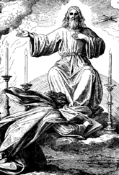
Sword of Judgment - the Vision of Christ in Revelation
Revelation 1: 13 and in the middle of the lampstands I saw one like a son of man, clothed in a robe reaching to the feet, and girded across His chest with a golden sash. 14 His head and His hair were white like white wool, like snow; and His eyes were like a flame of fire. 15 His feet were like burnished bronze, when it has been made to glow in a furnace, and His voice was like the sound of many waters. 16 In His right hand He held seven stars, and out of His mouth came a sharp two-edged sword; and His face was like the sun shining in its strength.
Notes:
Revelation 1: 13 and in the middle of the lampstands I saw one like a son of man, clothed in a robe reaching to the feet, and girded across His chest with a golden sash. 14 His head and His hair were white like white wool, like snow; and His eyes were like a flame of fire. 15 His feet were like burnished bronze, when it has been made to glow in a furnace, and His voice was like the sound of many waters. 16 In His right hand He held seven stars, and out of His mouth came a sharp two-edged sword; and His face was like the sun shining in its strength.
So in the Last book of scripture – we see Christ in his Glory with the imagery of a sword coming out of his mouth to judge

Slide 18
Review
God is Holy and Good
We have corrupt Hearts and are polluted by Sin
We’re lost and not fit for the Garden
We’re Under Wrath Now
Under God’s Wrath Now: bondage of sin, corruption in society, seared consciences,
We Will Face Judgment by a Holy God
Notes:
Read the Review
And for us, sometimes it’s hard to make this concrete – we think that sure, Rob, I believe these things. I look to Jesus as my righteousness.

Slide 19
Notes:
Jesus tells a story that shows us the depth of our problem in a way that I think we can all relate to – The Parable of The Rich Young Ruler
When I discuss modern moral issues I frequently run into the belief that people now have evolved and are so different from those we read about in the ancient world. This is patently false.
The fundamental drives, lusts, fears, hopes that people had 2000 years ago haven’t changed one bit. And this is exemplified in the Rich Young Ruler.
The thing about the Rich Young Ruler is that he’s
Rich
Young
Rules
Rich – he has money and resources – what would seem like unlimited resources
Young – From a secular perspective, he has time on his side.
Rules – He’s in a position of Authority
His deck is stacked
He has all a secularist would want then, and all a modern would want now.
If I were to put up someone here, I’d probably pick a young tech startup guy like a young Mark Zuckerberg, or maybe a young famous P&W leader, or some young celebrity who made it big at a young age like Tom Holland (Spiderman).

Slide 20
Rich Young Ruler – Matthew 19:16-25
16 And someone came to Him and said, “Teacher, what good thing shall I do that I may obtain eternal life?” 17 And He said to him, “Why are you asking Me about what is good? There is only One who is good; but if you wish to enter into life, keep the commandments.” 18 Then he *said to Him, “Which ones?” And Jesus said, “YOU SHALL NOT COMMIT MURDER; YOU SHALL NOT COMMIT ADULTERY; YOU SHALL NOT STEAL; YOU SHALL NOT BEAR FALSE WITNESS; 19 HONOR YOUR FATHER AND MOTHER; and YOU SHALL LOVE YOUR NEIGHBOR AS YOURSELF.” 20 The young man *said to Him, “All these things I have kept; what am I still lacking?” 21 Jesus said to him, “If you wish to be complete, go and sell your possessions and give to the poor, and you will have treasure in heaven; and come, follow Me.” 22 But when the young man heard this statement, he went away grieving; for he was one who owned much property.
“YOU SHALL NOT COMMIT MURDER;
YOU SHALL NOT COMMIT ADULTERY;
YOU SHALL NOT STEAL;
YOU SHALL NOT BEAR FALSE WITNESS;
HONOR YOUR FATHER AND MOTHER;
YOU SHALL LOVE YOUR NEIGHBOR AS YOURSELF.”
Notes:
16 And someone came to Him and said, “Teacher, what good thing shall I do that I may obtain eternal life?” 17 And He said to him, “Why are you asking Me about what is good? There is only One who is good; but if you wish to enter into life, keep the commandments.” 18 Then he *said to Him, “Which ones?” And Jesus said, “YOU SHALL NOT COMMIT MURDER; YOU SHALL NOT COMMIT ADULTERY; YOU SHALL NOT STEAL; YOU SHALL NOT BEAR FALSE WITNESS; 19 HONOR YOUR FATHER AND MOTHER; and YOU SHALL LOVE YOUR NEIGHBOR AS YOURSELF.” 20 The young man *said to Him, “All these things I have kept; what am I still lacking?” 21 Jesus said to him, “If you wish to be complete, go and sell your possessions and give to the poor, and you will have treasure in heaven; and come, follow Me.” 22 But when the young man heard this statement, he went away grieving; for he was one who owned much property.
When Jesus spoke to this young man what laws did he quote?
Deut 5:7-21
Question: What did he leave out?
(the first 5 were directly from the Decalogue – 10 commandments)
All these commandments were horizontal.
They were easy for the rich young ruler. (at least the way he thought he was performing them was easy)
All the Vertical Commandments were missing!
7 ‘You shall have no other gods before Me.
8 ‘You shall not make for yourself an idol,
11 ‘You shall not take the name of the LORD your God in vain,
12 ‘Observe the sabbath day to keep it holy, as the LORD your God commanded you
21 ‘You shall not covet
And to address these, Jesus asks one request – sell all you have and follow me.
I bet you could have heard a pin drop.
The disciples had to have been shocked. WHAT??? Nobody Does That Jesus!

Slide 21
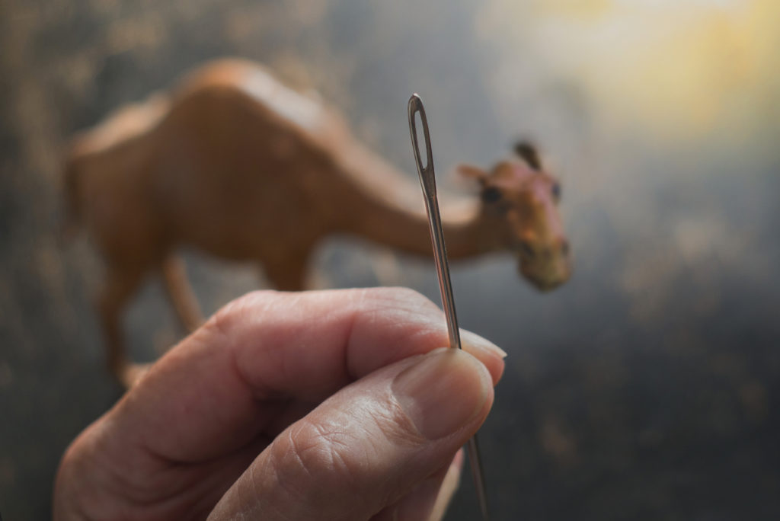
Rich Young Ruler – Matthew 19:16-25
23 And Jesus said to His disciples, “Truly I say to you, it is hard for a rich man to enter the kingdom of heaven. 24 Again I say to you, it is easier for a camel to go through the eye of a needle, than for a rich man to enter the kingdom of God.” 25 When the disciples heard this, they were very astonished and said, “Then who can be saved?” 26 And looking at them Jesus said to them, “With people this is impossible, but with God all things are possible.”
Notes:
Why? Because this guy was self-sufficient. This was his hope. This is secular, sinful hope regardless of your culture. And Jesus calls it out
CLICK
Matthew continues in vs 23:
23 And Jesus said to His disciples, “Truly I say to you, it is hard for a rich man to enter the kingdom of heaven. 24 Again I say to you, it is easier for a camel to go through the eye of a needle, than for a rich man to enter the kingdom of God.” 25 When the disciples heard this, they were very astonished and said, “Then who can be saved?” 26 And looking at them Jesus said to them, “With people this is impossible, but with God all things are possible.”
Jesus really meant this – it’s harder for wealthy people to go to heaven than for an actual camel to go through an eye of a needle. Why?
James 1:9 But the brother of humble circumstances is to glory in his high position; 10 and the rich man is to glory in his humiliation, because like flowering grass he will pass away.
The rich man is tempted to think he is sufficient, and he does not want to risk.
Proverbs 18:10 The name of the LORD is a strong tower;
The righteous runs into it and is safe.
11 A rich man’s wealth is his strong city,
And like a high wall in his own imagination.
Wealth is only a strong city in your imagination.
Jesus exposes the Rich Young ruler as insufficient on his own terms.
Earlier in Matthew – Jesus shocked them with his standard of Righteousness in chapter 5:
Matt 5:20 “For I say to you that unless your righteousness surpasses that of the scribes and Pharisees, you will not enter the kingdom of heaven.
This is the issue. With People. This is impossible.

Slide 22
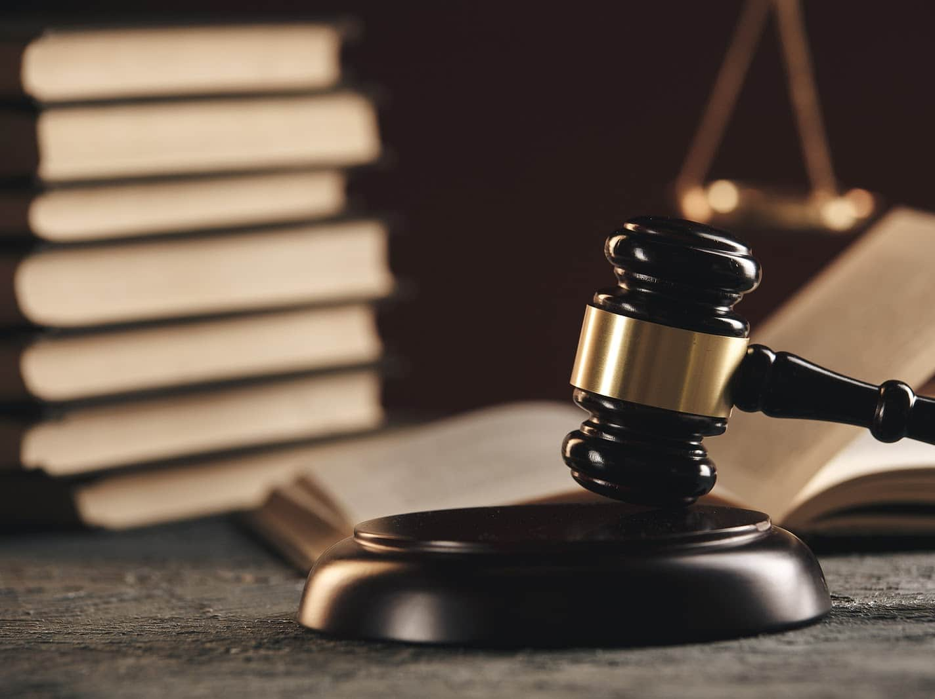
1. We Need Righteousness For the Day of Judgment
1 Corinthians 5:20-21
21 He made Him who knew no sin to be sin on our behalf, so that we might become the righteousness of God in Him.
Notes:
To stand in the Day of Judgment
Our righteousness before a holy God is so below standard that it’s repulsive to a Holy God (filthy rags)
1 Corinthians 5:20-21
21 He made Him who knew no sin to be sin on our behalf, so that we might become the righteousness of God in Him.

Slide 23
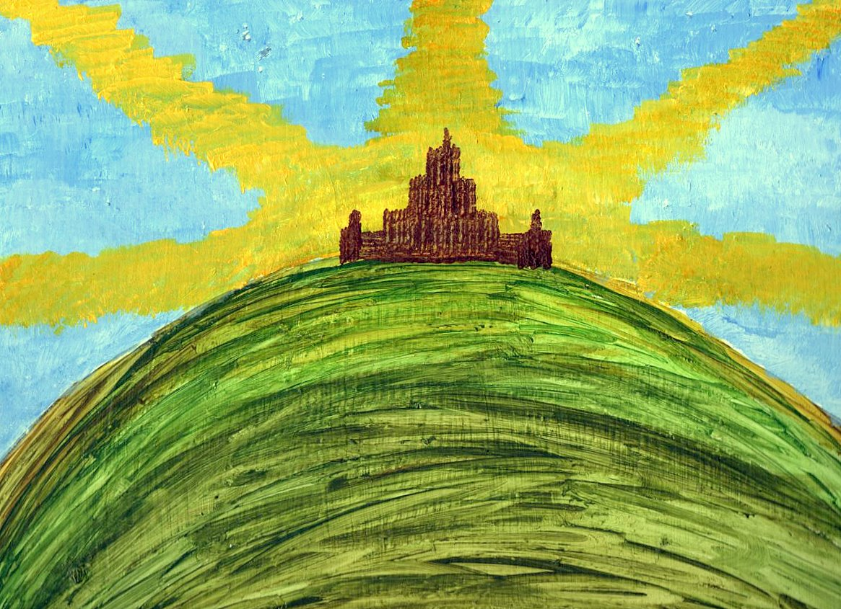
2. We Need Righteousness -To live out the life we long to live now.
14 “You are the light of the world. A city set on a hill cannot be hidden; 15 nor does anyone light a lamp and put it under a basket, but on the lampstand, and it gives light to all who are in the house. 16 Let your light shine before men in such a way that they may see your good works, and glorify your Father who is in heaven.
Notes:
14 “You are the light of the world. A city set on a hill cannot be hidden; 15 nor does anyone light a lamp and put it under a basket, but on the lampstand, and it gives light to all who are in the house. 16 Let your light shine before men in such a way that they may see your good works, and glorify your Father who is in heaven.
In the life we live now to overcome
The sins that we’re battling already
The sins you don’t even know you’re doing but wil eventually have to face one day
The fears and anxieties that trouble us because like the Rich Young Ruler, we’ve misplaced our hope and security.
To live as a city on a hill and bring the Glory of the Kingdom to others now.
See, you were made for Glory in Eternity, and Glory now.
Remember what Glory is – Glory is the natural radiant effect when Holiness enters an environment.

Slide 24
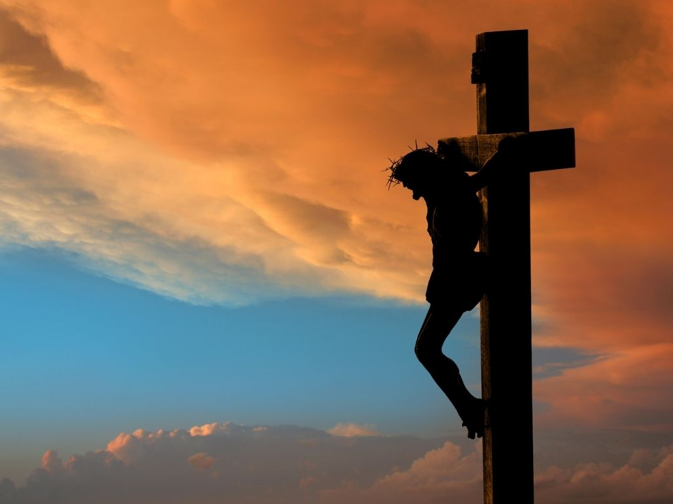
Gal 2:20
20 I have been crucified with Christ; and it is no longer I who live, but Christ lives in me; and the life which I now live in the flesh I live by faith in the Son of God, who loved me and gave Himself up for me.
Notes:
If you do any scripture memory, this is one of the top verses I recommend you start with.
Galatians 20 I have been crucified with Christ; and it is no longer I who live, but Christ lives in me; and the life which I now live in the flesh I live by faith in the Son of God, who loved me and gave Himself up for me.
The crux of the Christian life is this:
Just as you don’t have the resources to stand before a Holy God in Judgment.
You don’t have the resources to live the life you are called to on your own.
CS Lewis Quote - “If I find in myself desires which nothing in this world can satisfy, the only logical explanation is that I was made for another world.”
That’s true. BUT that world that you’re made for – that world of Glory – you must live from a regenerated heart
Jesus tells Nicodemus – you must be born again.
To live out the Glory you were made to live
– to be that city on a hill
To be free from that sin that’s enslaving you
To not be hostage to that fear that keeps you up at night.
To be kind to that relative that drives you nuts
To lovingly serve that one colleague that drives you nut
To have that conversation you need to have, but are scared to death of
To do that one thing you’re struggling with right now.
To live life to the full – john 10 - ; I came that they may have life, and have it abundantly.
You can only live it by dying to your flesh and surrendering to Christ’s righteousness in You.
you and I must be crucified with Jesus
His life must live in US
We must Live day by day, relying on His Power, and strength and life to be our source.

Slide 25
In Christ Alone
G D G A
In Christ alone my hope is found,
D/F# G A D
He is my light, my strength, my song;
G D G A
This Cornerstone, this solid Ground,
D/F# G A D
Firm through the fiercest drought and storm.
D/F# G D/F# A
What heights of love, what depths of peace,
D/F# G D/F# A
When fears are stilled, when strivings cease!
G D G A
My Comforter, my All in All,
D/F# G A D
Here in the love of Christ I stand.

Slide 26
In Christ Alone
G D G A
In Christ alone! Who took on flesh
D/F# G A D
Fullness of God in helpless babe!
G D G A
This gift of love and righteousness
D/F# G A D
Scorned by the ones he came to save:
D/F# G D/F# A
Till on that cross as Jesus died,
D/F# G D/F# A
The wrath of God was satisfied
G D G A
For every sin on Him was laid;
D/F# G A D
Here in the death of Christ I live.

Slide 27
In Christ Alone
G D G A
There in the ground His body lay
D/F# G A D
Light of the world by darkness slain:
G D G A
Then bursting forth in glorious Day
D/F# G A D
Up from the grave he rose again!
D/F# G D/F# A
And as He stands in victory
D/F# G D/F# A
Sin's curse has lost its grip on me,
G D G A
For I am His and He is mine
D/F# G A D
Bought with the precious blood of Christ.

Slide 28
In Christ Alone
G D G A
No guilt in life, no fear in death,
D/F# G A D
This is the power of Christ in me;
G D G A
From life's first cry to final breath.
D/F# G A D
Jesus commands my destiny.
D/F# G D/F# A
No power of hell, no scheme of man,
D/F# G D/F# A
Can ever pluck me from His hand;
G D G A
Till He returns or calls me home,
D/F# G A D
Here in the power of Christ I'll stand.

Slide 29
Aaron’s Benediction
22 Then the LORD spoke to Moses, saying, 23 “Speak to Aaron and to his sons, saying, ‘Thus you shall bless the sons of Israel. You shall say to them:
24 The LORD bless you, and keep you;
25 The LORD make His face shine on you,
And be gracious to you;
26 The LORD lift up His countenance on you,
And give you peace.’
(27 So they shall invoke My name on the sons of Israel, and I then will bless them.”)

