Slide 1
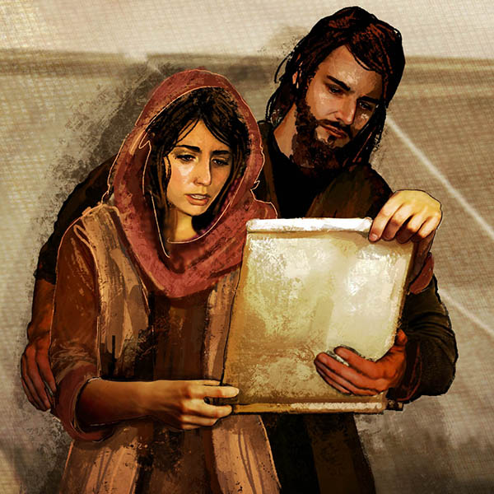
Living a life of purpose!!
Greet Prisca and Aquila, my fellow workers in Christ Jesus, who risked their necks for my life, to whom not only I give thanks but all the churches of the Gentiles give thanks as well… Romans 16:3-4

Slide 2
Living a life of purpose….
A life of purpose is a life submitted to the plans and will of God…
A life of purpose understands the place of challenges and the need to overcome them…
A life of purpose thinks about others and is not selfish…
A life of purpose understands the power of decisions and it’s implications…
A life of purpose brings glory to God…
Greet Prisca and Aquila, my fellow workers in Christ Jesus, who risked their necks for my life, to whom not only I give thanks but all the churches of the Gentiles give thanks as well… Romans 16:3-4

Slide 3
Background of Priscilla & Aquila…
A missionary couple that served along with Paul in ministering to gentiles.
The time frame of their missionary work starts from 49 A.D.
They are mentioned six times in the bible always together.
They worked as tentmakers.
They hosted the church in their home and trained people in sound doctrine of the word of God.
Often referred to as the ministry couple of the early church, Priscilla and Aquila present a very dynamic perspective and the possibility of serving God as a couple… They show great passion and understanding as Paul’s coworkers in the spreading of the gospel and training people in sound doctrine.

Slide 4
Biblical review…
Acts 18:1-3… After this Paul left Athens and went to Corinth. And he found a Jew named Aquila, a native of Pontus, recently come from Italy with his wife Priscilla, because Claudius had commanded all the Jews to leave Rome. And he went to see them, and because he was of the same trade he stayed with them and worked, for they were tentmakers by trade.
Acts 18:18-19… After this, Paul stayed many days longer and then took leave of the brothers and set sail for Syria, and with him Priscilla and Aquila. At Cenchreae he had cut his hair, for he was under a vow. And they came to Ephesus, and he left them there, but he himself went into the synagogue and reasoned with the Jews.
Acts 18:24-26… Now a Jew named Apollos, a native of Alexandria, came to Ephesus. He was an eloquent man, competent in the Scriptures. He had been instructed in the way of the Lord. And being fervent in spirit, he spoke and taught accurately the things concerning Jesus, though he knew only the baptism of John. He began to speak boldly in the synagogue, but when Priscilla and Aquila heard him, they took him aside and explained to him the way of God more accurately.

Slide 5
Biblical review…
Romans 16:3-4… Greet Prisca and Aquila, my fellow workers in Christ Jesus, who risked their necks for my life, to whom not only I give thanks but all the churches of the Gentiles give thanks as well.
1Corintians 16:19… The churches of Asia send you greetings. Aquila and Prisca, together with the church in their house, send you hearty greetings in the Lord.
2Timothy 4:19… Greet Prisca and Aquila, and the household of Onesiphorus.
The review of the texts featuring Priscilla & Aquila reveal a couple who understood their purpose. They understood they had a role to play in the advancement of the kingdom of God through sound teaching and were willing to sacrifice their very lives for that purpose to be achieved.

Slide 6
We are all called to be ministers of the Gospel…
The ministry… The what… The how…
2Corinthians 5:18…
All this is from God, who through Christ reconciled us to himself and gave us the ministry of reconciliation;
God created all things for His glory (Rev.4:11)
Sin separated us from God (Rom.3:23)
Believe and confess the finished work of Christ (Rom.10:9)
The place of fellowship and growth
We must be saved (John17:3)
Our lives (2Cor.3:2-3)
With our mouth (Rom.10:14)
Missions (Matt.28:19)
Supporting.
Luke 15:8-10…. “Or what woman, having ten silver coins, if she loses one coin, does not light a lamp and sweep the house and seek diligently until she finds it? And when she has found it, she calls together her friends and neighbors, saying, ‘Rejoice with me, for I have found the coin that I had lost.’ Just so, I tell you, there is joy before the angels of God over one sinner who repents.”

Slide 7
Conclusion…
Let us desire to be people of purpose!!!
Let us prioritize the heavenly agenda of soul winning…
Start now!!
Luke 12:8-9… “And I tell you, everyone who acknowledges me before men, the Son of Man also will acknowledge before the angels of God, but the one who denies me before men will be denied before the angels of God.

