Slide 1
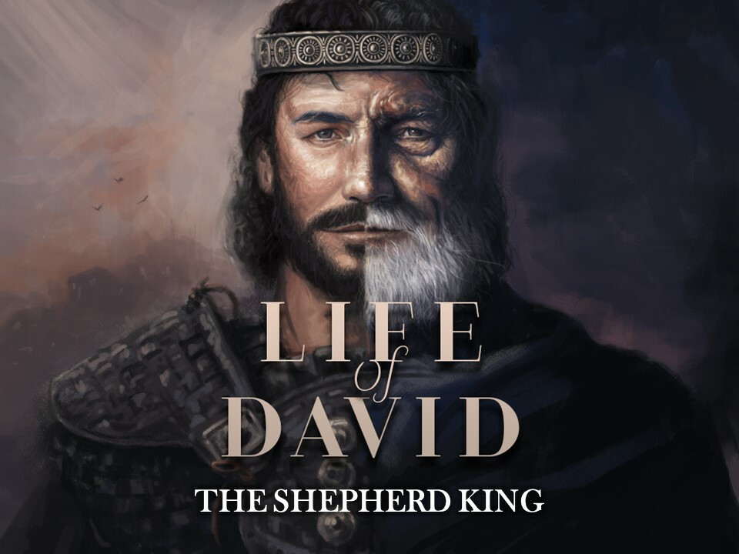
Psalm 71: 7 I have become a sign to many; you are my strong refuge (NIV).

Slide 2
Philippians 4: 11 Not that I am speaking of being in need, for I have learned in whatever situation I am to be content. 12 I know how to be brought low, and I know how to abound. In any and every circumstance, I have learned the secret of facing plenty and hunger, abundance and need. 13 I can do all things through him who strengthens me.
Humble in service (1 Sam. 16)
Fearless in danger (1 Sam. 17)
A leader to the outcast (1 Sam. 22: 1-2)
Faithful in persecution (1 Sam. 24)
Does not repay evil with evil (1 Sam. 24/26)
Humble in worship (2 Sam. 7)
Acknowledges his sin (2 Sam. 11-12)

Slide 3
David’s calling
Israel asks for a king (1 Samuel 8: 1-7)
When Samuel became old, he made his sons judges over Israel (...) Yet his sons did not walk in his ways but turned aside after gain. They took bribes and perverted justice. Then all the elders of Israel gathered together and came to Samuel at Ramah and said to him, “Behold, you are old and your sons do not walk in your ways. Now appoint for us a king to judge us like all the nations.” But the thing displeased Samuel when they said, “Give us a king to judge us.” And Samuel prayed to the Lord. And the Lord said to Samuel, “Obey the voice of the people in all that they say to you, for they have not rejected you, but they have rejected me from being king over them.

Slide 4
The Judges of Israel
Israel rebels against God
God disciplines them
Israel
repents
A judge to deliver them

Slide 5
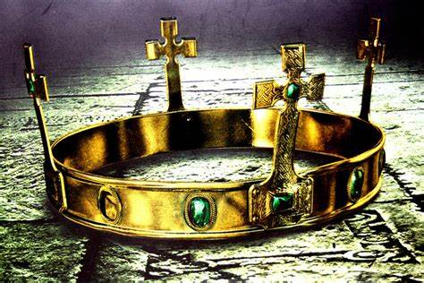
Saul anointed king (Samuel 10)
To lead a material-free life
To keep God’s laws and commandments
To live under the Levitical authority
To walk in humility before God and men
(Reference: Deut 17:14-20)

Slide 6
Saul’s Unlawful Sacrifice (Samuel 13: 8-14)
...But Samuel did not come to Gilgal, and the people were scattering from him. So Saul said, “Bring the burnt offering here to me, and the peace offerings.” And he offered the burnt offering. As soon as he had finished offering the burnt offering, behold, Samuel came. And Saul went out to meet him and greet him. Samuel said, “What have you done?” And Saul said, “When I saw that the people were scattering from me, and that you did not come within the days appointed, and that the Philistines had mustered at Michmash, I said, ‘Now the Philistines will come down against me at Gilgal, and I have not sought the favor of the Lord.’ So I forced myself, and offered the burnt offering.” And Samuel said to Saul, “You have done foolishly. You have not kept the command of the Lord your God, with which he commanded you. For then the Lord would have established your kingdom over Israel forever.

Slide 7
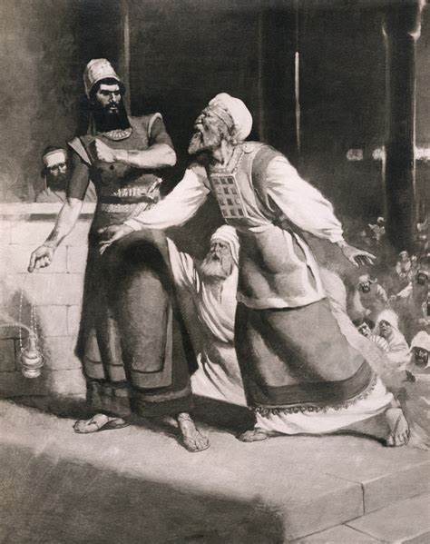
Uzziah’s Unlawful Sacrifice (2 Chronicles 26: 16-19)
But when he was strong, he grew proud, to his destruction. For he was unfaithful to the Lord his God and entered the temple of the Lord to burn incense on the altar of incense. But Azariah the priest went in after him, with eighty priests of the Lord who were men of valor, and they withstood King Uzziah and said to him, “It is not for you, Uzziah, to burn incense to the Lord, but for the priests, the sons of Aaron, who are consecrated to burn incense. Go out of the sanctuary, for you have done wrong, and it will bring you no honor from the Lord God.” Then Uzziah was angry. Now he had a censer in his hand to burn incense, and when he became angry with the priests, leprosy broke out on his forehead in the presence of the priests in the house of the Lord, by the altar of incense.

Slide 8
Saul disobeys God’s instructions
1 Samuel 15: 1 - 3
And Samuel said to Saul, “The Lord sent me to anoint you king over his people Israel; now therefore listen to the words of the Lord. Thus says the Lord of hosts, ‘I have noted what Amalek did to Israel in opposing them on the way when they came up out of Egypt. Now go and strike Amalek and devote to destruction all that they have. Do not spare them, but kill both man and woman, child and infant, ox and sheep, camel and donkey.’”

Slide 9
Saul disobeys God’s instructions
1 Samuel 15: 5 - 8
And Saul came to the city of Amalek and lay in wait in the valley.(...) And Saul defeated the Amalekites from Havilah as far as Shur, which is east of Egypt. And he took Agag the king of the Amalekites alive and devoted to destruction all the people with the edge of the sword. But Saul and the people spared Agag and the best of the sheep and of the oxen and of the fattened calves and the lambs, and all that was good, and would not utterly destroy them. All that was despised and worthless they devoted to destruction.

Slide 10
Saul’s stubbornness (1 Samuel 15: 13-14/17-19)
And Samuel came to Saul, and Saul said to him, “Blessed be you to the Lord. I have performed the commandment of the Lord.” And Samuel said, “What then is this bleating of the sheep in my ears and the lowing of the oxen that I hear?” And Samuel said, “Though you are little in your own eyes, are you not the head of the tribes of Israel? The Lord anointed you king over Israel. And the Lord sent you on a mission and said, ‘Go, devote to destruction the sinners, the Amalekites, and fight against them until they are consumed.’ Why then did you not obey the voice of the Lord? Why did you pounce on the spoil and do what was evil in the sight of the Lord?”

Slide 11
Saul’s stubbornness: God rejects Saul as King
Saul’s response (1 Samuel 15: 20-21)
“I have obeyed the voice of the Lord.
I have gone on the mission on which the Lord sent me.
But
I have brought Agag the king of Amalek, and I have devoted the Amalekites to destruction.
The people took of the spoil, sheep and oxen, the best of the things devoted to destruction, to sacrifice to the Lord your God in Gilgal.

Slide 12
1 Samuel 15: 22 “Has the Lord as great delight in burnt offerings and sacrifices, as in obeying the voice of the Lord? Behold, to obey is better than sacrifice, and to listen than the fat of rams. 23 For rebellion is as the sin of divination, and presumption is as iniquity and idolatry.
John 14: 21 Whoever has my commandments and keeps them, he it is who loves me. And he who loves me will be loved by my Father, and I will love him and manifest myself to him.”
James 1: 21-25 Therefore put away all filthiness and rampant wickedness and receive with meekness the implanted word, which is able to save your souls. But be doers of the word, and not hearers only, deceiving yourselves. For if anyone is a hearer of the word and not a doer, he is like a man who looks intently at his natural face in a mirror. For he looks at himself and goes away and at once forgets what he was like. But the one who looks into the perfect law, the law of liberty, and perseveres, being no hearer who forgets but a doer who acts, he will be blessed in his doing.
James 4: 7 Submit yourselves therefore to God. Resist the devil, and he will flee from you.

Slide 13
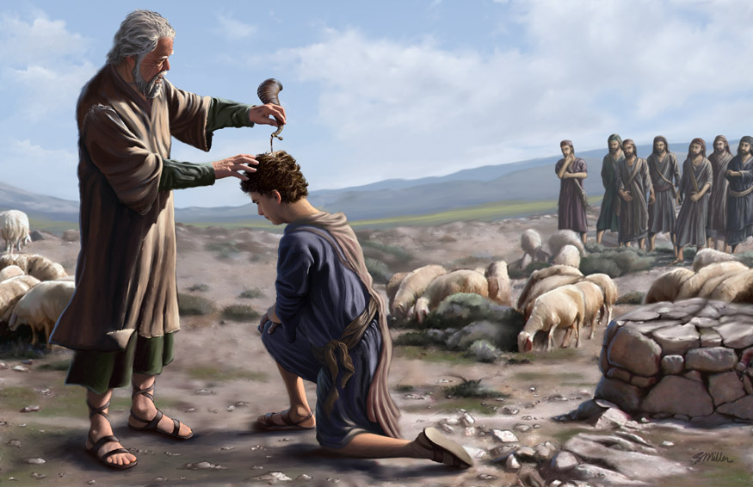
David’s anointed king
1 Samuel 16
12 And he sent and brought him in. Now he was ruddy and had beautiful eyes and was handsome. And the Lord said, “Arise, anoint him, for this is he.” 13 Then Samuel took the horn of oil and anointed him in the midst of his brothers. And the Spirit of the Lord rushed upon David from that day forward. And Samuel rose up and went to Ramah.

Slide 14
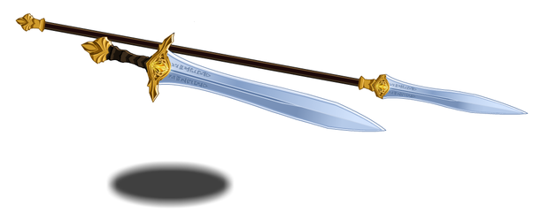
David defeats Goliath
1 Samuel 17: 45
Then David said to the Philistine, “You come to me with a sword and with a spear and with a javelin, but I come to you in the name of the Lord of hosts, the God of the armies of Israel, whom you have defied.

Slide 15
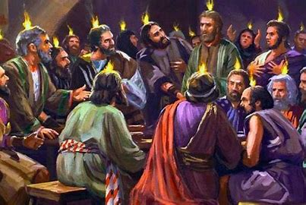
Acts 5:29 But Peter and the apostles answered, “We must obey God rather than men.
2 Corinthians 4: 8 We are afflicted in every way, but not crushed; perplexed, but not driven to despair; 9 persecuted, but not forsaken; struck down, but not destroyed; 10 always carrying in the body the death of Jesus, so that the life of Jesus may also be manifested in our bodies.

Slide 16
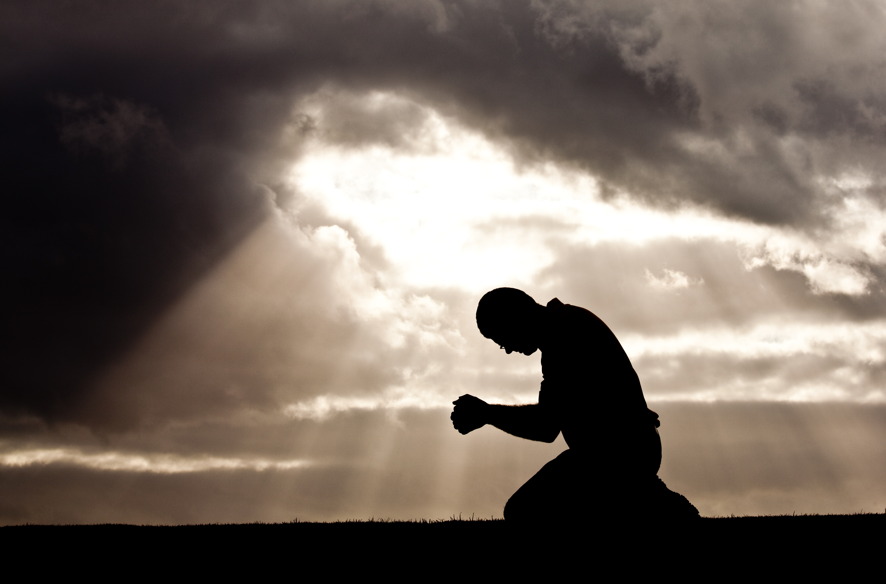
Psalm 71: 7 I have become a sign to many; you are my strong refuge (NIV).

Slide 17
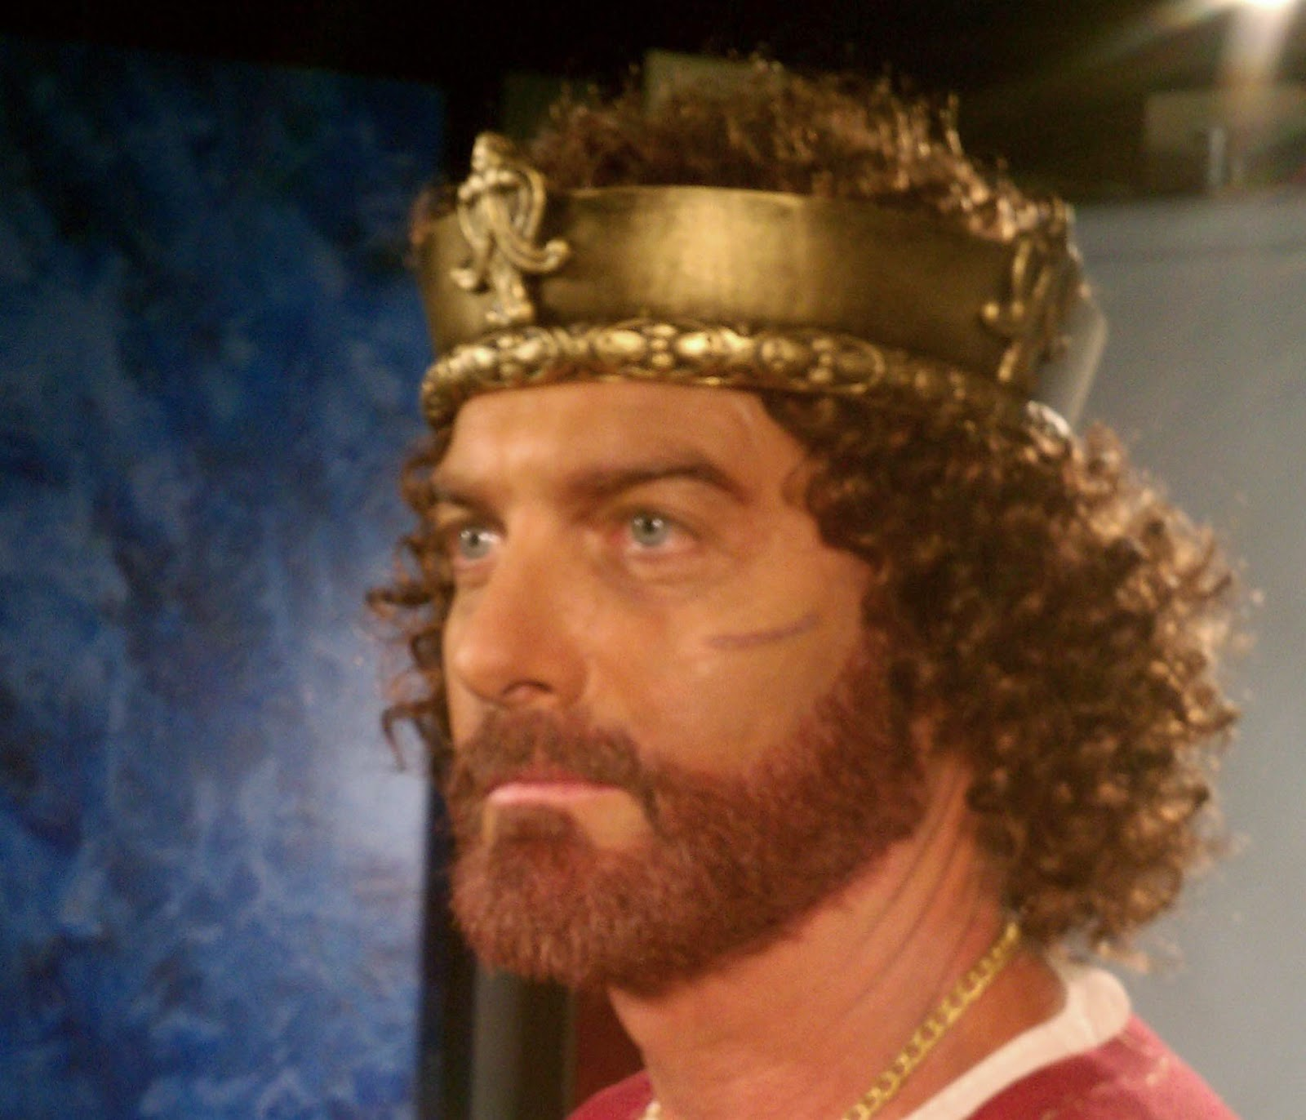
A king after God’s own heart
1 Kings 15: 5 David did what was right in the eyes of the Lord and did not turn aside from anything that he commanded him all the days of his life, except in the matter of Uriah the Hittite.

Slide 18
A sin punishable with death
2 Samuel 11: 2-4
It happened, late one afternoon, when David arose from his couch and was walking on the roof of the king's house, that he saw from the roof a woman bathing; and the woman was very beautiful. And David sent and inquired about the woman. And one said, “Is not this Bathsheba, the daughter of Eliam, the wife of Uriah the Hittite?” So David sent messengers and took her, and she came to him, and he lay with her.
Matthew 5: 27-28
John 8: 1-11

Slide 19
The Lord is slow to anger and abounding in love
David
Acknowledges his sin
Accepts God’s judgement
(1 Chronicles 21)
Psalm 32:5
I acknowledged my sin to you, and I did not cover my iniquity; I said, “I will confess my transgressions to the Lord,” and you forgave the iniquity of my sin.
1 John 1:9-10
If we confess our sins, he is faithful and just to forgive us our sins and to cleanse us from all unrighteousness. If we say we have not sinned, we make him a liar, and his word is not in us.

Slide 20
Conclusion
We need to live in total obedience
Acknowledged and repent from our sins
We need the Holy Spirit

Slide 21
Let us pray….

