Slide 1
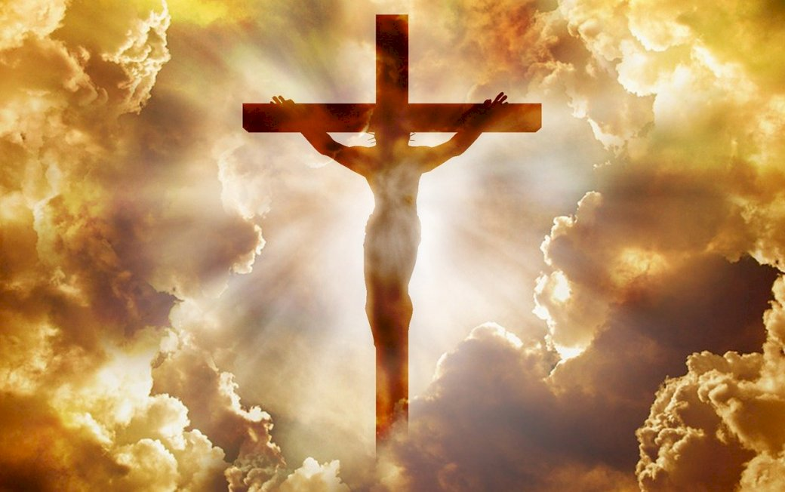
Jesus! God amongst humanity.
And the Word became flesh and dwelt among us, and we have seen his glory, glory as of the only Son1 from the Father, full of grace and truth… John 1:14

Slide 2
The introduction to the Gospel of John…
Jesus is the way the truth and the life…
but these are written so that you may believe that Jesus is the Christ, the Son of God, and that by believing you may have life in his name… John 20:31
Believe and be saved…
Jesus answered him, “Truly, truly, I say to you, unless one is born again he cannot see the kingdom of God.”… John 3:3
The gospel of John presents Jesus as God… He is become human to fulfill the agenda of heaven. Fully accomplishing what was written about Him as Prophet, Priest and King through His life lived on earth.

Slide 3
The life of Jesus Christ…
The birth of Jesus… And the Word became flesh and dwelt among us, and we have seen his glory, glory as of the only Son from the Father, full of grace and truth. John 1:14
The death of Jesus… When Jesus had received the sour wine, he said, “It is finished,” and he bowed his head and gave up his spirit. John 19:30
The resurrection and ascension of Jesus… 15. Jesus said to her, “Woman, why are you weeping? Whom are you seeking?” Supposing him to be the gardener, she said to him, “Sir, if you have carried him away, tell me where you have laid him, and I will take him away.” 16. Jesus said to her, “Mary.” She turned and said to him in Aramaic, “Rabboni!” (which means Teacher). 17. Jesus said to her, “Do not cling to me, for I have not yet ascended to the Father; but go to my brothers and say to them, ‘I am ascending to my Father and your Father, to my God and your God.’” 18. Mary Magdalene went and announced to the disciples, “I have seen the Lord”—and that he had said these things to her… John 20:15-18

Slide 4
The life of Jesus Christ…
Jesus depended on God… So Jesus said to them, “Truly, truly, I say to you, the Son can do nothing of his own accord, but only what he sees the Father doing. For whatever the Father does, that the Son does likewise… John 5:19
Jesus walked in humility and service… Jesus, knowing that the Father had given all things into his hands, and that he had come from God and was going back to God, rose from supper. He laid aside his outer garments, and taking a towel, tied it around his waist. Then he poured water into a basin and began to wash the disciples' feet and to wipe them with the towel that was wrapped around him… John 13:3-5
Jesus understood suffering… 16. So he delivered him over to them to be crucified. So they took Jesus, 17. and he went out, bearing his own cross, to the place called The Place of a Skull, which in Aramaic is called Golgotha… John 19:16-17

Slide 5
The ministry of Jesus Christ…
Revealing God to all creation… No one has ever seen God; the only God, who is at the Father's side, he has made him known. John 1:18
Redeeming creation from sin… “For God so loved the world, that he gave his only Son, that whoever believes in him should not perish but have eternal life… John 3:16
Destroying the works of the devil… So if the Son sets you free, you will be free indeed… John 8:36
Judging creation… 26. For as the Father has life in himself, so he has granted the Son also to have life in himself. 27. And he has given him authority to execute judgment, because he is the Son of Man. John 5:26-27

Slide 6
The ministry of Jesus Christ…
Jesus is interceding for us… 20. “I do not ask for these only, but also for those who will believe in me through their word, 21. that they may all be one, just as you, Father, are in me, and I in you, that they also may be in us, so that the world may believe that you have sent me. 22. The glory that you have given me I have given to them, that they may be one even as we are one, 23. I in them and you in me, that they may become perfectly one, so that the world may know that you sent me and loved them even as you loved me… John 17:20-23
Be encouraged Jesus is praying for you…
Jesus fully God, became fully man… lived a life of no sin and died for you and I that we would become Children of God… Living for God’s glory and establishing His will on earth.

Slide 7
Let us pray…
And this is eternal life, that they know you, the only true God, and Jesus Christ whom you have sent.… John 17:3

