Slide 1
The teachings & parables of Christ
John 7:37 “If anyone thirsts, let him come to me and drink.”

Slide 2
John 4
10 Jesus answered her, “If you knew the gift of God, and who it is that is saying to you, ‘Give me a drink,’ you would have asked him, and he would have given you living water.”
John 6:
27 Do not work for the food that perishes, but for the food that endures to eternal life, which the Son of Man will give to you. For on him God the Father has set his seal.”
33 For the bread of God is he who comes down from heaven and gives life to the world.” ... 35 ...“I am the bread of life; whoever comes to me shall not hunger, and whoever believes in me shall never thirst.

Slide 3
John 6:
51 I am the living bread that came down from heaven. If anyone eats of this bread, he will live forever. And the bread that I will give for the life of the world is my flesh.”
John 8:
31 ...“If you abide in my word, you are truly my disciples, 32 and you will know the truth, and the truth will set you free.”
51 Truly, truly, I say to you, if anyone keeps my word, he will never see death.

Slide 4
John 10:
10 The thief comes only to steal and kill and destroy. I came that they may have life and have it abundantly. 11 I am the good shepherd. The good shepherd lays down his life for the sheep.
John 12:
25 Whoever loves his life loses it, and whoever hates his life in this world will keep it for eternal life.
46 I have come into the world as light, so that whoever believes in me may not remain in darkness.
John 14:
6 Jesus said to him, “I am the way, and the truth, and the life. No one comes to the Father except through me.”

Slide 5
Matthew
Mark
Luke
Jesus as king
Jesus as servant
Jesus the son of man
John
Jesus as the son of God

Slide 6
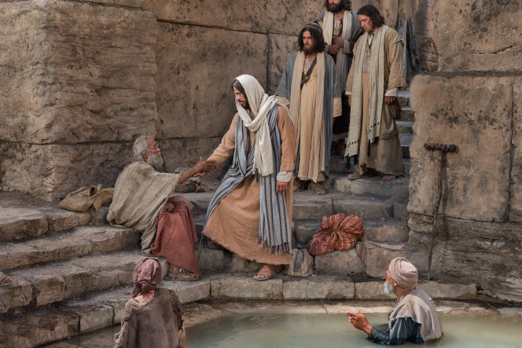
Jesus son of God
John 5: 17 But Jesus answered them, “My Father is working until now, and I am working.” 18 This was why the Jews were seeking all the more to kill him, because not only was he breaking the Sabbath, but he was even calling God his own Father, making himself equal with God.

Slide 7
Synoptic
Matthew
Mark
Luke
Jesus as king
Jesus as servant
Jesus the son of man
John
Jesus as the son of God

Slide 8
Jesus as the son of Man
Mark 14: 61...Again the high priest asked him, “Are you the Christ, the Son of the Blessed?” 62 And Jesus said, “I am, and you will see the Son of Man seated at the right hand of Power, and coming with the clouds of heaven.” 63 And the high priest tore his garments and said, “What further witnesses do we need? 64 You have heard his blasphemy. What is your decision?” And they all condemned him as deserving death.
(From Daniel 7:13-14)

Slide 9
Jesus’ teachings
1. Jesus’ teaching centered in the will of the father
Jonh 7: 16 So Jesus answered them, “My teaching is not mine, but his who sent me. 17 If anyone’s will is to do God’s will, he will know whether the teaching is from God or whether I am speaking on my own authority. 18 The one who speaks on his own authority seeks his own glory; but the one who seeks the glory of him who sent him is true, and in him there is no falsehood.

Slide 10
2. Jesus’ teaching centered on the promise of the Holy Spirit
John 7:37 On the last day of the feast, the great day, Jesus stood up and cried out, “If anyone thirsts, let him come to me and drink. 38 Whoever believes in me, as the Scripture has said, ‘Out of his heart will flow rivers of living water.’”
Isaiah 44: 3 For I will pour water on the thirsty land, and streams on the dry ground; I will pour my Spirit upon your offspring, and my blessing on your descendants.

Slide 11
3. Jesus’ teaching centered on the love of God for us
John 16: 27 for the Father himself loves you, because you have loved me and have believed that I came from God.

Slide 12
4. Jesus’ teaching centered on the oneness of the body of Christ
John 17: 20 “I do not ask for these only, but also for those who will believe in me through their word, 21 that they may all be one, just as you, Father, are in me, and I in you, that they also may be in us, so that the world may believe that you have sent me.

Slide 13
Four main points
The will of the father
The promise of the Holy Spirit
The love of God
The oness of the body of Christ

Slide 14
Let’s pray...

