Slide 1
You are the Light of the World
November 5, 2023

Slide 2
7 I Am Statements in John
I am the bread of life (John 6:35, 48)
I am the light of the world (John 8:12; 9:5; 12:46)
I am the door of the sheep fold (John 10:7)
I am the good shepherd (John 10:11)
I am the resurrection and the life (John 11:25)
I am the way, the truth and the life (John 14:6)
I am the true vine (John 15:1)

Slide 3
Matthew 5:14-16
You are the light of the world. A city set on a hill cannot be hidden; [15] nor does anyone light a lamp and put it under a basket, but on the lampstand, and it gives light to all who are in the house. [16] Let your light shine before men in such a way that they may see your good works, and glorify your Father who is in heaven.

Slide 4
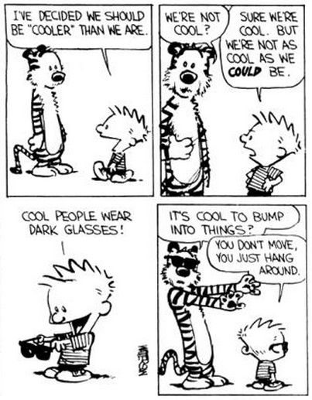

Slide 5
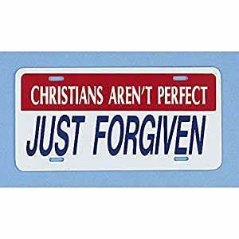

Slide 6
Romans 6:1-2
What shall we say then? Are we to continue in sin so that grace may increase?
MAY IT NEVER BE! HOW SHALL WE WHO DIED TO SIN STILL LIVE IN IT?

Slide 7
How do We Live? – Barna Group
…in 2007 we found that most of the lifestyle activities of born-again Christians were statistically equivalent to those of non-born-agains. When asked to identify their activities over the last thirty days, born-again believers were just as likely to bet or gamble, to visit a pornographic website, to take something that did not belong to them, to consult a medium or psychic, to physically fight or abuse someone, to have consumed enough alcohol to be considered legally drunk, to have used an illegal, non-prescription drug, to have said something to someone that was not true, to have gotten back at someone for something he or she did, and to have said mean things behind another person’s back.

Slide 8
Ephesians 5:1-7
Therefore be imitators of God, as beloved children; [2] and walk in love, just as Christ also loved you and gave Himself up for us, an offering and a sacrifice to God as a fragrant aroma. [3] But immorality or any impurity or greed must not even be named among you, as is proper among saints; [4] and there must be no filthiness and silly talk, or coarse jesting, which are not fitting, but rather giving of thanks.
[5] For this you know with certainty, that no immoral or impure person or covetous man, who is an idolater, has an inheritance in the kingdom of Christ and God. [6] Let no one deceive you with empty words, for because of these things the wrath of God comes upon the sons of disobedience. [7] Therefore do not be partakers with them;

Slide 9
Ephesians 5:8-21
[8] For you were formerly darkness, but now you are Light in the Lord; walk as children of Light [9] (for the fruit of the Light consists in all goodness and righteousness and truth), [10] trying to learn what is pleasing to the Lord. [11] Do not participate in the unfruitful deeds of darkness, but instead even expose them; [12] for it is disgraceful even to speak of the things which are done by them in secret.
[13] But all things become visible when they are exposed by the light, for everything that becomes visible is light. For this reason it says,
"Awake, sleeper, And arise from the dead, And Christ will shine on you."
[15] Therefore be careful how you walk, not as unwise men but as wise, [16] making the most of your time, because the days are evil.

Slide 10
Hebrews 3:7-8
Therefore, just as the Holy Spirit says,
"Today IF YOU HEAR HIS VOICE, [8]
Do NOT HARDEN YOUR HEARTS AS WHEN THEY PROVOKED ME,
AS IN THE DAY OF TRIAL IN THE WILDERNESS,

Slide 11
Ephesians 5:8-21
[17] So then do not be foolish, but understand what the will of the Lord is. [18] And do not get drunk with wine, for that is dissipation, but be filled with the Spirit, [19] speaking to one another in psalms and hymns and spiritual songs, singing and making melody with your heart to the Lord; [20] always giving thanks for all things in the name of our Lord Jesus Christ to God, even the Father; [21] and be subject to one another in the fear of Christ.

Slide 12
Philippians 2:3-4
[3] Do nothing from selfishness or empty conceit, but with humility of mind regard one another as more important than yourselves; [4] do not merely look out for your own personal interests, but also for the interests of others.

Slide 13
I John 2:8-10
On the other hand, I am writing a new commandment to you, which is true in Him and in you, because the darkness is passing away and the true Light is already shining. [9] The one who says he is in the Light and yet hates his brother is in the darkness until now. [10] The one who loves his brother abides in the Light and there is no cause for stumbling in him.

Slide 14
Philippians 2:14-16
[14] Do all things without grumbling or disputing; [15] so that you will prove yourselves to be blameless and innocent, children of God above reproach in the midst of a crooked and perverse generation, among whom you appear as lights in the world, [16] holding fast the word of life, so that in the day of Christ I will have reason to glory because I did not run in vain nor toil in vain.

Slide 15
I wish the Ring had never come to me. I wish none of this had happened. So do all who live to see such times, but that is not for them to decide. All we have to decide is what to do with the time that is given to us. There are other forces at work in this world, besides the will of evil. Bilbo was meant to find the Ring, in which case, you also were meant to have it. And that is an encouraging thought.

Slide 16
Matthew 22:37-40
[40] "'You SHALL LOVE THE LORD YOUR GOD WITH ALL YOUR HEART, AND WITH ALL YOUR SOUL, AND WITH ALL YOUR MIND.' [38] This is the great and foremost commandment. [39] The second is like it, 'You SHALL LOVE YOUR NEIGHBOR AS YOURSELF.' [40] On these two commandments depend the whole Law and the Prophets."

