Slide 1
Who are you, Lord? – Part 2 It is finished - about the fixed melody of creation John 19:28-30 & Genesis 1:31-2:2 (NIV)
December 3, 2023
Krijn de Jong

Slide 2
Last week – Who Are You Lord? – Part 1
God is compassionate – rachum; rechem = womb
In the womb we all have heard/felt the heartbeat of our mother
Listening to a heartbeat may heal!

Slide 3
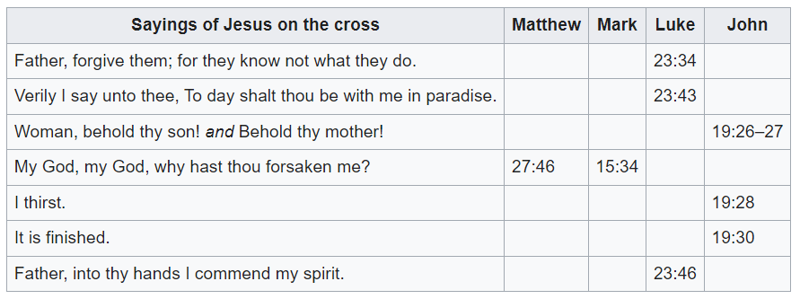
Who are You, Lord? – Part 2
Source: Wikipedia; KJV

Slide 4
The Death of Jesus – John 19:28-30 (NIV)
²⁸ Later, knowing that all was now completed, and so that Scripture would be fulfilled, Jesus said, “I am thirsty.” ²⁹ A jar of wine vinegar was there, so they soaked a sponge in it, put the sponge on a stalk of the hyssop plant, and lifted it to Jesus’ lips. ³⁰ When he had received the drink, Jesus said, “It is finished.” With that, he bowed his head and gave up his spirit.

Slide 5
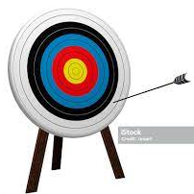
What Jesus has finished (1)
“all was now completed” – John 19:28
“Look, the Lamb of God, who takes away the sin of the world!” (John 1:29)
“He is the atoning sacrifice for our sins, and not only for ours but also for the sins of the whole world.” (1 John 2:2)
Sin = to miss out on goal

Slide 6
What Jesus has finished (2)
“For God did not send his Son into the world to condemn the world, but to save the world through Him.“ (John 3:17)
Jesus came to save and to heal the world
That we can now already “meet our goal” = to enjoy the presence of God (Augustine)
Live in harmony with God, ourselves and other people

Slide 7
It is finished – NT John 19:30
To finish = teleo (Gr)
“to finish, to bring to an end (telos, an end/goal/purpose), frequently signifies, not merely to terminate a thing, but to carry out a thing to the full.” (Vine's Expository Dictionary of New Testament Words)
It is completed/accomplished/vollbracht

Slide 8
It is finished – OT Genesis 1:31-2:2 (NIV)
31 God saw all that he had made, and it was very good. And there was evening, and there was morning—the sixth day.
1 Thus the heavens and the earth were completed (teleo*) in all their vast array.
2 By the seventh day God had finished (teleo*) the work he had been doing; so on the seventh day he rested from all his work.
* Septuagint, 3-2 BCE

Slide 9
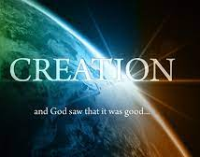
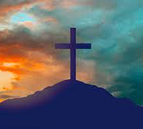
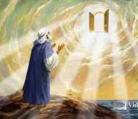
“It is finished” sounds throughout Bible/Creation
Genesis John Revelation
Creation Cross Second Coming

Slide 10
“It is finished”
‘Fixed melody’ of creation + cross + second coming of Jesus
A deeper truth than all other truths about creation
How do we hear this steadfast sound amidst all other sounds?
Music: How do we hear the Cantus Firmus?

Slide 11
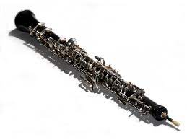
Cantus Firmus = fixed melody
Magnificat of Bach (song of praise of Maria) - Suscepit Israel (no 10)
Oboe → Cantus Firmus
Courtesy Tom & James

Slide 13
“I mean this: God and His eternity want to be loved wholeheartedly, but not so that earthly love will suffer or weaken, but rather as a cantus firmus, that form the background of which other voices of life come as counterpoints…p.255
In this polyphonic your life becomes truly one, such that you know that nothing fatal can happen, as long as the cantus firmus sounds….p.256
I note here (in prison) again and again that so few people are able to live with multiple things at the same moment in time. When airplanes approach they are only fear, when candy arrives they are only greed….they are blind for the fullness of life and the totality of their own existence. Christianity, on the other hand, places us in the different dimensions of life at the same time….p.260
(Dietrich Bonhoeffer, Letters from Prison)

Slide 14
Summary – Who Are You, Lord?
I am Jesus, I
love you untill the end (telos) – cf. John 13:1
died on the cross and rose from the grave
have taken away the sin of the world
have saved you and the world
I provide the ‘fixed melody’ of creation
Listen to that sound – read, pray, act
Help each other to hear the ‘heartbeat of the Father’
If you do not hear that sound, say aloud:
Jesus I believe what You have said: “It is finished”

Slide 15
