Slide 1
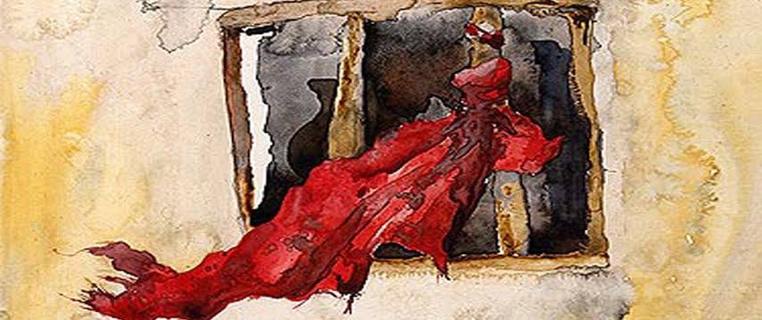
Unwanted but chosen!
By faith Rahab the prostitute did not perish with those who were disobedient, because she had given a friendly welcome to the spies. Hebrews 11:31

Slide 2
Who was Rahab?
A Canaanite prostitute. (Hebrews 11:31)
A biblical hero. (Hebrews 11:31)
A member of the lineage of Christ. (Matthew 1:5)
A woman of faith. (James 2:25)
A woman favoured by the Lord. (Romans 9:15)

Slide 3
The Story of Rahab and the Spies… Joshua 2:1-25
Joshua sends out the spies…
The encounter of Rahab & the King’s guards.
The encounter of Rahab & the Spies.
The Spies make a vow unto Rahab.
The deliverance of Rahab and her family.
But Rahab the prostitute and her father’s household and all who belonged to her, Joshua saved alive. And she has lived in Israel to this day, because she hid the messengers whom Joshua sent to spy out Jericho… Joshua 6:25

Slide 4
A shadow of Christ’s redemption in the story of Rahab…
The symbol of salvation for Rahab and her family was the scarlet cord in her window(Joshua 2:18-21) Today we can cling to another “scarlet cord”, the blood of Jesus, which cleanses us and makes us God’s prized possessions. We’ve been redeemed from the empty way of life that once enslaved us by the precious blood of Christ
knowing that you were ransomed from the futile ways inherited from your forefathers, not with perishable things such as silver or gold, but with the precious blood of Christ, like that of a lamb without blemish or spot. 1 Peter 1:18-19

Slide 5
Highlights from the story of Rahab for Godly living today…
Rahab formed an accurate understanding of God and His people. Joshua 2:8-11
Rahab trusted God and His people. Joshua 2:12-14
Rahab served God and the people of God. Joshua 2:15-16
Rahab followed instructions unto the salvation of her and her family!! Joshua 2:17-21

Slide 6
Conclusion…
Let us pray…
We all like Rahab have been undeserving of the love and salvation of God. But God sovereignty and divine plan revealed His graciousness and mercy through our salvation in Christ by heeding unto the word of God!!

