Slide 1
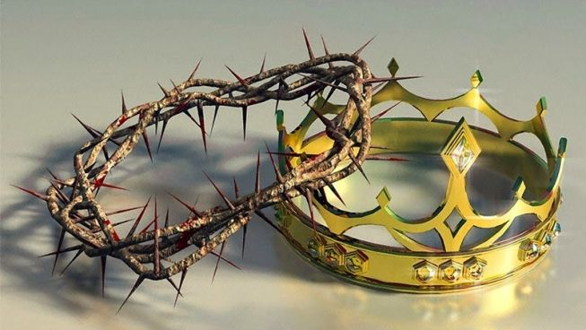
Jesus our King & Savior!!
Simon Peter replied, “You are the Christ, the Son of the living God.” Matthew 16:16

Slide 2
The Gospels & Christ….
Matthew: Emphasizes Jesus Christ as King and was directed especially to the Jews. The book opens with the royal genealogy and closes with the King commissioning His disciples.
Mark: Emphasizes Jesus Christ as the Servant of God and was directed to the Romans. No genealogy is given since Jesus is portrayed as a servant and no one is interested in the pedigree of a servant. The book closes with the Lord "working with them," laboring as a servant with His disciples.
Luke: Presents Jesus Christ as the "Son of Man," the perfect man and Savior of imperfect men. Luke 3 traces the human genealogy of Jesus back to Adam. Luke ends with this perfect man, Jesus, ascending back up to Heaven to His Father.
John: Stresses Jesus in His position as the Son of God. The book opens with Jesus the Word revealed as God. The closing verse of John indicates that the world could not contain all Jesus did during His earthly ministry. This is further evidence He was truly the Son of God.

Slide 3
The Gospel of Matthew….
The Gospel of Matthew’s author is not known but attributed to Matthew the accountant. It is the first book of the NT and has 28 chapters believed to have been aimed at the Jewish audience. (Matthew 5:17-18)
The Gospel of Matthew is one of the synoptic gospels (Matthew, Mark & Luke) and reveals Jesus as King and Messiah. (Matthew 16:16)
Highlighting the Lordship and Saving ability of Christ, the book of Matthew further teaches about the Kingdom of God and presents a sharp contrast to the kingdoms of our world. (Matthew 5)
The book of Matthew is the book with most references to the prophesies and allusions of the OT. More than a 130 references. (Matthew 13:35)

Slide 4
 | Announcement & arrival of the King His credentials - Birth - Baptism - Temptation Chapter 1 – 4 | Proclamation & reception of the King His message - Sermon on Mount - Miracles - Discourse - Parables Chapter 5 – 15 | Opposition & rejection of the King His suffering & death - Spread of opposition - Prep. His disciples - Final prediction - Crucifixion Chapter 16 – 27 | Resurrection & triumph of the King His conquest - God’s power - Great commission Chapter 28
Jesus the King | His Identity: Israel's promised King |  | His Destiny: To be crucified
Scope | Teaching the vast audience |  | Teaching the twelve apostles
Location | Bethlehem & Nazareth | Ministry in Galilee | Ministry in Judea
Reaction of people | Increased popularity |  | Increased hostility
Theme | Jesus as the King and Israel’s long awaited Messiah
Key verse | Simon Peter replied, “You are the Christ, the Son of the living God.” Matthew 16:16
Christ in the book of Matthew | Jesus the Messiah who fulfills all the prophecies, promises, allusions and expectations of the old testament scriptures.

Slide 5
Peter Confesses Jesus as the Christ – Matthew 16
13. Now when Jesus came into the district of Caesarea Philippi, he asked his disciples, “Who do people say that the Son of Man is?” 14. And they said, “Some say John the Baptist, others say Elijah, and others Jeremiah or one of the prophets.” 15. He said to them, “But who do you say that I am?” 16. Simon Peter replied, “You are the Christ, the Son of the living God.” 17. And Jesus answered him, “Blessed are you, Simon Bar-Jonah! For flesh and blood has not revealed this to you, but my Father who is in heaven. 18. And I tell you, you are Peter, and on this rock I will build my church, and the gates of hell shall not prevail against it. 19. I will give you the keys of the kingdom of heaven, and whatever you bind on earth shall be bound in heaven, and whatever you loose on earth shall be loosed in heaven.” 20. Then he strictly charged the disciples to tell no one that he was the Christ.

Slide 6
Jesus Foretells His Death and Resurrection – Matthew 16
21. From that time Jesus began to show his disciples that he must go to Jerusalem and suffer many things from the elders and chief priests and scribes, and be killed, and on the third day be raised. 22. And Peter took him aside and began to rebuke him, saying, “Far be it from you, Lord! This shall never happen to you.” 23. But he turned and said to Peter, “Get behind me, Satan! You are a hindrance to me. For you are not setting your mind on the things of God, but on the things of man.”
Jesus knew exactly who He was and for what purpose the Father had sent Him to the earth. He was focused, determined and fully reliant on God for the fulfilment of what had been written of Him in the books.

Slide 7
Highlights from the life of Christ…
Knowing who you are is very important.
Living a life of purpose is a must.
Be weary of distractions!!
A life that glorifies the Lord is a life that seeks to fulfill God’s expectation and heavens demands.
Your eyes saw my unformed substance; in your book were written, every one of them, the days that were formed for me, when as yet there was none of them… Psalm 139:16

Slide 8
Let us pray…
God’s purpose in creating the universe was that He would glorify Himself in all that He does in creation, revealing His providence and redemption. We as believers must live to make Christ look magnificent. – John Piper

