Slide 1
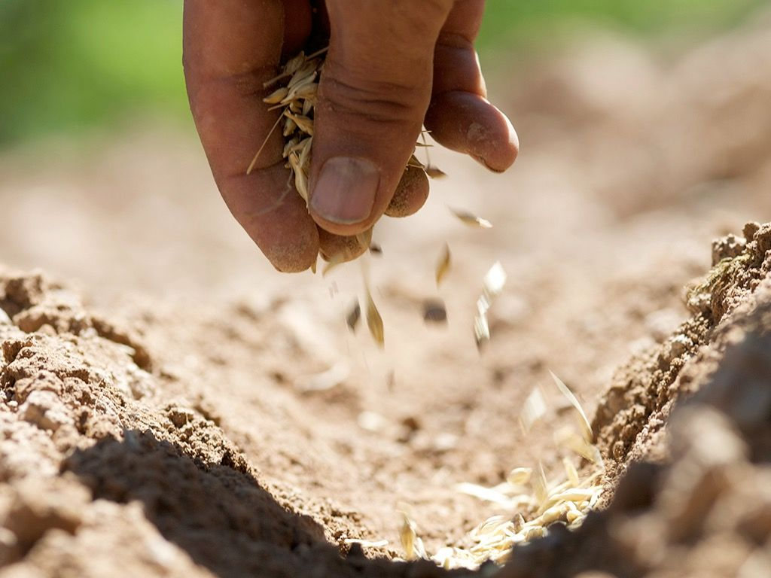
Parables of Jesus!!
This is why I speak to them in parables, because seeing they do not see, and hearing they do not hear, nor do they understand.
Matthew 13:13

Slide 2
Sermon on the mount: Matthew 5–7…
The sermon on the mount reveals Christ instructions for us believers and the way of life we ought to live as pilgrims on earth representing the Kingdom of heaven.
The sermon on the mount is not a list of principles for positive thinking, but a clear exhortation for us who have our hope in Christ and are resting in Him.
The sermon on the mount ultimately reveals Christ as the ultimate teacher with all authority and provides a vital teaching on Christian living for the Glory of God!!
In the same way, let your light shine before others, so that they may see your good works and give glory to your Father who is in heaven.
Matthew 5:16

Slide 3
The Beatitudes: Matthew 5:2-12
2. And he opened his mouth and taught them, saying:
3. “Blessed are the poor in spirit, for theirs is the kingdom of heaven.
4. “Blessed are those who mourn, for they shall be comforted.
5. “Blessed are the meek, for they shall inherit the earth.
6. “Blessed are those who hunger and thirst for righteousness, for they shall be satisfied.
7. “Blessed are the merciful, for they shall receive mercy.
8. “Blessed are the pure in heart, for they shall see God.
9. “Blessed are the peacemakers, for they shall be called sons of God.
10. “Blessed are those who are persecuted for righteousness' sake, for theirs is the kingdom of heaven.
11. “Blessed are you when others revile you and persecute you and utter all kinds of evil against you falsely on my account. 12. Rejoice and be glad, for your reward is great in heaven, for so they persecuted the prophets who were before you.

Slide 4
The Purpose of the Parables: Matthew 13:10-17
10. Then the disciples came and said to him, “Why do you speak to them in parables?” 11. And he answered them, “To you it has been given to know the secrets of the kingdom of heaven, but to them it has not been given. 12. For to the one who has, more will be given, and he will have an abundance, but from the one who has not, even what he has will be taken away. 13. This is why I speak to them in parables, because seeing they do not see, and hearing they do not hear, nor do they understand.
14. Indeed, in their case the prophecy of Isaiah is fulfilled that says: “‘“You will indeed hear but never understand, and you will indeed see but never perceive.” 15. For this people's heart has grown dull, and with their ears they can barely hear, and their eyes they have closed, lest they should see with their eyes and hear with their ears and understand with their heart and turn, and I would heal them.’ (Isaiah 6:9-10)
16. But blessed are your eyes, for they see, and your ears, for they hear. 17. For truly, I say to you, many prophets and righteous people longed to see what you see, and did not see it, and to hear what you hear, and did not hear it.

Slide 5
Parables in the book of Matthew.
The Lamp On a Stand - Matthew 5:14–16
The Speck and the Log - Matthew 7:1–5
The Wise and the Foolish Builders - Matthew 7:24–27
New Cloth and New Wineskins - Matthew 9:16–17
The Divided Kingdom - Matthew 12:24–30
The Sower - Matthew 13:3–23
The Weeds - Matthew 13:24–30
The Mustard Seed - Matthew 13:31–32
The Yeast - Matthew 13:33
The Hidden Treasure - Matthew 13:44
The Pearl - Matthew 13:45–46

Slide 6
Parables in the book of Matthew.
12. The Net - Matthew 13:47–50
13. The Householder - Matthew 13:52
14. The Lost Sheep - Matthew 18:12–14
15. The Unforgiving Servant - Matthew 18:23–31
16. The Workers In the Vineyard - Matthew 20:1–16
17. The Two Sons - Matthew 21:28–32
18. The Tenants - Matthew 21:33–44
19. The Wedding Banquet - Matthew 22:1–14
20. The Fig Tree - Matthew 24:32–35
21. The Ten Virgins - Matthew 25:1–13
22. The Talents - Matthew 25:14–30
23. The Sheep and Goats - Matthew 25:31–46

Slide 7
The parable of the sower: Matthew 13:1-9
1. That same day Jesus went out of the house and sat beside the sea. 2. And great crowds gathered about him, so that he got into a boat and sat down. And the whole crowd stood on the beach. 3. And he told them many things in parables, saying: “A sower went out to sow.
4. And as he sowed, some seeds fell along the path, and the birds came and devoured them. (The hardened heart)
5. Other seeds fell on rocky ground, where they did not have much soil, and immediately they sprang up, since they had no depth of soil, 6. but when the sun rose they were scorched. And since they had no root, they withered away. (The shallow heart)
7. Other seeds fell among thorns, and the thorns grew up and choked them. (The crowded heart)
8. Other seeds fell on good soil and produced grain, some a hundredfold, some sixty, some thirty. 9. He who has ears, let him hear.” (The fruitful heart)

Slide 8
The Parable of the Sower Explained: Matthew 13:18-23
18. “Hear then the parable of the sower: 19. When anyone hears the word of the kingdom and does not understand it, the evil one comes and snatches away what has been sown in his heart. This is what was sown along the path. (Acts 8:30)
20. As for what was sown on rocky ground, this is the one who hears the word and immediately receives it with joy, 21. yet he has no root in himself, but endures for a while, and when tribulation or persecution arises on account of the word, immediately he falls away. (Colossians 2:7)
22. As for what was sown among thorns, this is the one who hears the word, but the cares of the world and the deceitfulness of riches choke the word, and it proves unfruitful. (Revelations 3:3)
23. As for what was sown on good soil, this is the one who hears the word and understands it. He indeed bears fruit and yields, in one case a hundredfold, in another sixty, and in another thirty.” (Colossians 1:5-6)

Slide 9
Parables of Jesus!!
The Parables of Jesus are purposefully used to draw believers and listeners of our Lord Jesus Christ into a state of thinking, searching and introspection concerning the how we live our lives in the light of the expectations and values of the Kingdom of God.
We must be intentional about listening.
We must give our hearts to the searching & understanding of God’s word and living by it so as to yield fruits unto the glory of God.
Let us pray…

