Slide 1
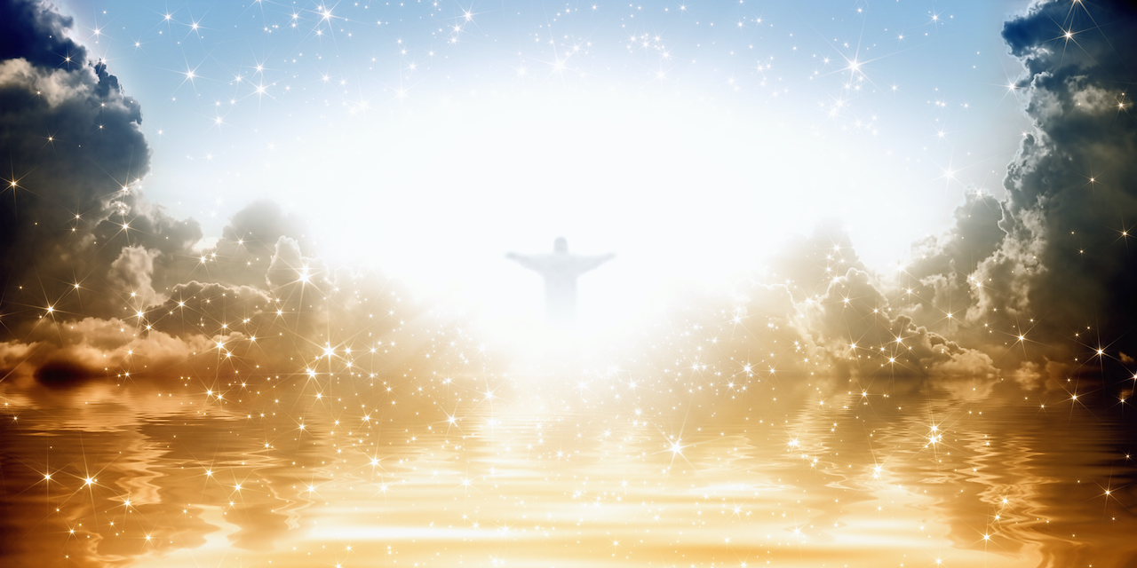
The return of Christ
Behold, he is coming with the clouds, and every eye will see him...(Revelation 1:7)

Slide 2
The return of Christ
The day
The day of judgement
The day of the Lord
The last days
End of the age
The end times

Slide 3
The Day of Judgement central in Jesus’ message in Matthew…
Matthew | Message | Judgement
10:14-15 | Jesus Sends Out the Twelve Apostles | It will be more bearable on the day of judgment for the land of Sodom and Gomorrah than for the towns which have rejected the gospel.
11:21-22 | Judgment to the cities that have rejected the manifestation of power | It will be more bearable on the day of judgment for Tyre and Sidon than for Chorazin, Bethsaida.
11:23-24 |  | Capernaum will be brought down to Hades. It will be more tolerable on the day of judgment for the land of Sodom than for Capernaum, for Sodom would have believed Jesus’ mighty works.
12:39-42 16:1-4 | The scribes and Pharisees ask for a sign | The men of Nineveh will rise up at the judgment with this generation and condemn it The queen of the South will rise up at the judgment with this generation and condemn it

Slide 4
The Day of Judgement central in Jesus’ message in Matthew…
Matthew | Message | Judgement pronounced
13:30 | The Parable of the Weeds | Gather the weeds first and bind them in bundles to be burned, but gather the wheat into my barn.
18:8-9 | Sin and the Eternal Fire | It is better for you to enter life crippled or lame than with two hands or two feet to be thrown into the eternal fire. It is better for you to enter life with one eye than with two eyes to be thrown into the hell of fire.
23 | Hypocrites and those who distort the word of God | You serpents, you brood of vipers, how are you to escape being sentenced to hell? (Mat. 23:33)

Slide 5
The Day of Judgement
Those who have been given the chance to receive the gift of life but rejected it
And if anyone will not receive you or listen to your words, shake off the dust from your feet when you leave that house or town. Truly, I say to you, it will be more bearable on the day of judgment for the land of Sodom and Gomorrah than for that town. (Matthew 10: 14-15)

Slide 6
The Day of Judgement
Those who do not know God
...in flaming fire, inflicting vengeance on those who do not know God and on those who do not obey the gospel of our Lord Jesus. They will suffer the punishment of eternal destruction, away from the presence of the Lord and from the glory of his might. (2 Thessalonians 1: 8-9)

Slide 7
The Day of Judgement
Those that knowing God, refuse to submit to His word
“Not everyone who says to me, ‘Lord, Lord,’ will enter the kingdom of heaven, but the one who does the will of my Father who is in heaven. On that day many will say to me, ‘Lord, Lord, did we not prophesy in your name, and cast out demons in your name, and do many mighty works in your name?’ And then will I declare to them, ‘I never knew you; depart from me, you workers of lawlessness.’ (Matthew 7: 21-23)

Slide 8
The Day of Judgement
Those who delight in sin
For if we go on sinning deliberately after receiving the knowledge of the truth, there no longer remains a sacrifice for sins, but a fearful expectation of judgment, and a fury of fire that will consume the adversaries. Anyone who has set aside the law of Moses dies without mercy on the evidence of two or three witnesses. How much worse punishment, do you think, will be deserved by the one who has trampled underfoot the Son of God, and has profaned the blood of the covenant by which he was sanctified, and has outraged the Spirit of grace? (Hebrews 10: 26-29)

Slide 9
What will be the signs?
And you will hear of wars and rumors of wars. (Matthew 24:6)
...there will be famines and earthquakes in various places. (Matthew 24:7)
Then they will deliver you up to tribulation and put you to death, and you will be hated by all nations for my name’s sake. (Matthew 24:9)
...the love of many will grow cold. (Matthew 24:12)
And this gospel of the kingdom will be proclaimed throughout the whole world (Matthew 24:14)
For false christs and false prophets will arise and perform great signs and wonders... (Matthew 24:24)

Slide 10
What should we do…
2 Peter 3: 11-13
Since all these things are thus to be dissolved, what sort of people ought you to be in lives of holiness and godliness, waiting for and hastening the coming of the day of God, because of which the heavens will be set on fire and dissolved, and the heavenly bodies will melt as they burn! But according to his promise we are waiting for new heavens and a new earth in which righteousness dwells.
Matthew 7: 13-14
Enter by the narrow gate. For the gate is wide and the way is easy that leads to destruction, and those who enter by it are many. For the gate is narrow and the way is hard that leads to life, and those who find it are few.

Slide 11
Let us pray…
There will be a day of judgement
We do not know when that day will be
There is assurance to those who love God, those who have received Christ as their Lord and savior

