Slide 1
The Path to Hope and Joy
A roadmap for Life from Romans 5

Slide 2
The Era of Anxiety

Slide 3
Causes of Anxiety
Expectation of constant excitement/comfort from the stream dopamine hits
No longer experience risk or face practical problems and overcome them
Parents are obsessed in 24-hour news cycle and projecting this fear onto their kids
Parents end up “Helicopter Parenting”
A blight of loneliness: One-to-many relationships that do little to encourage intimate relationships = Alone together
Rise of Therapy in Abagail Shrier’s book “Bad Therapy” =rise of parents hiring therapists for their children precludes them from deep relationships.

Slide 4
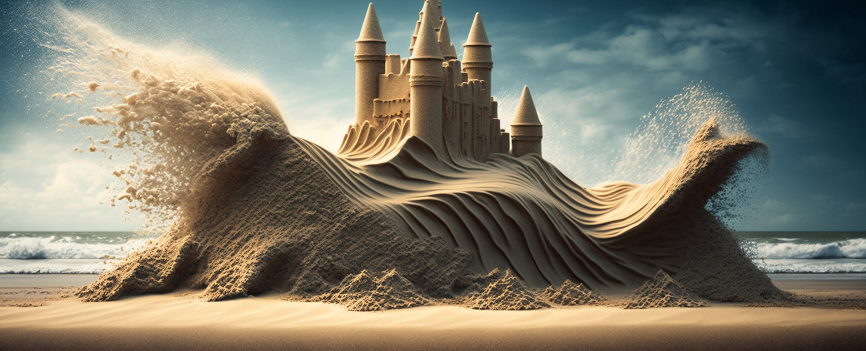
The World Seems Scarier Now
Massive Global shifts are going on
More Wars covered by the News
Many economies have big debt and income problems
Access to information is overwhelming, have to triangulate to know what’s real/fake.
Property Markets are crazy all over the world
Job market looks weirder than ever
The whole news and media environment is incentivized to invoke fear or anger

Slide 5
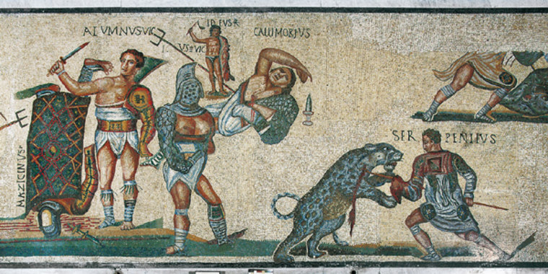
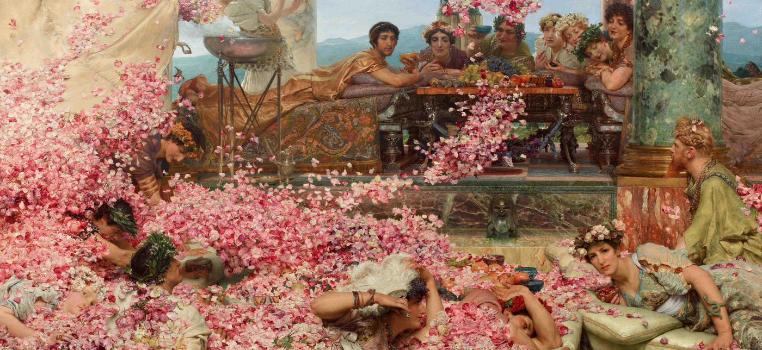
Paul Lived in a Crazy Time
Roman Gladiator Games
Temple Prostitutes, crazy morals
Life was not sacred or valuable
Exposed infants up to 3 years old
War was horrific, prisoners were enslaved
Uprisings were common
The government was Authoritarian
Public torture and killing was common
Christianity Wasn’t Popular

Slide 6
What is Your Biggest Problem Right Now?

Slide 10
Romans Summary: Ch 1:1-17
Paul explains his stewardship to preach to the Gentiles and to encourage them to live by faith and obedience through the powerful Gospel of Jesus.
Key Verse: 16 For I am not ashamed of the gospel, for it is the power of God for salvation to everyone who believes, to the Jew first and also to the Greek. 17 For in it the righteousness of God is revealed from faith to faith; as it is written, “ BUT THE RIGHTEOUS man SHALL LIVE BY FAITH.”

Slide 11
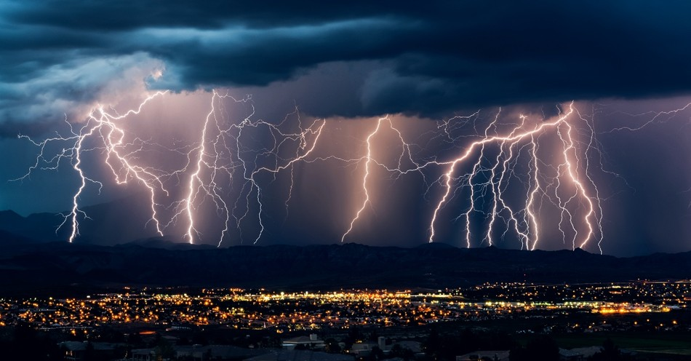
Romans Summary: Ch 1:18-32
God’s wrath is revealed against us because we have rejected his revelation and exchanged the his truth for self-oriented idolatry that degrades and corrupts every area of our lives.
Key Verse: Romans 1: 18 For the wrath of God is revealed from heaven against all ungodliness and unrighteousness of men who suppress the truth in unrighteousness, 19 because that which is known about God is evident within them; for God made it evident to them.

Slide 12
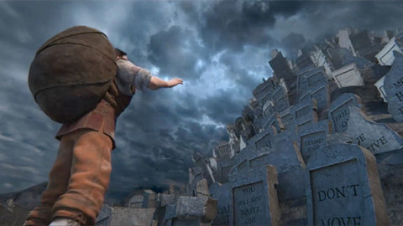
Romans Summary: Ch 2
Everyone has a law revealed to them, and is expected to follow it – either a law of one’s conscience or revealed word (Torah). It’s what you do that counts on the Day of Judgment. A real child of God has a heart that’s circumcised to follow this LAW. (circumcision=picture of holiness)
Key Verses:
Romans 2 12 For all who have sinned without the Law will also perish without the Law, and all who have sinned under the Law will be judged by the Law; 13 for it is not the hearers of the Law who are just before God, but the doers of the Law will be justified.
Romans 2:28 But he is a Jew who is one inwardly; … and circumcision is that which is of the heart, by the Spirit...

Slide 13
Romans Summary: Ch 3
Both the Jews and Gentiles guilty of transgressing their revelation from God (Torah Law or their Consciences) and can only be justified by God through faith in Christ, apart from their works.
Key Verses:
Romans 3:23 for all have sinned and fall short of the glory of God,
Rom 3:28 For we maintain that a man is justified by faith apart from works of the Law.

Slide 14
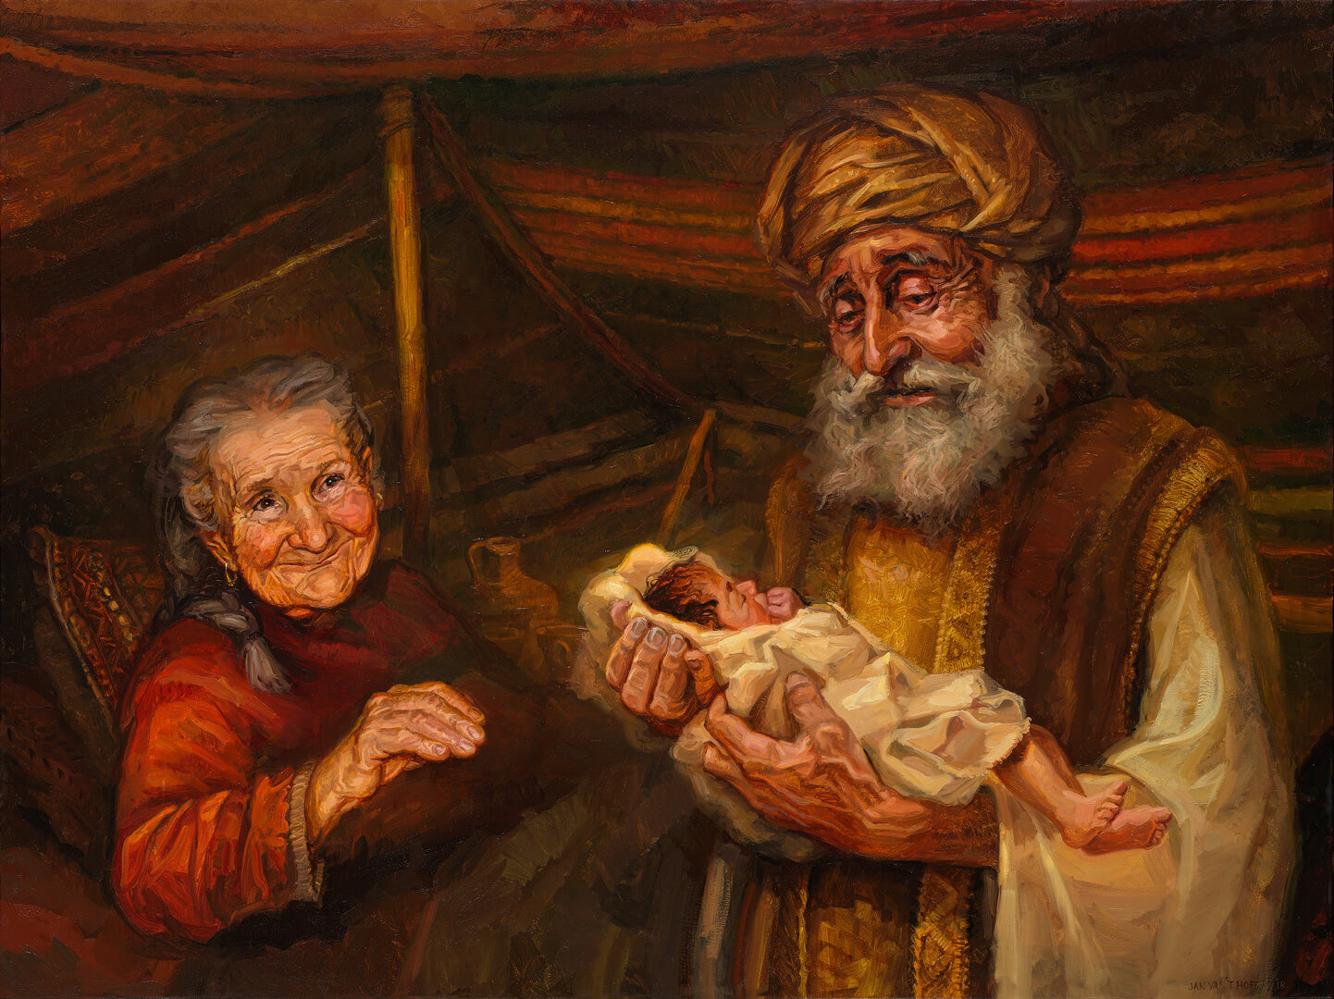
Romans Summary: Ch 4
Abraham is righteous because he believed, and circumcision is a sign of righteousness, not the cause of it. We are sons of Abraham, and made righteous by faith like Abraham’s – not by following the rules.
Key Verse: Romans 4: 20 yet, with respect to the promise of God, he did not waver in unbelief but grew strong in faith, giving glory to God, 21 and being fully assured that what God had promised, He was able also to perform. 22 Therefore IT WAS ALSO CREDITED TO HIM AS RIGHTEOUSNESS.

Slide 15
Faith = Trusting God’s Goodness, Power and Provision Despite Our Circumstances
Hebrews 11:1
Now faith is the assurance of things hoped for, the conviction of things not seen. 2 For by it the men of old gained approval.

Slide 16
Romans 1-4 Quick Overview
Ch1 part 1 – The Gospel is powerful to save us from sin, and Righteousness is only achieved by Faith
Ch 1 part 2 – The wrath of God and the great exchange
Ch 2 – You’ll be judged by the Law or your conscience on the Day of Judgment.
Ch 3 – everyone is Guilty. Vs 23 all fall short. Jesus is Just and our Justifier of those with faith
Ch 4 – Abraham is the Father of Faith – declared righteous before the Law was given. His life typifies a life of faith.

Slide 17
Repeated Review
I Need the Gospel to save me
God has revealed Himself and his requirements to me and I’ve rebelled.
I will experience wrath now and judgment later without the gospel
I need to be saved.
In the Old and New Testaments, God’s people are justified and live by faith – Look at Abraham.

Slide 18
Romans 5
1 Therefore, having been justified by faith, we have peace with God through our Lord Jesus Christ, 2 through whom also we have obtained our introduction by faith into this grace in which we stand; and we exult in hope of the glory of God. 3 And not only this, but we also exult in our tribulations, knowing that tribulation brings about perseverance; 4 and perseverance, proven character; and proven character, hope; 5 and hope does not disappoint, because the love of God has been poured out within our hearts through the Holy Spirit who was given to us.
…11 And not only this, but we also exult in God through our Lord Jesus Christ, through whom we have now received the reconciliation.

Slide 19
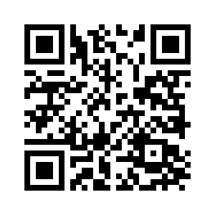
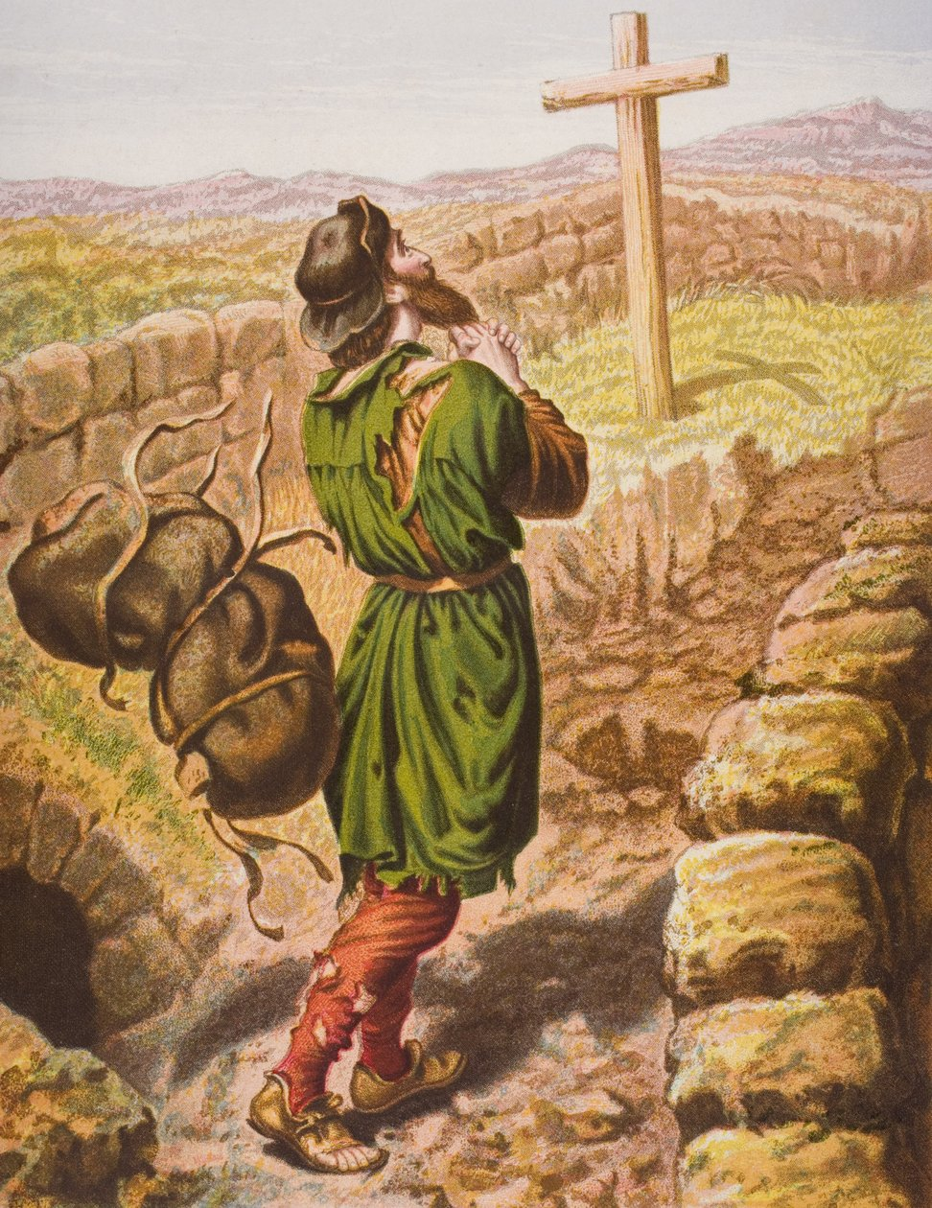
Romans 5: Peace with God – a sure foundation
1 Therefore, having been justified by faith, we have peace with God through our Lord Jesus Christ, 2 through whom also we have obtained our introduction by faith into this grace in which we stand; and we exult in hope of the glory of God. 3 And not only this, but we also exult in our tribulations, knowing that tribulation brings about perseverance; 4 and perseverance, proven character; and proven character, hope; 5 and hope does not disappoint, because the love of God has been poured out within our hearts through the Holy Spirit who was given to us.

Slide 20
Pilgrim’s Progress – The Third Stage
So I saw in my dream, that just as Christian came up with the cross, his burden loosed from off his shoulders, and fell from off his back, and began to tumble, and so continued to do till it came to the mouth of the sepulchre, where it fell in, and I saw it no more.
Then was Christian glad and lightsome, and said with a merry heart, “He hath given me rest by his sorrow, and life by his death.” Then he stood still a while, to look and wonder; for it was very surprising to him that the sight of the cross should thus ease him of his burden. He looked, therefore, and looked again, even till the springs that were in his head sent the waters down his cheeks. Zech. 12:10. Now as he stood looking and weeping, behold, three Shining Ones came to him, and saluted him with, “Peace be to thee.” So the first said to him, “Thy sins be forgiven thee,” Mark 2:5; the second stripped him of his rags, and clothed him with change of raiment, Zech. 3:4; the third also set a mark on his forehead, Eph. 1:13, and gave him a roll with a seal upon it, which he bid him look on as he ran, and that he should give it in at the celestial gate: so they went their way. Then Christian gave three leaps for joy, and went on singing,

Slide 21
Romans 5 καυχώμεθα
1 Therefore, having been justified by faith, we have peace with God through our Lord Jesus Christ, 2 through whom also we have obtained our introduction by faith into this grace in which we stand; and we exult in hope of the glory of God. 3 And not only this, but we also exult in our tribulations, knowing that tribulation brings about perseverance; 4 and perseverance, proven character; and proven character, hope; 5 and hope does not disappoint, because the love of God has been poured out within our hearts through the Holy Spirit who was given to us.
11 And not only this, but we also exult in God through our Lord Jesus Christ, through whom we have now received the reconciliation.

Slide 22
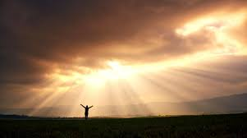
We exult in hope of the glory of God.

Slide 23
Romans 5: Exult in the Hope of the Glory of God
6 For while we were still helpless, at the right time Christ died for the ungodly. 7 For one will hardly die for a righteous man; though perhaps for the good man someone would dare even to die. 8 But God demonstrates His own love toward us, in that while we were yet sinners, Christ died for us. 9 Much more then, having now been justified by His blood, we shall be saved from the wrath of God through Him. 10 For if while we were enemies we were reconciled to God through the death of His Son, much more, having been reconciled, we shall be saved by His life. 11 And not only this, but we also exult in God through our Lord Jesus Christ, through whom we have now received the reconciliation.
. 11 And not only this, but we also exult in God through our Lord Jesus Christ, through whom we have now received the reconciliation.

Slide 24
Romans 5 Exult in our Tribulations
1 Therefore, having been justified by faith, we have peace with God through our Lord Jesus Christ, 2 through whom also we have obtained our introduction by faith into this grace in which we stand; and we exult in hope of the glory of God. 3 And not only this, but we also exult in our tribulations, knowing that tribulation brings about perseverance; 4 and perseverance, proven character; and proven character, hope; 5 and hope does not disappoint, because the love of God has been poured out within our hearts through the Holy Spirit who was given to us…
11 And not only this, but we also exult in God through our Lord Jesus Christ, through whom we have now received the reconciliation.

Slide 25
Why Do we now Exult in Tribulations?
Θλῖψις - "compression, tribulation”- carries the challenge of coping with the internal pressure of a tribulation, especially when feeling there is "no way of escape" ("hemmed in").

Slide 26
We can now exult in tribulation because
tribulation -> perseverance;
Perseverance -> proven character;
Proven character -> hope;
5 and hope does not disappoint, because the love of God has been poured out within our hearts through the Holy Spirit who was given to us.

Slide 27
1 Peter 1:6 In this you greatly rejoice, even though now for a little while, if necessary, you have been distressed by various trials, 7 so that the proof of your faith, being more precious than gold which is perishable, even though tested by fire, may be found to result in praise and glory and honor at the revelation of Jesus Christ; 8 and though you have not seen Him, you love Him, and though you do not see Him now, but believe in Him, you greatly rejoice with joy inexpressible and full of glory, 9 obtaining as the outcome of your faith the salvation of your souls.

Slide 28
5 and hope does not disappoint, (WHY?)
because the love of God has been poured out within our hearts through the Holy Spirit who was given to us.

Slide 31
The Path to Hope and Joy
You have a foundation of redemption from your sins and are at peace with a Holy God
You can rejoice that 1. you will one day be with God face to face and know true joy and satisfaction.
2 You can be confident that if you face your tribulations with hope –
you will overcome in this life and the next.

Slide 32
Homework/Discussion
What Fears/Challenges are you facing?
Are you facing them with hope and Joy?
How do you refill your “hope tank”
What discipline do I need to implement so that I grow my hope so I can exult in God and exult in my problems now?

