Slide 1
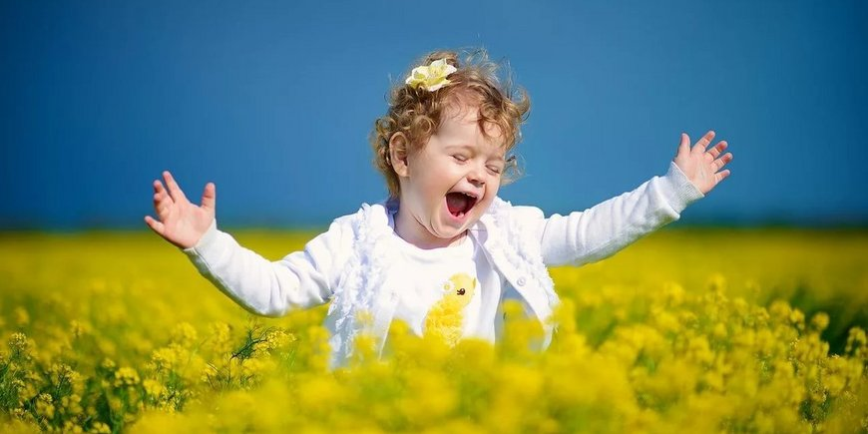
Joy in the Lord!!
….And do not be grieved, for the joy of the Lord is your strength”. Nehemiah 8:10

Slide 2
Our joy is not as a result of our performance but as a result of what God has done through Christ!! A clear indication of the kingdom we belong to is the Joy of the Lord in us…
For the kingdom of God is not a matter of eating and drinking but of righteousness and peace and joy in the Holy Spirit… Romans 14:17

Slide 3
The manifestation of the life we have in Christ is paramountcy through an effective daily walk with God in knowledge and obedience. We must be disciplined in our pursuit of God….
And this is eternal life, that they know you, the only true God, and Jesus Christ whom you have sent… John 17:3
And such as do wickedly against the covenant shall he corrupt by flatteries: but the people that do know their God shall be strong, and do exploits… Daniel 11:32

Slide 4
We must be very intentional about our daily fellowship with God… Just like a fish without water dies, a plant without soil eventually dies and a human without air suffocates and dies, so is a life without consistent fellowship destined for death…
O Lord, in the morning you hear my voice; in the morning I prepare a sacrifice for you and watch.… Psalm 5:3
And rising very early in the morning, while it was still dark, he departed and went out to a desolate place, and there he prayed… Mark 1:35

Slide 5
Conclusion
And now I commend you to God and to the word of his grace, which is able to build you up and to give you the inheritance among all those who are sanctified… Acts 20:32
Let us pray….

